Slide 1
Unit testing, mocking frameworks, continuous integration
Tapti Palit

Slide 2

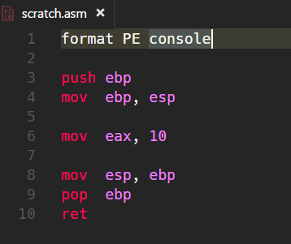

Recap: what is object code?
Object code is a representation of the source code at a lower level
C compiler translates it to machine code
Directly runnable on the hardware (hardware specific) [Demo: X86, ARM]

Slide 3
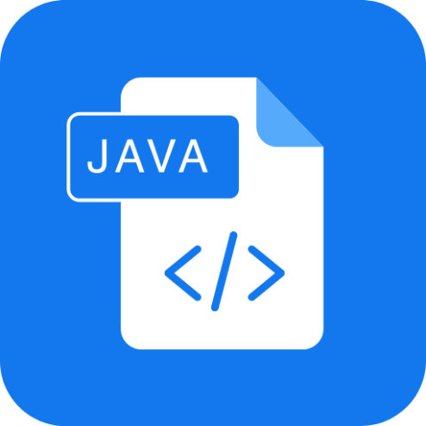
What is object code?
Object code is a representation of the source code at a lower level
Java compiler translates it to an “Intermediate Representation (bytecode)” [Demo]
Compiled from "MyApp.java"
public class MyApp {
public MyApp();
Code:
0: aload_0
1: invokespecial #1 // Method java/lang/Object."<init>":()V
4: return
public static void main(java.lang.String[]);
Code:
0: getstatic #7 // Field java/lang/System.out:Ljava/io/PrintStream;
3: ldc #13 // String Hello!
5: invokevirtual #15 // Method java/io/PrintStream.println:(Ljava/lang/String;)V
8: return
}
javac
MyApp.java
MyApp.class

Slide 4
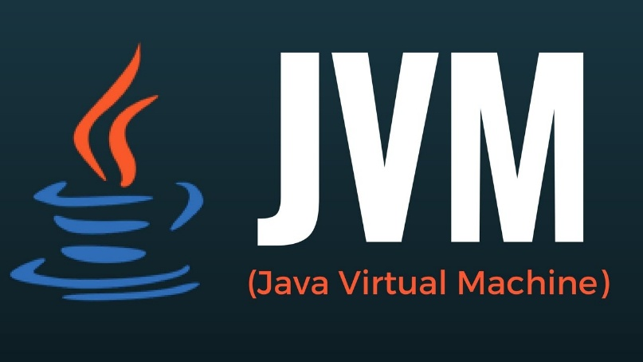
Java bytecode interpretation
Hardware does not know how to run Java bytecode
Needs a Java Virtual Machine (JVM) to execute the bytecode instructions at runtime
INTERPRETER
MyApp.class
Just-in-Time Compiler
[java]

Slide 5
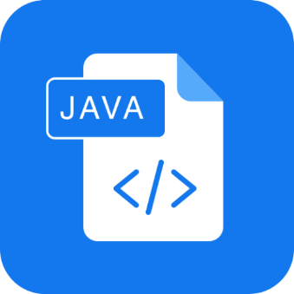

TL;DR
INTERPRETER
Compiled from "MyApp.java"
public class MyApp {
public MyApp();
Code:
0: aload_0
1: invokespecial #1 // Method java/lang/Object."<init>":()V
4: return
public static void main(java.lang.String[]);
Code:
0: getstatic #7 // Field java/lang/System.out:Ljava/io/PrintStream;
3: ldc #13 // String Hello!
5: invokevirtual #15 // Method java/io/PrintStream.println:(Ljava/lang/String;)V
8: return
}
javac
Just-in-Time Compiler
[java]
MyApp.java
Machine code
MyApp.class
Both steps performed when we press RUN on the IDE

Slide 6
Why does it matter?
Some checks happen at compile time
Syntax checking
Type-checking, generic type checking
… and so on
Other checks happen at run time
Runtime polymorphism
Array index out of bounds access
Null pointer access
File not found checks

Slide 7
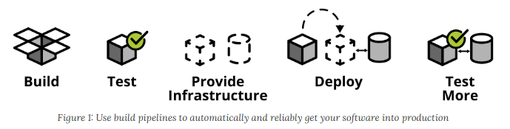
CI/CD and automated testing
Quicker software delivery timelines -> cannot rely on manual testing
Continuous integration, continuous deployment (CI/CD)
For large codebases, must automate testing
https://martinfowler.com/articles/practical-test-pyramid.html

Slide 8
What is unit testing?
Testing individual units of code (e.g., methods)
Ensures correctness and reliability
Executed during development for quick feedback
Catch regression bugs

Slide 9
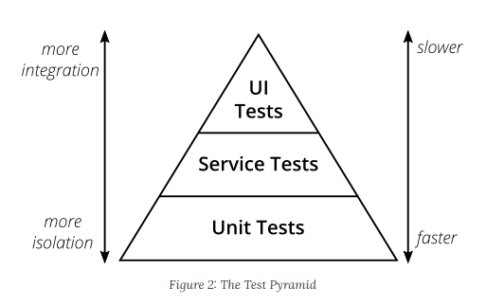
Test pyramid
Test pyramid shows how much testing on each layer
Unit tests fastest as they test single methods
UI tests slowest
1) Mike Crohn: Succeeding with Agile 2) https://martinfowler.com/articles/practical-test-pyramid.html

Slide 10
JUnit overview
Unit testing framework that simplifies testing
Without a framework how would you develop unit tests?
E.g. write unit tests for database functions (insert_sql_record(), delete_record())
Want to run your test on a clean test database
So, before running the unit test first, create a test database with the table
Then, invoke insert_sql_record() and perform any checks
Drop the table and the database after the test

Slide 11
Java annotations
Annotations are “metadata” added to Java code
They have no direct impact on code execution at runtime
Java provides some annotations, programmer can define more
Syntax: @Annotation_name
@Annotation1
public class Car {
@Annotation2
private int speed;
public Car(int speed) {
this.speed = speed;
}
@Annotation3
public void accelerate(int moreSpeed) {
this.speed += moreSpeed;
}
@Annotation3
public void decelerate(int lessSpeed) {
this.speed -= lessSpeed;
}
}

Slide 12
Java annotations
Some annotations are available only in the compiler
Java compiler checks
Some available at runtime
Widely used in popular frameworks
Framework can scan all classes with an annotation and create objects of that class at runtime
More when we study Annotations
@Annotation1
public class Car {
@Annotation2
private int speed;
public Car(int speed) {
this.speed = speed;
}
@Annotation3
public void accelerate(int moreSpeed) {
this.speed += moreSpeed;
}
@Annotation3
public void decelerate(int lessSpeed) {
this.speed -= lessSpeed;
}
}

Slide 13
Annotation targets
Annotations can be applied to
Classes
Fields
Methods
… many other program elements (Check https://docs.oracle.com/javase/tutorial/java/annotations/basics.html)

Slide 14
Key features of JUnit
Annotations simplify test creation
@Test, @BeforeEach, @AfterEach
Assertion methods validate expected outcomes
assertEquals(), assertNotEquals(), and so on…
Removes boilerplate code and simplifies test creation
Automatically generates a standardized report

Slide 15
@Test methods with JUnit
public class Car {
private String model;
private int speed;
public Car(String model, int speed) {
this.model = model;
this.speed = speed;
}
public int getSpeed() { return speed; }
public String getModel() { return model; }
... // setters
public void accelerate() {
this.speed += 10;
}
}
import org.junit.jupiter.api.Test;
import org.junit.jupiter.api.Assertions.assertEquals;
public class CarTest {
@Test
public void testAccelerate() {
Car car = new Car(“Toyota”, 50);
car.accelerate();
assertEquals(car.getSpeed(), 60);
}
}

Slide 16
Test lifecycle using JUnit
@BeforeEach, @AfterEach used to define methods that should be run before and after each test method
@BeforeClass, @AfterClass used to define methods that should be run before and after each test class
Useful for setup and cleanup operations
Create a test database, tables, and so on, before running the tests
Drop the test database, tables, and so on, after running the tests

Slide 17
Test lifecycle example
public class DbService {
public DB createDB(String db) { ... }
public Tbl createTable(Tbl tbl) { ... }
public void dropTable(String tbl) { ... }
public void insertRecord(Tbl t, ...) { ... }
public void deleteRecord(Tbl t, ...) { ... }
public void updateRecord(Tbl t, ...) { ... }
}
import org.junit.jupiter.api.Test;
import org.junit.jupiter.api.Assertions.assertEquals;
public class CarTest {
private Tbl tbl;
@BeforeClass public void setup() {
tbl = createTable(“testTbl”);
}
@Test public void testInsertRecord() {
insertRecord(tbl, <<record>>);
assertEquals(...);
}
@Test public void testDeleteRecord() { ...}
@AfterClass public void teardown() {
dropTable(tbl);
}
}

Slide 18
Continuous Integration

Slide 19

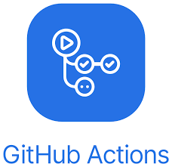
Continuous integration
Code changes are automatically built, tested, and integrated into a shared repository multiple times a day
Core process
Developer commits code
CI pipeline triggers
Build the project
Run automated tests
Integrated into GitHub and GitLab
Github Actions

Slide 20
Background: containerization
Github Actions are executed on Docker containers
Lightweight virtualization method that packages applications and their dependencies into isolated, portable containers
Containers share the host OS kernel but have their own filesystem, resources, and dependencies

Slide 21
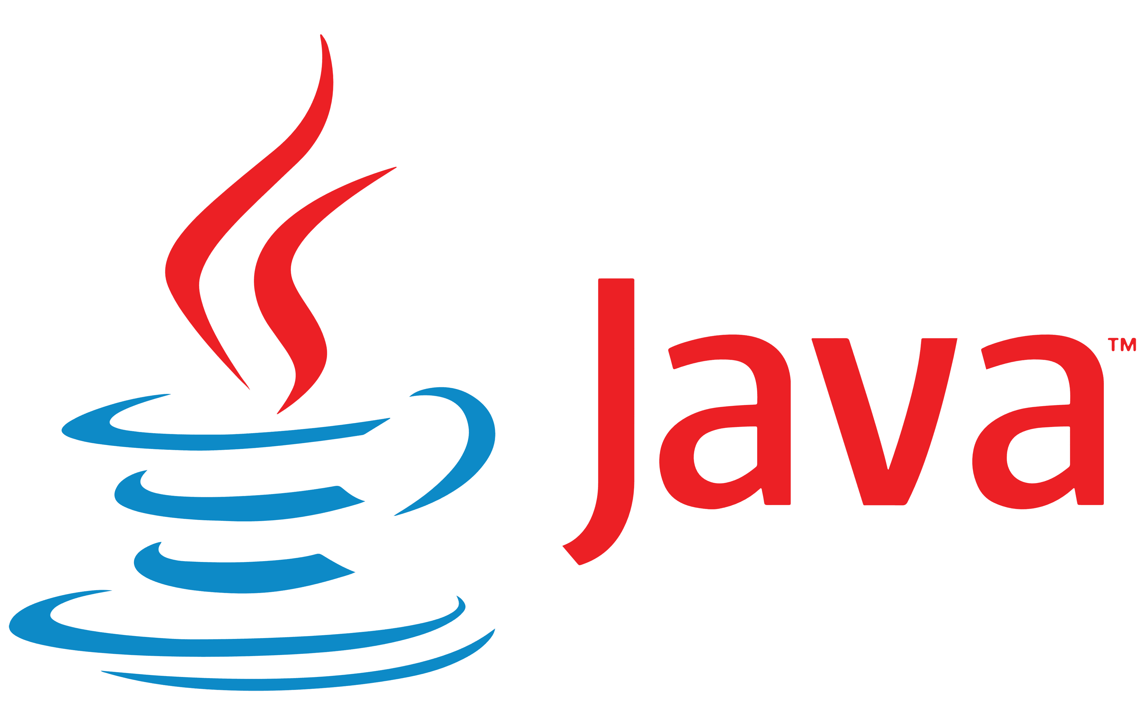
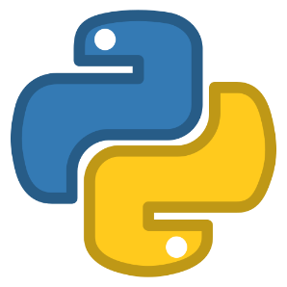
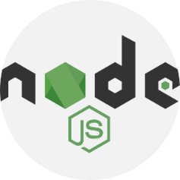




Containers
Ubuntu 22.04
Ubuntu 24.10
Fedora 24
Ubuntu 22.04
Linux kernel 5.4.1
Hardware
Will study how to create containers in Software Architecture module

Slide 22
What do containers provide?
Uniform build system for continuous integration
No weird issues with $PATH variables
No missing binaries
Automate deployment via continuous deployment
Containerize the application and deploy
… More later
Solves WOMM issues

Slide 23
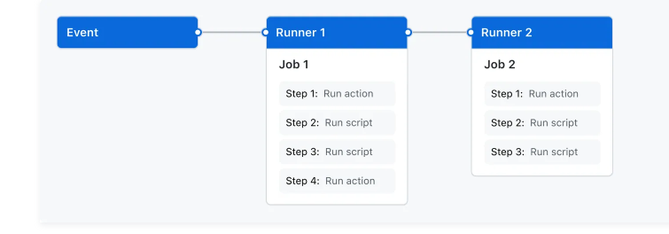
What is a Github Action?
A GitHub Actions workflow to be triggered when an event occurs
Push event, pull request opened
A workflow contains
One or more jobs
Each job has its own runner on which it is executed (typically a container)
Each job has one or more steps
Each step is either a script or command, or another Action

Slide 24
Sample scenarios
Continuous integration
Compile code and run all JUnit tests when someone pushes to main branch
Continuous deployment
Compile code, run all JUnit tests, package code, and deploy to remote server
When someone pushes to the prod (production) branch

Slide 25
Continuous deployment with Github Actions
Github Action specified in a YAML file
Configure a .github/workflows/[NAME].yml file
Define triggers (e.g., push, pull_request)
Specify jobs and steps (e.g., build, test)
name: Build and test pipeline
# Controls when the action will run. Workflow runs when manually triggered using the UI
# or API.
on: [push, pull_request]
# A workflow run is made up of one or more jobs that can run sequentially or in parallel
jobs:
build:
runs-on: ubuntu-22.04
steps:
- uses: actions/checkout@v3
- name: Set up JDK 21
uses: actions/setup-java@v3
with:
java-version: 21
distribution: 'temurin' # Use Temurin distribution (default)
- name: Verify Java version
run: java -version
- name: Build with Maven
run: mvn package
- name: Run JUnit tests
run: mvn test
Trigger
Runner
Job
Steps

Slide 26
Githubs CI/CD demo
In-class demo

