Slide 1
Fuzz testing
Tapti Palit

Slide 2
Announcements
Quiz on Friday on software security
HW2 questions?

Slide 3
What is unit testing?
Test individual functions
Add assertions to check if post-conditions hold
Test corner-cases
Manually created

Slide 4
What is service tests (integration tests)?
Test end-to-end functionality
Manually created

Slide 5
Hard to cover all code with manual testing
Linux kernel
~30 million lines of code
Google’s chromium browser
~28 million lines of code
Hard to manually write test-cases to cover all this code
Need automation

Slide 6
Fuzz testing
Goal: to find application inputs that reveal bugs
Test the entire application instead of individual functions
Generate inputs randomly until an error is uncovered

Slide 7

Fuzz testing
Source for random input on *nix systems
input
execute
/dev/random
application
Black-box testing

Slide 8
Types of bugs
Incorrect argument validation, incorrect type casting
Buffer overflows, memory leak, div-by-zero, use-after-free, segmentation fault, and so on…
Logic errors through assertion failures
Applications written in any language can be fuzzed

Slide 9
Pros and cons
Pros: generating random inputs is simple
Cons: random inputs are not good inputs
E.g., fuzzing a SQL database software
Real inputs: CREATE TABLE mytable AS (id INTEGER, … );
Random inputs: aVkjW3txpLZ044zo5kLdUlsU2MtlLNkhwxI8Aew7c0KPfTS115i2rzfBlgod
The database will reject such statements as invalid SQL and not execute the SQL command -> the SQL code will not even be tested

Slide 10
Mutation fuzzer - generate inputs via mutation
Start with some known valid inputs called “seeds”
Keep mutating them based on some “strategy”
1
2
seeds
pick
mutate
execute
seeds
seeds
input’
seeds
input
application
CREATE TABLE mytable AS (id INTEGER, … );
CREATE TABLE mZtablI AS (id INTEGER, … );
Notes:
These could be SQL commands

Slide 11
Mutation strategy – byte-level transformations
Shuffle bytes
Erase bytes
Insert byte
Change byte
Shuffle
0
1
1
1
0
1
0
1
0
0
1
1
1
0
0
1

Slide 12
Mutation strategy – byte-level transformations
Shuffle bytes
Erase bytes
Insert byte
Change byte
New input
0
1
1
1
0
1
0
0
0
1
1
1
1
1
0
0

Slide 13
Mutation strategy – byte-level transformations
Shuffle bytes
Erase bytes
Insert byte
Change byte
Erase
0
1
1
1
0
1
0
0
0
1
1
1
1
1
0
0

Slide 14
Mutation strategy – byte-level transformations
Shuffle bytes
Erase bytes
Insert byte
Change byte
Next input
0
1
1
1
0
1
0
0
0
1
1
0
0

Slide 15
Mutation strategy – byte-level transformations
Benefits:
Simple to implement
Good for binary inputs and streams
JPEG file encoder/decoder
Disadvantages:
Generates many invalid inputs for applications that expect structured inputs

Slide 16
Mutation strategy – dictionaries
Programmer provides a dictionary of “keywords”
For SQL, could include CREATE, DELETE, INSERT, INTO, FROM, INTEGER, and so on…
For HTML, could include HTML tags <html>, <body>, <p>, and so on…
Mutate the input by replacing or adding a chosen keyword from this dictionary
Input - <html><body><p>Hello world </p></body></html> Dictionary - {<html>, <body>, <p>,…} Mutated input – <html><body><p> Hello world <p>, Welcome!</p> </p></html>

Slide 17
Mutation strategy – dictionaries
Benefits:
Still simple to implement
Works reasonably well for structured inputs
Disadvantages
Still generates many invalid inputs for applications that expect structured inputs

Slide 18
Characteristics
All mutators produce many invalid inputs
E.g. malformed HTML, malformed SQL queries
<html><body></P.</ht~l>
Still produces enough valid test-cases to be very effective

Slide 19
Fuzzing pipeline
1
2
seeds
pick
mutate
execute
seeds
seeds
Input’
seeds
input
application
CREATE TABLE mytable AS (id INTEGER, … );
CREATE TABLE mZtablI AS (id INTEGER, … );

Slide 20
How to pick which seeds to mutate?
Goal: Should pick seeds that are “most promising” and likely to find bugs
What is “most promising”?

Slide 21
Metric of seed “goodness”: coverage
Amount of code or execution paths explored during fuzz testing
Input seeds that increase coverage are “more promising”
Explore new program behaviors
Ensures untested paths are tested
High coverage = high bug-finding potential

Slide 22
Metric of seed “goodness”: coverage
Amount of code or execution paths explored during fuzz testing
int function(int a, int b) {
if (a > 0) {
if (b > 0) {
if (b == 10) {
printf(“Hello!\n”);
} else {
printf(“Goodbye!\n”);
}
} else {
printf(“Welcome!\n”);
}
} else {
printf(“Hi!\n”);
} }

Slide 23
Metric of seed “goodness”: coverage
Amount of code or execution paths explored during fuzz testing
Input: a = 10, b = 0 -> new coverage!
int function(int a, int b) {
if (a > 0) {
if (b > 0) {
if (b == 10) {
printf(“Hello!\n”);
} else {
printf(“Goodbye!\n”);
}
} else {
printf(“Welcome!\n”);
}
} else {
printf(“Hi!\n”);
} }

Slide 24
Metric of seed “goodness”: coverage
Amount of code or execution paths explored during fuzz testing
Input: a = 11, b = 0 -> no new coverage
int function(int a, int b) {
if (a > 0) {
if (b > 0) {
if (b == 10) {
printf(“Hello!\n”);
} else {
printf(“Goodbye!\n”);
}
} else {
printf(“Welcome!\n”);
}
} else {
printf(“Hi!\n”);
} }

Slide 25
Metric of seed “goodness”: coverage
Amount of code or execution paths explored during fuzz testing
Input: a = 10, b = 1 -> new coverage!
int function(int a, int b) {
if (a > 0) {
if (b > 0) {
if (b == 10) {
printf(“Hello!\n”);
} else {
printf(“Goodbye!\n”);
}
} else {
printf(“Welcome!\n”);
}
} else {
printf(“Hi!\n”);
} }

Slide 26
Metric of seed “goodness”: coverage
Amount of code or execution paths explored during fuzz testing
Input: a = 10, b = 2 -> no new coverage!
int function(int a, int b) {
if (a > 0) {
if (b > 0) {
if (b == 10) {
printf(“Hello!\n”);
} else {
printf(“Goodbye!\n”);
}
} else {
printf(“Welcome!\n”);
}
} else {
printf(“Hi!\n”);
} }

Slide 27
Metric of seed “goodness”: coverage
Amount of code or execution paths explored during fuzz testing
Input: a = 10, b = 3 -> no new coverage!
int function(int a, int b) {
if (a > 0) {
if (b > 0) {
if (b == 10) {
printf(“Hello!\n”);
} else {
printf(“Goodbye!\n”);
}
} else {
printf(“Welcome!\n”);
}
} else {
printf(“Hi!\n”);
} }

Slide 28
Metric of seed “goodness”: coverage
Amount of code or execution paths explored during fuzz testing
Input: a = -1, b = 3 -> new coverage!
int function(int a, int b) {
if (a > 0) {
if (b > 0) {
if (b == 10) {
printf(“Hello!\n”);
} else {
printf(“Goodbye!\n”);
}
} else {
printf(“Welcome!\n”);
}
} else {
printf(“Hi!\n”);
} }

Slide 29
Coverage guided fuzzing
Record the coverage
Prioritize mutating input seeds which give higher coverage

Slide 30
Coverage-guided fuzzer pipeline
1
2
seeds
pick
mutate
execute
seeds
seeds
input’
seeds
input
application
CREATE TABLE mytable AS (id INTEGER, … );
CREATE TABLE mZtablI AS (id INTEGER, … );
Coverage detection
Add input’ to seeds if new coverage observed

Slide 31
Fuzzing – high level ideas
Randomly generate inputs
Mutation fuzzing
Start with known valid inputs
Mutate them
Byte-level transformations
Dictionary-based transformations
Pick inputs which resulted in new branch coverage for further mutation

Slide 32

AFL demo
American fuzzy lop (AFL)
Fuzzer for C/C++ applications

Slide 33
AFL demo
https://github.com/wolframroesler/afl-demo

Slide 34
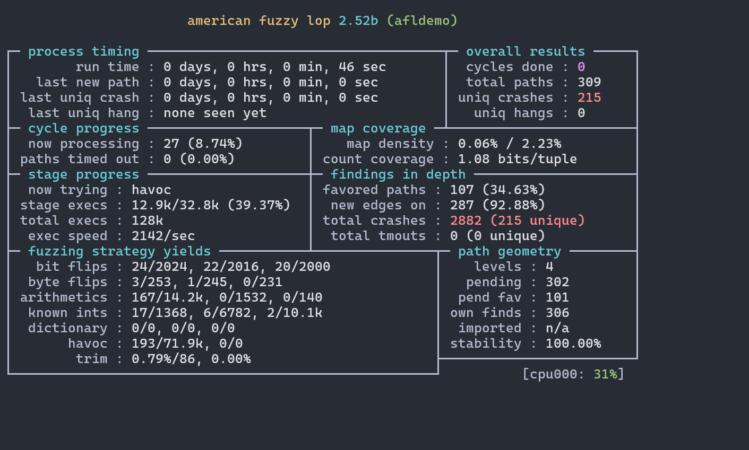
AFL demo
Throughput – number of inputs tested per second
Is higher always better?

Slide 35
AFL demo
Crashes found by the fuzzer
Crashes

Slide 36
AFL demo
Coverage – number of code paths executed
Coverage

Slide 37
Fuzz testing - sanitizers
Tapti Palit

Slide 38
Agenda
Sanitizers
Design patterns (intro)
Quiz (15 minutes/ 30 minutes)

Slide 39
Recall: memory safety bugs
Fuzzers execute the program with random inputs and look for crashes
But memory safety bugs may or may not crash the program
Undefined Behavior (UB)

Slide 40
Sanitizers: oracles for memory safety bugs
Adds additional compiler instrumentation to record object metadata
Turns silent UBs to crashes
Popular sanitizers
Address sanitizer (ASAN) – can detect buffer overflow
Leak sanitizer (LSAN) – can detect memory leak
Thread sanitizer (TSAN) – can detect data races
Significantly slows down the application; but can detect memory safety bugs!!

Slide 41
Address sanitizer
Goal – detect buffer overflow and UAF
Insert “red/poison zones” around memory
Updates to red zones indicate buffer overflow
Need to detect writes to red zones
void function(char* p) {
while(*p != ‘\0’) *p++ = ‘a’;
} int main(void) {
char* s = malloc(16); // heap object 1 char* p = malloc(8); // heap object 2
function(s);
}
0x1018
Heap obj2
0x1010
0x1008
Heap obj1
0x1000
App Memory

Slide 42
Shadow memory
Maintains shadow memory to record metadata about red and accessible zones
Each byte in shadow memory represents a corresponding 8 bytes in app
0x00 for valid
0xFF for poisoned range
0x01 – 0x07 – partially poisoned
void function(char* p) {
while(*p != ‘\0’) *p++ = ‘a’;
} int main(void) {
char* s = malloc(16); // heap object 1 char* p = malloc(8); // heap object 2
function(s);
}
0x1020
Heap obj2
0x10018
0x1018
0x10010
0x1010
Heap obj1
0x10008
0x1000
0x10000
App Memory
Shadow Memory

Slide 43
Compiler checks
Compiler adds instructions before each memory access to first check the shadow memory byte
void function(char* p) {
while(*p != ‘\0’) *p++ = ‘a’;
} int main(void) {
char* s = malloc(16); // heap object 1 char* p = malloc(8); // heap object 2
function(s);
}
0x1018
Heap obj2
0x10018
0x1010
0x10010
0x1008
Heap obj1
0x10008
0x1000
0x10000
App Memory
Shadow Memory

Slide 44
Compiler checks pseudocode
Compiler adds instructions before each memory access to first check the shadow memory byte
Pseudocode
shdw_poisoned(void*) computes the address of the shadow byte
Checks if it is fully/partially poisoned
void function(char* p) {
while(*p != ‘\0’) {
if (shdw_poisoned(p)) { assert(false); }
*p++ = ‘a’; }
} int main(void) {
char* s = malloc(16); // heap object 1 char* p = malloc(8); // heap object 2
function(s);
}
0x1018
Heap obj2
0x10018
0x1010
0x10010
0x1008
Heap obj1
0x10008
0x1000
0x10000
App Memory
Shadow Memory

Slide 45
Why shadow memory?
Shadow memory stores metadata about the 8-byte memory range
Fast computation of shadow byte address
shadow = (address >> 3) + SHADOW_OFFSET
Fast checks of shadow byte value
shadow_value = *shadow

Slide 46
Summary
Fuzzing is an effective testing mechanism
Unlike other testing approaches it can find new inputs that cause program misbehavior
Mutation and coverage are important for generating effective fuzzers
Sanitizers provide additional information needed to find silent UB bugs

