Slide 1
Background: Object Oriented Programming
Tapti Palit

Slide 2
Announcements
HW1, HW3, and potentially some components of HW2 can be done in Rust, Java, or C++
Part of HW2 will use Java Reflection and Annotations
Caveats
Only Java handout
Fewer resources if using Rust/C++
Using more than 95% safe Rust will have a 5% of the HW grade as extra-credit
Potentially other EC homeworks on Rust

Slide 3
Announcements
Oct 13 and Oct 15 lecture-discussion will be swapped
Colloquium attendance
Xingming will conduct discussion on Oct 13 during lecture hours
I will conduct lecture during Oct 15 discussion hours (and lecture hours)

Slide 4
Agenda
OO review
Ungraded quiz (15 minutes)
Software design principles

Slide 5
Agenda
OO review
Ungraded quiz (15 minutes)
Software design principles
Compilation process
Memory types: stack, heap, global
Networking fundamentals
Demo: GitHub and GitHub API
Next 3-4 lectures
Notes:
- Set you up for HW1

Slide 6




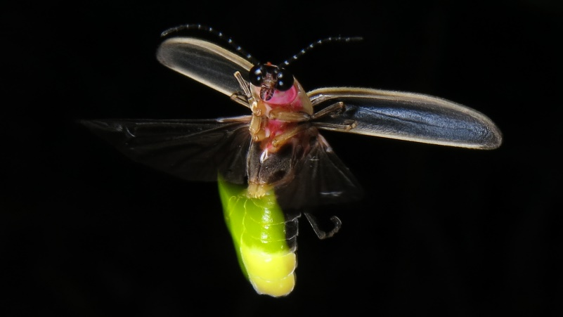

What is an object?
Objects have properties and functions

Slide 7
What is an object?
Objects have properties and functions
Properties
Model
Year
Mileage
Seats, and so on…
Functions
Start
Stop
Accelerate
Brake, and so on…

Slide 8
Java, an object-oriented language
Java is an object-oriented programming language
Everything is an object
A class is a blueprint for creating objects
Defines properties (fields) and behaviors (methods)
An object is an instance of a class
public class Car {
private String model;
private int year;
private int mileage;
public void start() { …}
public void stop() { … }
public void accelerate() { … }
public void brake() { … }
}
public class MyApplication {
public static void main(String[] args) {
Car car = new Car();
} }
Reference
Object
Notes:
- Will have code … slow down?

Slide 9
Encapsulation
Internal details of a class are hidden from outside world
Access is controlled using public, private, protected access modifiers
Direct access to private fields prevented
Needs getter and setter methods
… so what?
public class Car {
private String model;
public String getModel() {
return model;
}
public void setModel(String model) {
this.model = model;
}
// … other fields and methods
}
public class MyApplication {
public static void main(String[] args) {
Car car = new Car();
car.model = “Toyota Hybrid”; // COMPILER ERROR
}
}

Slide 10
What does encapsulation enable?
Last lecture – abstraction means hiding details
Enables user to use component without knowing details
Encapsulation enforces abstraction
Critical to ensuring users of your code use it in the way you intend!
-> Collaboration!
// Breaking abstractions
class ClassDetails { public List<Student> students; public void dropStudent(Student s) {
students.remove(s); if (s.isInternational()
&& !s.hasMinCredits()) {
s.notifyEmail();
} } }
Student s = …; ClassDetails details = …;
details.students.remove(s); // no check!

Slide 11
Inheritance
Reuse code
public class Car {
private String model;
private int year;
private int mileage;
public void start() { …}
public void stop() { … }
public void accelerate() { … }
public void brake() { … }
}
public class Bicycle {
private String model;
private int year; public void start() { …}
public void stop() { … }
public void accelerate() { … }
public void brake() { … }
public void ringBell() { … } }
Code duplication!

Slide 12


Inheritance
public class Vehicle { // shared properties
// and functions
private String model;
private int year;
public void start() { …}
public void stop() { … }
public void accelerate() { … }
public void brake() { … }
}
public class Car extends Vehicle {
private int mileage;
// getter and setter for mileage
}
public class Bicycle extends Vehicle {
public void ringBell() { … } }
public static void main(String[] args) {
Bicycle bicycle = new Bicycle();
bicycle.start();
bicycle.ringBell();
}
VEHICLE
extends
extends
Which methods are invoked?

Slide 13
Multiple inheritance
Java doesn’t support multiple inheritance
Class A
Class B
extends
extends
Class C
Notes:
For completeness
C supports it

Slide 14
Inheritance
public class Vehicle { // shared properties
// and functions
private String model;
private int year;
public void start() { …}
public void stop() { … }
public void accelerate() { … }
public void brake() { … }
}
public class Car extends Vehicle {
private int mileage;
// getter and setter for mileage
}
public class Bicycle extends Vehicle {
public void ringBell() { … } }
public static void main(String[] args) {
Bicycle bicycle = new Bicycle();
bicycle.start();
bicycle.ringBell();
}
VEHICLE
extends
extends
What does it mean to instantiate an object of type Vehicle?
Notes:
Going back to our code
Do we want to prevent the instantiation of Vehicle?

Slide 15
Abstraction via abstract classes
Use abstract class when you want to prevent a class to be initiated
An abstract class cannot be instantiated
Must be extended
public abstract class Vehicle {
private String model;
private int year;
public void start() { …}
public void stop() { … }
public void accelerate() { … }
public void brake() { … }
}
public class Car extends Vehicle {
private int mileage;
// getter and setter for mileage
}
public class Bicycle extends Vehicle {
public void ringBell() { … } }
public static void main(String[] args) {
Vehicle vehicle = new Vehicle(); // Compiler error!!
}

Slide 16
Abstraction via interfaces
Defines a contract for what a class must do but now how
Supports multiple inheritance
All methods in interface are abstract by default
Cannot instantiate interfaces
ILLUMINATABLE
implements
implements

Slide 17
Abstraction via interfaces
Defines a contract for what a class must do but now how
Supports multiple inheritance
All methods in interface are abstract by default
Cannot instantiate interfaces
public interface Illuminatable {
void emitLight();
}
public class Lamp implements Illuminatable {
public void emitLight() {
System.out.println(“Lamp emits light!”);
}
}
public class Firefly implements Illuminatable {
public void emitLight() {
System.out.println(“Firefly emits light”);
}
}

Slide 18
Runtime polymorphism
Real power behind inheritance
A parent type reference can point to a child type object
The method to be invoked is determined at runtime, depending on the type of object
… so what?
public class Bicycle { private int speed = 8;
public void accelerate() {
this.speed+=5;
}
}
public class ElectricBicycle extends Bicycle{
public void accelerate() {
this.speed+=10;
}
}
public static void main(String[] args) {
Bicycle b = new Bicycle();
accelerate(b); // call’s Bike
ElectricBike e = new ElectricBike();
accelerate(e); // call’s ElectricBike
} public static void accelerate(Bicycle b) { b.accelerate(); }

Slide 19
Library vs application
What is a library?
How is it different from an application?
What are the challenges of library design vs. application design?
Consider an open-source application and library
… REST endpoints?
… Frameworks?

Slide 20


Use case: database library
Designing a Java library to interface with database
MySQL database
MySqlDB createDB(String dbName); MySqlTbl createTable(MySqlDB db, String tblName, …);

Slide 21
Use case: database library
class MySQLInterfacer {
// private fields
public void MySqlDB createDB(String dbName) {
// … MySql-specific code
}
MySqlTbl createTable(MySqlDB db,
String tblName,
…) {
// Mysql-specific code
} }
MySQL database

Slide 22
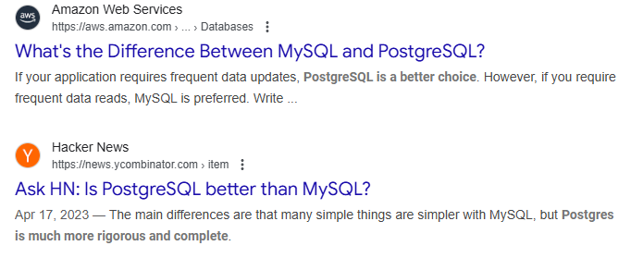



Use case: database library
MySQL database
uses
uses
uses
MySqlDB createDB(String dbName); MySqlTbl createTable(MySqlDB db,
String tblName, …);

Slide 23

Use case: database library
MySQL database
MySqlDB createMysqlDB(String dbName); MySqlTbl createTable(MySqlDB db,
String tblName, …); PgDB createPgDB(String dbName);
PgTbl createTable(PgDB db, String tblName, …);
Postgresql database
Notes:
- Look at an obviously bad solution

Slide 24
Problems with duplicating API functions
Potentially duplicate code
… problems with duplicate code?
Hard to maintain
class MySQLInterfacer {
// private fields
public void MySqlDB createDB(String dbName) {
// … MySql-specific code
}
MySqlTbl createTable(MySqlDB db,
String tblName,
…) {
// Mysql-specific code
} }
class PgInterfacer {
// private fields
public void PgDB createDB(String dbName) {
// … Pg-specific code
}
PgTbl createTable(PgDB db, String tblName,
…) {
// Pg-specific code
} }
Duplicate code

Slide 25
Significant changes on client-side
Library client must change all MySQL specific functions
Potentially significant changes
class SpotifyClient {
private MySqlInterfacer mysql
= new MySqlInterfacer(); public bool downloadSong(String songName) {
MySqlDb db = mysql.createDB(“sptdb”); MySqlTbl tbl = mysql.createTbl(db,
“songs”);
// … download and store songs
} }

Slide 26
Better design
Anticipate potential extensions
Create a DBInterfacer, DB, and Tbl interfaces or abstract class
Create concrete subclasses of for each database type
public interface DB {}
public class MysqlDB implements DB { .. }
public class PgDB implements DB { .. }
public interface Tbl {} public class MysqlTbl implements Tbl { ...}
public class PgTbl implements Tbl {..}
public interface DBInterfacer {
// private fields
public void DB createDB(String dbName);
public Tbl createTbl(Db db,
String tblName, ..); }
DB
Tbl
implements
implements
MysqlDB
PgDB
MysqlTbl
PgTbl

Slide 27
Better design
public interface DB {}
public class MysqlDB implements DB { .. }
public class PgDB implements DB { .. }
public interface Tbl {} public class MysqlTbl implements Tbl { ...}
public class PgTbl implements Tbl {..}
public interface DBInterfacer {
// private fields
public void DB createDB(String dbName);
public Tbl createTbl(Db db,
String tblName, ..); }
public class MySqlInterfacer implements DBInterfacer {
// private fields
public void DB createDB(..) {
MysqlDB db = new MysqlDB();
return db;
}
// same for createTbl }
Possible because parent type ref can point to child type object

Slide 28
Better design
public interface DB {}
public class MysqlDB implements DB { .. }
public class PgDB implements DB { .. }
public interface Tbl {} public class MysqlTbl implements Tbl { ...}
public class PgTbl implements Tbl {..}
public interface DBInterfacer {
// private fields
public void DB createDB(String dbName);
public Tbl createTbl(Db db,
String tblName, ..); }
public class MySqlInterfacer implements DBInterfacer {
// private fields
public void DB createDB(..) {
MysqlDB db = ...;
return db;
}
// same for createTbl }
public class PgInterfacer implements DBInterfacer {
// private fields
public void DB createDB(..) {
PgDB db = new PgDB();
return db;
}
// same for createTbl }
… why is this better design?

Slide 29
Client-side changes
// before
class SpotifyClient {
private MySqlInterfacer dbinterface
= new MySqlInterfacer(); public bool downloadSong(String songName) {
MySqlDb db = dbinterface.createDB(“sptdb”); MySqlTbl tbl = dbinterface.createTbl(
mysqldb,
“songs”);
// … download and store songs
} }
// With interface
class SpotifyClient {
private DBInterfacer dbinterface
= new MySqlInterfacer(); public bool downloadSong(String songName) {
DB db = dbinterface.createDB(“sptdb”); Tbl tbl = dbinterface.createTbl(db,
“songs”);
// … download and store songs
} }

Slide 30
Client-side changes
Runtime polymorphism ensures that when createDB and createTbl is invoked, the methods in MySqlInterface are called
Even though the type of dbInterface is DBInterfacer (parent interface)
// With interface
class SpotifyClient {
private DBInterfacer dbinterface
= new MySqlInterfacer(); public bool downloadSong(String songName) {
DB db = dbinterface.createDB(“sptdb”); Tbl tbl = dbinterface.createTbl(db,
“songs”);
// … download and store songs
} }

Slide 31
Client-side changes
Runtime polymorphism ensures that when createDB and createTbl is invoked, the methods in MySqlInterface are called
Even though the type of dbInterface is DBInterfacer (parent interface)
// With interface
class SpotifyClient {
private DBInterfacer dbinterface
= new MySqlInterfacer(); public bool downloadSong(String songName) {
DB db = dbinterface.createDB(“sptdb”); Tbl tbl = dbinterface.createTbl(db,
“songs”);
// … download and store songs
} }
What change is needed to move to Postgres?

Slide 32
Client-side changes
Now, runtime polymorphism ensures that when createDB and createTbl is invoked, the methods in PgInterface are called
Even though the type of dbInterface is DBInterfacer (parent interface)
// after
class SpotifyClient {
private DBInterfacer dbinterface
= new PgInterfacer(); public bool downloadSong(String songName) {
DB db = dbinterface.createDB(“sptdb”); Tbl tbl = dbinterface.createTbl(db,
“songs”);
// … download and store songs
} }
Inheritance and Runtime Polymorphism enable extension

Slide 33
Other programming languages
Rust doesn’t support inheritance, as such
Rust only supports Traits, which is similar to Interfaces in Java
C++ supports multiple inheritance
Some special rules for diamond inheritance
C++ supports runtime polymorphism only for virtual functions

Slide 34
Background: Object Oriented Programming
Tapti Palit

Slide 35
Announcements
HW1 and HW2 handouts uploaded
Contents can change slightly, but not by much
Up to Oct 10
Will add more “hints”

Slide 36
Agenda
Recap
Software design principles
Networking fundamentals
Compilation process recap

Slide 37
Recap
OO languages allow inheritance and runtime polymorphism
Better to “program to interfaces” than concrete class
public interface DB {}
public class MysqlDB implements DB { .. }
public class PgDB implements DB { .. }
public interface Tbl {} public class MysqlTbl implements Tbl { ...}
public class PgTbl implements Tbl {..}
public interface DBInterfacer {
public void DB createDB(String dbName);
public Tbl createTbl(Db db,
String tblName, ..); }
public class MysqlDBInterfacer implements DBInterfacer {
// concrete implementation
}
public class PgDBInterfacer implements DBInterfacer {
// concrete implementation }

Slide 38
Recap
Having a broader interface can allow certain bugs that narrower interface would not
Extensibility vs. correctness tradeoff
In real situations – rare to make such errors
public void downloadSong() {
DBInterface mysqlInt =
new MySqlDBInterface();
DBInterface pgInt = new PgDBInterface();
DB db1 = mySqlInt.createDB(..);
DB db2 = pgInt.createDB(..);
// Won’t produce compiler error Tbl tb = mysqlInt.createTbl(db2, ..);
}
MySQL interface
Postgres DB

Slide 39
Recap
Having a broader interface can allow certain bugs that narrower interface would not
Extensibility vs. correctness tradeoff
In real situations – rare to make such errors
public void downloadSong() {
MySqlDBInterface mysqlInt =
new MySqlDBInterface();
PgDBInterface pgInt = new PgDBInterface();
DB db1 = mySqlInt.createDB(..);
DB db2 = pgInt.createDB(..);
// Won’t produce compiler error Tbl tb = mysqlInt.createTbl(db2, ..);
}
MySQL interface
Postgres DB
Compiler error

Slide 40
Recap
Runtime polymorphism applies to classes too (both, abstract and concrete)
public [abstract] class DB {}
public class MysqlDB extends DB { .. }
public class PgDB extends DB { .. }
public interface Tbl {} public class MysqlTbl implements Tbl { ...}
public class PgTbl implements Tbl {..}
public interface DBInterfacer {
public void DB createDB(String dbName);
public Tbl createTbl(Db db,
String tblName, ..); }
public class MysqlDBInterfacer implements DBInterfacer {
// concrete implementation
}
public class PgDBInterfacer implements DBInterfacer {
// concrete implementation }

Slide 41
Software design principles (SOLID)

Slide 42
Single Responsibility Principle (SRP)
A class should have only one reason to change
Each class handles a single responsibility
Leads to clearer, testable code

Slide 43
Single Responsibility Principle (SRP)
Use case: read student details from a text file and save it to a database
class Student
private String name;
private int age;
// getters and setters
Bad design
class TextParser
private String readFile();
public List<Student> students parseStudents(String fileContents) public void saveStudent(Student s);
public void loadStudent(int studentId);

Slide 44
Single Responsibility Principle (SRP)
Better design
… why?
class Student
private String name;
private int age;
// getters and setters
class DBPersister
public void saveStudent(Student s); public Student loadStudent(int studentId);
class TextParser
private String readFile();
public List<Student> students parseStudents(String fileContents)

Slide 45
Open/Closed Principle (OCP)
Open for extension, closed for modification
Add new behavior via inheritance or composition
Avoids breaking existing code
E.g., make internal logic fields and methods private
… examples?

Slide 46
Liskov Substitution Principle (LSP)
Subtypes must be substitutable for base types
Derived classes shouldn’t break expected behavior
Ensures polymorphism works correctly

Slide 47
Liskov Substitution Principle (LSP)
Basically, we should always be able to substitute a subclass object for a parent class reference
public interface DB {}
public class MysqlDB implements DB { .. }
public class PgDB implements DB { .. }
public interface Tbl {} public class MysqlTbl implements Tbl { ...}
public class PgTbl implements Tbl {..}
public interface DBInterfacer {
public void DB createDB(String dbName);
public Tbl createTbl(Db db,
String tblName, ..); }
public class MSDBInterfacer implements DBInterfacer {
public void DB createDB(String dbName) {
delete_all_other_dbs(); }
}
Bad design

Slide 48
Interface Segregation Principle (ISP)
Prefer many small interfaces over one large one
Clients only depend on methods they use
Avoids “fat” interfaces and reduces side effects
Eg., DBInterfacer, DB, Tbl as interfaces and per-database-type concrete subclasses

Slide 49
Dependency Inversion Principle (DIP)
Depend on abstractions, not concrete classes
High-level modules should not depend on low-level modules
Enables flexible, decoupled architectures
… examples?

Slide 50
Compilation process

Slide 51

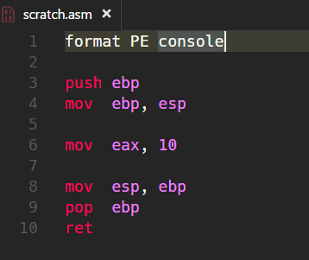

What is object code?
Object code is a representation of the source code at a lower level
C compiler translates it to machine code
Directly runnable on the hardware (hardware specific) [Demo: X86, ARM]

Slide 52
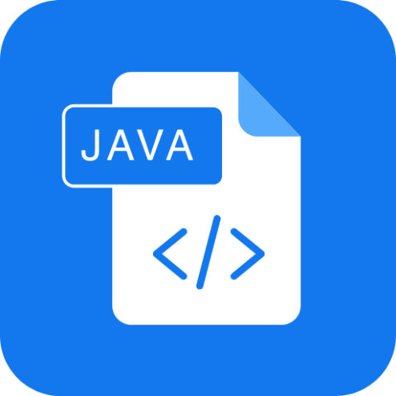
What is object code?
Object code is a representation of the source code at a lower level
Java compiler translates it to an “Intermediate Representation (bytecode)” [Demo]
Compiled from "MyApp.java"
public class MyApp {
public MyApp();
Code:
0: aload_0
1: invokespecial #1 // Method java/lang/Object."<init>":()V
4: return
public static void main(java.lang.String[]);
Code:
0: getstatic #7 // Field java/lang/System.out:Ljava/io/PrintStream;
3: ldc #13 // String Hello!
5: invokevirtual #15 // Method java/io/PrintStream.println:(Ljava/lang/String;)V
8: return
}
javac
MyApp.java
MyApp.class

Slide 53
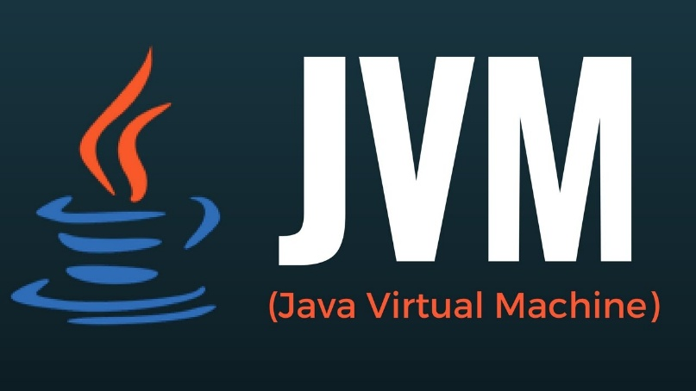
Java bytecode interpretation
Hardware does not know how to run Java bytecode
Needs a Java Virtual Machine (JVM) to execute the bytecode instructions at runtime
INTERPRETER
MyApp.class
Just-in-Time Compiler
[java]

Slide 54
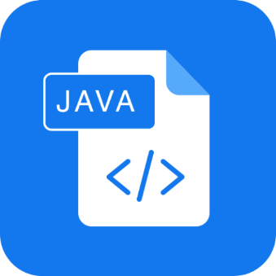

TL;DR
INTERPRETER
Compiled from "MyApp.java"
public class MyApp {
public MyApp();
Code:
0: aload_0
1: invokespecial #1 // Method java/lang/Object."<init>":()V
4: return
public static void main(java.lang.String[]);
Code:
0: getstatic #7 // Field java/lang/System.out:Ljava/io/PrintStream;
3: ldc #13 // String Hello!
5: invokevirtual #15 // Method java/io/PrintStream.println:(Ljava/lang/String;)V
8: return
}
javac
Just-in-Time Compiler
[java]
MyApp.java
Machine code
MyApp.class
Both steps performed when we press RUN on the IDE

Slide 55
Why does it matter?
Some checks happen at compile time
Syntax checking
Type-checking, generic type checking
… and so on
Other checks happen at run time
Runtime polymorphism
Array index out of bounds access
Null pointer access
File not found checks

Slide 56
Types of memory
[TBD]

Slide 57
Generics
Generics allows the programmer to define a “placeholder” for a type.
The placeholder gets replaced by the real type when the class is instantiated
Facilitates reusability
Wildcard “?”
Used to represent an unknown type
List<?> used to represent a list of any type
public class Container<T> {
private T item;
// Setter
public void setItem(T item) {
this.item = item;
}
// Getter
public T getItem() {
return item;
}
}
public class MyApplication(String[] args) {
Container<String> c1 = new Container<String>();
c1.setItem(new String(“hello”));
Container<Bicycle> c2 = new Container<Bicycle>();
c2.setItem(new Bike());
}

Slide 58
Bounded polymorphism
Allows the programmer to restrict the types that can be used in a generic class or method using “bounds”
Enforce constraints while maintaining flexibility
Upper Bound: T extends ClassName
Lower Bound: ? super ClassName
public <T extends Number> int sum (T a, T b) {
return a.intValue() + b.intValue();
}
// Usage
sum(5, 6); // Works
sum(5.5, 6.6); // Works
sum(“5”, “7”); // COMPILER ERROR
What is the benefit of using generic type
instead of Number?

