Slide 1
Networking Fundamentals
Tapti Palit

Slide 2


Browser – web server communication
REQUEST
RESPONSE
… how?
Notes:
- Focus mainly on addressing

Slide 3
Network layers
The kernel contains the networking code
TCP-IP is the most common networking stack
It is organized in layers
Layered architecture
Every layer has a protocol
Application Layer
Userspace
Transport Layer
TCP, UDP
Internet Layer
IP
Linux kernel
Link layer
Ethernet
Notes:
Networking code consists of different layers
Purely in software
OS manages most of the complexity
You only worry about the application layer (if that)

Slide 4
What is a protocol?
Every layer/protocol has a fixed message format
Header
Payload
[optional] Checksum
Structured set of messages that follow a predefined format
Multiple messages needed to establish and tear down a connection
[more in a networking class]
How is it different from API?
Header
Checksum
Payload
Notes:
Header meta-data
Checksum [drops, corruption]

Slide 5
Protocol vs API
API is more high-level
Does not mandate what the parameters mean, just that they should follow a “format”
int sort(List<Student> students, bool ascending);
Protocol is more low-level
Mandates what each field/parameter means
Internet Engineering Task Force (IETF) standardizes protocols
Protocol definition can span multiple messages

Slide 6
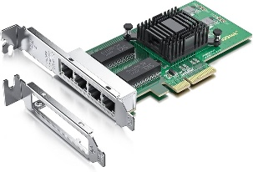
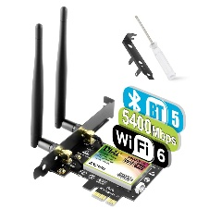
Link layer
Only layer that communicates with hardware devices
Abstracts low-level hardware details
Upper layers don’t need to worry about which NIC card plugged in
Application Layer
Userspace
Transport Layer
Internet Layer
Linux kernel
Link layer
00:15:5d:9c:c0:f4
00:15:5d:9c:c4:d8
Notes:
Networking code consists of different layers
Purely in software

Slide 7
Internet layer
Internet layer (IP layer)
Handles addressing
Unique address for each interface
localhost or 127.0.0.1 special “virtual” interface for the “loopback” interface
Physical devices can have different IPs
Sometimes multiple IPs
Userspace
Application Layer
Transport Layer
Internet Layer
130.245.42.104
24.11.201.33
Linux kernel
Link layer
Notes:
- End point provided by the kernel

Slide 8
Transport layer
Port is a logical abstraction provided by the transport layer
A port is associated with an IP address
Application Layer
Userspace
Port:80
Port:6379
Port:22
Transport Layer
Internet Layer
130.245.42.104
24.11.201.33
Linux kernel
Link layer
Notes:
- End point provided by the kernel

Slide 9
Transport layer
Port numbers go from 0 to 65535
< 1024, needs root access
Standard ports
Web servers typically bind to port 80
Redis to port 6379
Ssh to port 22
Application Layer
Userspace
Port:80
Port:6379
Port:22
Transport Layer
Internet Layer
130.245.42.104
24.11.201.33
Linux kernel
Link layer
Notes:
- End point provided by the kernel

Slide 10



Application layer
Applications talk to the rest of the networking layers using application layer protocols
Applications bind and listen to a particular transport layer port for requests
HTTP, Redis, SSH protocols
Application Layer
Userspace
Port:80
Port:6379
Port:22
Transport Layer
Internet Layer
130.245.42.104
24.11.201.33
Linux kernel
Link layer
Notes:
- End point provided by the kernel

Slide 11
Application layer
Multiple instances of the same application needs different ports
Application Layer
Userspace
Port:81
Port:80
Port:6379
Port:22
Transport Layer
Internet Layer
130.245.42.104
24.11.201.33
Linux kernel
Link layer
Notes:
- End point provided by the kernel

Slide 12
Network communication
Clients can connect to an IP address and a port
Application Layer
Application Layer
HW1-app
Transport Layer
Transport Layer
Port:80
Port:6379
Port:22
Port:15487
Internet Layer
Internet Layer
102.56.89.2
130.245.42.104
Link layer
Link layer
Machine B
Machine A
Notes:
- End point provided by the kernel

Slide 13
Socket end point
(port number, IP address) pair identifies a unique socket end point
E.g. (142.250.114.100, 80) -> google.com
(23.185.0.4, 80) -> ucdavis.edu
Socket API to open and close sockets
Userspace
Application Layer
Transport Layer
Port:80
Port:6379
Port:22
Port:81
Internet Layer
130.245.42.104
24.11.201.33
Linux kernel
Link layer
Notes:
- End point provided by the kernel

Slide 14
Networking key points
Applications bind to ports
Multiple instances of the same app needs different ports
Every physical interface has a corresponding IP address
(port, IP address) is a socket pair and uniquely identifies an internet end point
Notes:
http://httpforever.com/

Slide 15



HTTP server
Example – Apache httpd
Serves HTML and Javascript pages
Encapsulates and abstracts
All HTTP protocol parsing
All socket programming code
Nowadays, encrypted HTTPS protocol used
Application Layer
Userspace
Abstraction
Port:80
Transport Layer
Internet Layer
130.245.42.104
24.11.201.33
Linux kernel
Link layer
Notes:
Everything is abstraction
Don’t want to be writing a HTTP response for each request
Hides the details of the lower layers
python3 -m http.server 8000

Slide 16
HTTP and HTTP methods
HyperText Transfer Protocol
Used for communicating with web servers, microservices, and so on…
Supports multiple “methods” or “verbs”
Common ones
GET
POST
PUT
DELETE
Different types of messages that the protocol can understand
Notes:
- Important for the microservices

Slide 17
HTTP request
Request Line: Method, URL, HTTP version
Example: GET /index.html HTTP/1.1
Headers: Metadata like Content-Type, Authorization
Body: Optional, contains data for POST/PUT requests

Slide 18
HTTP response
Status Line: HTTP version, status code (e.g., 200 OK)
https://developer.mozilla.org/en-US/docs/Web/HTTP/Reference/Status
Headers: Metadata like Content-Type, Content-Length
Body: Optional, contains response data (e.g., HTML, JSON)

Slide 19
HTTP GET method
Used to retrieve data from the server
Does not modify the server state
Can send parameters
GET /url?id=100 HTTP 1.1
Use cases
Fetching a webpage
Retrieving information
> telnet google.com 80
GET /index.html HTTP/1.1
<html>
<head><title>…. </title></head>
<body> … </body>
</html>

Slide 20
Browser – web server communication
HTTP GET request
HTTP response

Slide 21
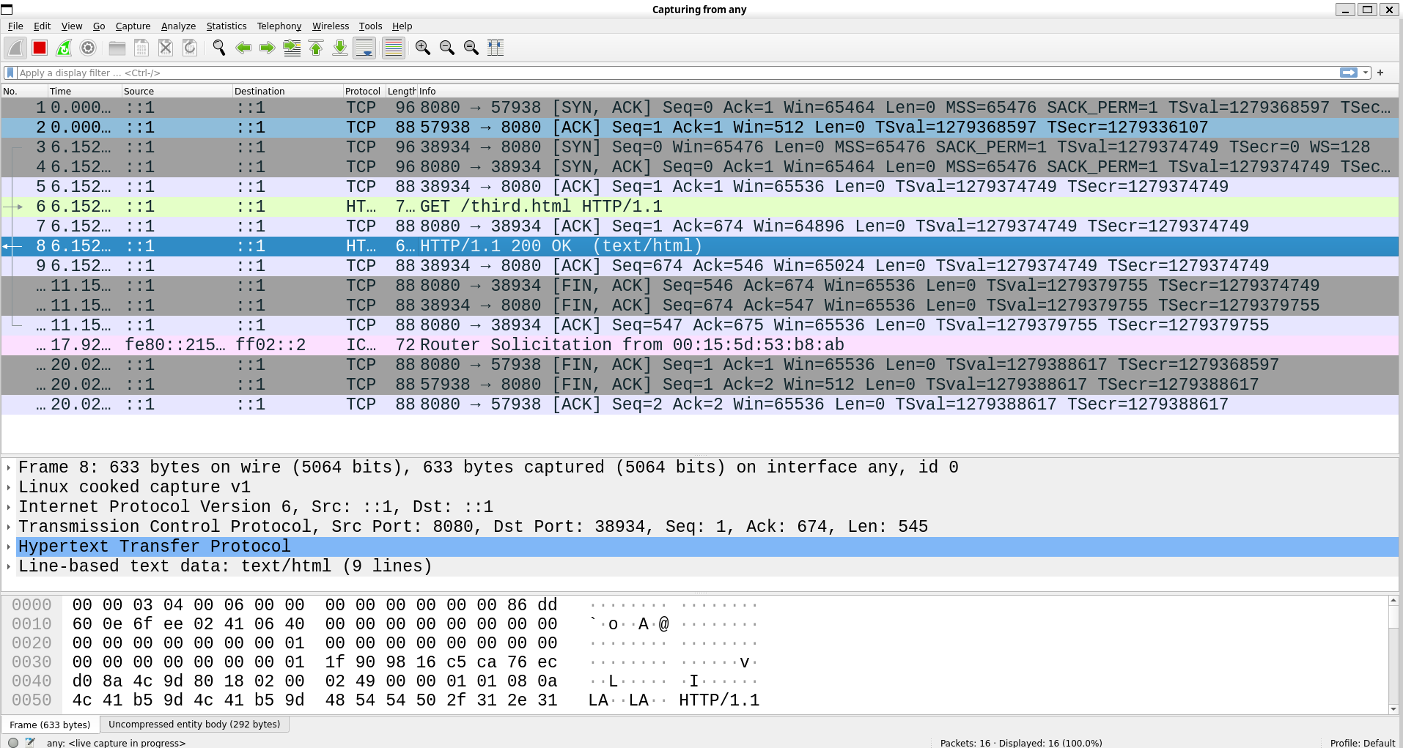
Wireshark demo
Wireshark demo

Slide 22
HTTP GET request
GitHub API
gh auth login
gh auth token
curl --request GET --url "https://api.github.com/repos/octocat/Spoon-Knife/issues" --header "Accept: application/vnd.github+json" --header "Authorization: [TOKEN]"

Slide 23
HTTP POST method
Used to send data to the server
Includes a body to send data to the server
Use cases
User registration
Submitting forms
> telnet site.com 80
POST /users HTTP/1.1
Content-Type: application/json
{
"name": "John Doe", "email": “john.doe@example.com”
}

Slide 24
HTTP PUT method
Used to update or replace an existing resource on the server
Includes a body to send updated data
Use cases
Updating user information
… and so on
> telnet site.com 80
PUT /users/10 HTTP/1.1
Content-Type: application/json
{
"name": "John Doe", "email": john.doe@example.com
}

Slide 25
HTTP DELETE method
Used to remove a resource from the server
Typically, does not have a request body
Use cases
Deleting user account
Removing items from a database
> telnet site.com 80
DELETE /users/10 HTTP/1.1

Slide 26
Key points
HTTP is just a protocol
The functionality of each HTTP method must be implemented by an application
Apache httpd webserver
Nginx webserver
You can develop your own webserver

Slide 27
Apache httpd demo
Start the HTTP web server
sudo service apache2 start
Update the port in /etc/apache2/ports.conf
Add any HTML/Javascript files in /var/www
Notes:
/etc/apache2 has the config
/var/www has the website

