Slide 1
GitHub API and JSON
Tapti Palit

Slide 2
Agenda
Networking recap and DNS servers
GitHub API and JSON parsing
Demo
Databases and Redis

Slide 3





Socket end point
(port number, IP address) pair identifies a unique socket end point
E.g. (142.250.114.100, 80) -> google.com
(23.185.0.4, 80) -> ucdavis.edu
Socket API to open and close sockets
Userspace
Application Layer
Transport Layer
Port:80
Port:6379
Port:22
Port:81
Internet Layer
130.245.42.104
24.11.201.33
Linux kernel
Link layer
Notes:
- End point provided by the kernel

Slide 4
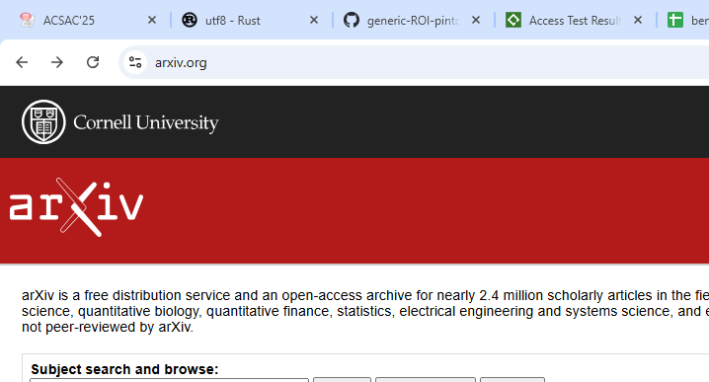
Domain names
No IP address, no port

Slide 5
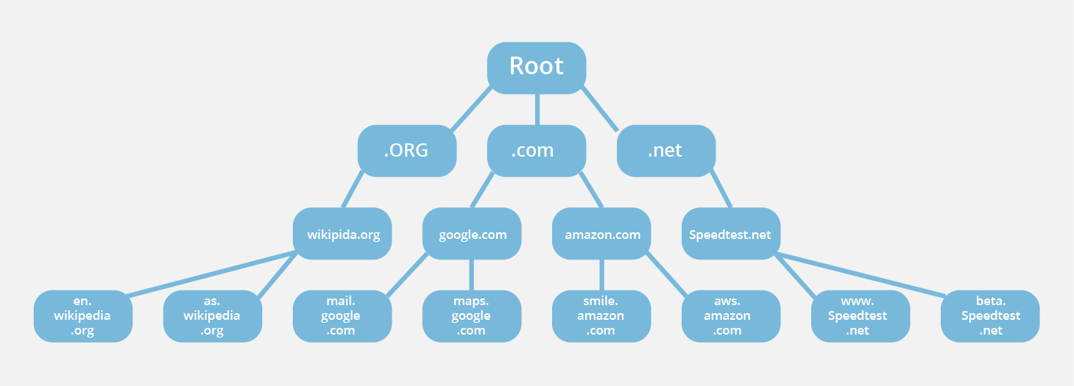
Domain names
Domain names are human-readable mappings to IP addresses
Who administers?
https://www.cloudflare.com/learning/dns/glossary/dns-root-server/

Slide 6
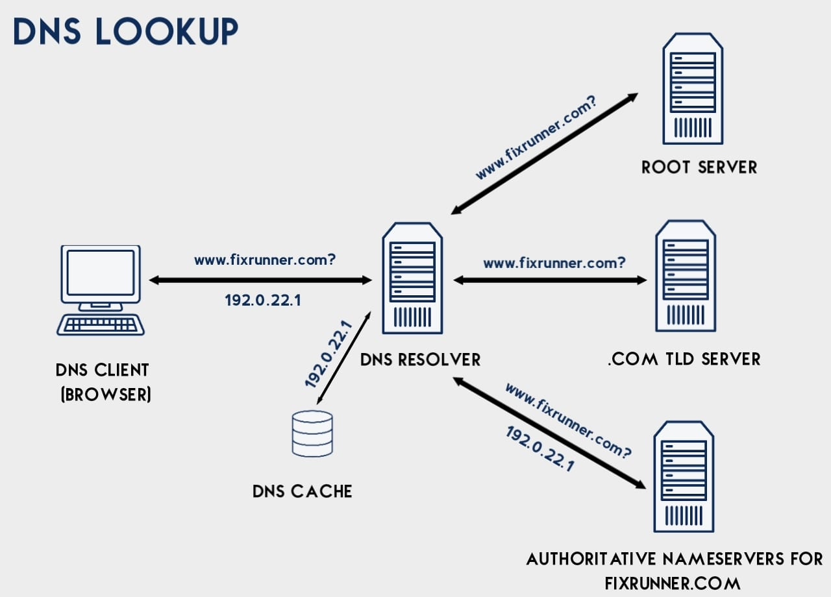
DNS lookup
https://www.fixrunner.com/what-is-dns/

Slide 7
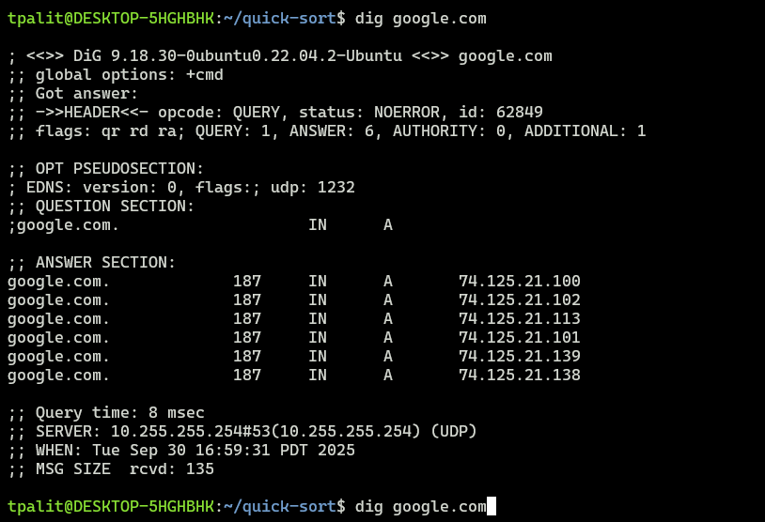
Map domain name to IP
dig [Domain name]

Slide 8
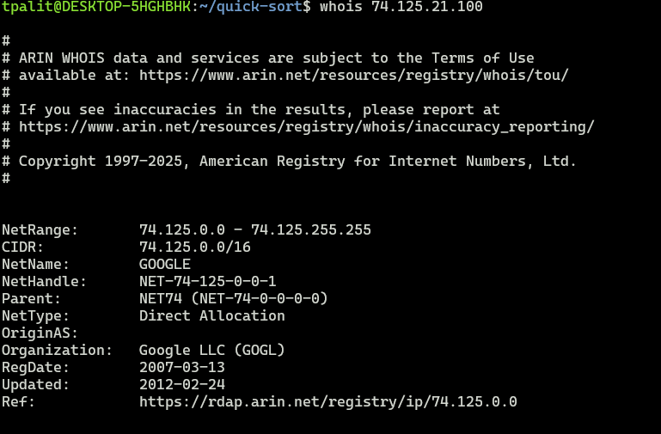
Map IP to domain name
whois [IP]

Slide 9
GitHub API

Slide 10
GitHub REST API
An HTTP-based interface to interact with GitHub programmatically
Authentication Methods
Personal Access Tokens
OAuth Apps

Slide 11
OAuth
Open Authorization
Technological standard that allows you to authorize one app or service to sign in to another without divulging private information, such as passwords

Slide 12
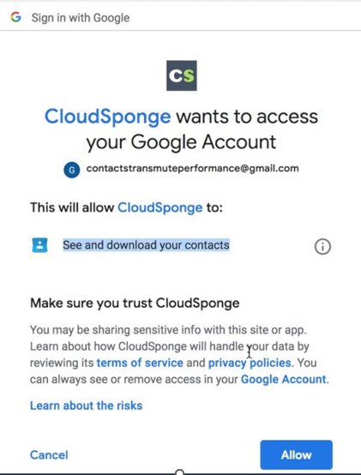
OAuth
Google (or GitHub) runs an OAuth server
Gives you an OAuth token
Use that token to make API calls

Slide 13
GitHub CLI demo
gh auth login
This launches OAuth authentication
cat ~/.config/gh/hosts.yml
Grab the Oauth token
Can run without authorization, but will be rate-limited

Slide 14
GitHub REST API
RESTful APIs
REST = Representational State Transfer
Stateless services
Implication: the service will not remember anything about previous interactions
Common Endpoints
GET /repos/{owner}/{repo} - Repo metadata
POST /repos/{owner}/{repo}/issues - Create an issue
GET /users/{username} - User profile data

Slide 15
What is JSON?
“JSON” stands for “JavaScript Object Notation”
Lightweight data-interchange format
Despite the name, JSON is a (mostly) language-independent way of specifying objects as name-value pairs
Structured representation of data object
Can be parsed with most modern languages
JSON Schema can be used to validated a JSON file
Credit: Some slide contents adapted from - https://www.cs.utexas.edu/~fares/cs330ef25/CS%20373_files/tutorials/JSON.ppt

Slide 16
JSON Syntax Rules
JSON is almost identical to python dictionary except for
In JSON, true and false are not capitalized
In JSON, null is used instead of None
Uses key/value pairs: {“name”: “John”}
Uses double quotes around KEY and VALUE
A value can be: A string, a number, true, false, null, an object, or an array
Strings are enclosed in double quotes, and can contain the usual assortment of escaped characters

Slide 17
JSON Example
{
"name": "John Smith",
"age": 35,
"address": {
"street": "5 main St.",
"city": "Austin"
},
"children": ["Mary", "Abel"]
}
Notes:
This is a single JSON object for a person. It’s wrapped in curly braces and uses the key/value pairs.
The first pair, which is the name, uses a string as the value, John Smith, must be wrapped in double quotes.
The second one is the number, and note that the number is not wrapped in double quotes.
The next is address which is actually an embedded object with a street and a city.
The last one is an array is an array of strings.

Slide 18
Demo
GET request
curl --request GET --url "https://api.github.com/repos/octocat/Spoon-Knife/issues" --header "Accept: application/vnd.github+json" --header "Authorization: [TOKEN]"
Postman
Cleaner interface (?)

Slide 19
Demo
curl -L -H "Accept: application/vnd.github+json" -H "X-GitHub-Api-Version: 2022-11-28" https://api.github.com/repos/davsec-teaching/ecs160-f25/commits
curl -L -H "Accept: application/vnd.github+json" -H "X-GitHub-Api-Version: 2022-11-28" https://api.github.com/repos/davsec-teaching/ecs160-f25/commits/061f8cb41d4dbb8b278356d61ec6e600ed2ea940

Slide 20
Demo
API: https://docs.github.com/en/rest?apiVersion=2022-11-28
Search API: https://docs.github.com/en/rest/search/search?apiVersion=2022-11-28

Slide 21
Using JSON with Gson
To work with JSON (string, or file containing JSON object), you can use the Gson json module.
Demo

