Slide 1
Software security
Tapti Palit

Slide 2
Announcements
HW2 – should finish the persistence framework with some sample test cases by this weekend
Quiz today
Do not share access code
Do not sign up on others’ behalf

Slide 3
Module goals
Understand software security concerns that influence software engineering
Memory safety and memory unsafe languages
Secure programming
Deeper dive in any topics “on-demand”

Slide 4
C vs Java vs Python
C/C++
Java
#include <stdio.h> int main(int argc, char** argv) { char a = ‘A’; char arr[4] = {‘a’, ‘b’, ‘c’, ‘d’}; int index = atoi(argv[1]); printf(“%c\n”, arr[index]);
}
> gcc test.c –o test > ./test 10 > Output???
class MyApp {
public static void main(String[] args) { char a = ‘A’;
char arr[] = {‘a’, ‘b’, ‘c’, ‘d’};
int index = Integer.parseInt(args[0]);
System.out.println(arr[index]);
}
}
> javac MyApp.java > java MyApp.class 10 > # Output?
import sys arr = [‘a’, ‘b’, ‘c’, ‘d’] index = int(sys.argv[1]) print(arr[index]) > python3 test.py 10
Python

Slide 5
C vs Java vs Python
C/C++
Java
#include <stdio.h> int main(int argc, char** argv) { char a = ‘A’; char arr[4] = {‘a’, ‘b’, ‘c’, ‘d’}; int index = atoi(argv[1]); printf(“%c\n”, arr[index]);
}
> gcc test.c –o test > ./test 10 > Output???
class MyApp {
public static void main(String[] args) { char a = ‘A’;
char arr[] = {‘a’, ‘b’, ‘c’, ‘d’};
int index = Integer.parseInt(args[0]);
System.out.println(arr[a]);
}
}
> javac MyApp.java > java MyApp.class 10 > Exception in thread "main" java.lang.ArrayIndexOutOfBoundsException: Index 10 out of bounds for length 4
import sys arr = [‘a’, ‘b’, ‘c’, ‘d’] index = int(sys.argv[1]) print(arr[index]) > python3 test.py 10 IndexError: list index out of range
Python

Slide 6
C vs Java vs Python
C/C++
Java
#include <stdio.h> int main(int argc, char** argv) { char a = ‘A’; char arr[4] = {‘a’, ‘b’, ‘c’, ‘d’}; int index = atoi(argv[1]); printf(“%c\n”, arr[index]);
}
> gcc test.c –o test > ./test 10 > �
class MyApp {
public static void main(String[] args) { char a = ‘A’;
char arr[] = {‘a’, ‘b’, ‘c’, ‘d’};
int index = Integer.parseInt(args[0]);
System.out.println(arr[a]);
}
}
> javac MyApp.java > java MyApp.class 10 > Exception in thread "main" java.lang.ArrayIndexOutOfBoundsException: Index 10 out of bounds for length 4
Undefined Behavior (UB)
import sys arr = [‘a’, ‘b’, ‘c’, ‘d’] index = int(sys.argv[1]) print(arr[index]) > python3 test.py 10 IndexError: list index out of range
Python

Slide 7
Memory layout
#include <stdio.h> int main(int argc, char** argv) { char a = ‘A’; char arr[4] = {‘a’, ‘b’, ‘c’, ‘d’}; int index = atoi(argv[1]); printf(“%c\n”, arr[index]);
}
> gcc test.c –o test > ./test 10 > �
.. garbage value ..
0x1004
… 6 bytes …
0xFFF
arr[3]
0xFFE
+10
arr[2]
0xFFD
arr[1]
0xFFC
arr[0]
0xFFB
a
0xFFA

Slide 8
C: lack of bounds checks
Buffers (arrays, strings) have bounds
[0, Size of the buffer]
char* p = malloc(128); // Bounds [0, 128]
C lacks bounds checks
p[1000]
Assume that p is pointing to a buffer that has at least 1000 elements
Try to access the 1000th element
Might crash if memory isn’t mapped
Might print whatever was in that memory

Slide 9

Memory safety and performance
Java compiler inserts bounds checks for array accesses that are inserted at runtime
Additional runtime checks reduces performance
Pseudo-code after Java compiler
inserts checks
Original Java code
char a = ‘A’; char arr[4] = {‘a’, ‘b’, ‘c’, ‘d’}; int index = atoi(argv[1]); printf(“%c\n”, arr[index]);
char a = ‘A’; char arr[4] = {‘a’, ‘b’, ‘c’, ‘d’}; int index = atoi(argv[1]); if (index < arr.length) {
System.out.println(arr[index]);
} else {
throw new ArrayIndexOutOfBoundsException();
}

Slide 10
So what?
In case of all programming languages, the program didn’t do what we wanted it to do
Java, Python -> it crashed [defined behavior]
C -> printed garbage or might crash [undefined behavior]
… why is the second option worse than the first?

Slide 11
Why is UB worse?
Undefined behavior leaves system in inconsistent state
Inconsistent state can be exploited by the attacker
… How??

Slide 12
Background: types of memory
Applications have (at least) 3 types of memory
Function local variables allocated on the “stack”
Heap variables allocated via malloc
Global variables
int global_arr[10];
int main(void) {
int a;
int b;
int local_arr[10];
int* p = malloc(10*sizeof(int));
}
Global variable
Stack variable
Heap variable

Slide 13
Background: stack layout
Stack grows downward
0x1000
Top of the stack
0xFFF
0xFFE
0xFFD
0xFFC
0xFFB

Slide 14
Buffer overflow
#include <stdlib.h>
#include <stdio.h>
int main(void) { uint8_t authenticated = 0;
uint8_t array[4];
uint8_t * p = array;
uint8_t num;
for (int i = 0; i <= 4; i++) {
printf(“Enter a number:”);
scanf(“%d”, &num);
}
return 0;
}
authenticated
0x1000
array[3]
0xFFF
array[2]
0xFFE
array[1]
0xFFD
array[0]
0xFFC
0xFFB

Slide 15
Alternative layout: Buffer overflow not possible
#include <stdlib.h>
#include <stdio.h>
int main(void) { uint8_t authenticated = 0;
uint8_t array[4];
uint8_t * p = array;
uint8_t num;
for (int i = 0; i <= 4; i++) {
printf(“Enter a number:”);
scanf(“%d”, &num);
}
return 0;
}
0x1000
array[3]
0xFFF
array[2]
0xFFE
array[1]
0xFFD
array[0]
0xFFC
authenticated
0xFFB

Slide 16
Buffer overflow
#include <stdlib.h>
#include <stdio.h>
int main(void) { uint8_t authenticated = 0;
uint8_t array[4];
uint8_t * p = array;
uint8_t num;
for (int i = 0; i <= 4; i++) {
printf(“Enter a number:”);
scanf(“%d”, &num);
}
return 0;
}
array[3]
0x1000
array[2]
0xFFF
array[1]
0xFFE
array[0]
0xFFD
authenticated
0xFFC
Scanf’s &num
0xFFB

Slide 17
Buffer overflow
#include <stdlib.h>
#include <stdio.h>
int main(void) { uint8_t authenticated = 0;
uint8_t array[4];
uint8_t * p = array;
uint8_t num;
for (int i = 0; i <= 4; i++) {
printf(“Enter a number:”);
scanf(“%d”, &num);
array[i] = num;
}
return 0;
} > Enter a number:
1 # 5 times
1
authenticated
0x1000
1
Overwrite authenticated
variable!!!
array[3]
0xFFF
1
array[2]
0xFFE
array[1]
0xFFD
1
array[0]
0xFFC
1
0xFFB

Slide 18
Vulnerable string-related libc functions
scanf (with the %s modifier) , strcpy, printf (with %n modifier)
String stored can be larger than the variable size
Will overwrite the contents of the adjacent memory
char* password = malloc(5); scanf(“%s”, password); // will overflow if user enters “AAAAAA”
Solution: use size-limited functions such as snprintf, scanf(“%5s”, password), strncpy, and so on

Slide 19
Vulnerable string-related libc functions
char* password = malloc(5); scanf(“%s”, password)
overflow if user enters “AAAAAA”
A
0x1000
A
0xFFF
A
0xFFE
Password
A
0xFFD
A
0xFFC
A
0xFFB

Slide 20
Buffer overflow demo
https://github.com/davsec-teaching/buffer-overflow-demo

Slide 21
Software security

Slide 22
Announcements
HW2 handout updated
Sample code to get all loaded classes
Part D requirements updated to reduce the number of LLM calls
HW1 grades will be released by today EOD
We could not run some submissions. These currently have a 0.
Please email me and set up a meeting with me.
Autoscaling content will be uploaded by this week

Slide 23
Agenda
More about stack memory on x86
Stack-based control flow hijack attacks
Heap-based attacks
Spatial and temporal memory safety
Defenses
Secure programming
Temporal safety approaches
Garbage Collection
The Rust way

Slide 24
Buffer overflow
#include <stdlib.h>
#include <stdio.h>
int main(void) { uint8_t authenticated = 0;
uint8_t array[4];
uint8_t * p = array;
uint8_t num;
for (int i = 0; i <= 4; i++) {
printf(“Enter a number:”);
scanf(“%d”, &num);
}
return 0;
}
authenticated
0x1000
array[3]
0xFFF
array[2]
0xFFE
array[1]
0xFFD
array[0]
0xFFC
0xFFB

Slide 25
Buffer overflow
#include <stdlib.h>
#include <stdio.h>
int main(void) { uint8_t authenticated = 0;
uint8_t array[4];
uint8_t * p = array;
uint8_t num;
for (int i = 0; i <= 4; i++) {
printf(“Enter a number:”);
scanf(“%d”, &num);
array[i] = num;
}
return 0;
} > Enter a number:
1 # 5 times
1
authenticated
0x1000
1
Overwrite authenticated
variable!!!
array[3]
0xFFF
1
array[2]
0xFFE
array[1]
0xFFD
1
array[0]
0xFFC
1
0xFFB

Slide 26
Vulnerable string-related libc functions
char* password = malloc(5); scanf(“%s”, password)
overflow if user enters “AAAAAA”
A
0x1000
A
0xFFF
A
0xFFE
Password
A
0xFFD
A
0xFFC
A
0xFFB

Slide 27





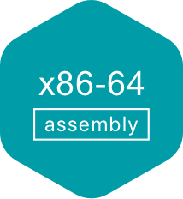
Programming languages and memory safety
Memory safety is a property of a programming language that ensures all memory accesses are
Well-defined
Adhere to object boundaries
Adhere to types of allocated objects
Some programming languages have memory safety and some do not
Memory safe
Memory unsafe

Slide 28
Then why would one use C/C++ over Java/Python???

Slide 29
Memory safety and performance
Java compiler inserts bounds checks for array accesses that are inserted at runtime
Additional runtime checks reduces performance
Pseudo-code after Java compiler
inserts checks
Original Java code
char a = ‘A’; char arr[4] = {‘a’, ‘b’, ‘c’, ‘d’}; int index = atoi(argv[1]); printf(“%c\n”, arr[index]);
char a = ‘A’; char arr[4] = {‘a’, ‘b’, ‘c’, ‘d’}; int index = Integer.parseInt(argv[1]); if (index < arr.length) {
System.out.println(arr[index]);
} else {
throw new ArrayIndexOutOfBoundsException();
}

Slide 30
C vs. Java performance
https://programming-language-benchmarks.vercel.app/c-vs-java
Notes:
Mathematical benchmarks

Slide 31






Performance critical software in C/C++
Web servers
Nginx, Apache Httpd
Key-value stores
Redis, Memcached
Database servers
MySQL
Postgresql
SQLLite

Slide 32
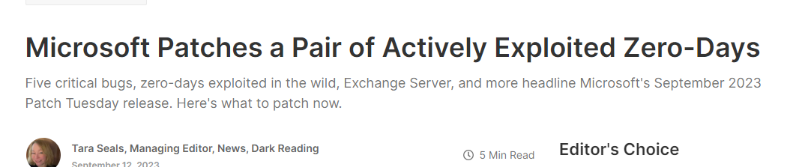

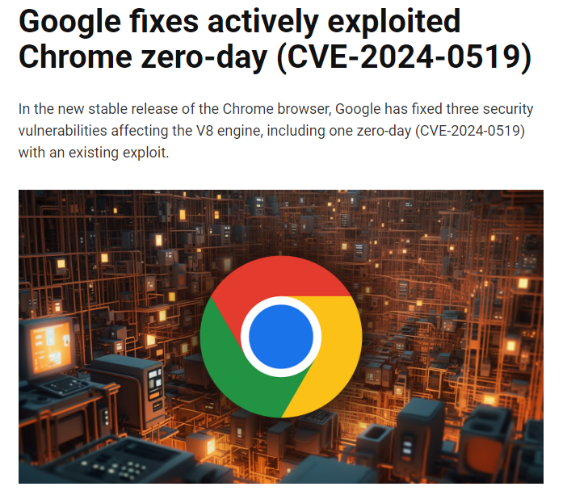
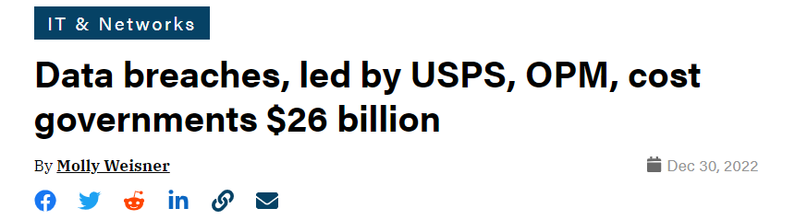
Security attacks

Slide 33
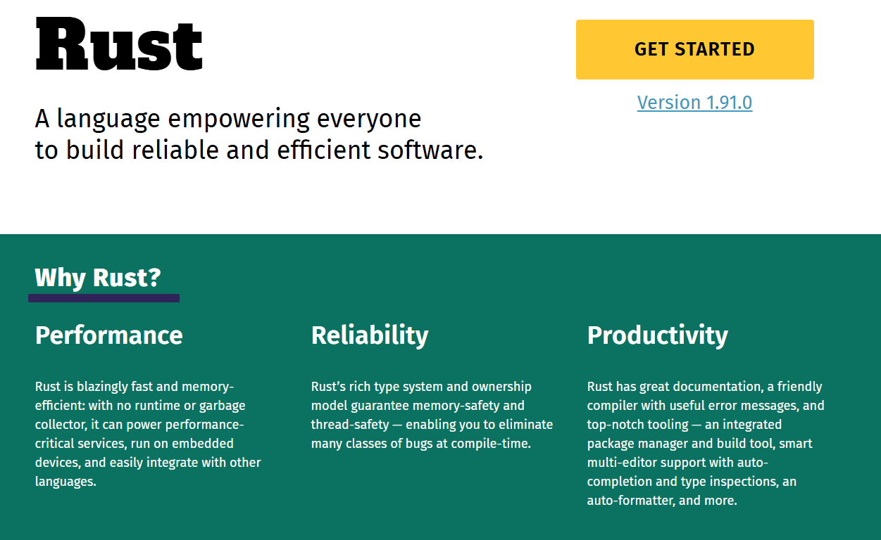
Potential solution: Rust?
We will discuss Rust on Friday and next Monday

Slide 34
Stack memory on x86 (high-level idea)
Function local variables are stored on stack
0x1000
Top of the stack
0xFFA
0xFF8
0xFF4
0xFF0
Notes:
- Specific to x86.. Most common archs operate in this way

Slide 35
Stack memory on x86 (high-level idea)
Function local variables and return addresses are stored on stack
1. int my_func(int a, int b) { 2. int result = 0; 3. if (a > b) { result = a – b; } 4. else { result = b – a; } 5. return result; 6. } 8. int main(void) { 9. int p = 10; 10. int q = 30; 11. int sub = my_func(p, q); 12. printf(“%d\n”, sub); }
p
0x1000
Top of the stack
q
0xFFA
return_addr@12
0xFF8
push
result
0xFF4
0xFF0
Notes:
- What else can you do with stack vulnerabilities

Slide 36
Stack memory on x86 (high-level idea)
Function local variables and return addresses are stored on stack
1. int my_func(int a, int b) { 2. int result = 0; 3. if (a > b) { result = a – b; } 4. else { result = b – a; } 5. return result; 6. } 8. int main(void) { 9. int p = 10; 10. int q = 30; 11. int sub = my_func(p, q); 12. printf(“%d\n”, sub); }
Top of the stack
p
0x1000
Stack frame for
main
q
0xFFA
return_addr@12
0xFF8
Stack frame for
my_func
result
0xFF4
On x86, stack grows downwards
0xFF0

Slide 37
Stack memory on x86 (high-level idea)
Function local variables and return addresses are stored on stack
1. int my_func(int a, int b) { 2. int result = 0; 3. if (a > b) { result = a – b; } 4. else { result = b – a; } 5. return result; 6. } 8. int main(void) { 9. int p = 10; 10. int q = 30; 11. int sub = my_func(p, q); 12. printf(“%d\n”, sub); }
Top of the stack
p
0x1000
Execution returns to
return_addr@12
q
0xFFA
return_addr@12
0xFF8
result
0xFF4
0xFF0

Slide 38
x86 feature
C function calls -> callq instruction
callq instruction pushes the address of the next instruction on the stack
Then, transfers control to the called function
C return statements -> retq instruction
retq instruction pops the return address from the stack
Then, transfers control to the return address

Slide 39
Implications…
Return addresses on the stack
At a higher address than function local variables
From the last lecture –
C has no protection against buffer overflows
p
0x1000
q
0xFFA
return_addr@12
0xFF8
result
0xFF4
0xFF0

Slide 40
Implications…
1. void authenticate () { 2. char password[8]; 3. printf(“Enter the password\n”); 3. scanf(“%s”, password); 4. return; 5. } 6. int main(void) { 7. authenticate(); 8. } 9. void super_secret_function() { 10. puts(“This is a super secret function\n”); 11.}
p
0x1000
Top of the stack
q
0xFFA
return_addr@7
0xFF8
&super_secret_func
Overflow
password
0xFF4
0xFF0

Slide 41
Implications…
The attacker can not only overwrite stack variables
But also hijack control flow
Known as
Control flow hijack attacks
Extremely powerful!!
“Negative synergy” between x86 architecture and C language
p
0x1000
Top of the stack
q
0xFFA
return_addr@12
0xFF8
&super_secret_func
Overflow
password
0xFF4
0xFF0

Slide 42
Demo
https://github.com/davsec-teaching/control-flow-hijack-demo

Slide 43
Interesting targets for control flow hijack
Security-critical functions in the program
Libc functions
execve() – can start executing a completely different program!!
Known as return-to-libc attacks (subset of control-flow hijack attacks)
What else?

Slide 44
What else? (Not in syllabus)
No requirement that the address should be the start of a function
Can “return” to the middle of a function
00000000004012e0 <super_secret_function>:
4012e0: 55 push %rbp
4012e1: 48 89 e5 mov %rsp,%rbp
4012e4: 48 bf 15 20 40 00 00 movabs $0x402015,%rdi
4012eb: 00 00 00
4012ee: e8 3d fd ff ff call 401030 <puts@plt>
4012f3: 5d pop %rbp
4012f4: c3 ret
4012f5: 66 2e 0f 1f 84 00 00 cs nopw 0x0(%rax,%rax,1)
4012fc: 00 00 00
4012ff: 90 nop

Slide 45
What else? (Not in syllabus)
No requirement that the address should be the start of a function
Can “return” to the middle of a function
Just overwrite with the address of your choice
p
0x1000
Top of the stack
q
0xFFA
return_addr@12
0xFF8
0x4012e4
Overflow
password
0xFF4
0xFF0

Slide 46
What else? (Not in syllabus)
On x86
No requirement that the address should be the start of an instruction!!
00000000004012e0 <super_secret_function>:
4012e0: 55 push %rbp
4012e1: 48 89 e5 mov %rsp,%rbp
4012e4: 48 bf 15 20 40 00 00 movabs $0x402015,%rdi
4012eb: 00 00 00
4012ee: e8 3d fd ff ff call 401030 <puts@plt>
4012f3: 5d pop %rbp
4012f4: c3 ret
4012f5: 66 2e 0f 1f 84 00 00 cs nopw 0x0(%rax,%rax,1)
4012fc: 00 00 00
4012ff: 90 nop

Slide 47
What else? (Not in syllabus)
00000000004012e0 <super_secret_function>:
4012e0: 55 push %rbp
4012e1: 48 89 e5 mov %rsp,%rbp
4012e4: 48 bf 15 20 40 00 00 movabs $0x402015,%rdi
4012eb: 00 00 00
4012ee: e8 3d fd ff ff call 401030 <puts@plt>
4012f3: 5d pop %rbp
4012f4: c3 ret
4012f5: 66 2e 0f 1f 84 00 00 cs nopw 0x0(%rax,%rax,1)
4012fc: 00 00 00
4012ff: 90 nop
p
0x1000
q
0xFFA
return_addr@12
0xFF8
0x4012e2
password
0xFF4
0xFF0
Overflow

Slide 48
Implications… (Not in syllabus)
Can hijack control flow to middle of a real instruction
From the attacker’s POV the program is a set of byte-sequence terminating in a return/jump
Return-oriented Programming (subset of control flow hijack attacks)
Such byte-sequence is known as “ROP gadget”
Can chain byte sequences to perform complex attacks
58 5a 5e c3 5f c3 ff e0 c3 ff d0 c3 89 c2 c3 89 c1 c3 31 c0 c3 83 c0 04 c3 90 90 90 90 90 90 90 90 90 90 c3 cc c3

Slide 49
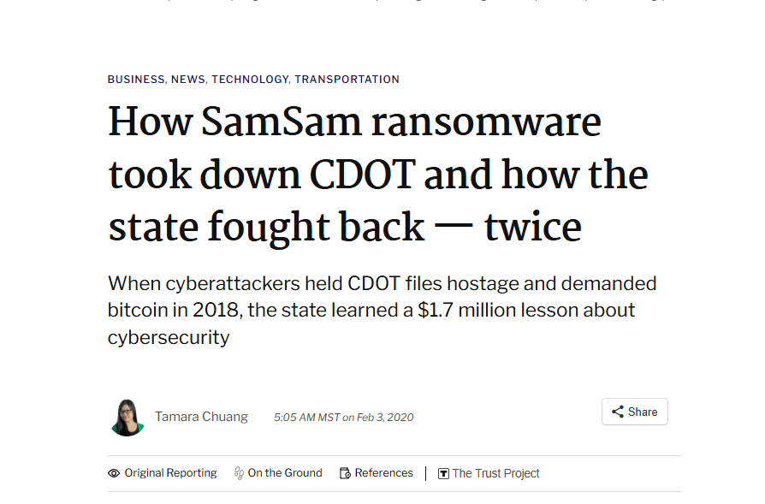
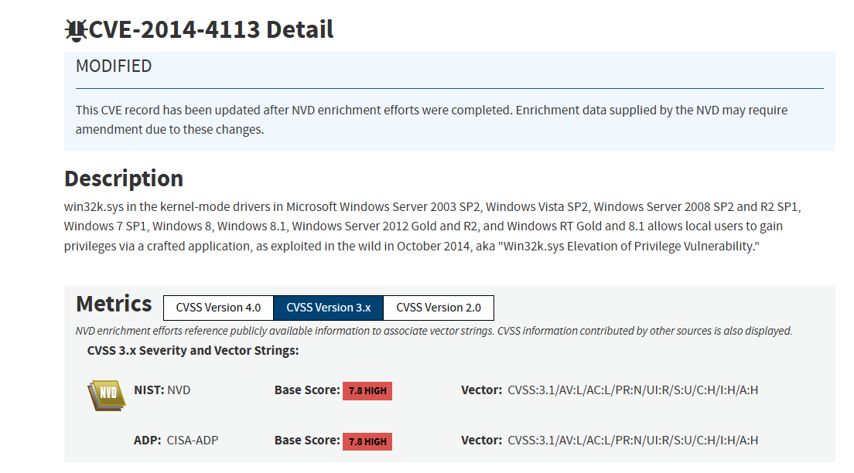

But isn’t all this too hard to exploit?
Notes:
multi-step attacks
ransomware

Slide 50
But isn’t all this too hard to exploit?
In 2025, the US Department of Defense (DoD) has been allocated approximately $30 billion for cybersecurity initiatives
Includes both defensive and offensive initiatives
2009-2010 Stuxnet attack disabled key part of Iranian nuclear program
https://www.csoonline.com/article/3632164/us-military-allocated-about-30-billion-to-spend-on-cybersecurity-in-2025.html
https://www.csoonline.com/article/562691/stuxnet-explained-the-first-known-cyberweapon.html
Notes:
- Not just individual hackers or hacker groups

Slide 51
Heap-based vulnerabilities/attacks
Heap memory used for dynamic memory allocation
char* p = malloc(1024);
free(p);
char* s = malloc(128);
Heap has no directionality of growth
Objects placed according to “heap allocation policy”

Slide 52
Heap overflow attacks
0x1000
void authenticate () { char* password = malloc(8);
int* authenticated = malloc(sizeof(int)); printf(“Enter the password\n”); scanf(“%s”, password);
if (strcmp(…)
authenticated = 1;
if (authenticated) {
printf(“Authenticated!\n”);
} else {
printf(“Not allowed!\n”);
} return; } int main(void) { authenticate(); }
authenticate
0xFFA
Overflow
password
0xFF8
0xFF4
0xFF0

Slide 53
Heap overflow attacks
0x1000
void authenticate () { char* password = malloc(8);
int* authenticated = malloc(sizeof(int)); printf(“Enter the password\n”); scanf(“%s”, password);
if (strcmp(…)
authenticated = 1;
if (authenticated) {
printf(“Authenticated!\n”);
} else {
printf(“Not allowed!\n”);
} return; } int main(void) { authenticate(); }
0xFFA
Overflow
password
0xFF8
0xFF4
0xFF0
authenticate

Slide 54
Types of memory safety
Memory safety
Spatial safety
Temporal safety
Buffer overflow
Compilers of memory-safe languages add bounds-checks

Slide 55
Memory allocator concepts
Manages how a program requests and releases memory dynamically at runtime
Allocators like malloc() and free() in C interface with the heap, a region of process memory used for dynamic allocation
Asks OS for a large chunk of memory (in MB)
Chunks it up and returns these chunks when malloc() called
Maintains metadata to maintain these chunks

Slide 56
Memory allocator concepts
int main() { char* p = malloc(10); *p = ‘a’; char* q = malloc(8); *q = ‘b’; return 0; }
User App
malloc(10)
Libc allocator
Linux kernel

Slide 57
Memory allocator concepts
int main() { char* p = malloc(10); *p = ‘a’; char* q = malloc(8); *q = ‘b’; return 0; }
User App
malloc(10)
Libc allocator
mmap(2048)
Linux kernel

Slide 58
Memory allocator concepts
int main() { char* p = malloc(10); *p = ‘a’; char* q = malloc(8); *q = ‘b’; return 0; }
User App
malloc(10)
Libc allocator
Buffer of size 2048
mmap(2048)
Linux kernel

Slide 59
Memory allocator concepts
int main() { char* p = malloc(10); *p = ‘a’; char* q = malloc(8); *q = ‘b’; return 0; }
User App
Metadata
malloc(10)
Libc allocator
Buffer of size 2048
mmap(2048)
Linux kernel

Slide 60
Memory allocator concepts
int main() { char* p = malloc(10); *p = ‘a’; char* q = malloc(8); *q = ‘b’; return 0; }
User App
Metadata
malloc(8)
Libc allocator
Buffer of size 2048
Linux kernel

Slide 61
Memory allocator concepts
int main() { char* p = malloc(10); *p = ‘a’; char* q = malloc(8); *q = ‘b’; return 0; }
User App
Metadata
malloc(8)
Libc allocator
Buffer of size 2048
Linux kernel

Slide 62
Memory allocator concepts
Takeaways
Not all malloc calls invoke the kernel
Allocators maintain metadata critical for managing heap memory
Corrupting this metadata is bad…
User App
Metadata
malloc(8)
Libc allocator
Buffer of size 2048
Linux kernel

Slide 63
Software Security

Slide 64
Announcements
HW2 checkpoint
Persistence Framework complete
Microservice framework WIP

Slide 65
Agenda
Temporal safety vulnerabilities
Defenses against common spatial safety attacks
Secure Programming
Approaches to temporal safety
Garbage Collection – the Java way
Ownership and Lifetimes - the Rust way

Slide 66
Memory safety
Memory safety – the ability of a programming language to ensure certain types of memory-related bugs/vulnerabilities do not exist
Spatial memory safety bugs
Buffer overflows
int arr[4]; arr[10] = 10; // Unsafe language does not detect this

Slide 67
Types of memory safety
Memory safety
Spatial safety
Temporal safety
Buffer overflow
Compilers of memory-safe languages add bounds-checks

Slide 68
Memory allocator concepts
int main() { char* p = malloc(10); *p = ‘a’; char* q = malloc(8); *q = ‘b’; free(p); return 0; }
User App
malloc(10)
Libc allocator
Linux kernel

Slide 69
Memory allocator concepts
int main() { char* p = malloc(10); *p = ‘a’; char* q = malloc(8); *q = ‘b’; free(p); return 0; }
User App
malloc(10)
Libc allocator
mmap(2048)
Linux kernel

Slide 70
Memory allocator concepts
int main() { char* p = malloc(10); *p = ‘a’; char* q = malloc(8); *q = ‘b’;
free(p); return 0; }
User App
malloc(10)
Libc allocator
Buffer of size 2048
mmap(2048)
Linux kernel

Slide 71
Memory allocator concepts
int main() { char* p = malloc(10); *p = ‘a’; char* q = malloc(8); *q = ‘b’;
free(p); return 0; }
User App
Metadata
malloc(10)
Libc allocator
Buffer of size 2048
mmap(2048)
Linux kernel

Slide 72
Memory allocator concepts
int main() { char* p = malloc(10); *p = ‘a’; char* q = malloc(8); *q = ‘b’;
free(p); return 0; }
User App
Metadata
malloc(8)
Libc allocator
Buffer of size 2048
Linux kernel

Slide 73
Memory allocator concepts
int main() { char* p = malloc(10); *p = ‘a’; char* q = malloc(8); *q = ‘b’;
free(p); return 0; }
User App
Metadata
malloc(8)
Libc allocator
Buffer of size 2048
Linux kernel

Slide 74
Memory allocator concepts
int main() { char* p = malloc(10); *p = ‘a’; char* q = malloc(8); *q = ‘b’;
free(p); return 0; }
User App
Metadata
malloc(8)
Libc allocator
Buffer of size 2048
Linux kernel

Slide 75
Memory allocator concepts
int main() { char* p = malloc(10); *p = ‘a’; char* q = malloc(8); *q = ‘b’;
free(p); return 0; }
User App
Metadata
malloc(8)
Libc allocator
Buffer of size 2048
Linux kernel

Slide 76
Memory allocator concepts
Takeaways
Not all malloc calls invoke the kernel
Not all free calls release memory back to the kernel
Allocators maintain metadata critical for managing heap memory
Corrupting this metadata is bad…
User App
Metadata
malloc(8)
Libc allocator
Buffer of size 2048
Linux kernel

Slide 77
Temporal safety vulnerabilities
C compiler will not detect updates to freed memory
void function () { char* buffer = malloc(8);
// do something with buffer
free(buffer);
// 1000 statements later
buffer[2] = ‘A’; return; }

Slide 78
Temporal safety vulnerabilities
C compiler will not detect updates to freed memory
void function () { char* buffer = malloc(8); // do something with buffer
free(buffer);
// 1000 statements later
char* SSL_KEY = malloc(8);
// 1000 statements later
buffer[2] = ‘A’; // will overwrite SSL_KEY return; }
0x1000
SSL_KEY
buffer
A
0xFFA
0xFF8
0xFF4
0xFF0

Slide 79
Temporal safety vulnerabilities
C compiler will not detect updates to freed memory
Use-after-free (UAF) vulnerability
The pointer involved is called a dangling pointer
void function () { char* buffer = malloc(8); // do something with buffer
free(buffer);
// 1000 statements later
char* SSL_KEY = malloc(8);
// 1000 statements later
buffer[2] = ‘A’; // will overwrite SSL_KEY return; }

Slide 80
How can an attacker exploit this?
Imagine the attacker wants to overwrite the third byte of the SSL_KEY
What does the attacker need?
void thread1 () { char* buffer = malloc(8); // do something with buffer
free(buffer);
// 1000 statements later
char* SSL_KEY = malloc(8);
// 1000 statements later
buffer[2] = ‘A’; // will overwrite SSL_KEY return; }
void echo_thread() {
while (1) {
char* request = malloc(128);
read_from_network(request);
send_to_network(request); } }

Slide 81
How can an attacker exploit this?
Imagine the attacker wants to overwrite the third byte of the SSL_KEY
What does the attacker need?
A way to “massage” the memory allocator such that malloc 2) reuses the same address as buffer
void thread1 () { char* buffer = malloc(8); // 1) // do something with buffer
free(buffer);
// 1000 statements later
char* SSL_KEY = malloc(8); // 2)
// 1000 statements later
buffer[2] = ‘A’; // will overwrite SSL_KEY return; }
void echo_thread() {
while (1) {
char* request = malloc(128); // 3)
read_from_network(request);
send_to_network(request); } }

Slide 82
How can an attacker exploit this?
Attacker corrupts SSL_KEY
void thread1 () { char* buffer = malloc(8); // 1) // do something with buffer
free(buffer);
// 1000 statements later
char* SSL_KEY = malloc(8); // 2)
// 1000 statements later for (i = 0; i< 8; i++) {
buffer[i] = ‘A’; // will overwrite SSL_KEY } return; }
void echo_thread() {
while (1) {
char* request = malloc(128); // 3)
read_from_network(request);
send_to_network(request);
free(request); } }
SSL_KEY
buffer
A
0xFFC
0xFF8
0xFF4
0xFF0

Slide 83
Temporal safety vulnerabilities
C compiler will not detect if an object is freed twice
Messes up the heap allocator’s meta-data
Can be exploited by the attacker
Can cause same memory to be allocated twice! (more in potentially in one of the next classes!)
Double-free vulnerability
void function () { char* buffer = malloc(8); // do something with buffer
free(buffer);
// 1000 statements later
free(buffer); // again
}

Slide 84
Software security defenses

Slide 85
Buffer overflow to corrupt sensitive stack data
Security-critical variable on the stack
scanf(“%s”, password);
authenticated
0x1000
Overflow
password
0xFFA
0xFF8
0xFF4
0xFF0

Slide 86
Buffer overflow to hijack control flow
Return addresses on the stack
At a higher address than function local variables
scanf(“%s”, password);
p
0x1000
q
0xFFA
return_addr@12
0xFF8
Overflow
password
0xFF4
0xFF0

Slide 87
Defenses - stack canaries
Can detect stack overflow into return address
1. void authenticate () { 2. char password[8]; 3. printf(“Enter the password\n”); 3. scanf(“%s”, password); 4. return; 5. } 6. int main(void) { 7. authenticate(); 8. } 9. void super_secret_function() { 10. puts(“This is a super secret function\n”); 11.}
Top of the stack
return_addr@8
0xFF8
Compiler pushes a
“canary” value
CANARY=0xDEADBEEF
0xFF4
password
0xFF0

Slide 88
Defenses - stack canaries
Can detect stack overflow into return address
1. void authenticate () { 2. char password[8]; 3. printf(“Enter the password\n”); 3. scanf(“%s”, password); 4. return; 5. } 6. int main(void) { 7. authenticate(); 8. } 9. void super_secret_function() { 10. puts(“This is a super secret function\n”); 11.}
Top of the stack
return_addr@8
0xFF8
Overflow corrupts
the canary
CANARY=0xDEADBEEF
0xFF4
password
0xFF0

Slide 89
Defenses - stack canaries
Can detect stack overflow into return address
1. void authenticate () { 2. char password[8]; 3. printf(“Enter the password\n”); 3. scanf(“%s”, password); 4. return; 5. } 6. int main(void) { 7. authenticate(); 8. } 9. void super_secret_function() { 10. puts(“This is a super secret function\n”); 11.}
Top of the stack
return_addr@9
0xFF8
Overflow corrupts
the canary
CANARY=0xABCDABCD
0xFF4
password
0xFF0

Slide 90
Defenses - stack canaries
Can detect stack overflow into return address
1. void authenticate () { 2. char password[8]; 3. printf(“Enter the password\n”); 3. scanf(“%s”, password); 4. return; 5. } 6. int main(void) { 7. authenticate(); 8. } 9. void super_secret_function() { 10. puts(“This is a super secret function\n”); 11.}
Top of the stack
Compiler checks
the canary for corruption -> old_value != new_value
-> Buffer overflow
return_addr@9
0xFF8
CANARY=0xABCDABCD
0xFF4
password
0xFF0

Slide 91
Defenses - stack canaries
Can detect stack overflow into return address
1. void authenticate () { 2. char password[8]; 3. printf(“Enter the password\n”); 3. scanf(“%s”, password); 4. return; 5. } 6. int main(void) { 7. authenticate(); 8. } 9. void super_secret_function() { 10. puts(“This is a super secret function\n”); 11.}
Top of the stack
return_addr@9
0xFF8
CANARY=0xABCDABCD
0xFF4
TERMINATE EXECUTION
password
0xFF0

Slide 92
Stack canaries
Available on most popular C/C++ compilers
gcc,clang
Can typically detect overflow across stack frames
Can typically NOT detect overflow within objects in the same stack frame
Can NOT detect overflow within same object on the stack
E.g., different fields in the struct type

Slide 93
Defenses – Address Space Layout Randomization
Systems have uniformity
Libraries on same Ubuntu distribution are identical
Attacker can recreate the same target environment locally
ASLR randomizes the address where the binary is loaded
Without ASLR the executable code for binaries and libraries are loaded at the same address every time – sometimes even across different machines
Very easy for the attacker to know the address of “interesting” functions
ASLR makes it harder for the attacker to guess the target address

Slide 94
Defenses – Address Space Layout Randomization
Randomizing addresses makes it harder for attacker to guess address
1. void authenticate () { 2. char password[8]; 3. printf(“Enter the password\n”); 3. scanf(“%s”, password); 4. return; 5. } 6. int main(void) { 7. authenticate(); 8. } 9. void super_secret_function() { 10. puts(“This is a super secret function\n”); 11.}
Top of the stack
return_addr@8
0xFF8
password
0xFF4
0xFF0

Slide 95
Defenses – Address Space Layout Randomization
Randomizing addresses makes it harder for attacker to guess address
1. void authenticate () { 2. char password[8]; 3. printf(“Enter the password\n”); 3. scanf(“%s”, password); 4. return; 5. } 6. int main(void) { 7. authenticate(); 8. } 9. void super_secret_function() { 10. puts(“This is a super secret function\n”); 11.}
Top of the stack
execve() address
0xFF8
password
0xFF4
0xFF0

Slide 96
Defenses – Address Space Layout Randomization
Attacker doesn’t know the address of execve…
1. void authenticate () { 2. char password[8]; 3. printf(“Enter the password\n”); 3. scanf(“%s”, password); 4. return; 5. } 6. int main(void) { 7. authenticate(); 8. } 9. void super_secret_function() { 10. puts(“This is a super secret function\n”); 11.}
Top of the stack
...???...
0xFF8
password
0xFF4
0xFF0

Slide 97
Defenses – Address Space Layout Randomization
Still not a foolproof method
Current ASLR systems are coarse-grained
Randomize only the base of a library/binary
execve()
mov rax, rbx; mov rbx, rbx;
mov rbx, rbx;
0x0300
fork()
cmp rbx, rdx;
jnc label1;
label1: cmp rcx; rdx;
0x0100
recv()
mov rax, rbx; cmp rbx, rdx;
jnc label1;
0x0000

Slide 98
Defenses – Address Space Layout Randomization
Possible layout with the base address of the library is 0x1000
execve()
mov rax, rbx; mov rbx, rbx;
mov rbx, rbx;
0x1300
fork()
cmp rbx, rdx;
jnc label1;
label1: cmp rcx; rdx;
0x1100
recv()
mov rax, rbx; cmp rbx, rdx;
jnc label1;
0x1000

Slide 99
Defenses – Address Space Layout Randomization
Another possible layout with base address at 0x4000
Takeaway
The offsets within the library do not change
execve()
mov rax, rbx; mov rbx, rbx;
mov rbx, rbx;
0x4300
fork()
cmp rbx, rdx;
jnc label1;
label1: cmp rcx; rdx;
0x4100
recv()
mov rax, rbx; cmp rbx, rdx;
jnc label1;
0x4000

Slide 100
So what…?
1. void f () { 2. int (*fork_ptr)() = &fork; 3. char msg[] = [H,e,l,l,o]; 3. char* resp = malloc(1024); 4. for (int i = 0; i < 1024; i++) { 5. resp[i] = msg[i]; 6. }
7. send_to_client(resp); 8. return; 9. }
execve()
mov rax, rbx; mov rbx, rbx;
mov rbx, rbx;
0x4300
fork()
cmp rbx, rdx;
jnc label1;
label1: cmp rcx; rdx;
0x4100
recv()
mov rax, rbx; cmp rbx, rdx;
jnc label1;
Attacker knows the address of fork() -> they know all addresses in the library
0x4000

Slide 101
So what…?
1. void f () { 2. int (*fork_ptr)() = &fork; 3. char msg[] = [H,e,l,l,o]; 3. char* resp = malloc(1024); 4. for (int i = 0; i < 1024; i++) { 5. resp[i] = msg[i]; 6. }
7. send_to_client(resp); 8. return; 9. }
10. void authenticate () { 11. char password[8]; 12. printf(“Enter the password\n”); 13. scanf(“%s”, password); 14. return; 15. }
execve()
mov rax, rbx; mov rbx, rbx;
mov rbx, rbx;
0x4300
fork()
cmp rbx, rdx;
jnc label1;
label1: cmp rcx; rdx;
0x4100
recv()
mov rax, rbx; cmp rbx, rdx;
jnc label1;
0x4000

Slide 102
So what…?
1. void f () { 2. int (*fork_ptr)() = &fork; 3. char msg[] = [H,e,l,l,o]; 3. char* resp = malloc(1024); 4. for (int i = 0; i < 1024; i++) { 5. resp[i] = msg[i]; 6. }
7. send_to_client(resp); 8. return; 9. }
10. void authenticate () { 11. char password[8]; 12. printf(“Enter the password\n”); 13. scanf(“%s”, password); 14. return; 15. }
Top of the stack
execve() address
0xFF8
password
0xFF4
0xFF0
Attacks can, and often do, consist of multiple steps

Slide 103
Software security

Slide 104
Announcements
HW2 discussion
LLM policy for discussion text
Quiz next Friday
Will cover materials until next Monday
Mostly Software Security

Slide 105
Agenda
Secure programming in C
Secure programming in C++
Sample software security questions
Temporal memory safety in Java – Garbage Collection
Temporal memory safety in Rust – Ownership and Lifetimes
Fuzzing
Design patterns

Slide 106
Recap: UAF bug
C compiler will not detect updates to freed memory
void function () { char* buffer = malloc(8);
// do something with buffer
free(buffer);
// 1000 statements later
buffer[2] = ‘A’; return; }

Slide 107
Recap: Double free
C compiler will not detect if an object is freed twice
Messes up the heap allocator’s meta-data
Can be exploited by the attacker
Can cause same memory to be allocated twice! (more in potentially in one of the next classes!)
Double-free vulnerability
void function () { char* buffer = malloc(8); // do something with buffer
free(buffer);
// 1000 statements later
free(buffer); // again
}

Slide 108
Secure programming
Observation: a few programming patterns lead to the majority of vulnerabilities
Solution: avoid those programming patterns

Slide 109
String functions
Strings end with ‘\0’
Use the size-checked variants of common string functions
char buffer[10]; scanf( “%9s”, buffer);
char dest[10]; char src[10]; strncpy(dest, src, 10);
strncmp, strncat

Slide 110
Avoiding temporal safety bugs
Avoid use-after-free bugs by setting freed pointers to NULL immediately
char* p = malloc(…); //… free(p); p = (char*) 0;
Why does this help?
Dereferencing or freeing a null pointer is not UB -> you will always crash

Slide 111
Avoiding temporal safety bugs
How C++ prevents temporal safety bugs
C++ provides “smart” pointers
std::unique_ptr
std::shared_ptr
Works only if you use them correctly!

Slide 112
Background: variable’s scope
Region of a program where the variable is accessible or can be referenced
int function() {
for (int i = 0; i < 10; i++) {
int temp = i;
printf(“%d\n”, temp);
}
printf(“%d\n”, temp); }
Scope of temp
COMPILER ERROR!

Slide 113
C++ destructors
Destructors are called when a
Stack object goes out of scope
delete is called on a heap object
struct MyClass {
int value;
MyClass(int v) : value(v) {}
~MyClass() {
std::cout << "Dropping object\n";
}
}; void function() {
{
MyClass myClass(10);
std::cout << myClass.value << "\n";
}
std::cout << “Hello” << "\n";
} // prints // 10 // “Dropping object” // “Hello”
Scope of myClass

Slide 114
C++ destructors
Destructors are called when a
Stack object goes out of scope
delete is called on a heap object
struct MyClass {
int value;
MyClass(int v) : value(v) {}
~MyClass() {
std::cout << "Dropping object\n";
}
}; void function() {
MyClass* myClass = new MyClass(10);
std::cout << myClass.value << "\n";
std::cout << “Hello” << "\n"; delete myClass;
} // prints // 10 // “Hello” // “Dropping object”

Slide 115
C++ smart pointers

Slide 116
C++ smart pointers
Goal: to eliminate temporal memory errors
Use-after-free bugs
Double-free bugs
How?
Automatically manage heap memory
Safe abstractions for heap memory management
Remove the burden of heap memory-management from the programmer
But programmer still has to use them correctly!

Slide 117
unique_ptr
How to create a new heap object using unique_ptr?
unique_ptr “owns” the heap object
When the pointer goes out of scope the heap object is automatically deleted
The pointer can be used transparently as its managed type
#include <memory>
struct MyClass {
int value;
MyClass(int v) : value(v) {}
~MyClass() {
std::cout << “Dropping object\n”;
}
};
void function() {
std::unique_ptr<MyClass> ptr = std::make_unique<MyClass>(42);
std::cout << ptr->value << “\n”;
}
int main() {
function();
return 0;
}

Slide 118
How does it work? (Not in syllabus)
A unique pointer type is just a parameterized class that contains a pointer to the heap object
The unique pointer’s destructor drops the pointer to the heap object
Copy constructor and copy assignment is deleted to prevent assignments without calling move
class MyUniquePtr<T> {
private:
T *ptr;
public:
MyUniquePtr(T *p) : ptr(p) {}
~MyUniquePtr() {
delete ptr;
}
// Disable copy constructor and copy assignment
MyUniquePtr(const MyUniquePtr&) = delete;
MyUniquePtr& operator=(const MyUniquePtr&) = delete;
// Enable move constructor and move assignment
// Please check the actual implementation
T& operator*() const {
return *ptr;
}
T* operator->() const {
return ptr;
}
}

Slide 119
unique_ptr
Ownership can be moved to another unique_ptr
Moving the ownership automatically sets the source pointer to zero
Prevents use-after-free bugs
#include <memory>
struct MyClass {
int value;
MyClass(int v) : value(v) {}
~MyClass() {
std::cout << “Dropping object\n”;
}
};
void function() {
std::unique_ptr<MyClass> ptr = std::make_unique<MyClass>(42);
std::cout << ptr->value << “\n”;
std::unique_ptr<MyClass> ptr2 =
std::move(ptr);
std::cout << ptr2->value << “\n”;
}
int main() {
function();
return 0;
}

Slide 120
unique_ptr
How does this prevent double-free bugs?
The programmer doesn’t have to worry about freeing memory at all
In-class demo
https://github.com/davsec-teaching/c-smart-pointers
#include <memory>
struct MyClass {
int value;
MyClass(int v) : value(v) {}
~MyClass() {
std::cout << “Dropping object\n”;
}
};
void function() {
std::unique_ptr<MyClass> ptr = std::make_unique<MyClass>(42);
std::cout << ptr->value << “\n”;
std::unique_ptr<MyClass> ptr2 =
std::move(ptr);
std::cout << ptr2->value << “\n”;
}
int main() {
function();
return 0;
}

Slide 121
unique_ptr: Incorrect use
Programmer still must make sure they don’t do something unsafe
Argument: calling get() should send more alarm bells ringing than calling delete or free
#include <memory>
struct MyClass {
int value;
MyClass(int v) : value(v) {}
~MyClass() {
std::cout << “Dropping object\n”;
}
};
void function() {
std::unique_ptr<MyClass> ptr = std::make_unique<MyClass>(42);
std::cout << ptr->value << “\n”;
std::unique_ptr<MyClass> ptr2 =
std::move(ptr);
std::cout << ptr2->value << “\n”;
MyClass* rawptr = ptr->get(); // Leak ownership
delete rawptr;
}
int main() {
function();
return 0;
}

Slide 122
What about multiple pointers to same var?
In C/C++, you can have multiple pointers to the same variable
Can smart pointers provide safe abstractions in this case?
#include <memory>
struct MyClass {
int value;
MyClass(int v) : value(v) {}
~MyClass() {
std::cout << “Dropping object\n”;
}
};
void function() {
MyClass* ptr = new MyClass(10);
MyClass* ptr2 = ptr;
ptr->v = 100; // update via ptr
std::cout << ptr2->v << “\n”; // print via ptr2
}
int main() {
function();
return 0;
}

Slide 123
Desired behavior
struct MyClass {
int value;
MyClass(int v) : value(v) {}
~MyClass() {
std::cout << “Dropping object\n”;
}
};
int main(void) { { Myclass* p = new MyClass(10); {
MyClass* q = p; // …
} }
// … 100 other statements }
p
q
Heap object

Slide 124
shared_ptr
Can share the object
Maintains a reference count of how many pointers point to the object
Object automatically deleted if the reference count goes to zero
At no point can you accidentally free an object too early!
#include <iostream>
#include <memory>
struct MyClass {
int value;
MyClass(int v) : value(v) {
std::cout << "MyClass(" << value << ") created\n";
}
~MyClass() {
std::cout << "MyClass(" << value << ") destroyed\n";
}
};
int main() {
std::shared_ptr<MyClass> ptr1 = std::make_shared<MyClass>(42);
{
std::shared_ptr<MyClass> ptr2 = ptr1; // Shared ownership
std::cout << "Value: " << ptr2->value << "\n";
std::cout << ptr1->value << "\n";
} // ptr2 goes out of scope
std::cout << ptr1->value << "\n";
} // ptr1 goes out of scope, and object is destroyed

Slide 125
More about smart pointers
https://en.cppreference.com/w/cpp/memory
How to specify custom destructors for smart pointers
shared_ptr can not have cyclical references
Need weak_ptr references to allow cyclical references
Takeaway – if you’re writing C++ code, please use smart pointers!!

Slide 126
Concluding thoughts
C++ makes smart pointers opt-in
Programmer can still make mistakes (e.g. leaking a raw pointer by calling get() and deleting using the raw pointer)
It is hard to audit such “mistakes” because safe code and unsafe code is intermixed
… Rust fixes many of these problems

Slide 127
Sample software security questions

Slide 128
Warm up – find vulnerabilities in code and fix them
void secret_function() {
printf("You have successfully exploited the buffer overflow!\n");
}
void vulnerable_function(char *input) {
char buffer[32];
strcpy(buffer, input);
printf("You entered: %s\n", buffer);
}
int main(int argc, char *argv[]) {
if (argc < 2) {
printf("Usage: %s <input>\n", argv[0]);
return 1;
}
vulnerable_function(argv[1]);
return 0;
}

Slide 129
Can the code below result in control flow hijack?
How to prevent it?
typedef struct {
char name[32];
void (*print_message)(); // Function pointer
} User;
void greet() {
printf("Hello, user!\n");
}
void hacked() {
printf("Exploit successful! Arbitrary code execution achieved.\n");
}
int main() {
User *user1 = (User *)malloc(sizeof(User));
scanf(“%s”, user1->name);
(*(user1->print_message))();
}

Slide 130
Can the code below result in control flow hijack?
typedef struct {
char name[32];
void (*print_message)(); // Function pointer
} User;
void greet() {
printf("Hello, user!\n");
}
void hacked() {
printf("Exploit successful! Arbitrary code execution achieved.\n");
}
int main() {
User *user1 = (User *)malloc(sizeof(User));
char temp_buff[100];
scanf(“%99s”, temp_buff);
strncpy(user1->name, temp_buff, 99);
(*(user1->print_message))();
}
Can stack canaries prevent it?

Slide 131
Software security

Slide 132
Agenda
Recap and memory leak
Temporal safety for Java (garbage collection)
Temporal safety for Rust
Fuzzing
Design patterns

Slide 133
Temporal memory safety bugs
Use-after-free bugs
Using a heap object after freeing it
Double-free bugs
Freeing a heap object twice
// Use after free
void fn() {
char* p = malloc(…);
free(p);
// some stuff
p[0] = 10;
}
void fn() {
char* p = new char[20];
delete p;
// some stuff
p[0] = 10;
}
// Double free
void fn() {
char* p = malloc(…);
free(p);
// some stuff
free(p);
}
void fn() {
char* p = new char[20];
delete p;
// some stuff
delete p;
}

Slide 134
Memory leak
Occurs when the pointer or reference goes out of scope, but the memory it was pointing to is not freed
Not a security issue directly
Can result in denial-of-service errors
#include <iostream>
#include <memory>
struct MyClass {
int value;
MyClass(int v) : value(v) {
std::cout << "MyClass(" << value << ") created\n";
}
~MyClass() {
std::cout << "MyClass(" << value << ") destroyed\n";
}
};
int main() {
do {
MyClass* ptr = new MyClass(100);
} while (// user doesn’t enter q);
}

Slide 135
Memory safety in Java
(and JS, Go, and to some extent Python)

Slide 136
Spatial memory safety in Java
Java compiler inserts bounds checks for array accesses that are inserted at runtime
Pseudo-code after Java compiler
inserts checks
Original Java code
char a = ‘A’; char arr[4] = {‘a’, ‘b’, ‘c’, ‘d’}; int index = atoi(argv[1]); printf(“%c\n”, arr[index]);
char a = ‘A’; char arr[4] = {‘a’, ‘b’, ‘c’, ‘d’}; int index = Integer.parseInt(argv[1]); if (index < arr.length) {
System.out.println(arr[index]);
} else {
throw new ArrayIndexOutOfBoundsException();
}

Slide 137
Temporal memory safety in Java
Automatic memory management
Heap objects created using new
E.g. Car c = new Car();
Heap objects are automatically freed when no valid reference remain to them
“Garbage collection”
No smart pointers

Slide 138
Garbage collection
A process of automatic memory management for dynamically allocated memory
Java runtime maintains object reachability graph
Garbage: Objects no longer reachable or usable by the program
Once an object is classified as “garbage” it is automatically reclaimed by a garbage collector thread
Prevents both dangling pointers and memory leaks
Many possible algorithms – e.g., Mark and Sweep

Slide 139
Mark and Sweep algorithm
Root node tracks all variables in scope
class EnergySource {}
class Car {
private EnergySource energySource;
public Car(EnergySource source) {
this.energySource = source;
}
}
List<Car> void func() {
EnergySource electricSource = new EnergySource(“electric”);
EnergySource gasSource = new EnergySource(“gas”);
Car c1 = new Car(electricSource);
Car c2 = new Car(gasSource);
Car c3 = new Car(electricSource);
List<Car> carList = new List<Car>();
carList.push(c1);
carList.push(c3); // c2 not pushed
return carList;
}
public static void main(..) {
List<Car> cars = func();
System.out.println(…);
}
electricSource
gasSource
c1
c3
c2
carList
ROOT

Slide 140
Mark and Sweep algorithm
Root node tracks all variables in scope
class EnergySource {}
class Car {
private EnergySource energySource;
public Car(EnergySource source) {
this.energySource = source;
}
}
List<Car> void func() {
EnergySource electricSource = new EnergySource(“electric”);
EnergySource gasSource = new EnergySource(“gas”);
Car c1 = new Car(electricSource);
Car c2 = new Car(gasSource);
Car c3 = new Car(electricSource);
List<Car> carList = new List<Car>();
carList.push(c1);
carList.push(c3); // c2 not pushed
return carList;
}
public static void main(..) {
List<Car> cars = func();
System.out.println(…);
}
electricSource
gasSource
c1
c3
c2
carList
ROOT

Slide 141
Mark and Sweep algorithm
Language runtime spawns a “garbage collector” thread when memory usage reaches a threshold
Identifies “garbage” – objects no longer reachable or usable by the program -> Mark Phase
Once an object is classified as “garbage” it is automatically deleted -> Sweep Phase

Slide 142
Mark phase
Tracks all reachable objects from ROOT
class EnergySource {}
class Car {
private EnergySource energySource;
public Car(EnergySource source) {
this.energySource = source;
}
}
List<Car> void func() {
EnergySource electricSource = new EnergySource(“electric”);
EnergySource gasSource = new EnergySource(“gas”);
Car c1 = new Car(electricSource);
Car c2 = new Car(gasSource);
Car c3 = new Car(electricSource);
List<Car> carList = new List<Car>();
carList.push(c1);
carList.push(c3); // c2 not pushed
return carList;
}
public static void main(..) {
List<Car> cars = func();
System.out.println(…);
}
✓
electricSource
gasSource
✓
c1
✓
c3
c2
✓
carList
Imagine GC invokes here
✓
ROOT

Slide 143
Sweep phase
Deletes all non-reachable objects
class EnergySource {}
class Car {
private EnergySource energySource;
public Car(EnergySource source) {
this.energySource = source;
}
}
List<Car> void func() {
EnergySource electricSource = new EnergySource(“electric”);
EnergySource gasSource = new EnergySource(“gas”);
Car c1 = new Car(electricSource);
Car c2 = new Car(gasSource);
Car c3 = new Car(electricSource);
List<Car> carList = new List<Car>();
carList.push(c1);
carList.push(c3); // c2 not pushed
return carList;
}
public static void main(..) {
List<Car> cars = func();
System.out.println(…);
}
✓
electricSource
gasSource
✓
c1
✓
c3
c2
✓
carList
Imagine GC invokes here
✓
ROOT

Slide 144
Important points
Garbage collection does not occur after every function return
Occurs rarely and typically only after high memory usage

Slide 145
Memory safety guarantees
Prevents both dangling pointers and memory leaks
How?
A heap object is never freed if it is reachable -> no use-after-free
If a heap object is not reachable it is guaranteed to be eventually freed -> no double frees and no memory leaks

Slide 146
Performance impact
Stop-the-world approach
Pauses all application threads while the garbage collector runs
Why? …
Typically, full STW approach is rare nowadays
Still partial STW

Slide 147
Performance of garbage collected languages
Garbage collection has a high overhead
Performance depends on application memory consumption
At lower memory usage, garbage collection is not triggered
Makes it hard to predict application behavior

Slide 148
Ownership-based memory safety

Slide 149

Rust language
Language imposes certain restrictions on what the programmer can do
In return, the compiler guarantees memory safety
If code compiles, then no spatial or temporal safety issues
As long as unsafe Rust is not used (Not in scope)

Slide 150
Spatial safety
Every dynamically sized object maintains its bounds
pub struct Vec<T, A: Allocator = Global> { buf: RawVec<T, A>, len: usize, }
All accesses to dynamically sized objects are bound-checked
Raise an exception at runtime
If code compiles, then no undetected out-of-bounds access

Slide 151
Demo
fn main() {
let vector = vec![1, 2, 3, 4, 5];
// read from user input
let mut input = String::new();
println!("Please enter a number:");
std::io::stdin()
.read_line(&mut input)
.expect("Failed to read line");
let input: usize = input.trim().parse().expect("Please enter a number");
println!("You chose to read: {}", vector[input]);
println!("Hello, world!");
}

Slide 152
Ownership types
Every heap object has a single owner
The owner is responsible for creating and destroying the object
The object is automatically dropped when the owner goes out of scope
Can have reference counted pointers, but the programmer has to opt-in for that
fn main() { let mut s = Box::new([1, 2, 3]); { let p = s; // p is the new owner, s can’t be accessed p[1] = 10; println!(“{}”, p[1]); // p goes out of scope // the string is dropped/freed. } println!(“{}”, s[2]); // Compiler error! }

Slide 153
Borrowing
References can borrow a value
Compiler will complain if the reference lives beyond the owner’s lifetime
fn main() { let s = Box::new([1, 2, 3]); { let p = s; // p is the new owner , s can’t be accessed
let r = &p;
println!(“{}”, r[1]); // works! println!(“{}”, p[1]); // p goes out of scope // the string is dropped/freed. } }

Slide 154
Rust smart pointers (Not in syllabus)
Box<T> - heap-allocates a single value
Rc<T>: reference counted pointer
Single-threaded use only
Read-only
Arc<T>: atomic reference counted pointer
Shared ownership across threads
Read-only
Mutex<T>: smart pointers enabling synchronized mutation

Slide 155
Can rust have temporal safety issues?
Double free bugs?
Use-after-free bugs?
Is there any performance overhead?
Garbage collection vs. ownership types

Slide 156
For completeness: data races
Data races can happen in multi-threaded apps if incorrect locking is used
Data races can happen if two memory operations in different threads write to the same variable and one of them is a write
int counter = 0;
void* thread1() {
counter = counter + 1;
}
void* thread2() {
counter = counter + 1;
}
// final value of counter?
// could be 1 or 2

Slide 157
Mutability XOR aliasing
Rust has mutability XOR aliasing
Does not allow you to create mutable references to data when another reference to it exists
If you want to share mutable data across different threads you must use Rust’s smart pointers Arc<Mutex<T>>
If multithreaded code compiles, then no data race
fn main() { let mut s = String::from(“AAA”); let s_ref = &mut s; // mutable ref 1 let s_ref2 = &s; // ref 2
// compiler error println!(“{}”, s_ref); }

Slide 158
Benefits of Rust
Most code can be expressed using ownership and borrows
No runtime overhead
Compiler ensures that if your code compiles it will just work

Slide 159
Summary
Memory safety is critical for security
Lack of memory safety -> sensitive data corruption, control flow hijack
Secure programming can mitigate lack of memory safety in C/C++
scanf(“%9s”, buffer), strncpy(d, s, size);
C++ smart pointers
Some languages achieve temporal memory safety through garbage collection -> high overhead
Rust mitigates those high overheads

Slide 160
More sample software security questions

Slide 161
Question 1
#include <stdio.h>
#include <stdlib.h>
#include <string.h>
typedef struct {
char *data;
} Buffer;
void freeBuffer(Buffer *buf) {
free(buf->data);
}
void process(Buffer *buf) {
freeBuffer(buf);
if (strlen(buf->data) > 5) {
printf("Buffer contains: %s\n", buf->data);
}
}
int main() {
Buffer *buf = malloc(sizeof(Buffer));
buf->data = malloc(20);
strcpy(buf->data, "Hello, world!");
process(buf);
free(buf);
return 0;
}
Does this code have a memory safety bug?

Slide 162
Question 2
Does this code have a memory safety bug?
How can the attacker exploit it?

Slide 163
Question 2
void run_cmd(char *msg) {
system(msg);
}
void print_msg(char *msg) {
printf("Message: %s\n", msg);
}
void *admin_func(void *arg) {
while (1) {
char *buf = malloc(10);
strcpy(buf, “time”);
run_cmd(buf);
free(buf);
// … 1000 statements later …
run_cmd(buf);
}
return NULL;
}
void *user_func(void *arg) {
char temp[100];
while (1) {
Buffer* buf = malloc(10);
scanf(“%s”, buf);
print_msg(buf);
}
return NULL;
} int main(void) {
pthread_t t1, t2; pthread_create(&t1, NULL, admin_func, NULL);
pthread_create(&t2, NULL, user_func, NULL);
pthread_join(t1, NULL);
pthread_join(t2, NULL);
return 0; }

Slide 164










Sensitive user data

Slide 165
Software security principles
Confidentiality: information is only accessible to those authorized to it
Integrity: information is modified only by those authorized to do so
Availability: information is available to authorized users when needed

Slide 166
What is software security?
Informally, the software should perform only the programmer-intended operation
Surprisingly hard to ensure
Bugs are software flaws or defects that causes the program to behave unexpectedly
Some bugs lead to software vulnerabilities
Software vulnerabilities are software flaws that attackers can exploit to compromise the system

Slide 167
Spatial memory safety
Ensures that memory accesses are confined to the boundaries of the allocated memory block
E.g, when using a pointer to access an array, the pointer should point to memory within the array bounds
Out-of-bounds accesses are prevented
int array[4] = {10, 20, 30, 40};
10
20
30
40
‘A’
int* ptr = array; ptr++;

Slide 168
Lack of spatial memory safety
C/C++ allows out of bounds access
Out of bound access does not crash like in Java and other memory safe languages
Accesses whatever was in the adjacent memory location

Slide 169
Types of memory
Two types of memory
Stack ← will focus more on stack memory
Heap ← similar issues happen with heap memory too
Heap allocations
Car car = new Car(); // Java
int* my_array = malloc(10*sizeof(int)); // C
Stack allocations
int num; // C or Java

Slide 170
Function calls on X86 architectures
Push return address on stack
Allocate stack variables
0x1000
Top of the stack
0xFFF
0xFFE
0xFFD
0xFFC
0xFFB

Slide 171
Function calls on X86 architectures
#include <stdlib.h>
#include <stdio.h>
int main(void) {
authenticate();
}
void authenticate(void) { uint8_t authenticated = 0;
uint8_t password[4];
scanf(“%s”, password);
return 0;
}
void allow_access(void) {
}
Stack grows downward
return_addr
0x1000
Top of the stack
authenticated
0xFFF
password[3]
0xFFE
password[2]
0xFFD
password[1]
0xFFC
password[0]
0xFFB

Slide 172
Control flow hijack
#include <stdlib.h>
#include <stdio.h>
int main(void) {
authenticate();
}
void authenticate(void) { uint8_t authenticated = 0;
uint8_t password[4];
scanf(“%s”, password);
return 0;
}
void allow_access(void) {
}
Stack grows downward
return_addr
0x1000
Top of the stack
authenticated
0xFFF
password[3]
0xFFE
Overflow can overwrite the return_addr on the stack. Jump to attack selected address on return!!!
password[2]
0xFFD
password[1]
0xFFC
password[0]
0xFFB

Slide 173
Temporal memory safety
Ensures that memory is only accessed while it is valid
E.g., a pointer can not point to an object that is freed
No “dangling pointers”
int main(void) {
char* mystring = malloc(1024);
// some stuff
free(mystring);
// mystring not zeroed
*mystring = ‘a’; // write to a dangling pointer
return 0;
}

