Slide 1

Security in Container Environments
David Unterholzner, Jakob Hofer, Jakob Khom, Leo Lach

Slide 2
Contents
Isolation Techniques
Isolation Layers in Linux Containers
Past Exploits

Slide 3
Isolation Techniques

Slide 4
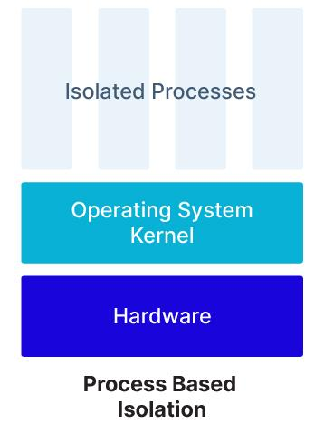
Isolation Techniques
Linux containers
Kernel features
Sandboxed containes
Sanbox software
VM-Based containers
Virtualisierung (Hypervisor)
Linux containers.
Image taken from [blog.aquasec.com]

Slide 5
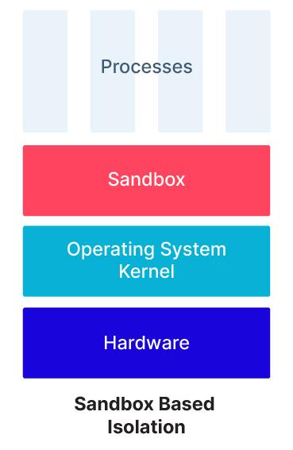
Isolation Techniques
Linux containers
Kernel features
Sandboxed containes
Sanbox software
VM-Based containers
Virtualisierung (Hypervisor)
Sandboxed containers.
Image taken from [blog.aquasec.com]

Slide 6
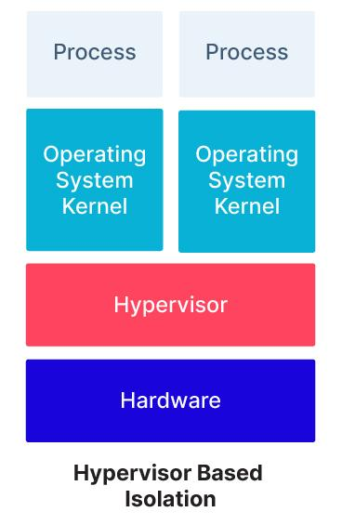
Isolation Techniques
Linux containers
Kernel features
Sandboxed containes
Sanbox software
VM-Based containers
Virtualisierung (Hypervisor)
VM-Based containers.
Image taken from [blog.aquasec.com]

Slide 7
Isolation Layers
In Linux Containers

Slide 8
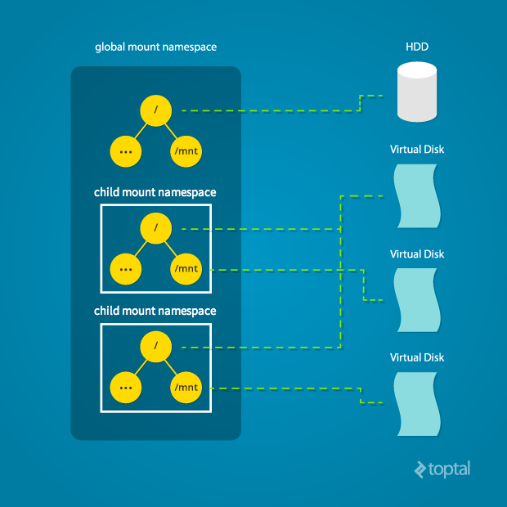
Namespaces
Isolate resources
8 in total
Key namespaces:
Mount (mnt)
PID (pid)
Network (net)
User (user)
Mount namespace.
Image taken from [www.toptal.com]

Slide 9
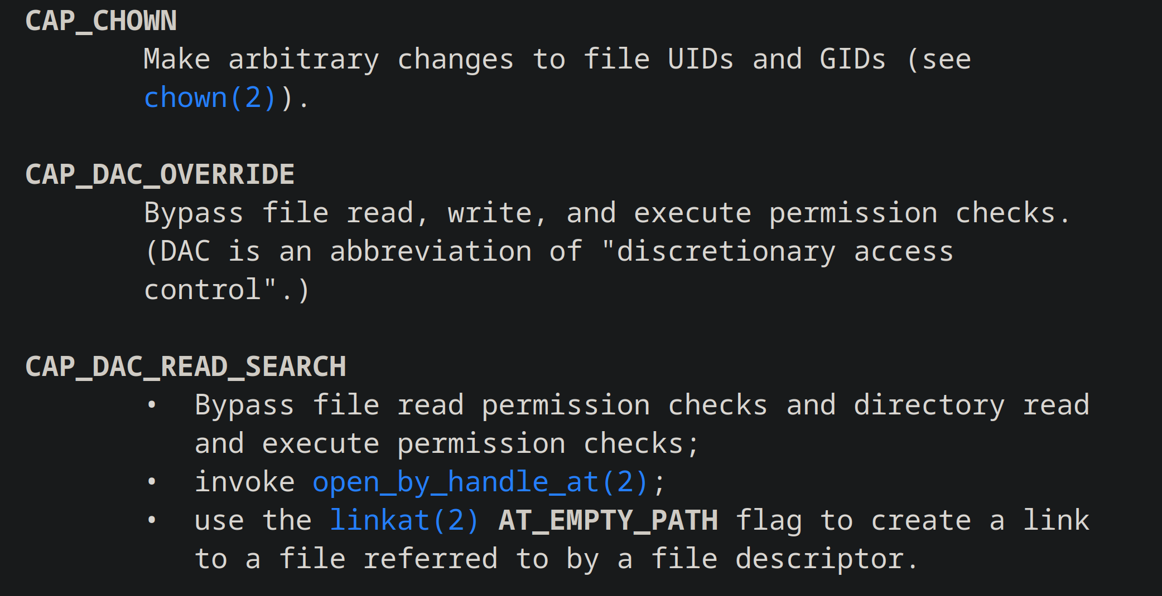
Capabilities
Divide root privileges
Over 40 privileges
Granular control
Only required priviledges
Manual capabilities cutout.
Screenshot taken from [man7.org]

Slide 10
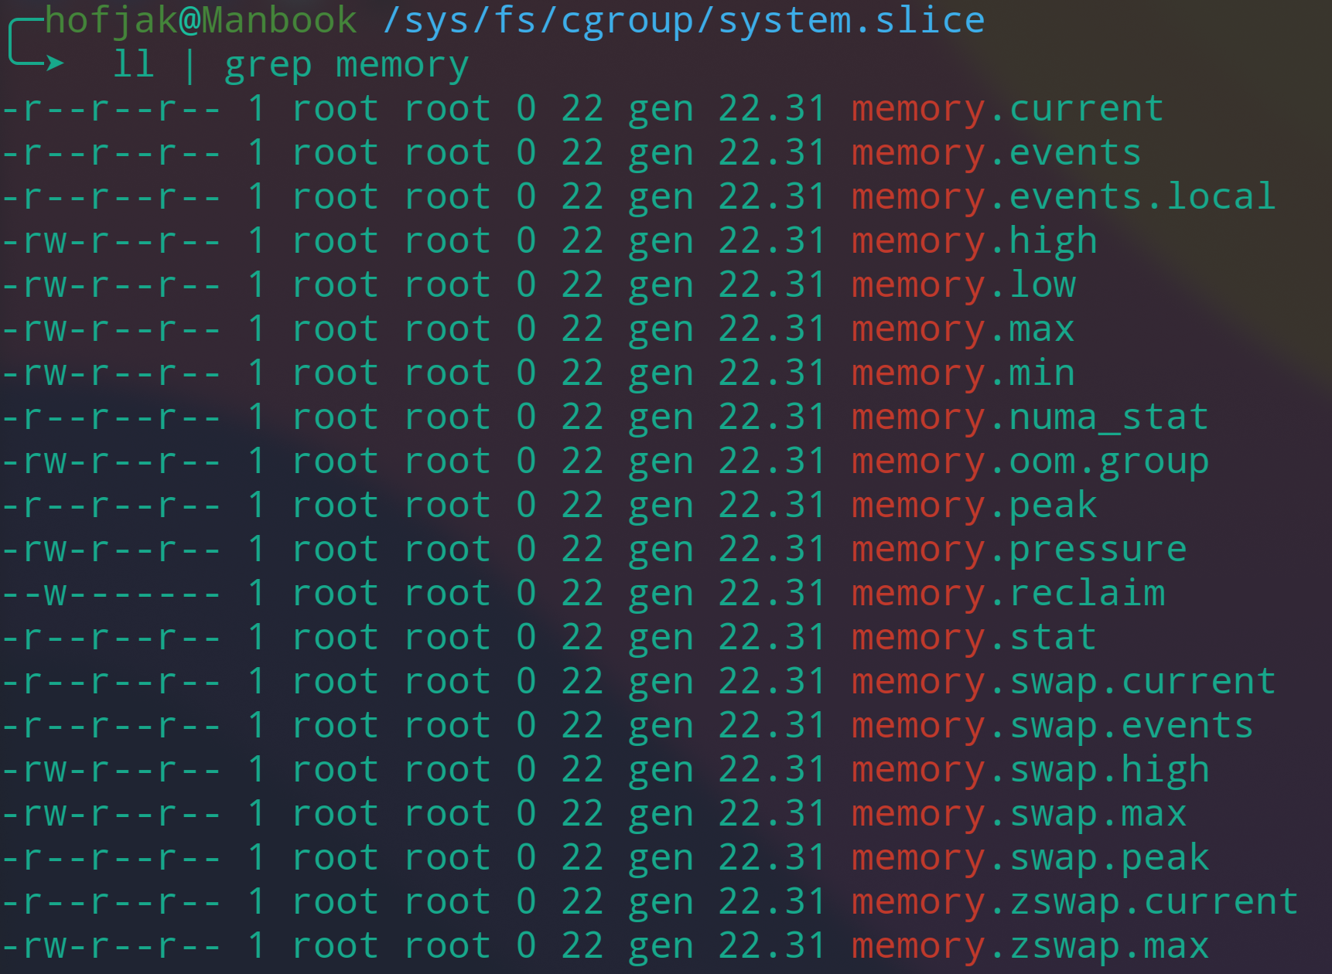
cgroups
Control groups
Managed through vfs
Mountpoint: /sys/fs/cgroup
Resource management
Monitor, limit
Hierarchy
Screenshot of memory parameter files.

Slide 11
Past Exploits

Slide 12

Attack Types
Container malware
Malware in container
Privilege escalation
Unauthorized resource access
Access Control
Too many Container Privileges
Network security
Unauthorized communication
Container Orchestration
Exploit orchestration tool
Container escape.
Image taken from [www.crowdstrike.com]

Slide 13

Vote for Us
https://fbr.io/join/xyucs

