Slide 1

Security in Container Environments
David Unterholzner, Jakob Hofer, Jakob Khom, Leo Lach

Slide 2
Contents
Isolation Techniques
Isolation Layers in Linux Containers
Past Exploits

Slide 3
Isolation Techniques

Slide 4
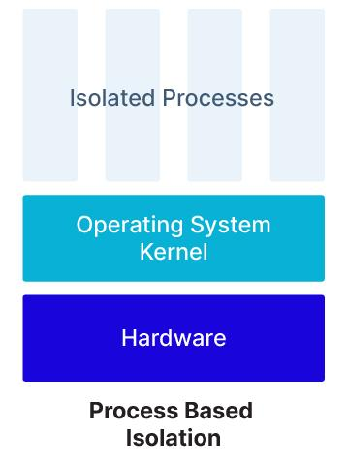
Isolation Techniques
Linux containers
Kernel features
Sandboxed containes
Sanbox software
VM-Based containers
Virtualisierung (Hypervisor)
Linux containers.
Image taken from [blog.aquasec.com]

Slide 5
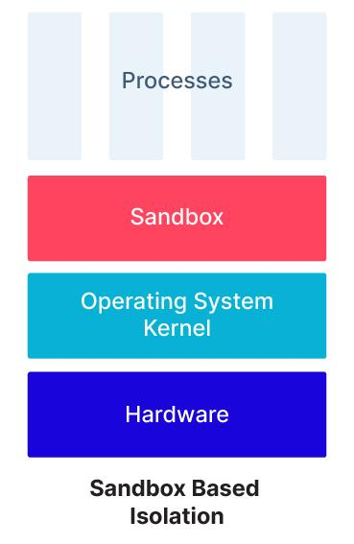
Isolation Techniques
Linux containers
Kernel features
Sandboxed containes
Sanbox software
VM-Based containers
Virtualisierung (Hypervisor)
Sandboxed containers.
Image taken from [blog.aquasec.com]

Slide 6
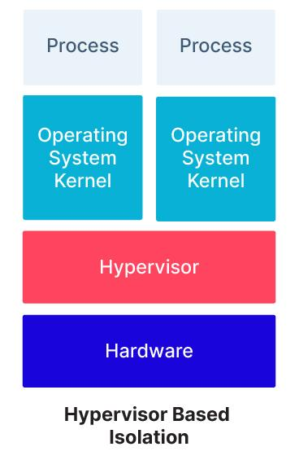
Isolation Techniques
Linux containers
Kernel features
Sandboxed containes
Sanbox software
VM-Based containers
Virtualisierung (Hypervisor)
VM-Based containers.
Image taken from [blog.aquasec.com]

Slide 7
Isolation Layers
In Linux Containers

Slide 8
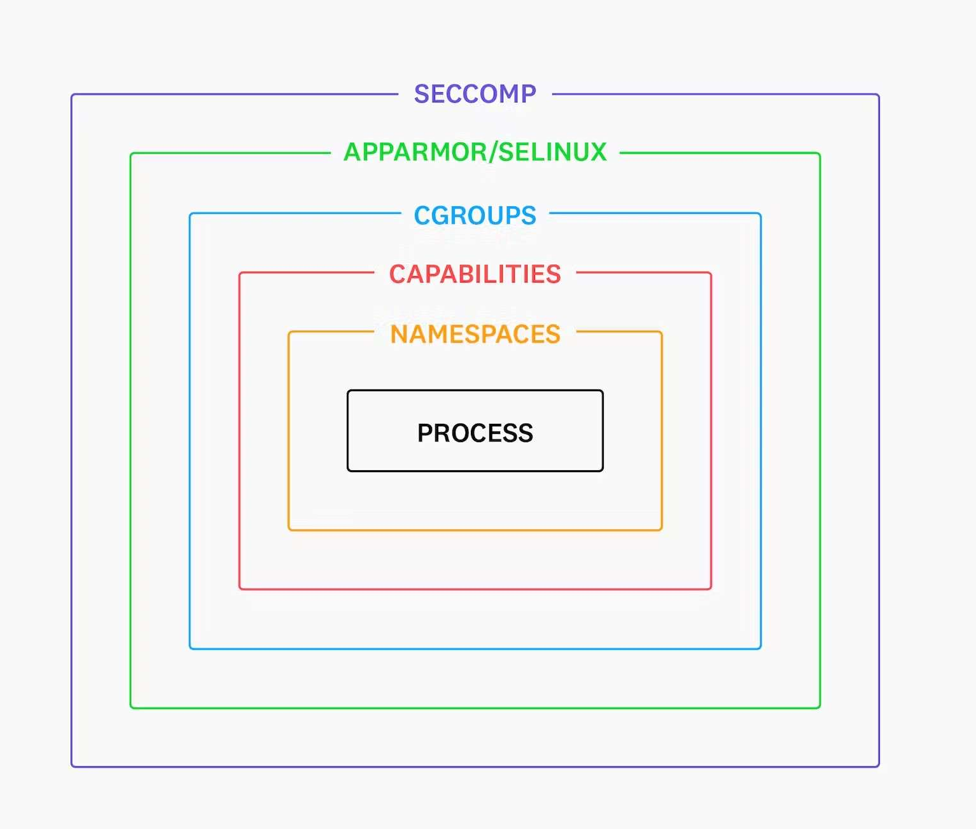
Namespaces
Isolate different system-resources
In total 8 namespaces:
Mount (mnt)
PID (pid)
Network (net)
IPC (ipc)
UTS (uts)
Cgroups (cgroup)
User (user)
Time (time)
Isolation Layers.
Image taken from [www.securitylabs.datadoghq.com]

Slide 9
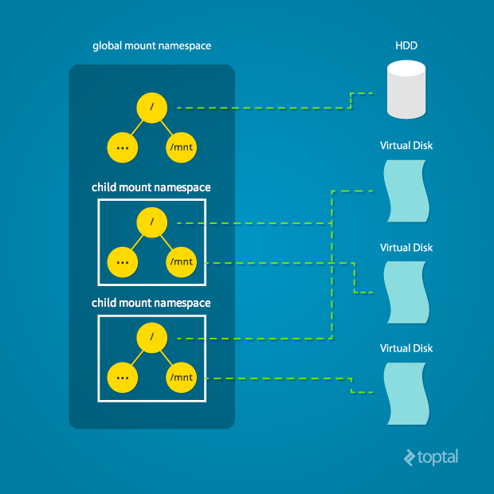
Important Namespaces
Mount namespace:
Provides isolated view of filesystem hierarchy
PID namespace:
Provides isolation within the set of process IDs
Network namespace:
Is responsible for the isolation of network-related resources
User namespace:
Isolates the user IDs
Mount namespace.
Image taken from [www.toptal.com]

Slide 10
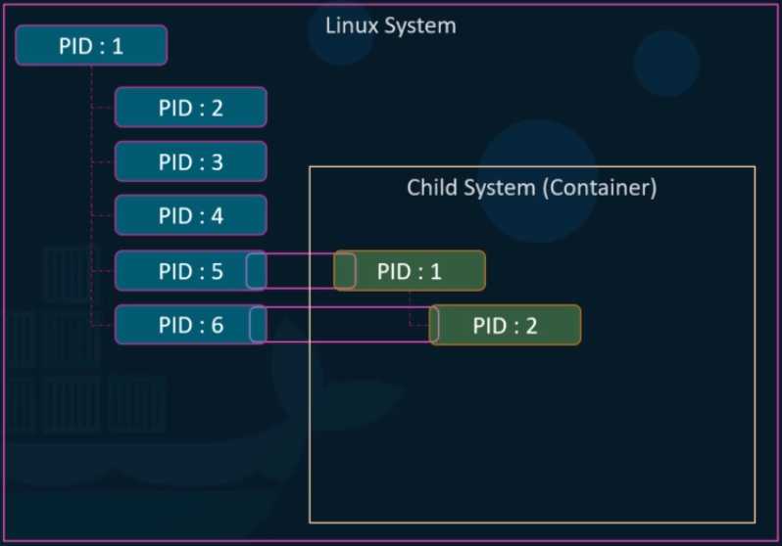
Important Namespaces
Mount namespace:
Provides isolated view of filesystem hierarchy
PID namespace:
Provides isolation within the set of process IDs
Network namespace:
Is responsible for the isolation of network-related resources
User namespace:
Isolates the user IDs
PID namespace.
Image taken from [www.waytoeasylearn.com]

Slide 11
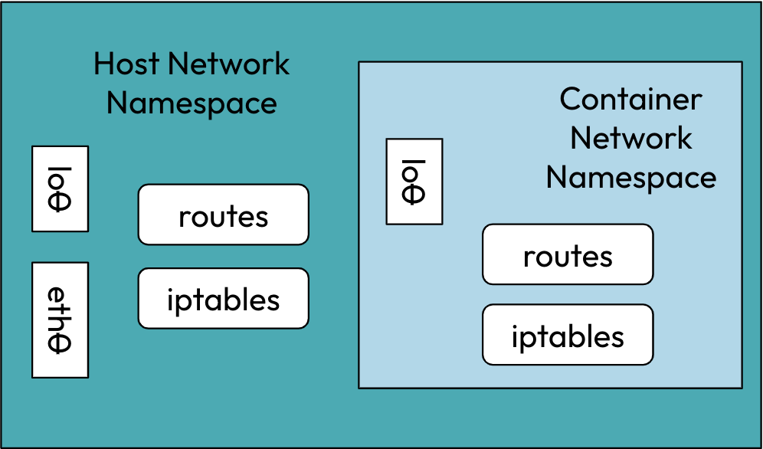
Important Namespaces
Mount namespace:
Provides isolated view of filesystem hierarchy
PID namespace:
Provides isolation within the set of process IDs
Network namespace:
Is responsible for the isolation of network-related resources
User namespace:
Isolates the user IDs
Network namespace.
Image taken from [www.infraspec.dev]

Slide 12
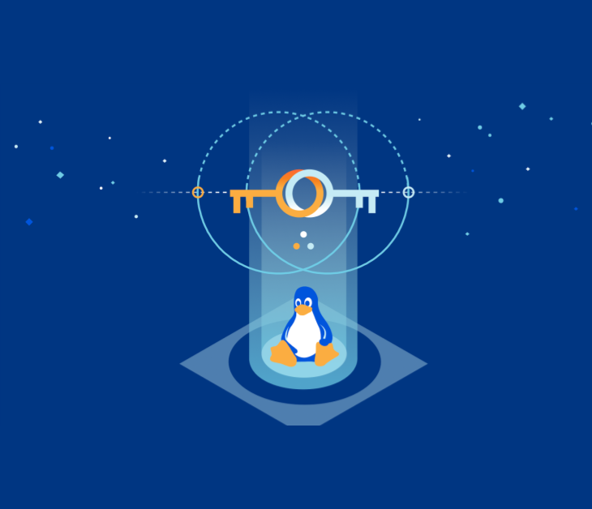
Important Namespaces
Mount namespace:
Provides isolated view of filesystem hierarchy
PID namespace:
Provides isolation within the set of process IDs
Network namespace:
Is responsible for the isolation of network-related resources
User namespace:
Isolates the user IDs
Image taken from [www.cloudflare.com]

Slide 13
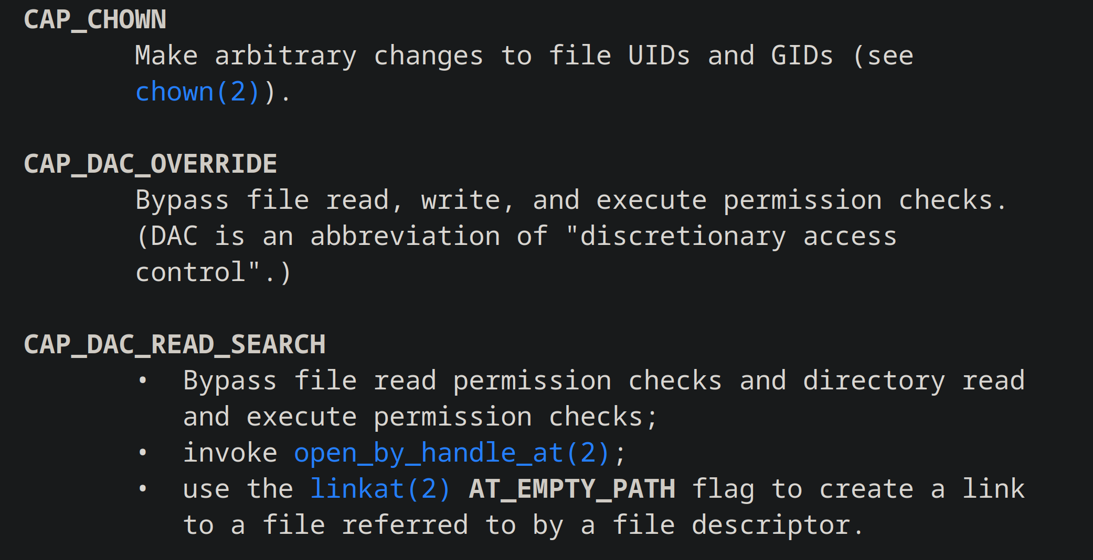
Capabilities
Divide root privileges
Over 40 privileges
Granular control
Only required priviledges
Manual capabilities cutout.
Screenshot taken from [man7.org]

Slide 14
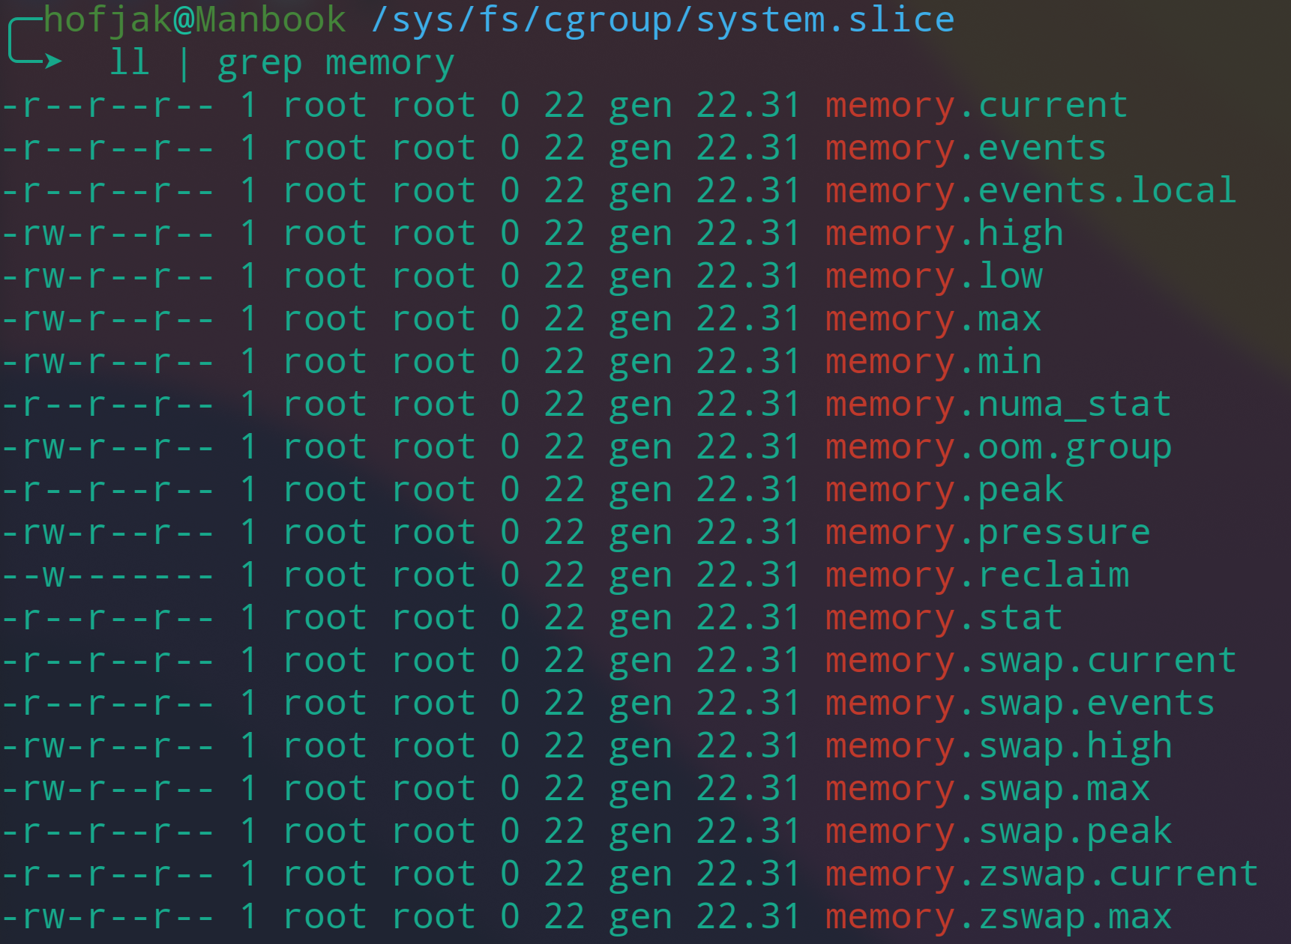
cgroups
Control groups
Managed through vfs
Mountpoint: /sys/fs/cgroup
Resource management
Monitor, limit
Hierarchy
Screenshot of memory parameter files.

Slide 15
seccomp
Container
Host
Secure Computing Mode
Linux kernel feature
Blocks syscalls
Docker default profile
finit_module
reboot
ptrace
...
System Call
System Call
Kernel

Slide 16
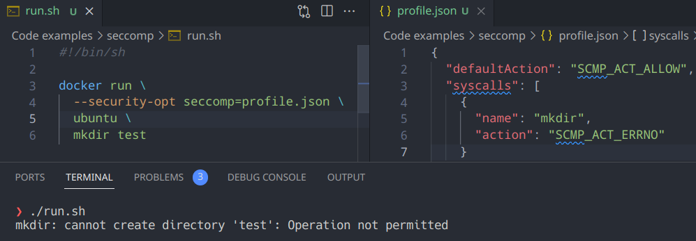
seccomp
Custom seccomp profile.

Slide 17
Past Exploits

Slide 18

Attack Types
Container malware
Malware in container
Privilege escalation
Unauthorized resource access
Access Control
Too many Container Privileges
Network security
Unauthorized communication
Container Orchestration
Exploit orchestration tool
Container escape.
Image taken from [www.crowdstrike.com]

Slide 19

Vote for Us
https://fbr.io/join/xyucs

