Slide 1

GestFHIR
Exploring FHIR Data Using Gesture

Slide 2

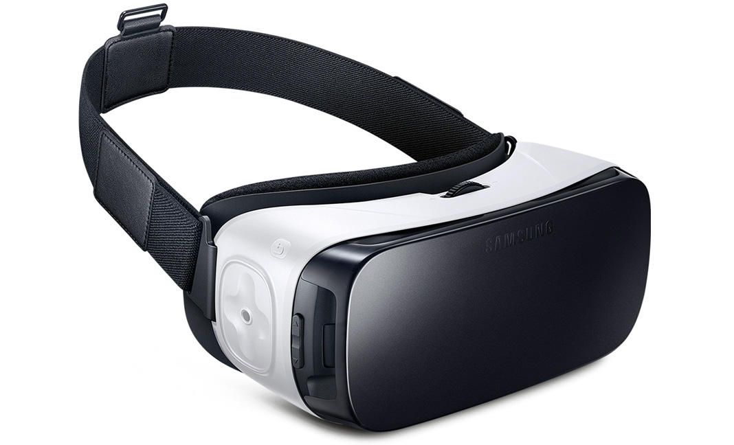
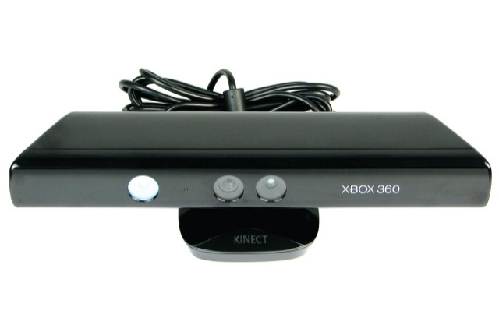

GestFHIR
+
+

Slide 3
GestFHIR
Problem : There has to be better way to explore data!
Solution : Gesture Through It!

Slide 4
GestFHIR
Demo!

