Slide 1

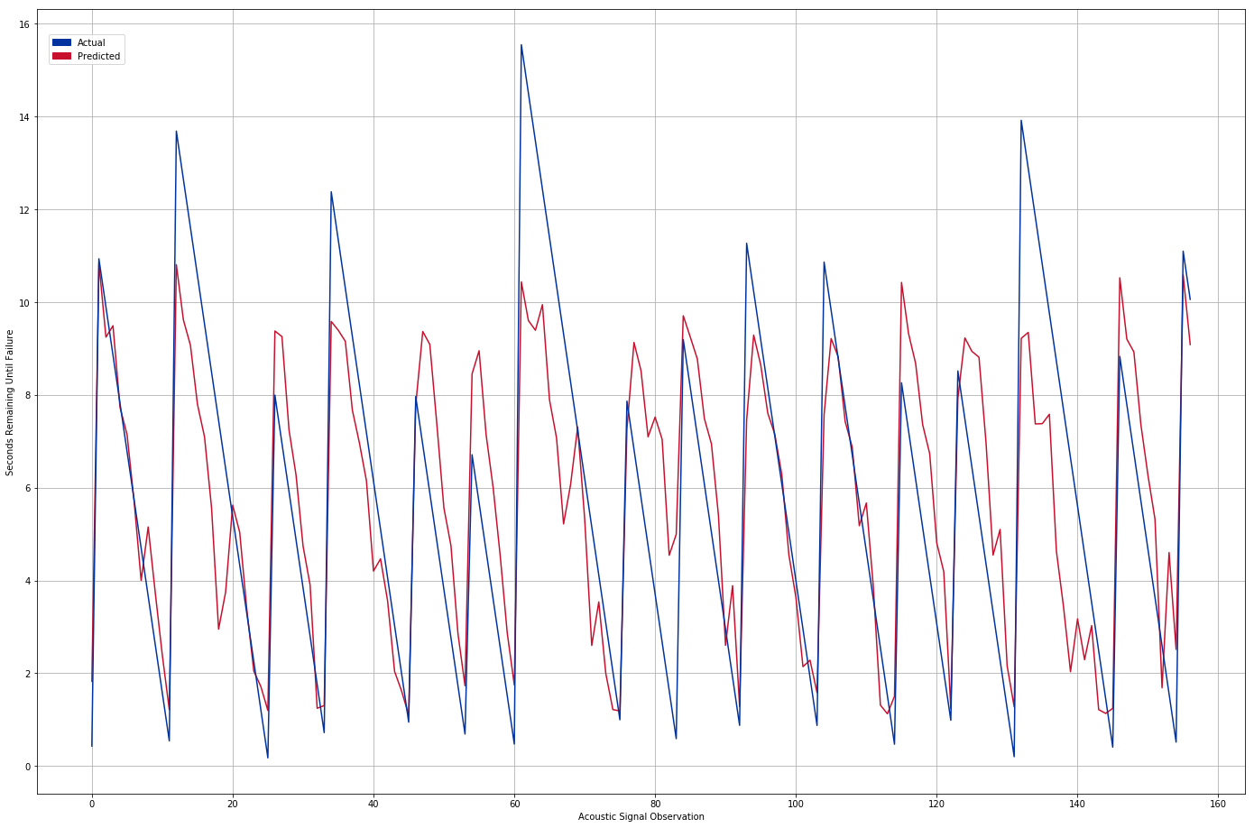
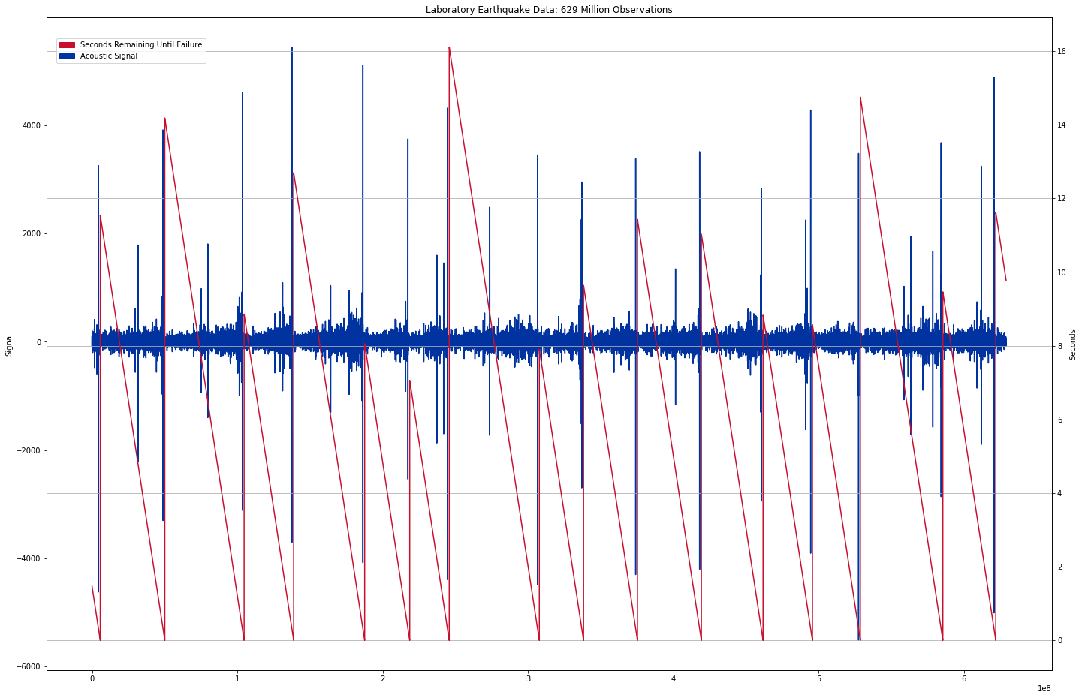
Laboratory Earthquake Prediction
Daniel Davieau and Olga Tanyuk
Master of Science in Data Science
Southern Methodist University, Dallas, TX 75275, USA
Laboratory Research
Problem
Machine Learning can Predict Laboratory Earthquakes
  In 2017 Los Alamos National Laboratory proved this is possible with 90% accuracy
  Since 2017 there have been advances in data collection and processing technologies
Can Improved Technology Improve Accuracy?
  Given advanced data collection instruments can the accuracy of predictions be improved?
  Do improvements in data processing enable greater accuracy?
The Lab to the Real World
Can Laboratory Earthquake Predictions Help in the Real World?
  Los Alamos National Laboratory acknowledges that the physical traits of the lab experiment differ from the real world
  However analysis of application to real earthquakes is ongoing
  This method can be applied outside of seismology to many fields such as aerospace and energy
Conclusions
Our application of machine learning predicts laboratory earthquakes with TBD seconds mean absolute error and TBD coeﬃcient of determination
  The evidence in this observational study suggests an improvement in the statistical scores of our predictions over the original study
  This analysis only applies to the data collected in this study.
  An 8-16 second prediction prior to failure may not be practical however the results are encouraging and could be applied to other fields of study

