Slide 1



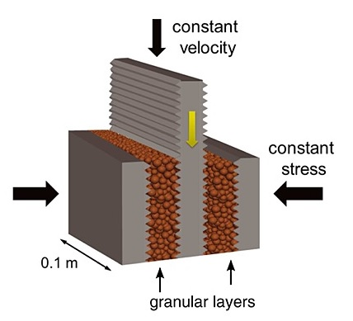
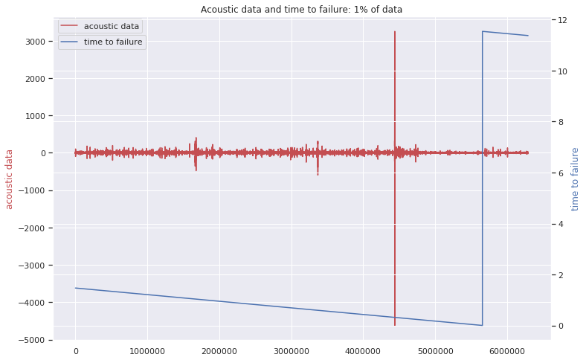
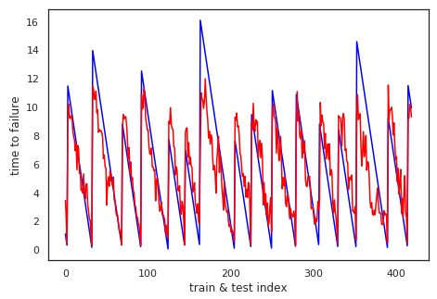
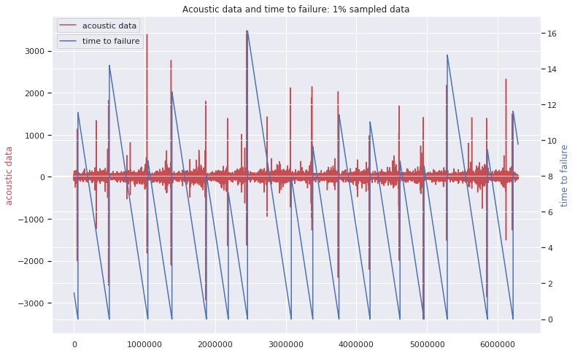
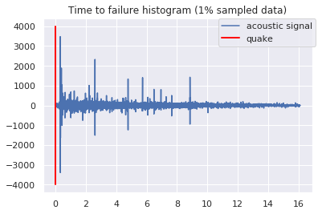
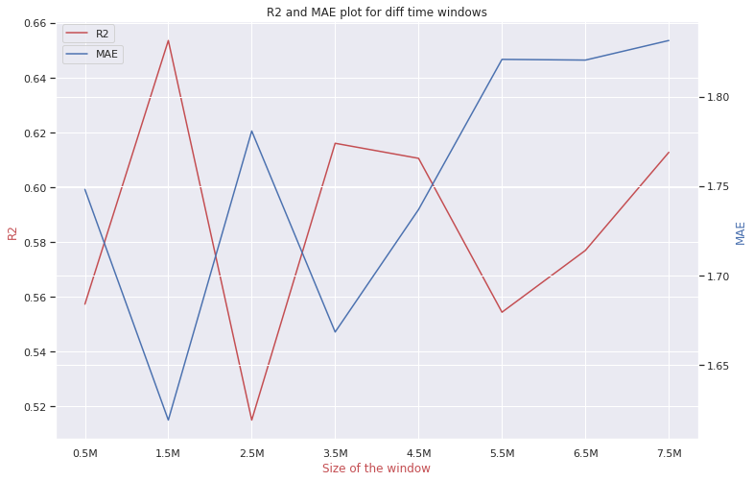
Machine Learning Predicts
Aperiodic Laboratory Earthquakes
Olha Tanyuk, Daniel Davieau, Dr. Charles South and Dr. Daniel W. Engels
Southern Methodist University, Dallas, TX 75205, USA
Abstract
Our goal is to find the pattern of aperiodic seismic signals that precede earthquakes. We apply machine learning to data set, that comes from a classic laboratory experiment involving repeated stick-slip displacement (“earthquake”) on a sliding interface, a type of experiment which has been studied in depth as a tabletop analog of seismogenic faults for decades. Here we show that by listening to the acoustic signal emitted by a laboratory fault, an algorithm tuned through machine learning can predict the time remaining before it fails with a 0.65 coefficient of determination and 1.61 sec mean absolute error. These predictions are based solely on the instantaneous physical characteristics of the acoustical signal and do not make use of its history. Los Alamos' initial work showed that the prediction of laboratory earthquakes from continuous seismic data is possible in the case of quasi-periodic laboratory seismic cycles. In this work we use a much more challenging dataset with considerably more aperiodic earthquake failures with more akin to the observed behavior of natural earthquakes.
Introduction
Methodology
Results
In August 2017 Los Alamos National Laboratory (LANL) conducted an experiment that illuminates the mechanics of slow-slip phenomena. They predicted the remaining time until laboratory earthquakes occur with 89% accuracy.
Problem that we solve: we use acoustic data, which was provided by LANL in January 2019, which represent laboratory slow-slip earthquakes, to find the pattern of acoustic signals to predict the time at which laboratory earthquakes will occur. Data from this experiment exhibit a very aperiodic and more natural behavior (Fig 1) compared to the data LANL studied earlier, with earthquakes occurring very irregularly. The results of this experiment are potentially applicable to the field of real world earthquakes.
Fig. 1
The data are from an experiment conducted on rock in a double direct shear geometry subjected to bi-axial loading, a classic laboratory earthquake model (Fig. 2).
Fig. 2
Two fault gouge layers are sheared simultaneously while subjected to a constant normal load and a prescribed shear velocity. The laboratory faults fail in repetitive cycles of stick and slip that is meant to mimic the cycle of loading and failure on tectonic faults. While the experiment is considerably simpler than a fault in Earth, it shares many physical characteristics.
The data used in this work is a chunk of 157.275 seconds of seismic data (ordered in time), which is recorded at 4MHz, hence 629,145,480 data points, and the output is time remaining until the following lab earthquake, in seconds.
The voltage rate of acoustic precursors accelerates as failure approaches, suggesting that upcoming laboratory earthquake timing could be predicted (Fig.3). In Fig. 3 we used 1% sample of the data. Red line indicates, that quake occurs, when time to failure approaches to 0.
Fig. 3
On zoomed-in-time plot we can see that the large oscillation before the failure is not in the last moment. 90% of high acoustic values (absolute value greater than 1000 voltages) are around 0.31 seconds before a quake (Fig. 4)
Fig. 4
We divided our data into time windows that each contain 0.3 seconds of data (1,500,000 observations), which is small enough compared with lab quake cycle (8 to 16 sec).
From each time window, we compute a set of 95 potentially relevant statistical features (e.g., mean, variance, kurtosis, min/max, threshold and so on).
We checked how sensitive our results are to the size of the window, and found that the highest R2 and smallest MAE we were able to get with 1.5M observations in each time window (Fig. 5).
Fig. 5
We run different techniques on a training data set (50% of the full data). We quantify the accuracy of our model using R2 (the coefficient of determination) and MAE (mean absolute error), applying predicting model on test data set. The best results we achieved using Extra Trees Regressor technique: MAE: 1.61, r2_score: 0.65.
When making a prediction (red curve), we emphasize that there is no past or future information considered: each prediction uses only the information within one single time window of the acoustic signal (Fig. 6)
Fig. 6
Top 3 the most important features are: 90% Quantile of rolling standard deviation, 95% Quantile of rolling standard deviation, 95% Quantile of the time window.
Materials
Conclusion
Slow Slip Earthquake (SSE) are fault behaviors that occur slowly enough to make them undetectable without instrumentation. They do not shake the ground and cause widespread destruction like regular earthquakes do. They occur near the boundaries of large earthquake rupture zones. There is evidence to suggest that there is a relationship between slow slip earthquakes and more noticeable regular earthquakes.
In our work we show that ML applied to this experiment provides failure forecasts with 1.61 sec mean absolute error and 0.65 coefficient of determination based on the instantaneous analysis of the acoustic signal at any time in the slip cycle. Our findings are sensitive to the size of time window that is used for new feature construction. Having data just from 0.3 sec period of time, we can predict the failure at any moment of the cycle. These results should encourage ML analysis of seismic signals in Earth. We found that more than 90% of high acoustic values (absolute value greater than 1000 voltages) are around 0.31 seconds before an earthquake.

