Slide 1



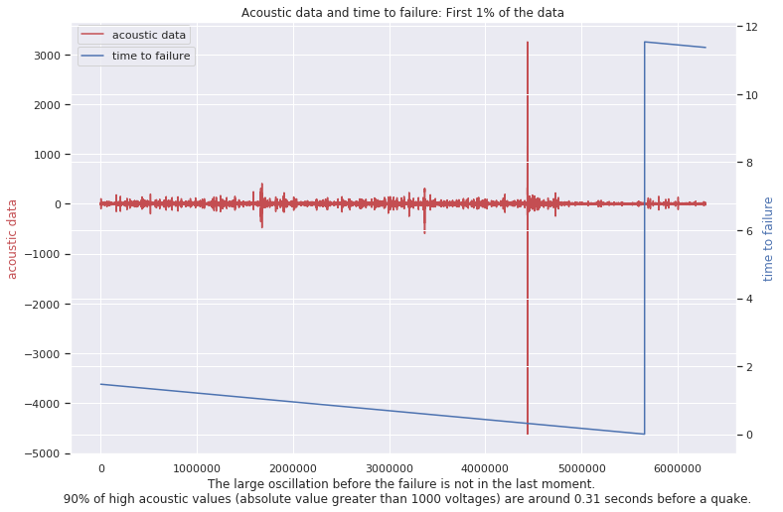
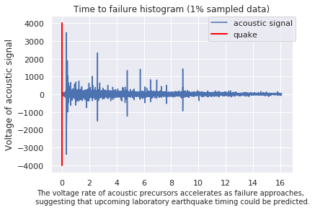
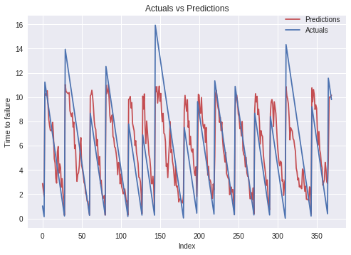
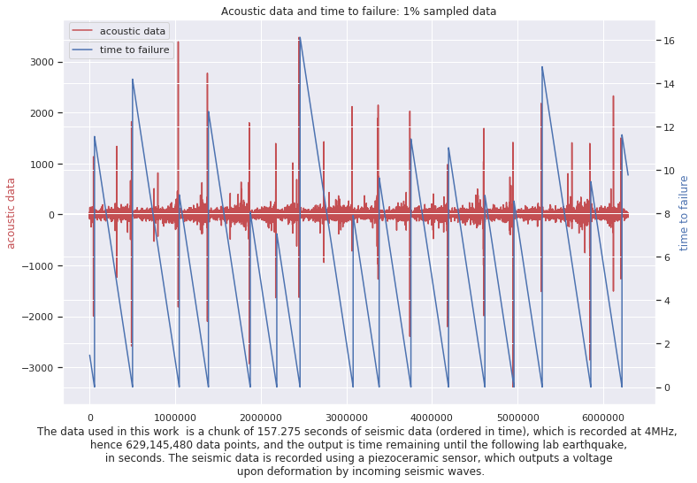
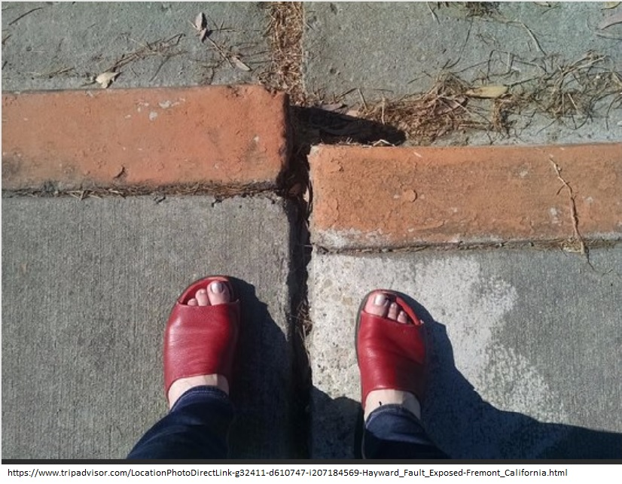

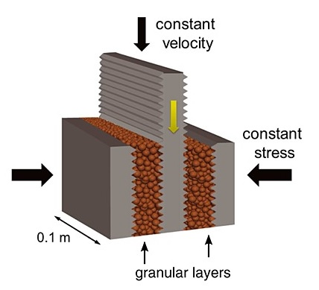
Machine Learning Predicts
Aperiodic Laboratory Earthquakes
Olha Tanyuk, Daniel Davieau, Dr. Charles South and Dr. Daniel W. Engels
Southern Methodist University, Dallas, TX 75205, USA
Abstract
Our goal is to find the pattern of aperiodic seismic signals that precede earthquakes. We apply machine learning to data set, that comes from a classic laboratory. Here we show that by listening to the acoustic signal emitted by a laboratory fault, an algorithm tuned through machine learning can predict the time remaining before it fails with a 0.65 coefficient of determination and 1.61 sec mean absolute error. These predictions are based solely on the instantaneous physical characteristics of the acoustical signal and do not make use of its history. Los Alamos' initial work [1] showed that the prediction of laboratory earthquakes from continuous seismic data is possible in the case of quasi-periodic laboratory seismic cycles. In this work we use a much more challenging dataset with considerably more aperiodic earthquake failures with more akin to the observed behavior of natural earthquakes.
Introduction
Methodology
Results
A traditional method to predict earthquakes is to look to past recurrence intervals. Because the recurrences are not constant, predictions can only be made within broad time windows. Over the last 15 years, there has been renewed hope that progress can be made regarding forecasting owing to tremendous advances in instrumentation quality and density.
In August 2017 Los Alamos National Laboratory (LANL) conducted an experiment that illuminates the mechanics of slow-slip phenomena. They predicted the remaining time until laboratory earthquakes occur with 89% accuracy. [1]
Problem that we solve: we use acoustic data, which was provided by LANL in January 2019 [2], which represent laboratory slow-slip earthquakes, to find the pattern of acoustic signals to predict the time at which laboratory earthquakes will occur. Data from this experiment exhibit a very aperiodic and more natural behavior compared to the data LANL studied earlier, with earthquakes occurring very irregularly. The results of this experiment are potentially applicable to the field of real world earthquakes.
We divided our data into time windows that each contain 0.3 seconds of data (1,500,000 observations), which is small enough compared with lab quake cycle (8 to 16 sec). From each time window, we compute a set of 95 potentially relevant statistical features (e.g., mean, variance, kurtosis, min/max, threshold and so on).
We checked how sensitive our results are to the size of the window, and found that the highest R2 and smallest MAE we were able to get with 1.5M observations in each time window.
We run different techniques on a training data set (50% of the full data). We quantify the accuracy of our model using R2 (the coefficient of determination) and MAE (mean absolute error), applying predicting model on test data set. The best results we achieved using Extra Trees Regressor technique: MAE: 1.61, r2_score: 0.65.
When making a prediction (red curve), we emphasize that there is no past or future information considered: each prediction uses only the information within one single time window of the acoustic signal (Fig. 2)
Fig. 2
Top 3 the most important features are: 90% Quantile of rolling standard deviation, 95% Quantile of rolling standard deviation, 95% Quantile of the time window.
Given aperiodic slow-slip failures, can we predict laboratory earthquakes?
Materials
Conclusion
Slow Slip Earthquake (SSE) are fault behaviors that occur slowly enough to make them undetectable without instrumentation. There is evidence to suggest that there is a relationship between slow slip earthquakes and more noticeable regular earthquakes.
The data are from an experiment conducted on rock in a double direct shear geometry subjected to bi-axial loading, a classic laboratory earthquake model (Fig. 1).[2]
Fig. 1
The evidence suggests that given the more realistic data, Machine Learning can provide failure forecasts with 65 % coefficient of determination and 1.61 sec mean absolute error.
Our findings are sensitive to the size of the time window that is used for new feature construction. Having data just from 0.3 sec period of time, we can predict the failure at any moment of the quake cycle.
The results are encouraging Machine Learning analysis of seismic signals in Earth.
References:
1. Bertrand Rouet-Leduc, Claudia Hulbert, N.L.K.B.C.J.H.P.A.J.: Machine learning predicts laboratory earthquakes
2. LANL-Earthquake-Prediction. https://www.kaggle.com/c/LANL-Earthquake-Prediction/overview, 7/7/2019

