Slide 1
NHibernate
Object/Relational Persistence for .NET

Slide 2
A little bit of background information…

Slide 3
.NET port of the Hibernate project (Java)

Slide 4
Mature architecture and proven
concepts, already in use in many
enterprise Java applications

Slide 5
Already quite popular in the .NET world as well

Slide 6
Popularity seems to be increasing :)

Slide 7
General Philosophy Of NHibernate

Slide 8
It’s all about POCO

Slide 9
Should work on most databases

Slide 10
As few constraints on your code as possible

Slide 11
Full OO support: inheritance, polymorphism, composition, single-valued and many-valued associations

Slide 12
Maximize performance and flexibility

Slide 13
Keep your code clean

Slide 14
Strong Points

Slide 15
Ideally suited for OLTP scenarios (web applications, service layers, …)

Slide 16
Database independence

Slide 17
Rich feature set

Slide 18
Mature

Slide 19
Extensible architecture

Slide 20
Large, active, helpful and growing user base

Slide 21
Plenty of articles, blog posts and documentation available

Slide 22
It’s Open Source (LGPL)!

Slide 23
Weak Points

Slide 24
Not suited (at all) for bulk data processing

Slide 25
No code generation, and no designer support either

Slide 26
Bad reputation in some companies due to
lazy coding ( = abuse of lazy loading )

Slide 27
Plenty of outdated articles, blog posts and documentation available

Slide 28
It’s Open Source!
(some companies just don’t like that)

Slide 29
Let’s look at some of the things we can do with NHibernate…

Slide 30
Transitive Persistence

Slide 31
Managing associations between classes in a transparent manner

Slide 32
Allows you to persist object graphs with one instruction

Slide 33
Needs to be configured for each association
=> fine-grained control over cascade settings

Slide 34
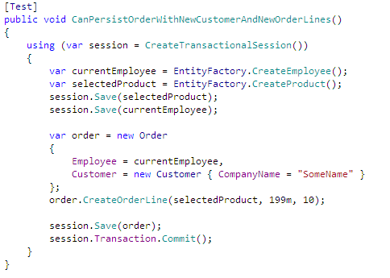

Slide 35
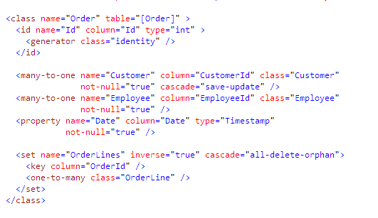

Slide 36
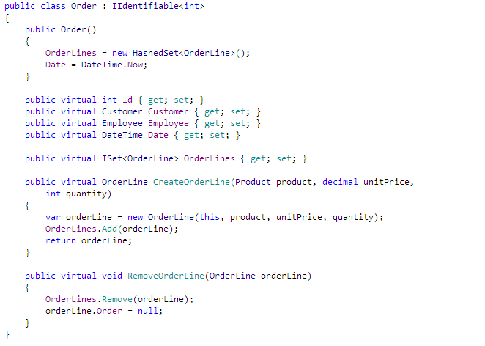

Slide 37
Hold on… why was every member in the Order
class virtual?

Slide 38
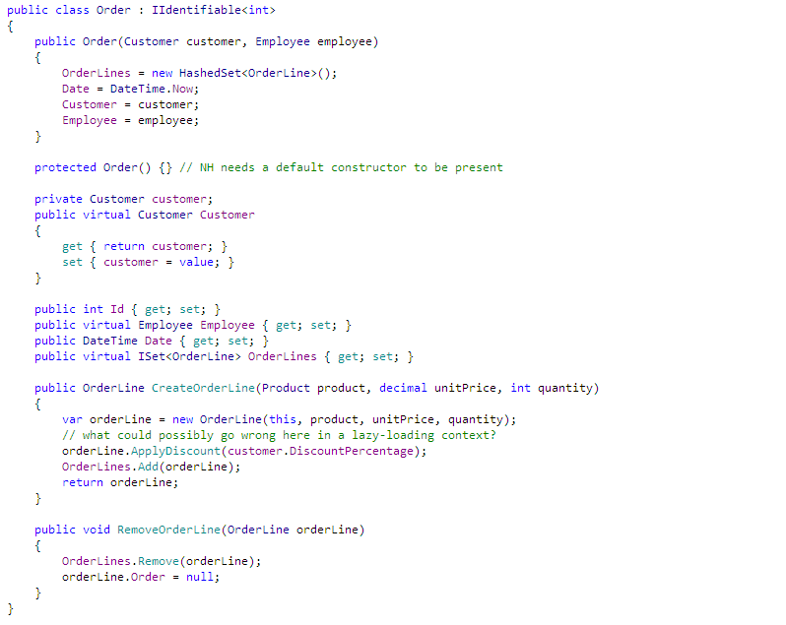

Slide 39
I wouldn’t want to debug that either :)

Slide 40
Storing data in the database in an easy manner is great and all, but what about getting it out again?

Slide 41
Querying with NHibernate

Slide 42
Hibernate Query Language

Slide 43
It’s an Object Oriented query language

Slide 44
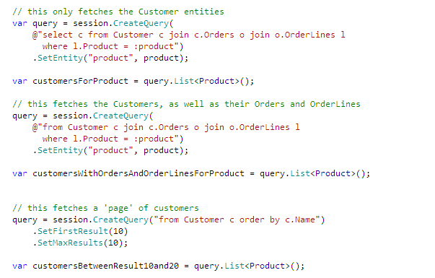

Slide 45
Criteria API

Slide 46
Makes it easier to compose queries dynamically from code.

Slide 47
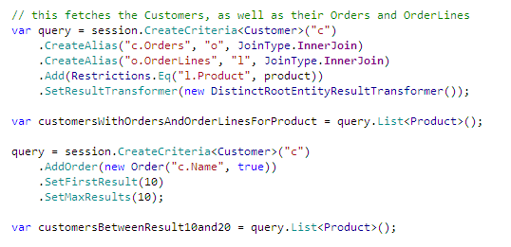

Slide 48
LINQ… still not fully supported

Slide 49
Wouldn’t it be great if we could execute multiple queries in only one database roundtrip?

Slide 50
Future Queries

Slide 51
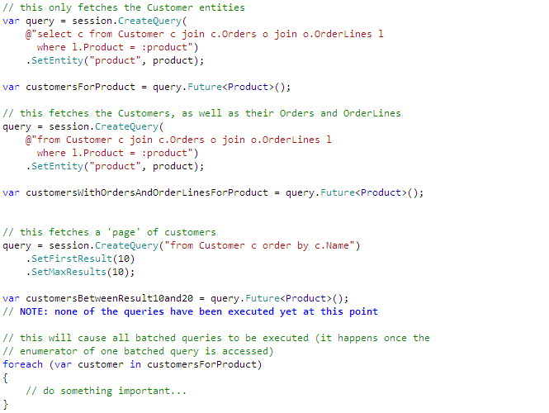

Slide 52
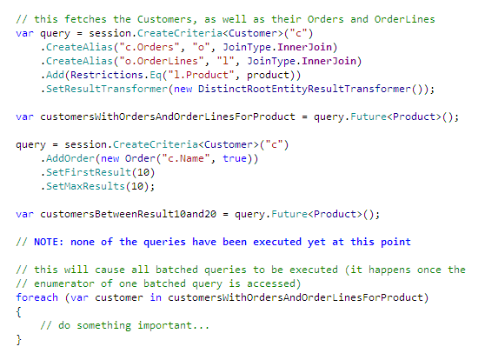

Slide 53
Can we efficiently update multiple records in one roundtrip as well?

Slide 54
As of NHibernate 2.1, we can do this with some new HQL statements

Slide 55
Data Modification With HQL

Slide 56
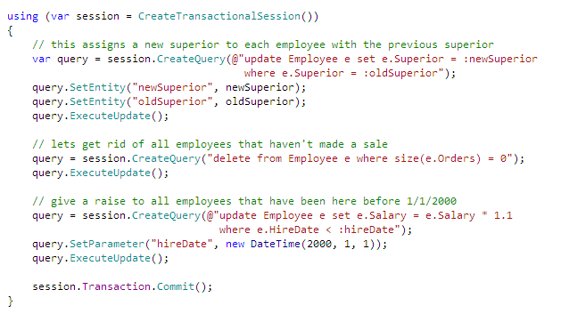

Slide 57
What about caching? Do we need to do that manually?

Slide 58
Of course not :)

Slide 59
Second Level Cache

Slide 60
Second Level Cache data is available to
all sessions

Slide 61
We can cache entity instances…

Slide 62
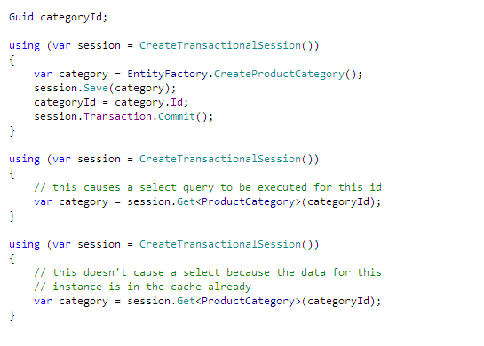

Slide 63
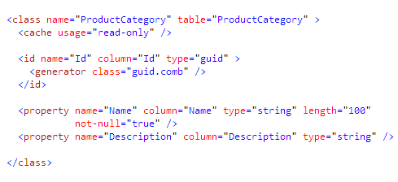

Slide 64
But we can also cache the results of queries…

Slide 65
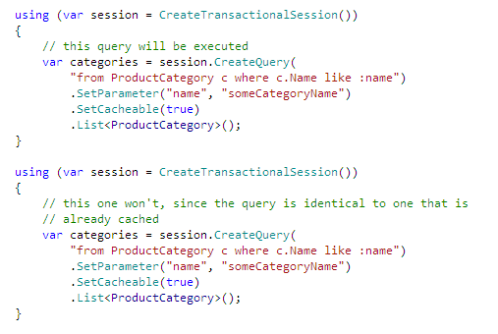

Slide 66
This is ideal for static (reference) data or even data that doesn’t change frequently

Slide 67
How does the cache deal with modified data, though?

Slide 68
We’ll update the database and the cache

Slide 69
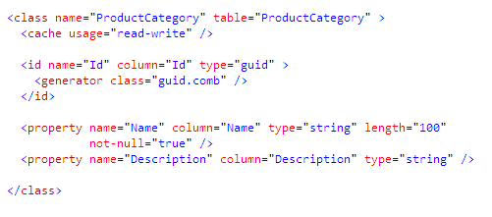

Slide 70
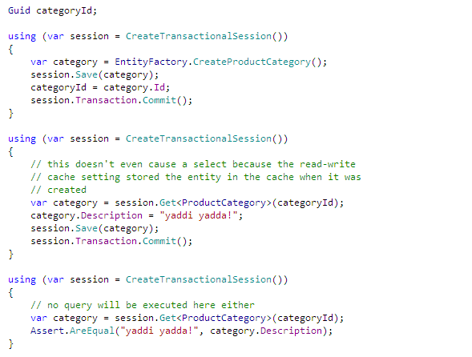

Slide 71
NHibernate will never cache anything in the Second Level Cache automatically

Slide 72
It needs to be configured on a per-entity and per-query basis

Slide 73
All the caching power you want, without having to pollute your code

Slide 74
Only use this for data that doesn’t change frequently though

Slide 75
But where is the cache’s data stored?

Slide 76
That’s up to you… multiple providers are available: ASP.NET cache, MemCached, Velocity, Prevalence, …

Slide 77
At this point, I’m almost running out of time and there is a lot more interesting stuff that we won’t get to cover.

Slide 78
Like optimistic concurrency strategies…

Slide 79
Or pessimistic locking strategies…

Slide 80
Or the various identifier strategies…

Slide 81
Or the various inheritance strategies…

Slide 82
Or how automatic dirty tracking works…

Slide 83
Or how you can implement your own dirty tracking…

Slide 84
Or custom user types…

Slide 85
Or how to deal with entities that were detached from the session…

Slide 86
Or the generation of DDL scripts, for your specific database…

Slide 87
Or the various mapping strategies for complex domain models…

Slide 88
We didn’t cover any of the many extensibility points either…

Slide 89
Maybe some other time :)

Slide 90
If you want to learn more, be sure to visit http://nhforge.org

Slide 91
Oh, and check out my blog if you liked this presentation: http://davybrion.com

Slide 92
Questions?

