Slide 1
Pan/Pot State Detection System
MobileNet v2 Powered Kitchen Safety Detection
100% Training & Verification
Hybrid Circle + YOLO Detection
MobileNet v2 - 3.5M Params

Slide 2
System Workflow Overview
Input Image
(Kitchen Camera)
Object Detection
(Circle + YOLO)
State Classification
(MobileNet v2)
Output Result
(with Marking)
Detected States:
Normal
Boiling
Smoking
On Fire

Slide 3
Detailed Processing Pipeline
Data Preparation
Model Training
Prediction
Collect Images
Data Augmentation
Load Model
Manual Crop
(manual_crop.py)
Train Classifier
(MobileNet v2)
YOLO Detection
Label States
Model Validation
State Prediction
(predict_veri.py)
Evaluation
(evaluate_classifier.py)

Slide 4
Key Features & Capabilities
🎯 Hybrid Detection
Circle detection + YOLO v8 fallback
🖼️ Accurate Wireframes
Tight fit around circular cookware
🧠 Lightweight Model
MobileNet v2 (3.5M params)
🎨 Color Optimized
Preserves critical color features
📊 High Accuracy
100% training & verification
⚡ Fast Inference
Optimized for edge devices

Slide 5
Model Performance & Predictions
Training Accuracy
100%
Model Architecture
MobileNet v2
~3.5M parameters
Verification Set
100% (4/4)
Sample Predictions
cooking-pot_normal_01.jpg
Pred: normal
36.2%
✓
frying-pan_boiling_01.jpg
Pred: boiling
66.5%
✓
frying-pan_on-fire_01.jpg
Pred: on_fire
54.3%
✓
frying-pan_smoking_01.jpg
Pred: smoking
42.8%
✓

Slide 6
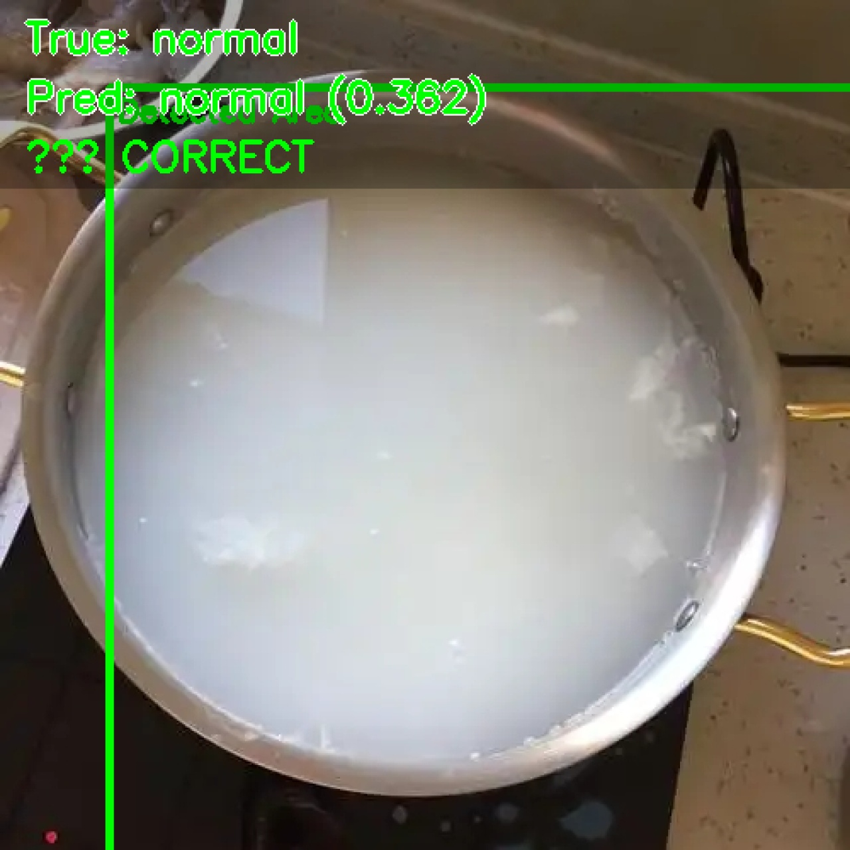
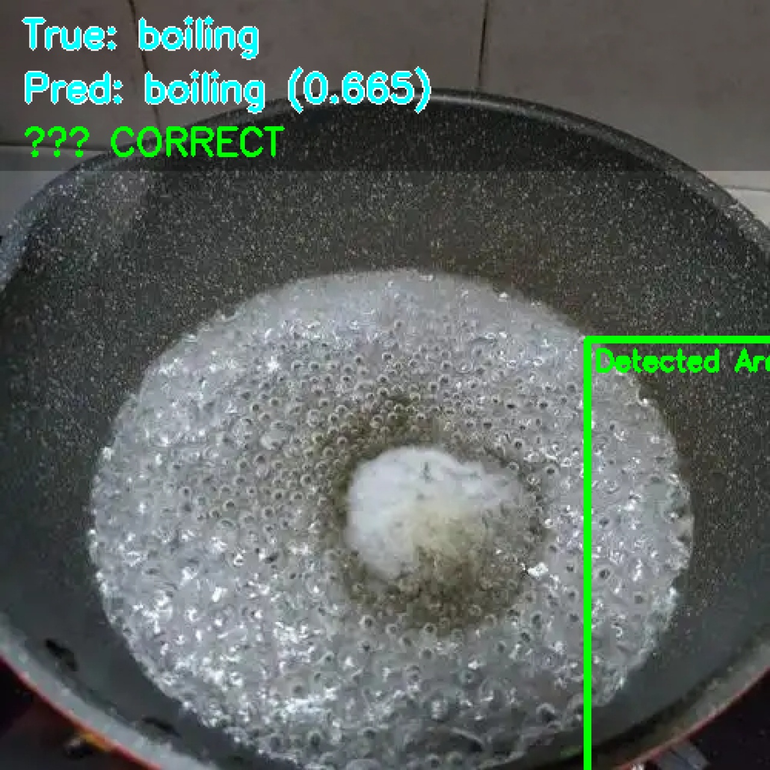
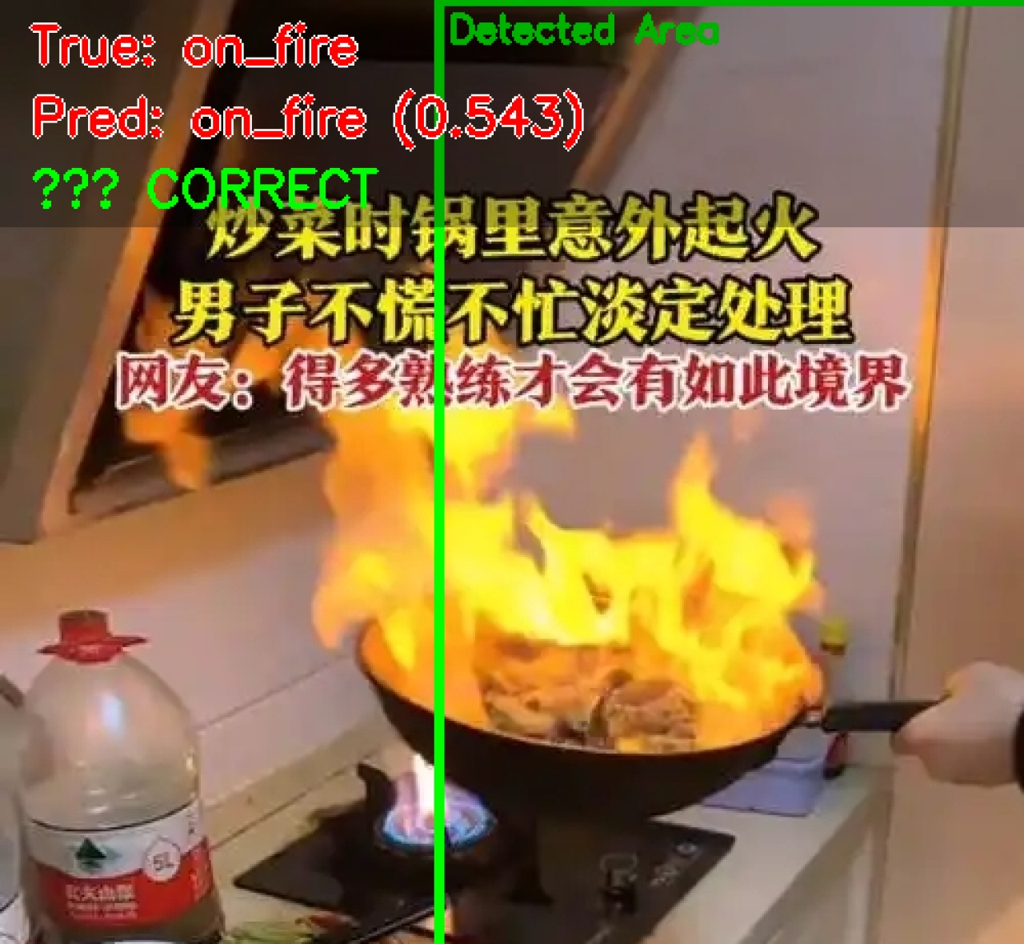
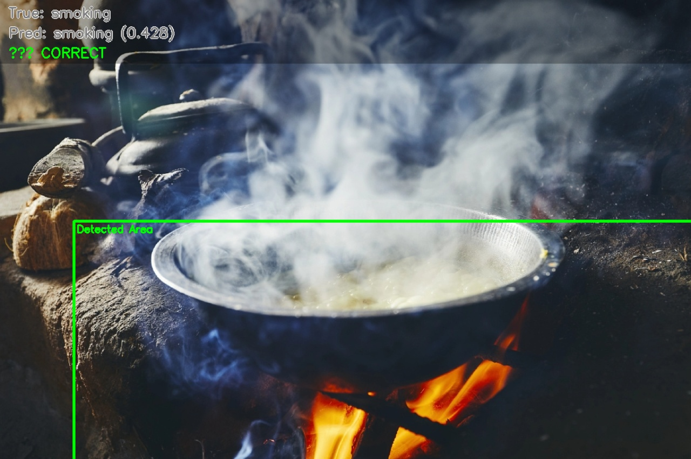
Marked Detection Results
cooking-pot normal 01
frying-pan boiling 01
frying-pan on-fire 01
frying-pan smoking 01

