Slide 1

Course Scheduler
Deborah Bernstein
Ruth Davydov
Rachel Hollander
Shterna Morosou

Slide 2
Problem:
College students often have a hard time prioritizing necessary courses into their schedules because of the many options that are offered.
Purpose of the Course Scheduler:
Help students overcome the daunting task of prioritizing and organizing a course schedule.
A program to efficiently work out a viable schedule for each individual student, catering to his/her needs and specifications.

Slide 3
Goal:
To build a program which generates a personalized schedule for college students based on the courses that are offered that semester.
User inputs desired courses
Program eliminates all time slot conflicts
Program generates the best possible schedule

Slide 4
Development Process
Course Object class
Holds all the information about a course
CRN
Course Code
Course Title
Professor
Time Slot
Credits
Interesting Point:
We decided to use a unique code to identify each time slot. This way we can easily compare two courses and see if their time slots conflict.

Slide 5
Development Process
A Table in SQL Server Database:
Stores all courses being offered in the college for the current semester
Corresponds to the Course Object
Easily retrieve information about each course
Use the query result to manipulate the data in Java and create a schedule

Slide 6
Development Process
Database Connection Object:
Connects our Java program to the local database
Instantiation Object:
Uses the Database Connection Object as a parameter
Queries the database for all the courses
Loops through the results, instantiates a Course for each record
Adds the course to the course list

Slide 7
Development Process
Course Schedule Object:
The actual schedule which is returned to the user at the completion of the program
ArrayList of Courses
Semester
Credit Limit
Throws CreditOverflowException
Throws TimeSlotConflictException

Slide 8
Development Process
Created Application Window:
Using Eclipse WindowBuilder
Implements the code in a user-friendly format
Various design elements to make a functional GUI
Interesting Point:
Instead of using multiple frames and switching between them, we used CardLayout on our frame to be able to switch easily between panels by changing visibility.

Slide 9
Development Process
SearchCourses Algorithm:
Search algorithm used across the whole program
Parameters: courses ArrayList, a course code
Goes through an ArrayList of all the courses available
Returns a subgroup of all courses that match the requested course code

Slide 10
Development Process
The ScheduleAlgorithm:
Receives an ArrayList of the requested course codes and returns a CourseSchedule Object
Tries to add all the requested courses without running into a conflict
Prioritized by the number of times each course is being offered
The first course to be added to the schedule is the one that is offered the least amount of times
Consequently, the rest of the courses are added
A loop which continues to add a different section of the course as long as there is still a conflict in the schedule

Slide 11
Development Process
The ScheduleAlgorithm -Interesting Points:
To order the courses based on the number of times each one is being offered:
Use the SearchCourses algorithm, retrieve an individual list of all the options for each requested course code.
The individual lists are then added to a greater overall list to compare them
Using a Comparator, the outer ArrayList is sorted by the size attributes of the inner ArrayLists
ArrayList<Course> courseOptions = SearchCourses.search(courses, reqCourses.get(i));
allCourses.add(courseOptions);
Collections.sort(allCourses, new ArrayListSizeComparator());

Slide 12
Development Process
The ScheduleAlgorithm -Interesting Points:
To notify the user which courses were not able to be added to the schedule due to a conflict:
The method can only return one object – the CourseSchedule
No need for it to crash/throw exception when an error occurs, schedule needs to be generated whether all courses could be added or not
Used a shallow copy of the list of requested course codes that was passed in
When a Course is added successfully to the CourseSchedule, remove that course code from the ‘requestedCourses’ list.
In the front end, the list of requested course codes gets displayed if it’s not empty
The user is aware of the courses that could not be added

Slide 13
Development Process
Unit Testing:
JUNIT
Thoroughly tested the Course object, the base of our program
Demonstrates that a Course cannot be created with null values
The compareTo of the Course is based on Course Code and Time Slot
All methods perform as expected

Slide 14
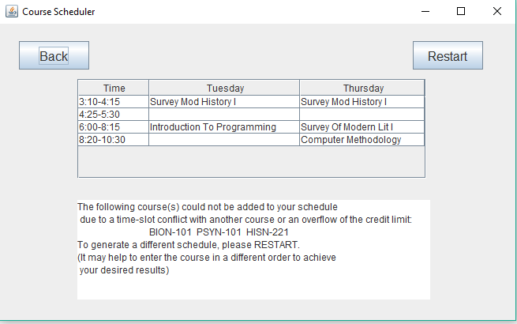
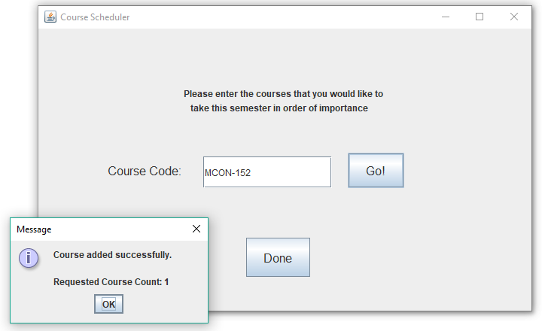
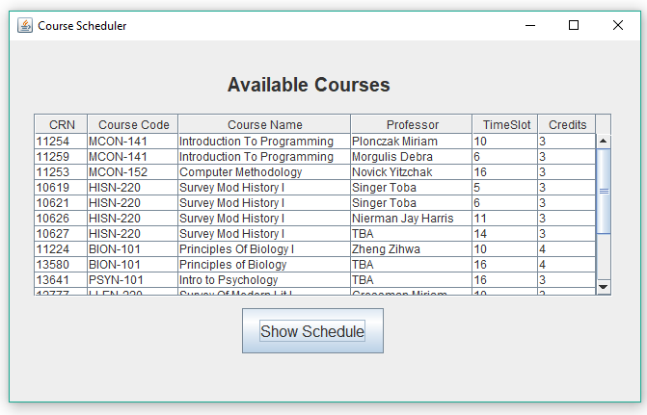
Results

Slide 15
Alternate Features
Room for Improvement:
Shuffle button for the schedule
Use a different algorithm for scheduling the Courses
Based on the time slot – if a course is given in a time slot that is unique, it should be added first to the schedule
Give the user a choice of which algorithm to use when generating the schedule
Cater to personal preference of professor and time slot
User Login - save settings, preferences, previous schedules
Connect user to others who are enrolled in the same courses

