Slide 1
Running Game
Ruth Davydov
Shterna Morosou

Slide 2

Have a spare minute? Try it out!
A simple and fun game in which the player must keep his character jumping up and down as obstacles head his way.
Features:
Your character actually simulates running
Only one tap to jump and avoid obstacles
The obstacles keep coming for as long as the game is running
Menu with adjustable settings, about page
How long can you keep on running before you need to catch your breath?

Slide 3
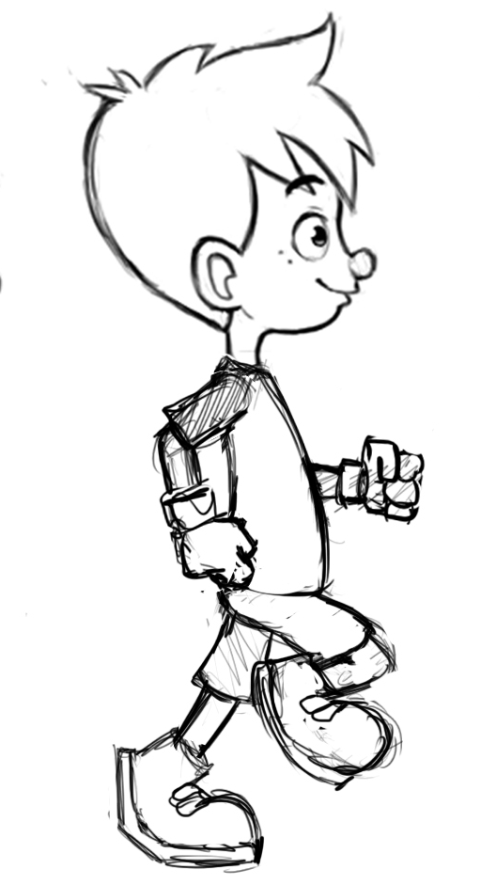

Meet The Characters:
Sticky:
The main character
Always overcoming obstacles…
Runs, jumps, crashes (try not to!)
Bricky:
The obstacle presented to Sticky
Spawns more of itself as game runs
Kills the game if crashed into

Slide 4
Structural Breakdown
For The Android Developer:
Activities:
GameActivity: Window in which the game plays. Sets fullscreen, title features, and MenuItem selection functionality.
MainActivity: Starting screen. Has toolbar, FAB to play, menu, background. This is the “intro page” to the game.
SettingsActivity: Allows for the customizable settings/features available in Running Game.
Classes:
BrickWallObject: Bricky! Contains logic for bricky’s simulation. Draws and updates Bricky’s movements to the screen.
GameObject: Abstract class game objects extend. Allows access to location on screen, and Bitmap creation methods.
GameSurface: Game as the player sees it. Contains logic for game creation, refresh, and Sticky jumping and crashing.
GameThread: The thread on which the game runs. Keeps the game canvas up to date and thread-safe.
StickFigureCharacter: Sticky McStickerson! This is where sticky’s running animation and movements are set up.
Utils: Utilities for use throughout the project. For all the dialogs/random actions that need to occur as the game runs.

Slide 5
