Slide 1
Video Processing
Session 07
Henry Lucky, S.Kom., M.Kom.

Slide 2
Learning Outcomes
Session 7
At the end of this session, students will be able to:
LO 2: Explain terms like machine learning, deep learning, neural networks, natural language processing, computer vision, speech recognition, etc.
LO 3: Use AI tools and platforms to perform various tasks such as content creation, assessment, feedback, etc.
LO 4: Evaluate the performance and limitations of AI systems and tools

Slide 3
outline
Session 7
Introduction to Video Processing
Object tracking
Video-based 3D data inference
Video restoration
Video generator

Slide 4
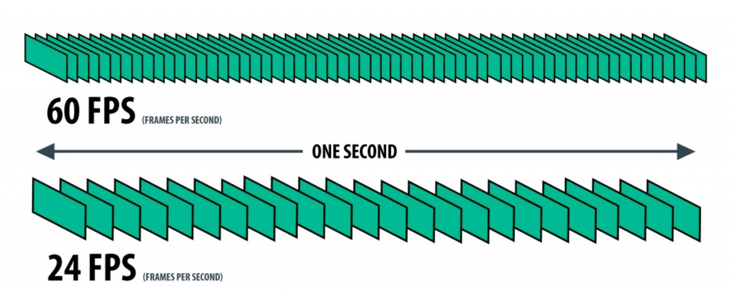
Introduction to video processing
definition
Video is a time-ordered sequence of frames presented at a frame rate (FPS). Audio may accompany the video, but it is not required.

Slide 5
LAB 1 | Frames and FPS
GOOGLE COLAB · INTRODUCTION
Observe
Compare 12 FPS, 24 FPS and 48 FPS using one animated scene.
Experiment
Change the frame rate. Keep the motion duration fixed. What changes visually?
Discuss
Does a higher FPS always mean better information or more accurate AI?
Notebook: Session_07_Video_Processing_Lab_2026.ipynb · Experiment 1
Notes:
Ask students to predict which video will appear smoothest before running the cells. Distinguish frame rate from video playback speed.

Slide 6
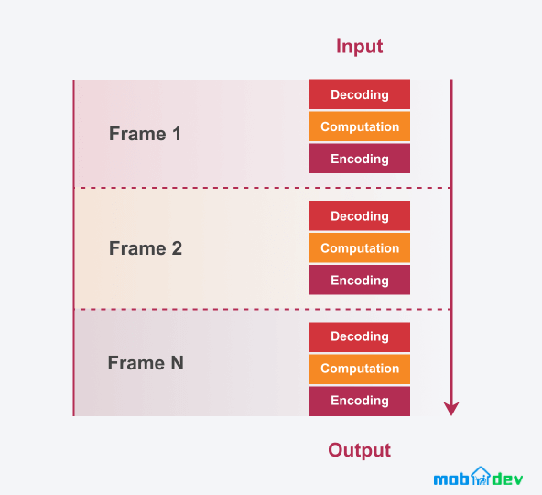
Introduction to video processing
definition
Video processing refers to the manipulation and analysis of video data to extract useful information, enhance quality, or generate new content.
Processing can operate on individual frames and across time. Tracking, optical flow, and video AI analyze motion or relationships between multiple frames.

Slide 7
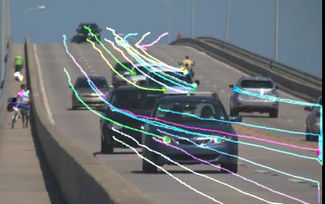
Object tracking
definition
Object tracking is a program that tracks detected objects as they move around frames in a video.
Object tracking also involves Object detection, however it also tracks the object instead of just detecting it.
Source: https://viso.ai/deep-learning/object-tracking/

Slide 8
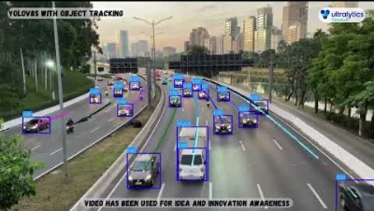
Object tracking
Historical example: YOLOv8 + SORT (still useful). Modern practice: YOLO + ByteTrack / BoT-SORT.

Slide 9
LAB 2 | Object Detection vs Tracking
GOOGLE COLAB · MULTI-OBJECT ANALYSIS
Detect
Bounding boxes identify objects in an individual frame.
Track
Persistent IDs link each object between frames. Test occlusions and crossings.
2026 stack
Three real demos in one notebook: Smart Traffic Monitoring, Drone Human Detection, and Smart CCTV. Optional upgrade: YOLO + ByteTrack / BoT-SORT.
Discussion: Why can an object ID change when two people cross?
Notes:
Students can first run the CPU-friendly synthetic scene. Then introduce Ultralytics modern tracker modes as an optional exercise.

Slide 10
GOOGLE COLAB DEMOS | THREE REAL-WORLD SCENARIOS
2026 CLASSROOM PACKAGE
A. Smart Traffic Monitoring
B. Drone Human Detection
C. Smart CCTV Analytics
Roadside or highway video with cars and motorcycles.
Aerial video to monitor hikers or people in open areas.
Static surveillance video for people counting and flow analysis.
Detect vehicles
Detect people from above
Detect moving pedestrians
Track IDs across frames
Estimate crowd size
Count entry/exit
Count line crossing
Track movement paths
Estimate occupancy
Discuss accuracy in congestion
Discuss tiny-object challenges
Discuss privacy and consent
Teaching strategy: use Traffic as the easiest demo, Drone as the most challenging, and CCTV as the most relatable to daily life.
Notes:
Introduce all three demos here. Ask students which one they want to try first and why.

Slide 11
DEMO A | SMART TRAFFIC MONITORING
OBJECT DETECTION + TRACKING + COUNTING
How the demo works
Student deliverables
Input video
A fixed roadside video with cars and motorcycles.
1 annotated output video
What students observe
Bounding boxes, object IDs, and vehicle counting when objects cross a virtual line.
1 screenshot of results
1 short explanation of errors
Minimum open-source stack
OpenCV baseline for motion + optional YOLO and ByteTrack for stronger results.
1 idea for improvement
1 ethics note
Discussion prompt
How do rain, shadows, traffic jams, and overlapping vehicles affect detection and counting?
Suggested class flow:
run demo → inspect errors → discuss improvements
Best first demo because the targets are large and visually easy to follow.
Notes:
Best first demo because the targets are large and visually easy to follow.

Slide 12
DEMO B | DRONE HUMAN DETECTION
AERIAL VISION FOR SAFETY MONITORING
How the demo works
Student deliverables
Input video
A drone video over a hiking path, open field, or disaster area.
1 annotated output video
What students observe
People often appear small, move irregularly, and may be partially occluded by vegetation.
1 screenshot of results
1 short explanation of errors
Minimum open-source stack
Classroom-tested: YOLOv8s (person class) + ByteTrack; HOG failed on aerial people.
1 idea for improvement
1 ethics note
Discussion prompt
Why is drone human detection harder than traffic monitoring even when the code looks similar?
Suggested class flow:
run demo → inspect errors → discuss improvements
Connect this slide to mountain safety, SAR, and disaster-response applications.
Notes:
Connect this slide to mountain safety, SAR, and disaster-response applications.

Slide 13
DEMO C | SMART CCTV ANALYTICS
PEOPLE COUNTING AND OCCUPANCY FLOW
How the demo works
Student deliverables
Input video
A hallway, gate, lobby, or public-area CCTV clip from a fixed camera.
1 annotated output video
What students observe
Pedestrian detection, ID tracking, entry/exit counting, and simple occupancy estimation.
1 screenshot of results
1 short explanation of errors
Minimum open-source stack
Classroom-tested: YOLO + ByteTrack with a virtual crossing line and event log.
1 idea for improvement
1 ethics note
Discussion prompt
How can we balance security benefits with privacy, consent, and responsible data usage?
Suggested class flow:
run demo → inspect errors → discuss improvements
This is the most relatable scenario because students can imagine campus, mall, and office environments.
Notes:
This is the most relatable scenario because students can imagine campus, mall, and office environments.

Slide 14
FROM THEORY TO REAL VIDEO AI
THREE CLASSROOM DEMOS · GOOGLE COLAB
DEMO A | SMART TRAFFIC
Upload traffic MP4 → detect motion → track moving objects → crossing estimate.
OpenCV baseline; no verified vehicle-specific YOLO results yet.
DEMO B | DRONE HUMAN DETECTION
Upload aerial MP4 → YOLO person detection → ByteTrack IDs → annotated video and detection chart.
Tested on a real aerial crowd video.
DEMO C | SMART CCTV ANALYTICS
Load surveillance sample → YOLO + ByteTrack → virtual vertical line → event CSV and graphs.
Tested on OpenCV pedestrian footage.
Notes:
Do not represent the traffic baseline as a trained vehicle classifier. Explain three scenarios and what has actually been run in class.

Slide 15
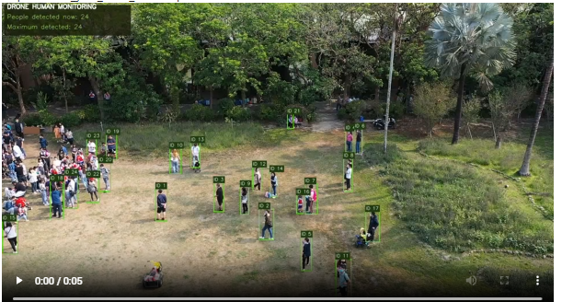
DEMO B | DRONE HUMAN DETECTION
ACTUAL COLAB OUTPUT · YOLO + BYTETRACK
35 MAX DETECTIONS
Maximum number of person detections in a single frame.
26.6 AVERAGE
Average detections per frame across 300 processed frames.
63 TRACK IDs
Not a verified number of unique people. IDs can be reassigned.
Observed improvement: HOG detected 0; YOLO detected people in the same aerial scene.
Notes:
Show original HOG output first. Then contrast with YOLO output. Ask why small aerial targets and crowd occlusion challenge detection. 63 IDs does not equal 63 people.

Slide 16
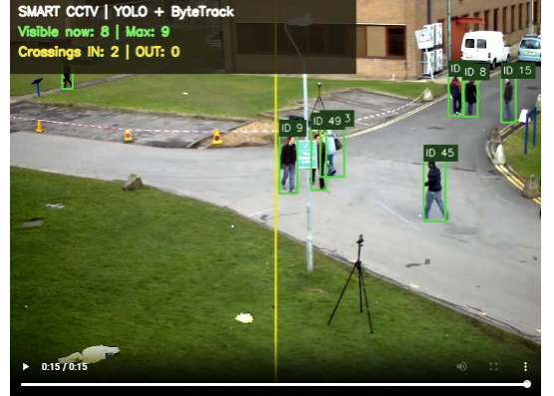
DEMO C | SMART CCTV
ACTUAL COLAB OUTPUT · VERTICAL CROSSING LINE
2 IN / 0 OUT
Detected crossing events in the tested 150-frame clip.
9 MAX / 5.7 AVG
Person detections per frame; the maximum is simultaneous detections.
16 OBSERVED IDs
Tracker IDs are not unique-person counts. Count events need manual checks.
Crossing events ≠ people inside the area (occupancy).
Notes:
Play full clip: start display is zero; cumulative IN reaches 2 at the end. Remind that no OUT event can reflect clip direction and boundary choice; not necessarily a model failure.

Slide 17
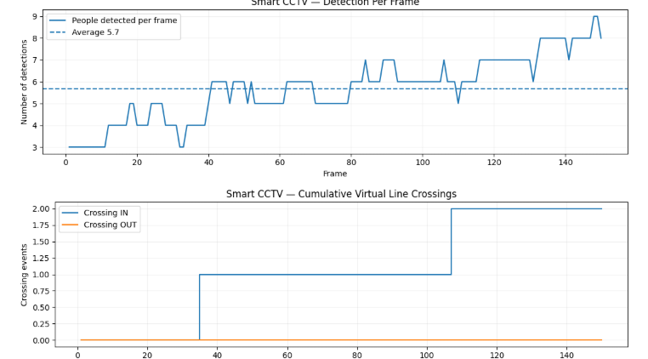
READ THE CCTV GRAPHS
DETECTIONS ARE NOT THE SAME AS CROSSING COUNTS
DETECTION CURVE
How many people were detected in each frame? Why can this change without people entering?
CUMULATIVE EVENTS
Crossings grow stepwise at observed boundary events: 2 IN, 0 OUT.
INTERPRET CAREFULLY
Compare with manual viewing; false crossings, ID switches, and missed people are possible.
Notes:
Ask students to distinguish count per frame from event count and evaluate cases around frames with cumulative jumps.

Slide 18
READY-TO-RUN COLAB WORKFLOW
STUDENT PRACTICE · NO PAID DESKTOP EDITOR
01 PREPARE
Open the appropriate notebook; enable GPU for YOLO if available.
02 INPUT
Traffic: upload MP4. Drone: upload aerial MP4. CCTV: load vtest sample or upload MP4.
03 ANALYZE
Run detection and tracking. Select line location and counting direction where applicable.
04 EVALUATE
Compare annotated MP4, per-frame graph, crossing log CSV, and manual observations.
Notes:
For each notebook use Runtime > Run all. For student group exercise allow 10 to 20 seconds clip per group. Video sources must be appropriately licensed or consented.

Slide 19
STUDENT CHALLENGE | EVALUATE AI
GROUP DISCUSSION · 15 MINUTES
A. TRAFFIC
Why does foreground motion detection not classify cars vs motorcycles? What changes with YOLO?
B. DRONE
Why did HOG miss visible people? What happens if the camera moves or the person is tiny?
C. CCTV
Manually verify 2 IN / 0 OUT. Does a crossing event prove a person entered a building?
REPORT
Give one screenshot, one failure case, one useful metric, and one privacy/ethics risk.
Notes:
Answer key: motion masks detect changing pixels rather than semantic classes; aerial HOG detector does not generalize to bird-eye small people; crossing counts depend on position and orientation of line; occupancy requires a defined area and initial population.

Slide 20
Video-based 3d data inference
definition
Video-based 3D data inference refers to the process of using video footage to derive three-dimensional information about objects, scenes, or environments captured in the video.
There are some tasks which are the key aspect of it:
  3D Scene Understanding: Interpreting the 3D structure of a scene to understand the spatial relationships between objects, the layout of the environment, and the context within which actions occur.
  3D Reconstruction: Transforming 2D video frames into a 3D model of the environment or objects.

Slide 21
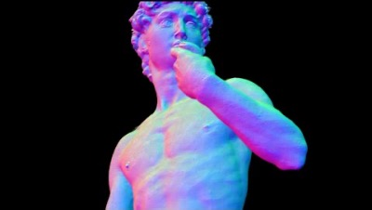
Video-based 3d data inference
3D Reconstruction from Video: Neuralangelo (2023) as a research milestone
More info: Li et al (2023). Neuralangelo. https://research.nvidia.com/labs/dir/neuralangelo/

Slide 22
LAB 3 | Motion vs 3D Reconstruction
GOOGLE COLAB · 3D REASONING
Try optical flow
Plot apparent motion vectors across consecutive frames.
Understand the limitation
Optical flow measures image motion; it does not directly provide metric 3D depth.
Explore modern approaches
Multi-view geometry / SfM, monocular depth, NeRF and 3D Gaussian Splatting.
Challenge: Which additional observations help recover depth?
Notes:
Do not claim optical flow is 3D reconstruction. Explain camera calibration, parallax and scale ambiguity.

Slide 23
Video restoration
definition
Video restoration involves improving the quality of old, damaged, or degraded video footage.
This process can include removing noise, correcting colors, repairing damaged frames, and enhancing overall clarity and sharpness.
Video restoration can be applied to historical footage, damaged recordings, or any video that requires quality enhancement.
Software examples:
Examples: Adobe Premiere Pro / DaVinci Resolve Studio (commercial features vary). Free lab: Python + OpenCV.

Slide 24
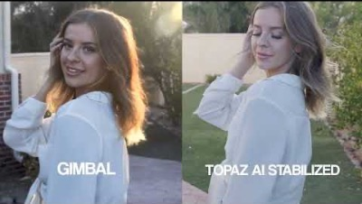
Video restoration
Historical commercial example: Topaz Video AI. In Colab: denoising, contrast and sharpening with OpenCV.

Slide 25
LAB 4 | Restore a Degraded Video
GOOGLE COLAB · OPENCV
Create a test
Add image noise, reduced brightness and blur to frames.
Improve
Apply denoising, contrast adjustment and controlled sharpening.
Evaluate
Compare before/after and identify artifacts. Sharper is not always more accurate.
No paid video editor required · OpenCV + NumPy
Notes:
Have students discuss hallucination risks: enhancement cannot guarantee restoration of lost details.

Slide 26
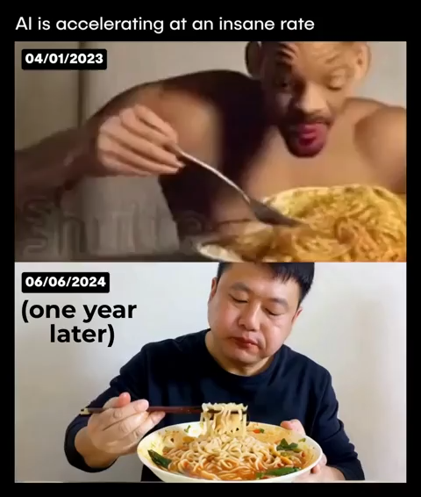
Video generation
Definition & examples
Video generation is a program to generate video automatically using text or image as input.
Here, we have a joke video comparison
The first video is made using ModelSpace: https://huggingface.co/spaces/ali-vilab/modelscope-text-to-video-synthesis (You can try inputting “Will smith eating spaghetti)
Meanwhile the second one is made using Sora by OpenAI.
Notes:
Note that despite the comparison, the video of Will Smith eating spaghetti did not represent the state of the art in text-to-video synthesis at the time of its creation in March 2023 (that title would likely apply to Runway's Gen-2: https://research.runwayml.com/gen2, which was then in closed testing). However, the spaghetti video was reasonably advanced for open weights models at the time, having used the ModelScope AI model. More capable video synthesis models had already been released at that time, but due to the humorous cultural reference, it's arguably more fun to compare today's AI video synthesis to Will Smith grotesquely eating spaghetti than to teddy bears washing dishes (https://arstechnica.com/information-technology/2022/10/googles-newest-ai-generator-creates-hd-video-from-text-prompts/)
Source: https://arstechnica.com/information-technology/2024/02/will-smith-parodies-viral-ai-generated-video-by-actually-eating-spaghetti/

Slide 27
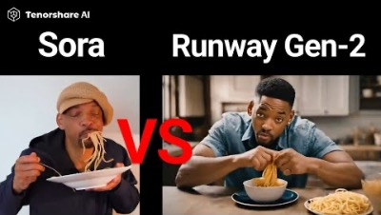
Video Generation
Historical comparison (2023–2024): Runway Gen-2 vs Sora. These are NOT current product benchmarks.

Slide 28
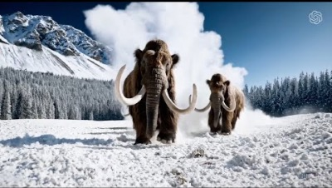
Video generation
Sora video example (historical). Product discontinued April 26, 2026.

Slide 29
VIDEO GENERATION | 2026 Landscape
HISTORICAL MILESTONES → NEWER MODELS
Historical references
ModelScope (2023), Runway Gen-2, early Sora examples, Stable Video Diffusion.
2026 examples
Google Veo 3.1 and newer Runway models illustrate progress in controllability and realism.
Access and provenance
Services vary by geography, quota and price. Evaluate audio, temporal consistency, consent and provenance.
Sora product was discontinued on April 26, 2026 · Historical slides retained
Notes:
Avoid presenting older examples as the current state of the art; highlight changing product availability.

Slide 30
Video generation
Stability demo
Outdated statement removed. By 2026, several advanced video-generation models have been released; access, pricing, and limits vary.
Stable Video Diffusion remains useful as a research example, but may require substantial GPU memory.
Historical demo links (availability may change):
  https://huggingface.co/spaces/Kvikontent/Stable-Video-Diffusion-Img2Vid
  https://huggingface.co/spaces/multimodalart/stable-video-diffusion

Slide 31
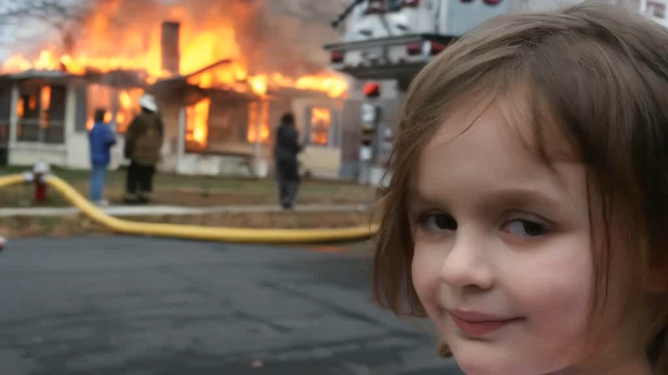
Video generation
Stability demo
Historical image-to-video example (“Disaster Girl”). Discussion: motion realism, consistency, provenance and consent.

Slide 32
LAB 5 | Generate and Evaluate Video
GOOGLE COLAB · ANIMATION VS GENERATIVE AI
Hands-on (CPU)
Generate a short animation with Python; modify movement, color and duration.
Conceptual comparison
Procedural video synthesis follows code rules; text-to-video models learn complex visual patterns.
Critical thinking
Evaluate temporal consistency, unrealistic physics, copyright, deepfakes and disclosure.
The CPU exercise is NOT a text-to-video diffusion model.
Notes:
Ask students to distinguish procedural frames from generative video model outputs.

Slide 33
References
Session 7
Raymond S. T. Lee. 2020. Artificial Intelligence in Daily Life. Springer. China. ISBN 9789811576959
Richard Szeliski. Computer Vision: Algorithms and Applications, 2nd ed.

Slide 34
2026 Sources and Student Challenge
REFERENCE LINKS · CLOSING DISCUSSION
Documentation
Ultralytics tracking: docs.ultralytics.com/modes/track | OpenCV: docs.opencv.org
Modern video AI
Google Veo 3.1: blog.google (Jan 2026) | Runway: runwayml.com
Group challenge
Choose traffic, campus security or disaster response. Propose a video pipeline, metrics and ethical safeguards.
Further reading: Szeliski (Computer Vision, 2nd ed.); NVIDIA Neuralangelo (2023).
Notes:
Groups should explain input video, FPS, detector/tracker, computation, output and limits.

