Slide 1
ELEVENLABS TRACK / MISSISSAUGA
Who gets
heard by voice AI?
Measured speech gaps, where affected language communities live,
and a Cantonese callback prototype.
FLEURS • CENSUS • 311 • ELEVENLABS
Findings snapshot | November 2026
Exploratory analysis; not a resident-level failure estimate.
01

Slide 2
THE SIGNAL
A measurable gap—and a clear caveat
All 14 FLEURS language groups were processed; request-audio coverage is shown separately.
26.43%
10,765
989 / 2,653
Highest mean FLEURS CER
Cantonese home-language speakers
Clips transcribed
Cantonese • 40 clips
2021 census count
Cached Scribe results across the inventory
What we can say Cantonese has the highest CER in the completed FLEURS sample.
What we cannot say That 26% of Cantonese callers—or 10,765 residents—will be misunderstood.
Why FLEURS is read speech, with unmatched prompts and no speaker IDs; service-request audio is missing.
Sources: outputs/asr_summary.csv; 2021 census-derived language counts; outputs/REPORT.md.
02

Slide 3
01 / UNDERSTOOD?
Cantonese and Urdu stand out on CER
Mean character error rate across 40 FLEURS clips per language; lower is better.
Cantonese
26.43%
Read this carefully
Urdu
20.59%
Punjabi
8.25%
Mandarin and Cantonese WER is near 100% because word boundaries/tokenization differ.
CER is more informative here. Cantonese also has the highest CER, not just a WER artifact.
FLEURS is read speech—not live 311 calls.
Hindi
6.76%
Mandarin Chinese
2.94%
Tamil
2.62%
Gujarati
1.73%
Portuguese
1.67%
Accent Archive: 419/468 English-accent clips processed.
Matched prompt ID 1589: one clip per language. It controls text, not speaker, gender, or dialect.
Source: outputs/asr_summary.csv and outputs/paired_fleurs_summary.csv; normalized CER/WER.
03

Slide 4
02 / WHO AND WHERE?
Cantonese speakers are present across the city
The census identifies potential reach for better language access—not individual outcomes.
10,765
Largest ward counts
Largest neighbourhood counts
citywide Cantonese speakers
Ward 6
2,520
East Credit
2,225
Ward 5
1,270
Hurontario
1,520
Ward 4
1,125
Central Erin Mills
1,095
Ward 8
1,105
Churchill Meadows
905
Ward 11
1,095
DT Core
630
Counts are home-language speakers and may overlap with other language counts.
Source: 01_people_census/derived/geo_language_long.csv (corrected derived geography).
04

Slide 5
03 / ROUTED?
Transcription is only one part of understanding
The request-audio corpora are banking and voice-assistant data, not Mississauga 311 calls.
Audio → transcript → intent
Separate text-only baseline
MInDS-14
5 / 5 correct
MInDS-14
90.6–98.1%
Speech-MASSIVE
1 / 5 correct
Speech-MASSIVE
55.2–62.1%
Audio transcripts are classified against dataset labels. These remain banking and virtual-assistant tasks, not city services.
Classifier input is reference text—not Scribe audio output. Tasks are banking and virtual-assistant labels, not city services.
Design implication: confirm the interpreted request and offer a human/alternate-language fallback.
Sources: outputs/audio_intent_evaluation.csv; outputs/intent_evaluation.csv; sample sizes n=1 per audio language.
05

Slide 6
04 / WHERE TO PRIORITIZE?
The index points to places for follow-up
Higher scores combine language-group errors with census speaker counts; they are not failure probabilities.
Wards
Populated neighbourhoods
Index score
Cooksville (East)
25.4
Ward 10
23.1
Clarkson Village CN
24.8
Ward 7
21.6
Churchill Meadows
24.7
Ward 3
21.4
Sheridan CN
23.8
Ward 4
20.2
Streetsville CN
23.5
Ward 8
19.4
Ward 7 has the largest ward-level weighted-error proxy (4,133.6); index leaders differ from proxy-count leaders.
Source: outputs/unheard_index.csv; 50 geographies. Full FLEURS CER + limited audio-intent evidence.
06

Slide 7
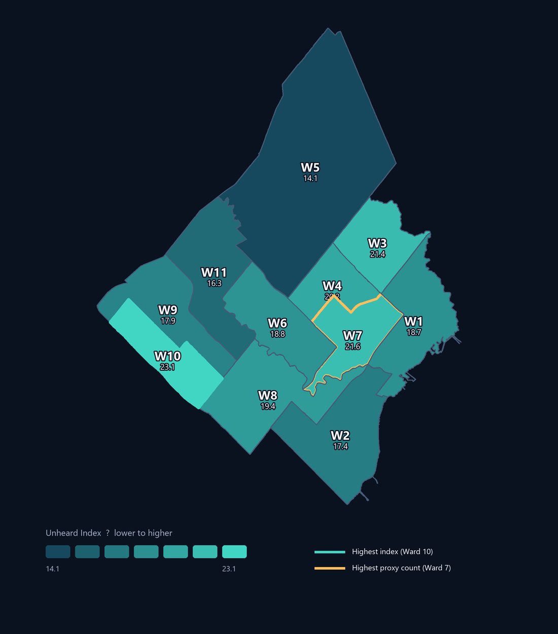
04 / WHERE TO PRIORITIZE?
A geographic view of the exploratory index
Ward boundaries with population-weighted benchmark signals; not observed caller failures.
23.096
4,133.6
Highest ward index
Largest proxy count
Ward 10 • 23.31% coverage
Ward 7 • not known failed calls
Neighbourhood signal
Cooksville (East) • index 25.449 • 11.96% coverage
Interpret with care
The index combines available FLEURS CER and pilot intent errors. The request-audio pilot has only one clip per language; scores are not service-level outcomes or resident-level risk.
Boundaries: City of Mississauga Ward Boundaries service. Scores: 2021 census-derived outputs/unheard_index.csv; verify boundary crosswalk.
07

Slide 8
05 / CLOSE THE LOOP
A Cantonese callback proof of concept
TTS gives the measured gap a tangible response—but it does not prove service effectiveness.
CANTONESE / TRADITIONAL CHARACTERS
Before any real use
你好，我哋收到你嘅請求。
1 Fluent Cantonese review of translation and pronunciation.
2 Test comprehension with community participants.
3 Keep human assistance available; TTS is not automatic translation.
“Hello, we received your request.”
Audio: outputs/311_callback_yue.mp3 • 39,749 bytes
Generated with ElevenLabs TTS voice available to this account. No comprehension study has been run.
08

Slide 9
NEXT STEPS
The evidence is useful—and still incomplete
The next phase should improve coverage before making service-level claims.
Remaining Scribe inventory
Recommended next
Accent Archive
49
01 Expand consented 311-style speech examples in missing languages.
02 Validate transcripts and routing with fluent speakers.
03 Test translation, callback comprehension, and human fallback.
04 Revisit geography scores with service-specific outcome evidence.
MInDS-14
1,045
Speech-MASSIVE
570
1,664 clips remain
Cached results are preserved for resume.
Treat these findings as a prioritization signal—not as a count of residents already misunderstood.
Detailed methods and caveats: outputs/REPORT.md • Original project README preserved.
09

