Slide 1


Top Football Clubs Website
A Comprehensive Platform for Football Enthusiasts
By David Frederick

Slide 2
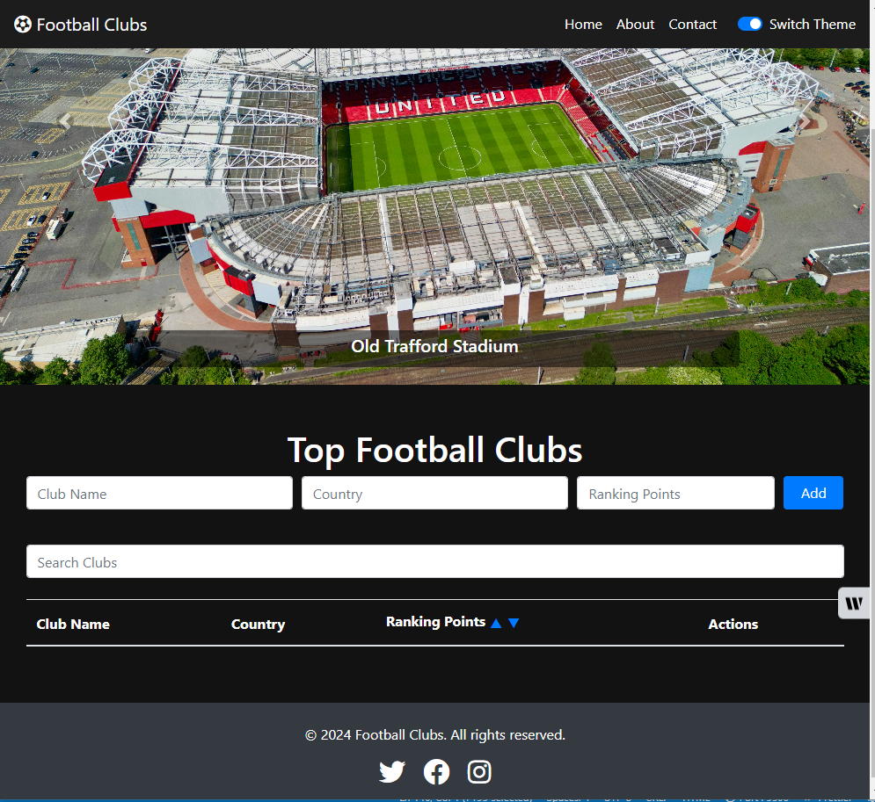
Introduction
Purpose: Ranking and information about top football clubs.
Audience: Football enthusiasts and researchers.
Navigation: Home (Football Clubs), About, and Contact pages.
Additional Features Theme toggle: Dark/Light theme preference.

Slide 3
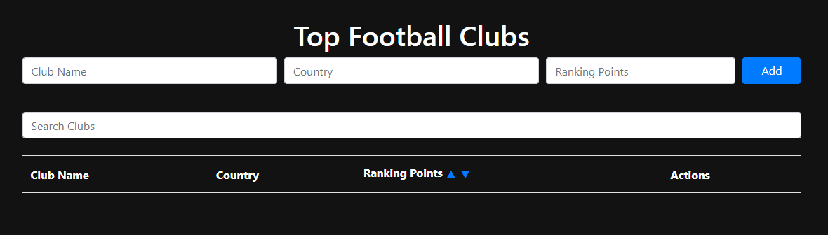
Main Features
Club Management: Add, delete, and search clubs functionality.
Dynamic Table: Displays club rankings, sortable by ranking points.

Slide 4
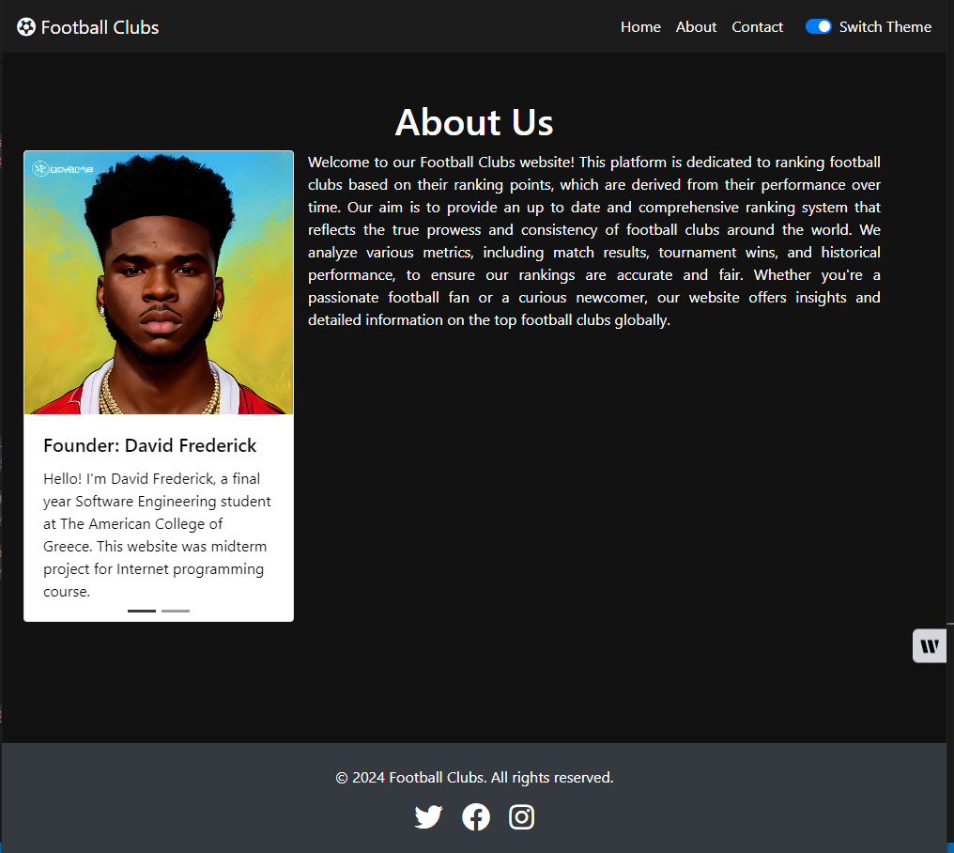
About Us
Team Introduction: David Frederick and ChatGPT.
About Us: Brief background and roles in website development.

Slide 5
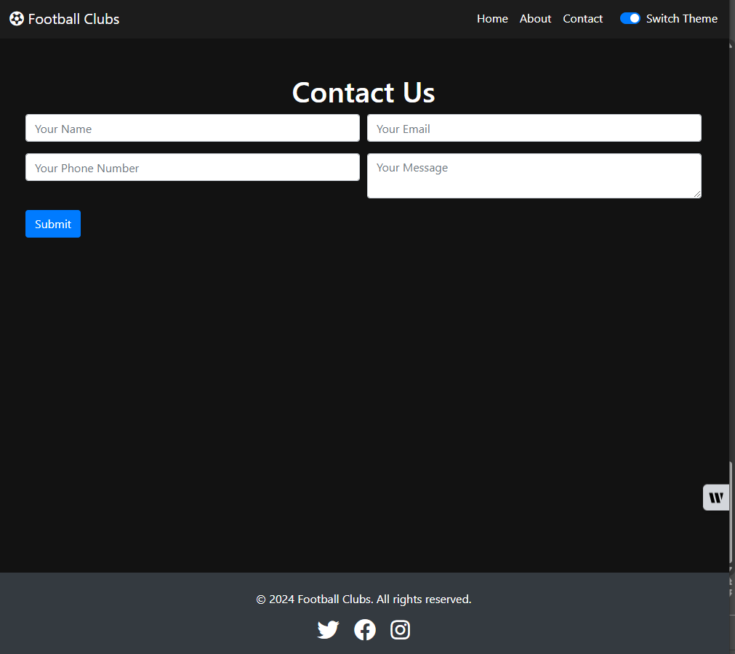
Contact
Contact Us: Easy-to-use form for inquiries and feedback.

Slide 6
Tools and GitHub Link
HTML and CSS
Bootstrap
Javascript (Jquery)
https://github.com/davystine/ITC4214-MidTerm

