Slide 1


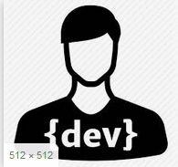
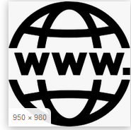
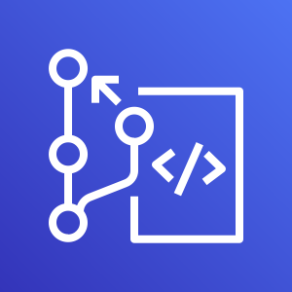



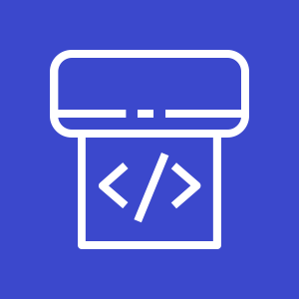


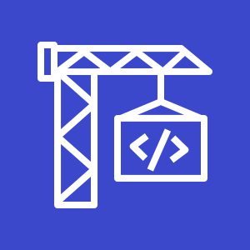
AWS Cloud
Terraform apply to launch following Infrastructure;
ECS Fargate Cluster
UMSL CodePipeline
Application load balancer
Elastic Container registry
Cloudwatch event rule and trigger
1 - Developer Pushed Code to CodeCommit
http://ALBUSML-1410632175.eu-west-1.elb.amazonaws.com:8081/services/UMSL/
2 Change to Repo is captured by Cloudwatch Event Rule and triggers pipeline.
AWS CodeCommit
Registry
AWS CodeCommit
Application Load Balancer
Image
Task
AWS CodePipeline
AWS CodeBuild
AWS CodeBuild
AWS CodeBuild
AWS Fargate
3 First stage of Pipeline is to pull in USML repo to codebuild
4 package Jar file and run tests, build docker image and push to ECR
5 Run Deploy.py to update the ECS server with latest Image
6 New task is registered behind ALB, old one removed.

