Slide 1
Problem and Goal
Context-aware bass stem generation
Task
Why this is hard
Input: mixture without bass
Condition: target instrument = bass
Output: generated bass stem
Audio must sound plausible
Bass must match rhythm, harmony, and structure
Limited compute: small faithful reproduction
Research question: can a small audio-token masked model reproduce the core StemGen idea?
StemGen reproduction | audio-token bass stem generation
1/4

Slide 2
Scaled-Down StemGen Pipeline
Context audio
mixture - bass
EnCodec tokens
24 kHz, 2 RVQ
Masked Transformer
predict target tokens
Decode audio
iterative mask-predict
Training setup
Engineering fixes
10-second clips; target = bass
Context = mixture minus bass
Mask ratio: 50% to 100%
Multi-codebook cross-entropy
Filter silent / weak-bass clips
Precompute token cache
Separate codec, partial-mask, full-mask diagnostics
StemGen reproduction | audio-token bass stem generation
2/4

Slide 3
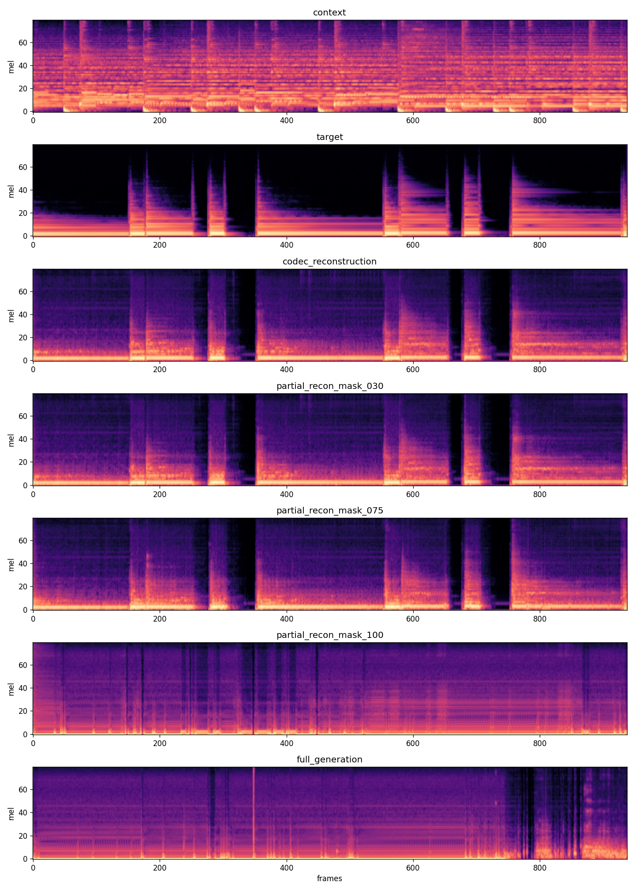
Results and Effectiveness
Quantitative improvement plus spectrogram evidence
Best validation results
550 cached: loss 3.4507, acc 0.521
1000 stride10: loss 3.0279, acc 0.572
Validation loss improved by ~12.3%
Why the result is meaningful
Partial-mask reconstruction follows target-like spectral blocks
Output is not only unstructured noise
Full 100% mask remains the bottleneck
Evidence shown at right
Full diagnostic mel-spectrogram: context, target, codec reconstruction, partial reconstructions, and full generation.
StemGen reproduction | audio-token bass stem generation
3/4

Slide 4
Findings and Next Steps
What worked
Main limitation
Output is no longer pure noise
Partial-mask reconstruction shows audible and spectral structure
Larger track coverage + less overlap improved validation metrics
Full 100% mask generation is still unstable
Model learns reconstruction better than full context-to-stem synthesis
Next steps
Improve full-mask decoding and mask schedule
Add classifier-free guidance / condition dropout
Standardize audio + spectrogram diagnostics
StemGen reproduction | audio-token bass stem generation
4/4

