Slide 1
Bayesian Hierarchical Modelling of Helium Signatures in Red Giant Stars
Joshua Cardrick
Partner: Dan Williams
Supervisor: Guy Davies

Slide 2
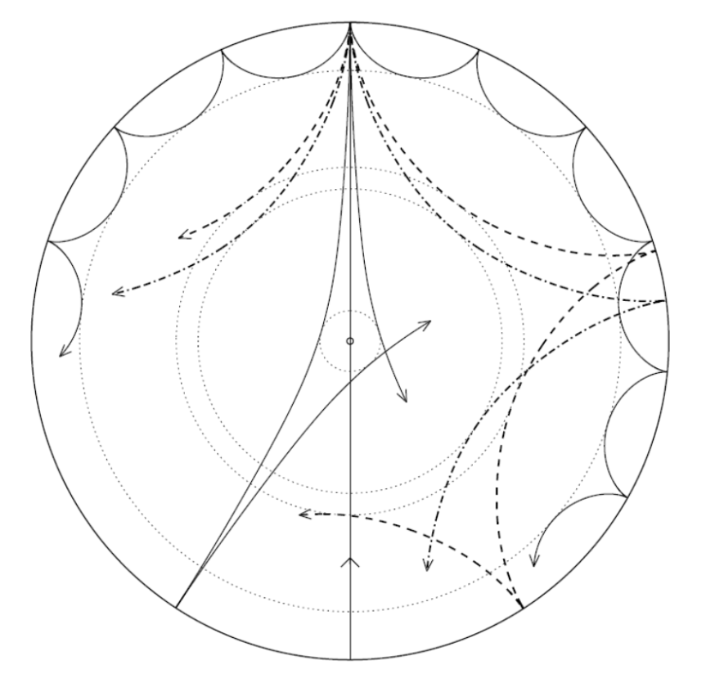
Context
Helium abundance
Asteroseismology
Helium Glitch
Notes:
2nd most abundant element,
amount of Helium is poorly understood,
since the big bang, enrichment in stars increased helium
modern asteroseismology techniques allow the probing of the internalcomp
Stars oscillate due to standing waves in the stellar interior
Pressure waves which in lower temp stars, propagate the envelope
HeII ionization zone causes a sharp deviation in composition
Which can be detected as a glitch in the oscillations

Slide 3
Data
Kepler data
1000+ stars

