Slide 1
Dynamic Adaptive Streaming for Multi-Viewpoint Omnidirectional Videos
Junpeng Qiu
jqiu6

Slide 2
Outline
Objectives & Motivation
Background Knowledge
Algorithm
Evaluation
Pros & cons
Suggestions
Conclusion
Q&A
References

Slide 3
Objective & Motivation
Objective: Streaming videos in Virtual Reality:
Conditions: multi-viewpoint choices & free head rotation
Study: quality of expiriece (QoE) & bandwidth under proactive/reactive stratiges
Streaming of omnidirectional video: bandwidth >> regular video
Current VR Streaming:
Only responding to head orientation
Not displacement involved
Degree of Freedom (dof): 3
Introducing displacement -> dof of 6, more immersive

Slide 4
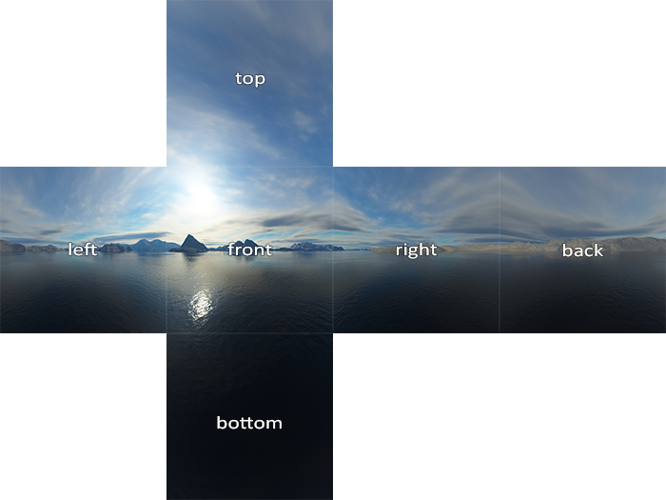
Background Knowledge
Tiling:
Segment each omnidirectional frame into pieces, i.e. tiles
Individually playable -> download tile(s) in view, not whole frame
Example: cubemap baseball layout

Slide 5
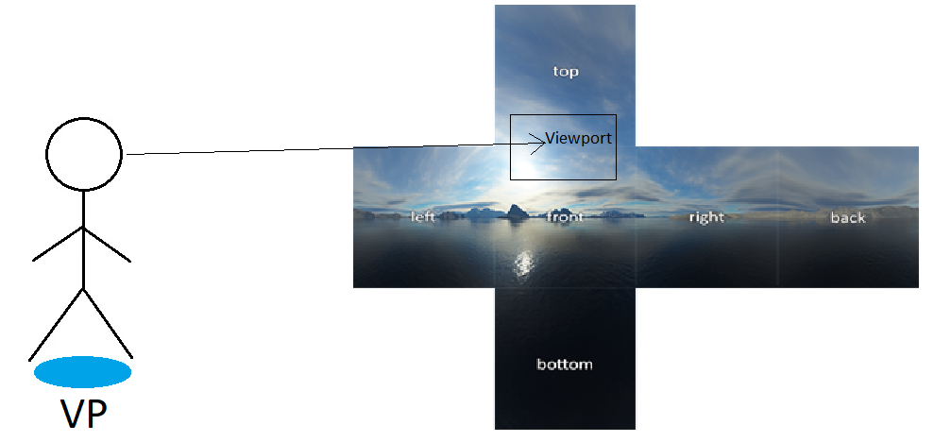
Background Knowledge
Viewport v.s. viewpoints (VP)
Viewport: viewed portion on the frame/tile(s)
VP: audience position within the VR world

Slide 6
Background Knowledge
QoE metrics:
Distortion:
Displayed v.s. original content for given viewport
Comparison Algorithms:
Peak Signal to Noise Ratio (PSNR): avg err of pixel intensity
Multiscale-Structural Similarity (MS-SSIM): structural similarity, range from 0 to 1
Stalls:
pause due to current frame/tile(s) unavailable, likely after unanticipated viewpoint switch
Viewpoint Switching Lag:
Times cost to execute viewpoint switch command: can only switch when viewports available to display in such VP

Slide 7
Background Knowledge
Bit-rate & quality
Higher quality requires higher bit-rate
Server stores frames/tile(s) in multiple quality
Switch VP or tile(s):
Immediately provide lower quality streaming to catch up
Stable: switching to higher quality

Slide 8
Background Knowledge
Predict
Network condition in next sec
VP switch
Head orientation
For deciding downloading representations at certain
Quality
Time segment
VP
Frame/tile(s)

Slide 9
Background Knowledge
Only 2 extreme cases studied:
Proactive strategies:
Download representation of current quality and frame/tile(s) at all VP for future segment
Reactive strategies:
Only download future segment for current VP until commanding VP switch

Slide 10

Algorithm
Notations:
$q$: quality
$v$: VP
$τ$: tile
$r_{i,q,v,τ}$: representation at segment i, quality q, VP v, and tile $τ$
$b_{i,q,v,τ}$: bit-rate for downloading $r_{i,q,v,τ}$
$d_{i,j,q,v,τ}$: downloaded ration of $r_{i,q,v,τ}$ at time segment j
$s_{j}$: number of segments waited for downloading segment j
$S_{j}$: whether stall occurred at segment j

Slide 11

Algorithm
Binary variables:
$x_{i,q,v,τ}$: if user wants $r_{i,q,v,τ}$
$y_{i,v}$: if user wants to switch to VP at v in time segment I
Average distortion:
$Q_{i,q,v,τ}$: actual v.s. displayed $r_{i,q,v,τ}$
Multiple tiles can be within a viewport:
Weighted avg of distortion, weight: portion of tile(s) within the viewport $V_{i},τ$
$Q_{i}={\sum_{v,τ}{V}}_{i}∙(\sum_{q}{(x_{i,q,v,τ}∙Q_{i,q,v,τ})})$

Slide 12
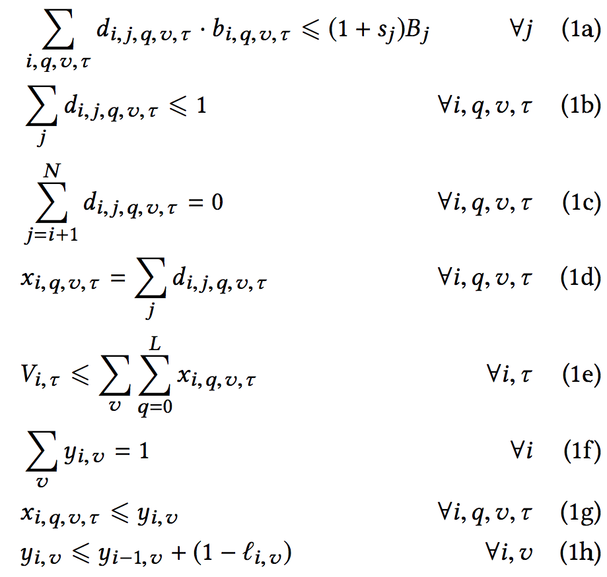

Algorithm
Quantify QoE:
$min\left\{x_{i,q,v,τ}\right\}\sum_{i}{\left(Q_{i}+β∙l_{i,v}∙y_{i,v}\right)}+α\sum_{j}{(s_{j}+S_{j})}$
$α$ and $β$ are constants that will be evaluated later
Conditions:

Slide 13
Algorithm
Bandwidth constraints
Same representation at most download once (redundant)
No downloading past deadline
Only fully downloaded representation can be displayed, summation of d is confined to 0 or 100%
Force to display one available r when tile visible in i
1 and only 1 VP is selected in any i
Certain representation can only be displayed if in VP v
Representation can be from previous segment

Slide 14
Algorithm

