Slide 1



NETFLIX DATA ANALYTICS PROJECT
AN END-TO-END DATA ANALYSIS USING PYTHON, SQL, POWER BI & TABLEAU
By Daweep Kaur
TOOLS & TECHNOLOGIES
Python (Pandas, Matplotlib) | SQL | Power BI | Tableau | Excel
FOCUS AREAS
Content Trends • Genre Analysis • Country-wise Production • Growth Over Time
Portfolio Project | 2026

Slide 2


PROJECT OBJECTIVE
To analyze Netflix’s global content library using data analytics techniques and uncover key insights related to:
• Content type distribution (Movies vs TV Shows)
• Country-wise content trends
• Genre distribution
• IMDb ratings & popularity trends
TOOLS USED
Python | Pandas | SQL | Power BI | Tableau | Excel

Slide 3
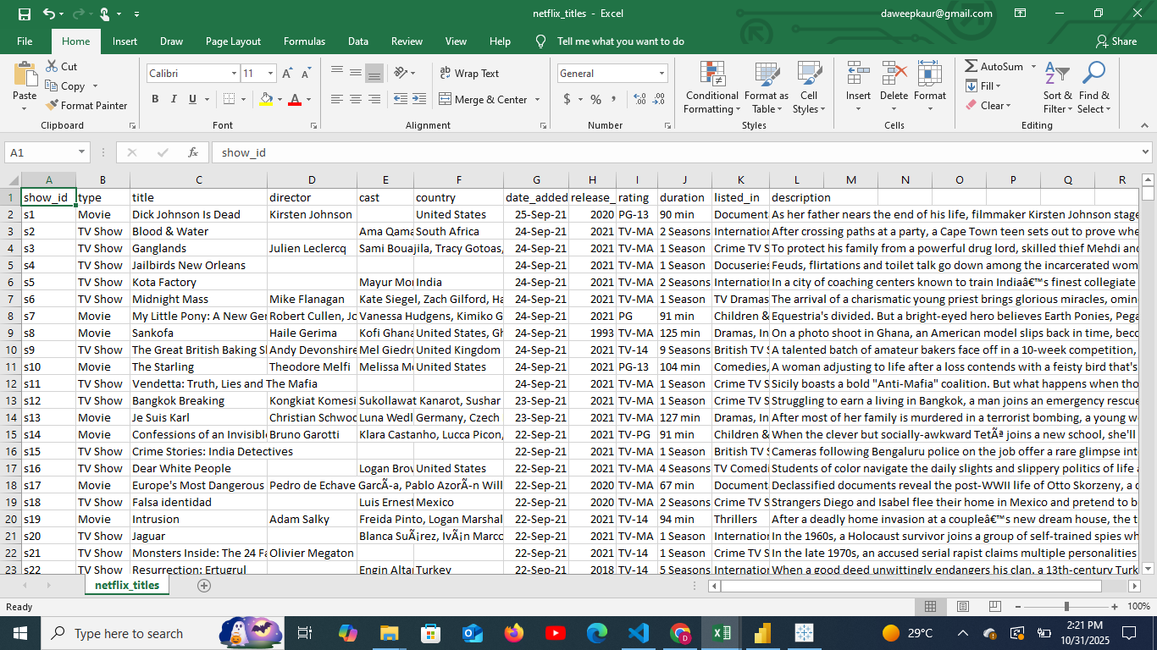
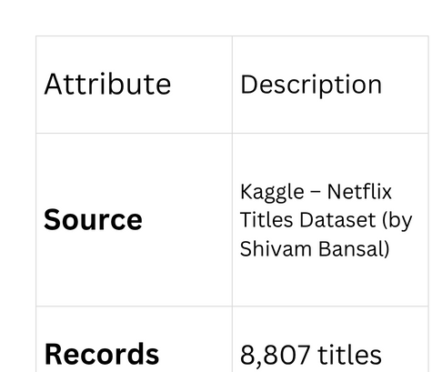
📊 DATASET DETAILS
Snapshot of the Original Netflix Titles Dataset containing 8,807 records and 12 attributes.
Workflow
netflix_titles.csv → netflix_cleaned.csv → netflix_enriched.csv

Slide 4
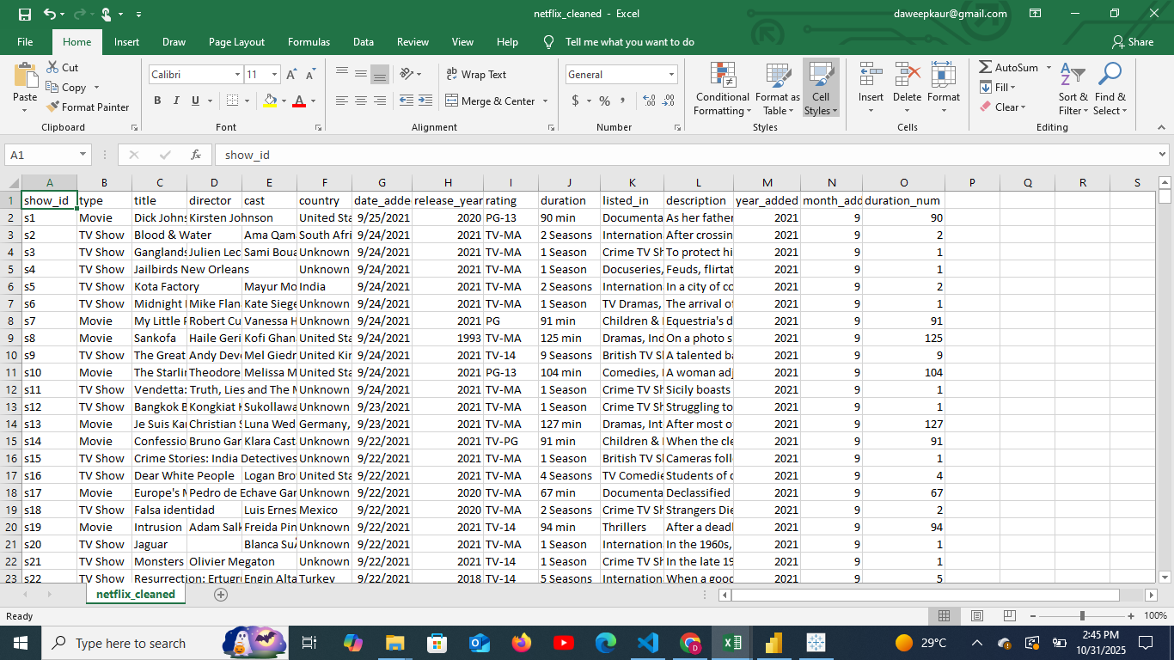
DATA CLEANING PROCESS
  Removed duplicates and handled missing values (e.g., Unknown filled for missing countries).
  Standardized date formats in date_added.
  Extracted year_added and month_added columns.
  Converted durations (like “90 min”, “2 Seasons”) into numeric values (duration_num).
  Exported the cleaned dataset → netflix_cleaned.csv
  Libraries: Pandas, NumPy
Cleaned Netflix Dataset after preprocessing and feature extraction.

Slide 5
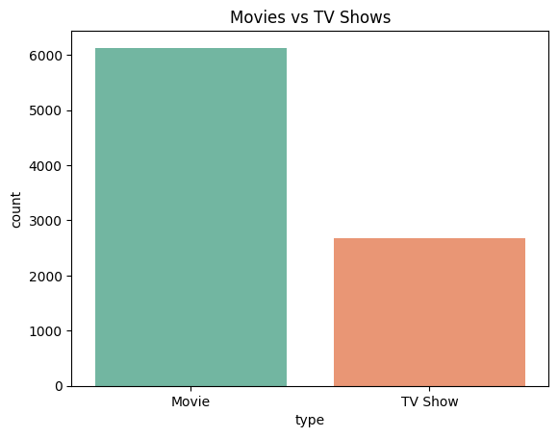
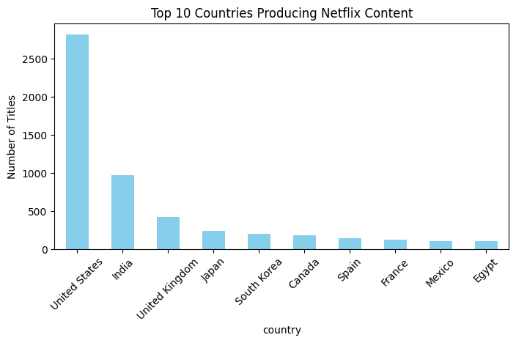
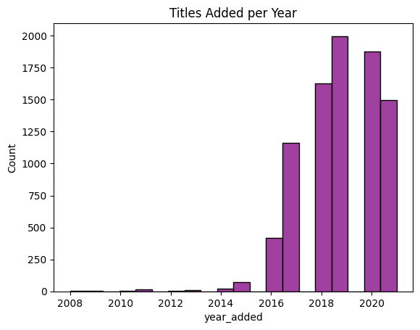
📈 EXPLORATORY DATA ANALYSIS (EDA)
🎨Visuals Performed:
  Movies vs TV Shows
  Top 10 Countries
  Titles Added per Year
📊 Findings:
  Netflix has more movies than TV shows
  USA, India, UK dominate
  Content growth accelerated post-2015

Slide 6

🌍 WEB SCRAPING & IMDB RATINGS ENRICHMENT
  Used OMDb API to fetch IMDb ratings
  Added new column → imdb_rating
  Enriched dataset saved as → netflix_enriched.csv
  Tools: Requests, Dotenv, Pandas
Enrich Netflix data with IMDb ratings

Slide 7
SQL ANALYSIS
Database Used: SQLite
Queries Performed:
SELECT type, COUNT(*) FROM netflix GROUP BY type;
Output:
type total
Movie 127
TV Show 73
Process Overview:
🗄️ Connected to SQLite database (netflix.db)
📥 Imported enriched dataset → created netflix table
💻 Executed SQL query to group content by type
📊 Retrieved results directly into Python DataFrame

Slide 8
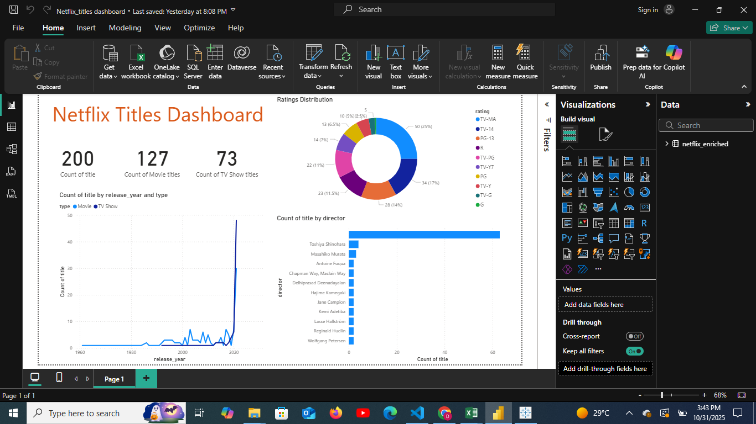
POWER BI DASHBOARD
VISUALS:
  CARDS: TOTAL TITLES, MOVIES, TV SHOWS
  LINE CHART: TITLES ADDED PER YEAR
  BAR CHART:COUNT OF TITLE BY DIRECTOR
  PIE CHART: RATINGS DISTRIBUTION
  📂 FILE: /DASHBOARDS/NETFLIX_DASHBOARD.PBIX

Slide 9
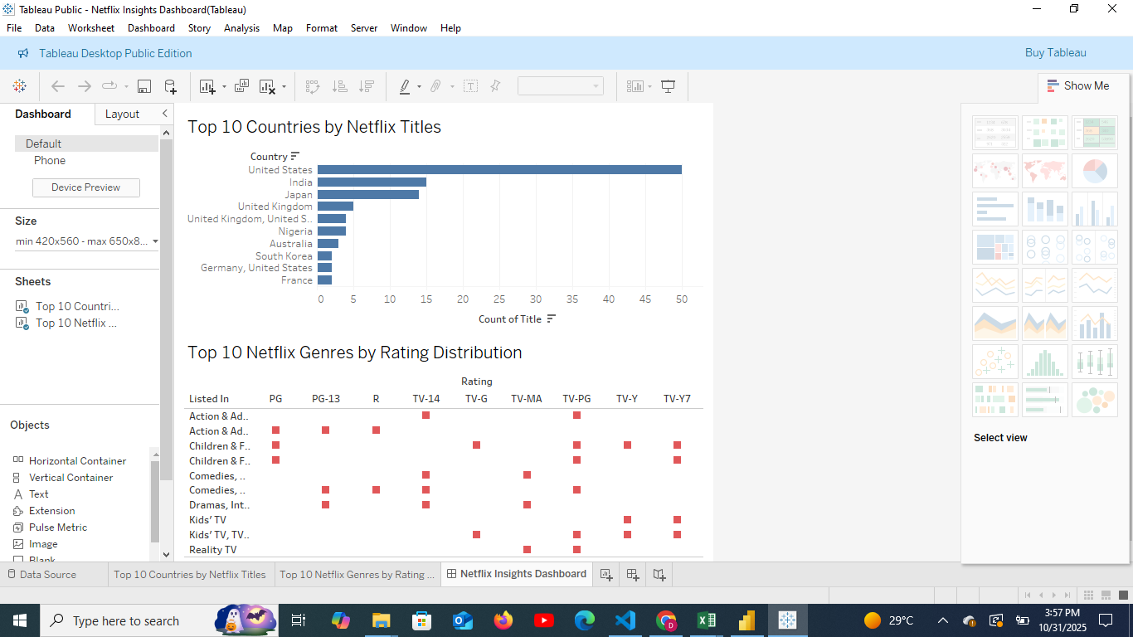
TABLEAU DASHBOARD
VISUALS:
  BAR CHART: TOP 10 COUNTRIES BY TITLES
  HEATMAP: GENRE VS RATING DISTRIBUTION
  📂 FILE: /DASHBOARDS/NETFLIX_TABLEAU.TWBX

Slide 10
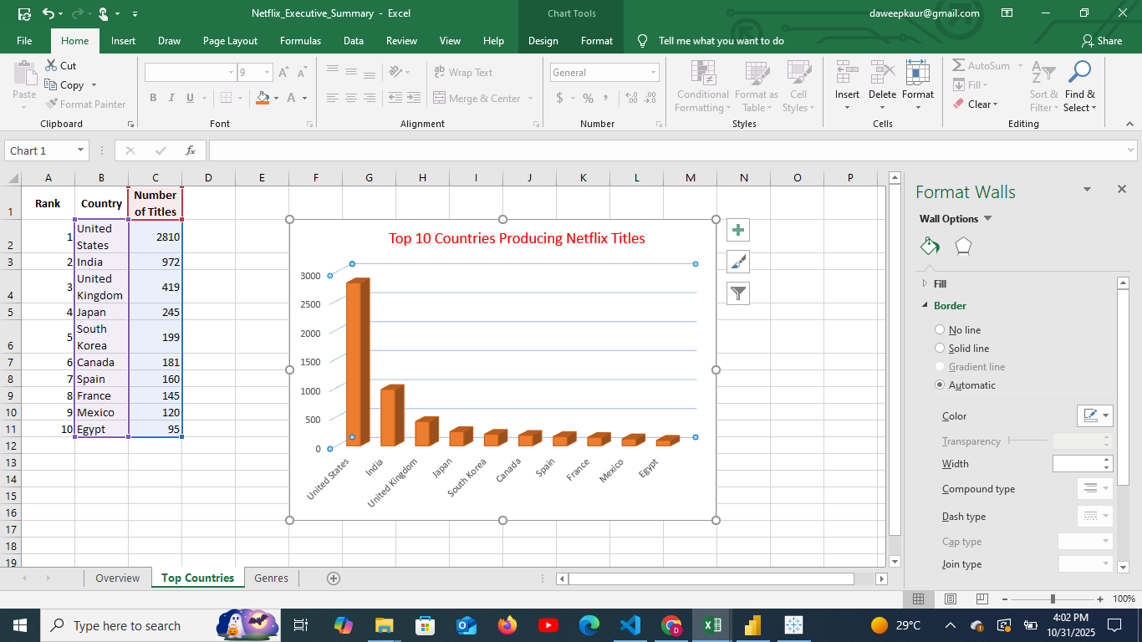
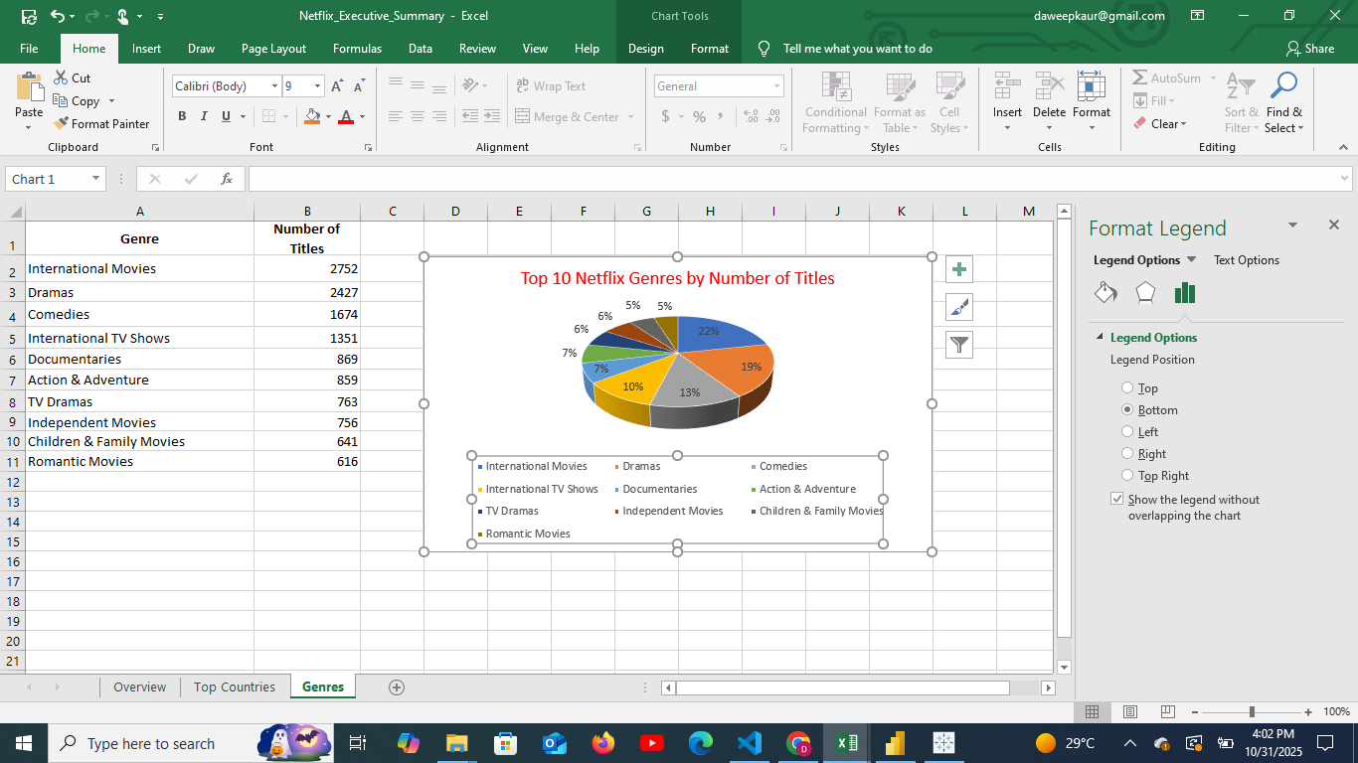
EXCEL EXECUTIVE SUMMARY
SHEETS INCLUDED:
1. OVERVIEW – TOTAL TITLES AND TYPE COUNT
2. TOP COUNTRIES – BAR CHART VISUALIZATION
3. GENRES – PIE CHART VISUALIZATION
📂 FILE: /REPORTS/NETFLIX_EXECUTIVE_SUMMARY.XLSX

Slide 11
💡 KEY INSIGHTS FROM THE ANALYSIS
Movies dominate Netflix’s catalog, accounting for nearly 70% of total titles, while TV Shows form the remaining 30%, showing a clear preference toward film content
USA, India, and the UK lead as the top content-producing countries, reflecting Netflix’s global partnerships and regional expansion strategy.
Dramas and Comedies are the most common genres, indicating viewer interest in story-driven and light-entertainment content across audiences.
Content addition accelerated significantly after 2015, aligning with Netflix’s global expansion phase and increased production of Originals.
IMDb data enrichment revealed that Documentaries and Dramas generally receive higher average ratings, indicating stronger audience engagement and quality perception.
Power BI and Tableau dashboards provided clear visualization of country-wise distribution, genre popularity, and ratings trends, enabling better business understanding of content diversity.
SQL analysis confirmed dataset reliability, supporting accurate grouping, filtering, and aggregation for decision-ready insights.
Overall insight: Netflix’s content strategy emphasizes quantity and diversity, but future growth could focus on regional and highly rated genres to improve user satisfaction and retention.

Slide 12
🎯 PROJECT CONCLUSION
  NETFLIX’S LIBRARY IS MOVIE-DOMINANT WITH A STRONG INTERNATIONAL FOCUS.
  USA, INDIA, AND UK LEAD IN GLOBAL CONTENT PRODUCTION.
  DRAMAS AND COMEDIES ARE THE MOST POPULAR GENRES.
  INTEGRATING IMDB DATA ENHANCED QUALITY AND RATING INSIGHTS.
  POWER BI & TABLEAU DASHBOARDS OFFER CLEAR BUSINESS UNDERSTANDING.

Slide 13
TOOLS, REFERENCES & CONTACT
1. TOOLS & TECHNOLOGIES
🐍 PYTHON | 🗃 SQL | 📊 POWER BI | 📈 TABLEAU | 📘 EXCEL
2. REFERENCES
KAGGLE NETFLIX DATASET (SHIVAM BANSAL)
OMDB API DOCUMENTATION
PYTHON DOCS: PANDAS, MATPLOTLIB, SEABORN
3. CONTACT
👩‍💻 DAWEEP KAUR
🎓 DATA ANALYTICS ENTHUSIAST
🐍 PYTHON • SQL • POWER BI • TABLEAU
📧 daweepkaur@gmail.com
❤️ THANK YOU! ❤️

