Slide 1
Detecting patterns in purchase-history using association rule learning methods
Faculty of
Computer Science
Master of Data Science
Moscow
2023

Slide 2
Introduction to association rule learning methods and limitations
Master of Data Science Program
Detecting patterns in purchase history using association rule learning methods
Well known implementations like A-Priori, Eclat and FP-Growth
Association rule learning is a relatively simple and powerful data mining method to find the associative items. It addresses the main question: What items are bought together?
Use case is recommendation system (online-store) or shelf-management (traditional physical store)
1. Limitation: Quote from Kotsiantis, S. and Kanellopoulos, D (2006) [1]: "In many cases, the algorithms generate an extremely large number of association rules, often in thousands or even millions. Further, the association rules are sometimes very large. It is nearly impossible for the end users to comprehend or validate such a large number of complex association rules, thereby limiting the usefulness of the data mining results.“
2. Limitation: Frequency in items does not consider multiple the same items per transaction

Slide 3
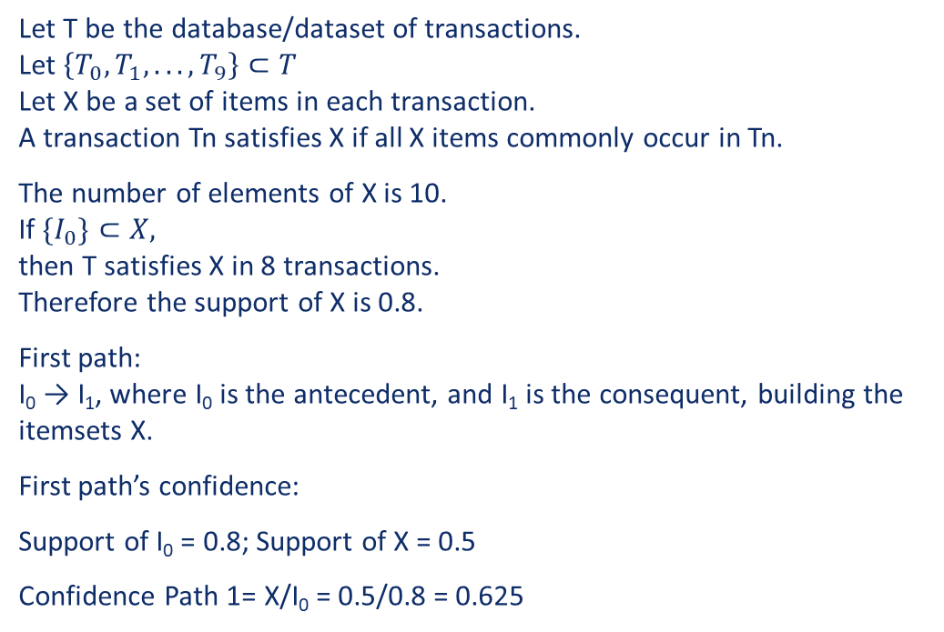
Key terms by Agrawal et al. [1]
Master of Data Science Program
Detecting patterns in purchase history using association rule learning methods
Index | I₀ | I₁ | I₂ | I₃ | I₄ | I₅ | I₆ | I₇ | I₈ | I₉ | I
T₀ | 1 | 1 | 1 | 1 | 1 | 1 | 0 | 1 | 0 | 0 | 7
T₁ | 1 | 0 | 1 | 1 | 1 | 1 | 1 | 1 | 0 | 0 | 7
T₂ | 1 | 0 | 1 | 1 | 0 | 0 | 0 | 0 | 1 | 0 | 4
T₃ | 1 | 1 | 0 | 0 | 1 | 0 | 1 | 1 | 1 | 1 | 7
T₄ | 1 | 1 | 0 | 0 | 1 | 0 | 0 | 0 | 1 | 1 | 5
T₅ | 1 | 1 | 0 | 0 | 0 | 0 | 0 | 1 | 1 | 1 | 5
T₆ | 1 | 0 | 0 | 0 | 0 | 1 | 0 | 0 | 1 | 0 | 3
T₇ | 1 | 1 | 0 | 1 | 0 | 0 | 0 | 0 | 0 | 1 | 4
T₈ | 0 | 1 | 1 | 0 | 0 | 0 | 0 | 0 | 1 | 0 | 3
T₉ | 0 | 1 | 0 | 0 | 1 | 0 | 0 | 0 | 0 | 1 | 3
T | 8 | 7 | 4 | 4 | 5 | 3 | 2 | 4 | 6 | 5 | 48
Let T be the database/dataset of transactions. Let $\left\{T_{0}, T_{1}, . . . , T_{9}\right\}⊂T$ Let X be a set of items in each transaction. A transaction Tn satisfies X if all X items commonly occur in Tn.
The number of elements of X is 10. If ${\{I}_{0}\}⊂X,$ then T satisfies X in 8 transactions. Therefore the support of X is 0.8.
First path: I₀ → I₁, where I₀ is the antecedent, and I₁ is the consequent, building the itemsets X.
First path’s confidence:
Support of I₀ = 0.8; Support of X = 0.5
Confidence Path 1= X/I₀ = 0.5/0.8 = 0.625

Slide 4
Modified FP-growth Baseline algorithm
Master of Data Science Program
Detecting patterns in purchase history using association rule learning methods
I chose FP-algorithm as baseline algorithm.
A-priori, Eclat and FP-Growth all lead to the same outcome, but differentiate themselves in time and space complexity.
For small datasets, all 3 algorithms are fast
A-priori -> Time-Complexity: O(2^{n}) -> Test with 77’264 transactions 40,777 unique items -> 14.1 seconds
FP-growth -> Time-Complexity: O(n²) -> Test with 77’264 transactions 40,777 unique items -> 142.3 seconds

Slide 5
Modified FP-growth Implementation of a profit function
Master of Data Science Program
Detecting patterns in purchase history using association rule learning methods
Index | Items | profits
T₀ | {I₀, I₁, I₂, I₃, I₄, I₅, I₇} | {10, 20, 30, 40, 50, 60, 80}
T₁ | {I₀, I₂, I₃, I₄, I₅, I₆, I₇} | {10, 30, 40, 50, 60, 70, 80}
T₂ | {I₀, I₂, I₃, I₈} | {10, 30, 40, 90}
T₃ | {I₀, I₁, I₄, I₆, I₇, I₈, I₉} | {10, 20, 50, 70, 80, 90, 100}
T₄ | {I₀, I₁, I₄, I₈, I₉} | {10, 20, 50, 90, 100}
T₅ | {I₀, I₁, I₇, I_{8,} I_{8,} I₉} | {10, 20, 80, 90, 90, 100}
T₆ | {I₀, I₅, I₈} | {10, 60, 90}
T₇ | {I₀, I₁, I₃, I₉} | {10, 20, 40, 100}
T₈ | {I₁, I₂, I₈, I₈, I₈} | {20, 30, 90, 90, 90}
T₉ | {I₁, I₄, I₉} | {20, 50, 100}
Finding stronger patterns by filtering support with a profit function. Moreover introduced “associated profit” of an itemset as an additional metric
The same method of filtering and showing “associated profit” allows to have the same items multiple times in a transaction and calculates the average price/profit, instead of only the frequency.

Slide 6
Modified FP-growth (Electronics Store)
Master of Data Science Program
Detecting patterns in purchase history using association rule learning methods
Top 7 Itemsets found by traditional FP-Growth
Top 7 Itemsets found by modified FP-Growth
sets | support | product_id | category | brand | price
0 | 26,080 | 1515966223523303310 | 8.10 | - | -
0 | 26,080 | 1515966223523303314 | 9.26 | - | -
1 | 19,844 | 1515966223523303301 | 16.18 | - | -
1 | 19,844 | 1515966223523303321 | 16.18 | - | -
2 | 12,109 | 1515966223523303310 | 8.10 | - | -
2 | 12,109 | 1515966223523303312 | 6.94 | - | -
3 | 10,401 | 1515966223523303314 | 9.26 | - | -
3 | 10,401 | 1515966223523303312 | 6.94 | - | -
4 | 9,031 | 1515966223523303310 | 8.10 | - | -
4 | 9,031 | 1515966223523303312 | 6.94 | - | -
4 | 9,031 | 1515966223523303314 | 9.26 | - | -
5 | 8,726 | 1515966223523303310 | 8.10 | - | -
5 | 8,726 | 1515966223523303308 | 29.63 | - | -
6 | 8,304 | 1515966223523303314 | 9.26 | - | -
6 | 8,304 | 1515966223523303301 | 16.18 | - | -
sets | support | product_id | category | brand | price
0 | 3,863 | 2273948218662322995 | - | grohe | 184.72
0 | 3,863 | 2273948218662322996 | - | grohe | 143.98
1 | 1,007 | 2273948218662322995 | - | grohe | 184.72
1 | 1,007 | 2273948218662322996 | - | grohe | 143.98
1 | 1,007 | 2273948186248741817 | - | incase | 97.20
2 | 1,386 | 2273948218662322995 | - | grohe | 184.72
2 | 1,386 | 2273948186248741817 | - | incase | 97.20
3 | 1,001 | 1515966223509088532 | electronics.smartphone | samsung | 300.90
3 | 1,001 | 1515966223509117074 | - | samsung | 30.07
4 | 359 | 1515966223509088567 | electronics.smartphone | apple | 856.23
4 | 359 | 2273948297037087396 | - | goodride | 48.82
5 | 1,605 | 1515966223509117074 | - | samsung | 30.07
5 | 1,605 | 2273948316473492113 | electronics.smartphone | samsung | 162.01
6 | 1,208 | 2273948218662322996 | - | grohe | 143.98
6 | 1,208 | 2273948186248741817 | - | incase | 97.20

Slide 7
Modified FP-growth (Jewellery Store)
Master of Data Science Program
Detecting patterns in purchase history using association rule learning methods
Top 7 Itemsets found by traditional FP-Growth
Top 7 Itemsets found by modified FP-Growth
sets | support | product_id | category | metal | gem | price
0 | 51 | 1313614230015967859 | Ring | gold | diamond | 904
0 | 51 | 1944945390285488528 | Ring | gold | diamond | 534
1 | 34 | 1944422271028298685 | Earring | gold | diamond | 493
1 | 34 | 1937902773722939556 | Ring | gold | diamond | 856
2 | 29 | 1956663836207481431 | Ring | gold | - | 146
2 | 29 | 1956663836207481430 | Earring | gold | - | 120
3 | 26 | 1313614230015967859 | Pendant | gold | Diamond | 904
3 | 26 | 1343446704099164925 | Ring | gold | Diamond | 411
4 | 25 | 1956663836207481430 | Ring | gold | - | 120
4 | 25 | 1956663840309510725 | Earring | gold | - | 134
5 | 24 | 1956663848287077290 | Ring | gold | amethyst | 288
5 | 24 | 1956663848287077291 | Ring | gold | amethyst | 198
6 | 23 | 1956663846349308653 | Ring | gold | diamond | 329
6 | 23 | 1956663840242401751 | Ring | gold | - | 260
sets | support | product_id | category | metal | gem | price
0 | 51 | 1313614230015967859 | Earring | gold | diamond | 904
0 | 51 | 1944945390285488528 | Ring | gold | diamond | 534
1 | 34 | 1944422271028298685 | Ring | gold | diamond | 493
1 | 34 | 1937902773722939556 | Earring | gold | diamond | 856
2 | 16 | 1956663846340920038 | Ring | gold | diamond | 1,082
2 | 16 | 1956663845602721816 | Earring | gold | diamond | 1,198
3 | 18 | 1860421116053422140 | Ring | gold | diamond | 671
3 | 18 | 1845870160691331313 | Earring | gold | diamond | 1,281
4 | 7 | 1806829191514031042 | - | gold | mix | 2,781
4 | 7 | 1956663836668854462 | - | gold | - | 2,266
5 | 26 | 1313614230015967859 | Earring | gold | diamond | 904
5 | 26 | 1343446704099164925 | Pendant | gold | diamond | 411
6 | 17 | 1956663845736939738 | Ring | gold | diamond | 575
6 | 17 | 1956663836392031040 | Earring | gold | diamond | 1,294

Slide 8
Modified FP-growth (Cosmetics Store)
Master of Data Science Program
Detecting patterns in purchase history using association rule learning methods
Top 7 Itemsets found by traditional FP-Growth
Top 7 Itemsets found by modified FP-Growth
sets | support | product_id | category_id | brand | price
0 | 1180 | 5809910 | 1602943681873052386 | grattol | 5.24
0 | 1180 | 5809912 | 1602943681873052386 | grattol | 5.24
1 | 837 | 5751422 | 1487580005268456287 | uno | 10.95
1 | 837 | 5751383 | 1487580005092295511 | uno | 10.32
2 | 756 | 5809910 | 1602943681873052386 | grattol | 5.24
2 | 756 | 5809911 | 1602943681873052386 | grattol | 5.24
3 | 569 | 5809910 | 1602943681873052386 | grattol | 5.24
3 | 569 | 5816170 | 1602943681873052386 | grattol | 5.24
4 | 546 | 5809912 | 1602943681873052386 | grattol | 5.24
4 | 546 | 5809911 | 1602943681873052386 | grattol | 5.24
5 | 529 | 5751422 | 1487580005268456287 | uno | 10.95
5 | 529 | 5849033 | 1487580005092295511 | uno | 10.32
6 | 411 | 5809912 | 1602943681873052386 | grattol | 5.24
6 | 411 | 5816170 | 1602943681873052386 | grattol | 5.24
sets | support | product_id | category_id | brand | price
0 | 837 | 5751383 | 1487580005092295511 | uno | 10.32
0 | 837 | 5751422 | 1487580005268456287 | uno | 10.95
1 | 1,180 | 5809912 | 1602943681873052386 | grattol | 5.24
1 | 1,180 | 5809910 | 1602943681873052386 | grattol | 5.24
2 | 529 | 5849033 | 1487580005092295511 | uno | 10.32
2 | 529 | 5751422 | 1487580005268456287 | uno | 10.95
3 | 756 | 5809911 | 1602943681873052386 | grattol | 5.24
3 | 756 | 5809910 | 1602943681873052386 | grattol | 5.24
4 | 178 | 3762 | 1487580005411062629 | cnd | 19.37
4 | 178 | 4185 | 1487580005411062629 | cnd | 19.37
5 | 340 | 5528034 | 1487580005553668971 | nan | 9.52
5 | 340 | 5528035 | 1487580005553668971 | nan | 9.52
6 | 381 | 5809910 | 1602943681873052386 | grattol | 5.24
6 | 381 | 5809912 | 1602943681873052386 | grattol | 5.24
6 | 381 | 5809911 | 1602943681873052386 | grattol | 5.24

Slide 9
Mutiple items per transaction
Master of Data Science Program
Detecting patterns in purchase history using association rule learning methods
The Electronic store dataset has 1,435,266 transactions, thereof 649 (0.05%) transactions contain the same item multiple times
The Jewellery store dataset has 74,760 transactions, thereof 2,298 (3.07%) transactions contain the same item multiple times
The Jewellery store dataset has 155'617 transactions, thereof 10,123 (6.51%) transactions contain the same item multiple times

Slide 10
Conclusion
Master of Data Science Program
Detecting patterns in purchase history using association rule learning methods
Modified FP-Growths solves the fundamental of multiple same items per transactions
Experiments showed that the modified FP-Growth delivers mostly stronger itemsets by focusing on profit-based selection criteria (Avg. Profit per Item * Frequency) selection criteria

Slide 11
Master of Data Science Program
Detecting patterns in purchase history using association rule learning methods
THANK YOU FOR YOUR ATTENTION

Slide 12
References used in presentation:
Master of Data Science Program
Detecting patterns in purchase history using association rule learning methods
1. Kotsiantis, S., Kanellopoulos, D. 2006. Association Rules Mining: A Recent Overview. GESTS International Transactions on Computer Science and Engineering. Vol.32 (1), 2006, pp. 71-82

