Slide 1
Detecting patterns in purchase-history using association rule learning methods
Faculty of
Computer Science
Master of Data Science
Moscow
2023

Slide 2
Introduction to association rule learning and limitations
Master of Data Science Program
Detecting patterns in purchase history using association rule learning methods
Association rule learning is a relatively simple and powerful data mining method
A use case is a recommendation system (online store) or shelf management (traditional physical store)
Well-known implementations like A-Priori, Eclat, and FP-Growth
1. Limitation: Quote from Kotsiantis, S. and Kanellopoulos, D (2006) [1]: "In many cases, the algorithms generate an extremely large number of association rules, often in thousands or even millions. Further, the association rules are sometimes very large. It is nearly impossible for the end users to comprehend or validate such a large number of complex association rules, thereby limiting the usefulness of the data mining results.“
2. Limitation: Frequency in items does not consider multiple the same items per transaction

Slide 3
What problem do I want to solve by my paper?
Master of Data Science Program
Detecting patterns in purchase history using association rule learning methods
Considering multiple the same items per transaction -> Ignored problem
The Ultimate business goal is overall profit, not frequency alone -> Therefore taking into account profitability as support selection & rule performance metric (Avg. Profit per Item * Frequency)

Slide 4
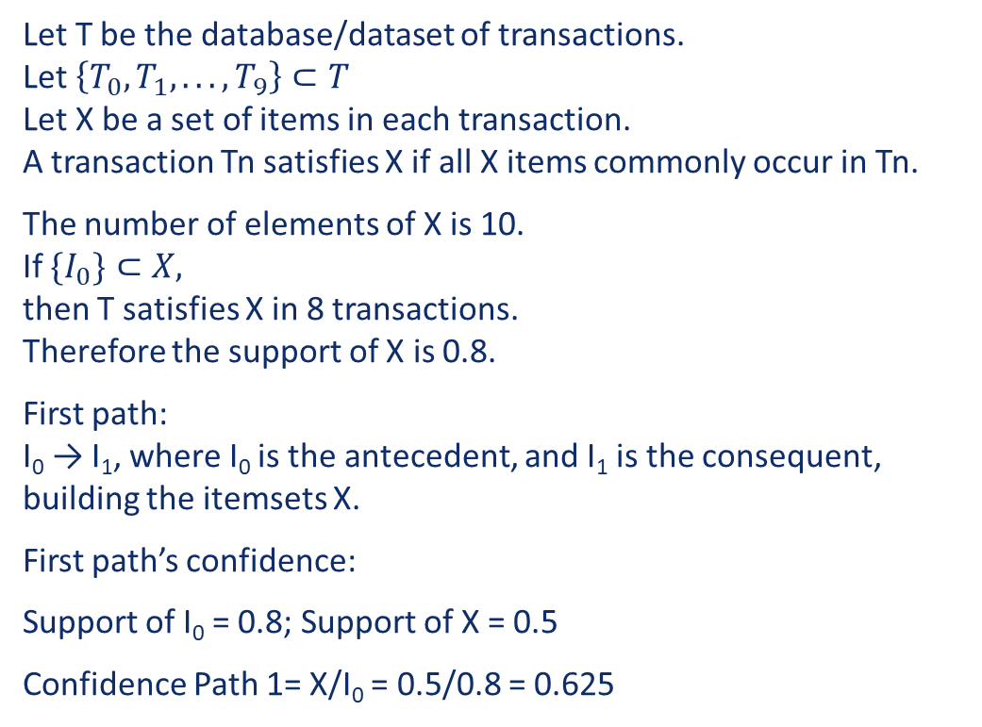
Key terms by Agrawal et al. [2]
Master of Data Science Program
Detecting patterns in purchase history using association rule learning methods
Let T be the database/dataset of transactions. Let $\left\{T_{0}, T_{1}, . . . , T_{9}\right\}⊂T$ Let X be a set of items in each transaction. A transaction Tn satisfies X if all X items commonly occur in Tn.
The number of elements of X is 10. If ${\{I}_{0}\}⊂X,$ then T satisfies X in 8 transactions. Therefore the support of X is 0.8.
First path: I₀ → I₁, where I₀ is the antecedent, and I₁ is the consequent, building the itemsets X.
First path’s confidence:
Support of I₀ = 0.8; Support of X = 0.5
Confidence Path 1= X/I₀ = 0.5/0.8 = 0.625
Index | I₀ | I₁ | I₂ | I₃ | I₄ | I₅ | I₆ | I₇ | I₈ | I₉ | I
T₀ | 1 | 1 | 1 | 1 | 1 | 1 | 0 | 1 | 0 | 0 | 7
T₁ | 1 | 0 | 1 | 1 | 1 | 1 | 1 | 1 | 0 | 0 | 7
T₂ | 1 | 0 | 1 | 1 | 0 | 0 | 0 | 0 | 1 | 0 | 4
T₃ | 1 | 1 | 0 | 0 | 1 | 0 | 1 | 1 | 1 | 1 | 7
T₄ | 1 | 1 | 0 | 0 | 1 | 0 | 0 | 0 | 1 | 1 | 5
T₅ | 1 | 1 | 0 | 0 | 0 | 0 | 0 | 1 | 1 | 1 | 5
T₆ | 1 | 0 | 0 | 0 | 0 | 1 | 0 | 0 | 1 | 0 | 3
T₇ | 1 | 1 | 0 | 1 | 0 | 0 | 0 | 0 | 0 | 1 | 4
T₈ | 0 | 1 | 1 | 0 | 0 | 0 | 0 | 0 | 1 | 0 | 3
T₉ | 0 | 1 | 0 | 0 | 1 | 0 | 0 | 0 | 0 | 1 | 3
T | 8 | 7 | 4 | 4 | 5 | 3 | 2 | 4 | 6 | 5 | 48

Slide 5
Modified FP-growth Baseline algorithm
Master of Data Science Program
Detecting patterns in purchase history using association rule learning methods
A-priori, Eclat, and FP-Growth all lead to the same outcome but differentiate themselves in time and space complexity.
A-priori -> Time-Complexity: O(2^{n}) -> Test with 77’264 transactions 40,777 unique items -> 14.1 seconds
FP-growth -> Time-Complexity: O(n²) -> Test with 77’264 transactions 40,777 unique items -> 142.3 seconds
I chose the FP-growth algorithm as the baseline algorithm because of Performance.

Slide 6
Modified FP-growth Profit metric
Master of Data Science Program
Detecting patterns in purchase history using association rule learning methods
Index | Items | profits
T₀ | {I₀, I₁, I₂, I₃, I₄, I₅, I₇} | {10, 20, 30, 40, 50, 60, 80}
T₁ | {I₀, I₂, I₃, I₄, I₅, I₆, I₇} | {10, 30, 40, 50, 60, 70, 80}
T₂ | {I₀, I₂, I₃, I₈} | {10, 30, 40, 90}
T₃ | {I₀, I₁, I₄, I₆, I₇, I₈, I₉} | {10, 20, 50, 70, 80, 90, 100}
T₄ | {I₀, I₁, I₄, I₈, I₉} | {10, 20, 50, 90, 100}
T₅ | {I₀, I₁, I₇, I_{8,} I_{8,} I₉} | {10, 20, 80, 90, 90, 100}
T₆ | {I₀, I₅, I₈} | {10, 60, 90}
T₇ | {I₀, I₁, I₃, I₉} | {10, 20, 40, 100}
T₈ | {I₁, I₂, I₈, I₈, I₈} | {20, 30, 90, 90, 90}
T₉ | {I₁, I₄, I₉} | {20, 50, 100}
I_{8_old} = 90; I_{8_new} = 9 / 6 * 90 = 135
New Filter & Performance criterion:
Avg_Profit * Frequency/Support = “Associated Profit” as Filter & Performance criterion
Example “Associated Profit” for itemset {I₂,I₈}: Common Transactions: 2 {T₂,T₈}; Resulting “Associated Profit” = (135+30) * 2 = 330

Slide 7
Mutiple items per transaction
Master of Data Science Program
Detecting patterns in purchase history using association rule learning methods
The Electronic store dataset has 1,435,266 transactions, thereof 649 (0.05%) transactions contain the same item multiple times
The Jewellery store dataset has 74,760 transactions, thereof 2,298 (3.07%) transactions contain the same item multiple times
The Jewellery store dataset has 155'617 transactions, thereof 10,123 (6.51%) transactions contain the same item multiple times

Slide 8
Modified FP-growth (Electronics Store)
Master of Data Science Program
Detecting patterns in purchase history using association rule learning methods
Top 7 Itemsets found by traditional FP-Growth
Top 7 Itemsets found by modified FP-Growth
sets | support | product_id | category | brand | price
0 | 26,080 | 1515966223523303310 | 8.10 | - | -
0 | 26,080 | 1515966223523303314 | 9.26 | - | -
1 | 19,844 | 1515966223523303301 | 16.18 | - | -
1 | 19,844 | 1515966223523303321 | 16.18 | - | -
2 | 12,109 | 1515966223523303310 | 8.10 | - | -
2 | 12,109 | 1515966223523303312 | 6.94 | - | -
3 | 10,401 | 1515966223523303314 | 9.26 | - | -
3 | 10,401 | 1515966223523303312 | 6.94 | - | -
4 | 9,031 | 1515966223523303310 | 8.10 | - | -
4 | 9,031 | 1515966223523303312 | 6.94 | - | -
4 | 9,031 | 1515966223523303314 | 9.26 | - | -
5 | 8,726 | 1515966223523303310 | 8.10 | - | -
5 | 8,726 | 1515966223523303308 | 29.63 | - | -
6 | 8,304 | 1515966223523303314 | 9.26 | - | -
6 | 8,304 | 1515966223523303301 | 16.18 | - | -
sets | support | product_id | category | brand | price
0 | 3,863 | 2273948218662322995 | - | grohe | 184.72
0 | 3,863 | 2273948218662322996 | - | grohe | 143.98
1 | 1,007 | 2273948218662322995 | - | grohe | 184.72
1 | 1,007 | 2273948218662322996 | - | grohe | 143.98
1 | 1,007 | 2273948186248741817 | - | incase | 97.20
2 | 1,386 | 2273948218662322995 | - | grohe | 184.72
2 | 1,386 | 2273948186248741817 | - | incase | 97.20
3 | 1,001 | 1515966223509088532 | electronics.smartphone | samsung | 300.90
3 | 1,001 | 1515966223509117074 | - | samsung | 30.07
4 | 359 | 1515966223509088567 | electronics.smartphone | apple | 856.23
4 | 359 | 2273948297037087396 | - | goodride | 48.82
5 | 1,605 | 1515966223509117074 | - | samsung | 30.07
5 | 1,605 | 2273948316473492113 | electronics.smartphone | samsung | 162.01
6 | 1,208 | 2273948218662322996 | - | grohe | 143.98
6 | 1,208 | 2273948186248741817 | - | incase | 97.20

Slide 9
Modified FP-growth (Jewellery Store)
Master of Data Science Program
Detecting patterns in purchase history using association rule learning methods
Top 7 Itemsets found by traditional FP-Growth
Top 7 Itemsets found by modified FP-Growth
sets | support | product_id | category | metal | gem | price
0 | 51 | 1313614230015967859 | Ring | gold | diamond | 904
0 | 51 | 1944945390285488528 | Ring | gold | diamond | 534
1 | 34 | 1944422271028298685 | Earring | gold | diamond | 493
1 | 34 | 1937902773722939556 | Ring | gold | diamond | 856
2 | 29 | 1956663836207481431 | Ring | gold | - | 146
2 | 29 | 1956663836207481430 | Earring | gold | - | 120
3 | 26 | 1313614230015967859 | Pendant | gold | Diamond | 904
3 | 26 | 1343446704099164925 | Ring | gold | Diamond | 411
4 | 25 | 1956663836207481430 | Ring | gold | - | 120
4 | 25 | 1956663840309510725 | Earring | gold | - | 134
5 | 24 | 1956663848287077290 | Ring | gold | amethyst | 288
5 | 24 | 1956663848287077291 | Ring | gold | amethyst | 198
6 | 23 | 1956663846349308653 | Ring | gold | diamond | 329
6 | 23 | 1956663840242401751 | Ring | gold | - | 260
sets | support | product_id | category | metal | gem | price
0 | 51 | 1313614230015967859 | Earring | gold | diamond | 904
0 | 51 | 1944945390285488528 | Ring | gold | diamond | 534
1 | 34 | 1944422271028298685 | Ring | gold | diamond | 493
1 | 34 | 1937902773722939556 | Earring | gold | diamond | 856
2 | 16 | 1956663846340920038 | Ring | gold | diamond | 1,082
2 | 16 | 1956663845602721816 | Earring | gold | diamond | 1,198
3 | 18 | 1860421116053422140 | Ring | gold | diamond | 671
3 | 18 | 1845870160691331313 | Earring | gold | diamond | 1,281
4 | 7 | 1806829191514031042 | - | gold | mix | 2,781
4 | 7 | 1956663836668854462 | - | gold | - | 2,266
5 | 26 | 1313614230015967859 | Earring | gold | diamond | 904
5 | 26 | 1343446704099164925 | Pendant | gold | diamond | 411
6 | 17 | 1956663845736939738 | Ring | gold | diamond | 575
6 | 17 | 1956663836392031040 | Earring | gold | diamond | 1,294

Slide 10
Modified FP-growth (Cosmetics Store)
Master of Data Science Program
Detecting patterns in purchase history using association rule learning methods
Top 7 Itemsets found by traditional FP-Growth
Top 7 Itemsets found by modified FP-Growth
sets | support | product_id | category_id | brand | price
0 | 1180 | 5809910 | 1602943681873052386 | grattol | 5.24
0 | 1180 | 5809912 | 1602943681873052386 | grattol | 5.24
1 | 837 | 5751422 | 1487580005268456287 | uno | 10.95
1 | 837 | 5751383 | 1487580005092295511 | uno | 10.32
2 | 756 | 5809910 | 1602943681873052386 | grattol | 5.24
2 | 756 | 5809911 | 1602943681873052386 | grattol | 5.24
3 | 569 | 5809910 | 1602943681873052386 | grattol | 5.24
3 | 569 | 5816170 | 1602943681873052386 | grattol | 5.24
4 | 546 | 5809912 | 1602943681873052386 | grattol | 5.24
4 | 546 | 5809911 | 1602943681873052386 | grattol | 5.24
5 | 529 | 5751422 | 1487580005268456287 | uno | 10.95
5 | 529 | 5849033 | 1487580005092295511 | uno | 10.32
6 | 411 | 5809912 | 1602943681873052386 | grattol | 5.24
6 | 411 | 5816170 | 1602943681873052386 | grattol | 5.24
sets | support | product_id | category_id | brand | price
0 | 837 | 5751383 | 1487580005092295511 | uno | 10.32
0 | 837 | 5751422 | 1487580005268456287 | uno | 10.95
1 | 1,180 | 5809912 | 1602943681873052386 | grattol | 5.24
1 | 1,180 | 5809910 | 1602943681873052386 | grattol | 5.24
2 | 529 | 5849033 | 1487580005092295511 | uno | 10.32
2 | 529 | 5751422 | 1487580005268456287 | uno | 10.95
3 | 756 | 5809911 | 1602943681873052386 | grattol | 5.24
3 | 756 | 5809910 | 1602943681873052386 | grattol | 5.24
4 | 178 | 3762 | 1487580005411062629 | cnd | 19.37
4 | 178 | 4185 | 1487580005411062629 | cnd | 19.37
5 | 340 | 5528034 | 1487580005553668971 | nan | 9.52
5 | 340 | 5528035 | 1487580005553668971 | nan | 9.52
6 | 381 | 5809910 | 1602943681873052386 | grattol | 5.24
6 | 381 | 5809912 | 1602943681873052386 | grattol | 5.24
6 | 381 | 5809911 | 1602943681873052386 | grattol | 5.24

Slide 11
Conclusion, Limitation & Future Research
Master of Data Science Program
Detecting patterns in purchase history using association rule learning methods
Modified FP-Growths consider the fundamental problem of multiple same items per transactions -> Limitation: The average profit could falsify the outcome of rulesets if the distribution of multiple the same items is very uneven. That could be addressed in future research
Experiments show that the modified FP-Growth delivers mostly stronger itemsets by focusing on a profit-based metric (Avg. Profit per Item * Frequency) as filtering and rule performance criterion -> Suggestion: Instead of taking a fixed margin of 10% of revenue, I suggest determining the average profit margin categories. The outcome of such new, more correct “experiments” would be interesting and could further prove the method.

Slide 12
Master of Data Science Program
Detecting patterns in purchase history using association rule learning methods
THANK YOU FOR YOUR ATTENTION

Slide 13
References used in presentation:
Master of Data Science Program
Detecting patterns in purchase history using association rule learning methods
Kotsiantis, S., Kanellopoulos, D. 2006. Association Rules Mining: A Recent Overview. GESTS International Transactions on Computer Science and Engineering. Vol.32 (1), 2006, pp. 71-82
Agrawal, R., Imieliński, T., Swami, A. 1993. Mining association rules between sets of items in large databases. Proceedings of the 1993 ACM SIGMOD international conference on Management of data - SIGMOD '93. p. 20

