Slide 1
Detecting patterns in purchase-history using association rule learning methods
Faculty of
Computer Science
Master of Data Science Program
Moscow
2023

Slide 2
Introduction to association rule learning methods and limitations
Master of Data Science Program
Detecting patterns in purchase history using association rule learning methods
Well known implementations like A-Priori, Eclat and FP-Growth
Association rule learning is a relatively simple and powerful data mining method to find the associative items. It addresses the main question: What items are bought together?
Use case is recommendation system (online-store) or shelf-management (traditional physical store)
The limitation of the traditional algorithms is already stated by Agrawal et al. [1] the inventors of the early a-priori algorithm in 1993: “The algorithm proposed in this paper is targeted at discovering qualitative rules. However, the rules we discover are not classification rules. We have no pre-specified classes. Rather, we find all the rules that describe the association between sets of items.
The limitation is further stated in a paper by Kotsiantis, S. and Kanellopoulos, D (2006) [2]: "In many cases, the algorithms generate an extremely large number of association rules, often in thousands or even millions. Further, the association rules are sometimes very large. It is nearly impossible for the end users to comprehend or validate such a large number of complex association rules, thereby limiting the usefulness of the data mining results."
Moreover, a non-academic online article by Chou, T [3] (2020) states the limitation for businesses: I would like to share an interesting story. While I was writing this article after work, a full-time engineer walked by, and he saw that I was writing something about A-priori and F-Growth. He said, "Interesting, but not realistic." He further explained that this algorithm doesn't take weighing under consideration. For example, what about a transaction with multiple same items? There are also more subtle conditions that are not included in this algorithm. And that's why companies won't implement this in their business."

Slide 3
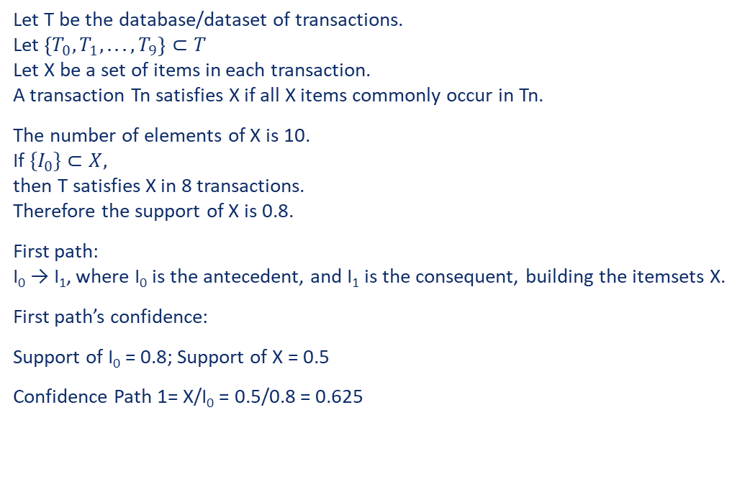
Key terms by Agrawal et al. [1]
Master of Data Science Program
Detecting patterns in purchase history using association rule learning methods
Index | I₀ | I₁ | I₂ | I₃ | I₄ | I₅ | I₆ | I₇ | I₈ | I₉ | I
T₀ | 1 | 1 | 1 | 1 | 1 | 1 | 0 | 1 | 0 | 0 | 7
T₁ | 1 | 0 | 1 | 1 | 1 | 1 | 1 | 1 | 0 | 0 | 7
T₂ | 1 | 0 | 1 | 1 | 0 | 0 | 0 | 0 | 1 | 0 | 4
T₃ | 1 | 1 | 0 | 0 | 1 | 0 | 1 | 1 | 1 | 1 | 7
T₄ | 1 | 1 | 0 | 0 | 1 | 0 | 0 | 0 | 1 | 1 | 5
T₅ | 1 | 1 | 0 | 0 | 0 | 0 | 0 | 1 | 1 | 1 | 5
T₆ | 1 | 0 | 0 | 0 | 0 | 1 | 0 | 0 | 1 | 0 | 3
T₇ | 1 | 1 | 0 | 1 | 0 | 0 | 0 | 0 | 0 | 1 | 4
T₈ | 0 | 1 | 1 | 0 | 0 | 0 | 0 | 0 | 1 | 0 | 3
T₉ | 0 | 1 | 0 | 0 | 1 | 0 | 0 | 0 | 0 | 1 | 3
T | 8 | 7 | 4 | 4 | 5 | 3 | 2 | 4 | 6 | 5 | 48
Let T be the database/dataset of transactions. Let $\left\{T_{0}, T_{1}, . . . , T_{9}\right\}⊂T$ Let X be a set of items in each transaction. A transaction Tn satisfies X if all X items commonly occur in Tn.
The number of elements of X is 10. If ${\{I}_{0}\}⊂X,$ then T satisfies X in 8 transactions. Therefore the support of X is 0.8.
First path: I₀ → I₁, where I₀ is the antecedent, and I₁ is the consequent, building the itemsets X.
First path’s confidence:
Support of I₀ = 0.8; Support of X = 0.5
Confidence Path 1= X/I₀ = 0.5/0.8 = 0.625

Slide 4
Research directions of traditional association rule learning methods
Master of Data Science Program
Detecting patterns in purchase history using association rule learning methods
Reducing the number of passes over the database
Sampling the database
Adding extra constraints on the structure of patterns
Increase efficiency through parallelization

Slide 5
Modified FP-growth Baseline algorithm
Master of Data Science Program
Detecting patterns in purchase history using association rule learning methods
The author chose FP-algorithm as baseline algorithm.
A-priori, Eclat and FP-Growth all lead to the same outcome, but differentiate themselves in time and space complexity.
For small datasets, all 3 algorithms are fast
A-priori -> Time-Complexity: O(2^{n}) -> Test with 77’264 transactions 40,777 unique items -> 14.1 seconds
FP-growth -> Time-Complexity: O(n²) -> Test with 77’264 transactions 40,777 unique items -> 142.3 seconds
There is no advantage in using A-priori, but only the simplicity of algorithm compared to the tree-based FP-Growth
Therefore the author chose to implement and modify the algorithm based on FP-Growth and calls it modified FP-Growth

Slide 6
Modified FP-growth Implementation of a profit function
Master of Data Science Program
Detecting patterns in purchase history using association rule learning methods
Index | Items | profits
T₀ | {I₀, I₁, I₂, I₃, I₄, I₅, I₇} | {10, 20, 30, 40, 50, 60, 80}
T₁ | {I₀, I₂, I₃, I₄, I₅, I₆, I₇} | {10, 30, 40, 50, 60, 70, 80}
T₂ | {I₀, I₂, I₃, I₈} | {10, 30, 40, 90}
T₃ | {I₀, I₁, I₄, I₆, I₇, I₈, I₉} | {10, 20, 50, 70, 80, 90, 100}
T₄ | {I₀, I₁, I₄, I₈, I₉} | {10, 20, 50, 90, 100}
T₅ | {I₀, I₁, I₇, I_{8,} I_{8,} I₉} | {10, 20, 80, 90, 90, 100}
T₆ | {I₀, I₅, I₈} | {10, 60, 90}
T₇ | {I₀, I₁, I₃, I₉} | {10, 20, 40, 100}
T₈ | {I₁, I₂, I₈, I₈, I₈} | {20, 30, 90, 90, 90}
T₉ | {I₁, I₄, I₉} | {20, 50, 100}
Finding stronger patterns by filtering support with a profit function. Moreover introduced “associated profit” of an itemset as an additional metric
The same method of filtering and showing “associated profit” allows to have the same items multiple times in a transaction and calculates the average price/profit, instead of only the frequency.
Example: If apples are always bought I₈ 9 times, but we have only 6 transactions with I₆ , the average price I consider is 9 / 6 * 90 = 135, instead of 90. The standard FP-Growth algorithm will ignore that and only considers the item 1 time with a price of 90.
- The author will use the total profit of I₈ as 9 times, when filtering out the minimum support.

Slide 7
Modified FP-growth Use case to find better itemsets/rules
Master of Data Science Program
Detecting patterns in purchase history using association rule learning methods
Top 7 Itemsets found by traditional FP-Growth
Top 7 Itemsets found by modified FP-Growth
itemsets | support | product_id | category | brand | price
0 | 26,080 | 1515966223523303310 | 8.10 | - | -
0 | 26,080 | 1515966223523303314 | 9.26 | - | -
1 | 19,844 | 1515966223523303301 | 16.18 | - | -
1 | 19,844 | 1515966223523303321 | 16.18 | - | -
2 | 12,109 | 1515966223523303310 | 8.10 | - | -
2 | 12,109 | 1515966223523303312 | 6.94 | - | -
3 | 10,401 | 1515966223523303314 | 9.26 | - | -
3 | 10,401 | 1515966223523303312 | 6.94 | - | -
4 | 9,031 | 1515966223523303310 | 8.10 | - | -
4 | 9,031 | 1515966223523303312 | 6.94 | - | -
4 | 9,031 | 1515966223523303314 | 9.26 | - | -
5 | 8,726 | 1515966223523303310 | 8.10 | - | -
5 | 8,726 | 1515966223523303308 | 29.63 | - | -
6 | 8,304 | 1515966223523303314 | 9.26 | - | -
6 | 8,304 | 1515966223523303301 | 16.18 | - | -
itemsets | support | product_id | category | brand | price
0 | 3,863 | 2273948218662322995 | - | grohe | 184.72
0 | 3,863 | 2273948218662322996 | - | grohe | 143.98
1 | 1,007 | 2273948218662322995 | - | grohe | 184.72
1 | 1,007 | 2273948218662322996 | - | grohe | 143.98
1 | 1,007 | 2273948186248741817 | - | incase | 97.20
2 | 1,386 | 2273948218662322995 | - | grohe | 184.72
2 | 1,386 | 2273948186248741817 | - | incase | 97.20
3 | 1,001 | 1515966223509088532 | electronics.smartphone | samsung | 300.90
3 | 1,001 | 1515966223509117074 | - | samsung | 30.07
4 | 359 | 1515966223509088567 | electronics.smartphone | apple | 856.23
4 | 359 | 2273948297037087396 | - | goodride | 48.82
5 | 1,605 | 1515966223509117074 | - | samsung | 30.07
5 | 1,605 | 2273948316473492113 | electronics.smartphone | samsung | 162.01
6 | 1,208 | 2273948218662322996 | - | grohe | 143.98
6 | 1,208 | 2273948186248741817 | - | incase | 97.20

Slide 8
Modified FP-growth Implementation of a profit function
Master of Data Science Program
Detecting patterns in purchase history using association rule learning methods
Index | Items | profits
T₀ | {I₀, I₁, I₂, I₃, I₄, I₅, I₇} | {10, 20, 30, 40, 50, 60, 80}
T₁ | {I₀, I₂, I₃, I₄, I₅, I₆, I₇} | {10, 30, 40, 50, 60, 70, 80}
T₂ | {I₀, I₂, I₃, I₈} | {10, 30, 40, 90}
T₃ | {I₀, I₁, I₄, I₆, I₇, I₈, I₉} | {10, 20, 50, 70, 80, 90, 100}
T₄ | {I₀, I₁, I₄, I₈, I₉} | {10, 20, 50, 90, 100}
T₅ | {I₀, I₁, I₇, I_{8,} I_{8,} I₉} | {10, 20, 80, 90, 90, 100}
T₆ | {I₀, I₅, I₈} | {10, 60, 90}
T₇ | {I₀, I₁, I₃, I₉} | {10, 20, 40, 100}
T₈ | {I₁, I₂, I₈, I₈, I₈} | {20, 30, 90, 90, 90}
T₉ | {I₁, I₄, I₉} | {20, 50, 100}
Finding stronger patterns by filtering support with a profit function. Moreover introduced “associated profit” of an itemset as an additional metric
The same method of filtering and showing “associated profit” allows to have the same items multiple times in a transaction and calculates the average price/profit, instead of only the frequency.
Example: If apples are always bought I₈ 9 times, but we have only 6 transactions with I₆ , the average price I consider is 9 / 6 * 90 = 135, instead of 90. The standard FP-Growth algorithm will ignore that and only considers the item 1 time with a price of 90.
- The author will use the total profit of I₈ as 9 times, when filtering out the minimum support.

Slide 9
Adding extra constraints on the structure of patterns Implementation of a date-decay function
Master of Data Science Program
Detecting patterns in purchase history using association rule learning methods
Sometimes more recent transactions should have more weight, than older ones
The author therefore implemented in the modified FP-growth function the ability to weigh the transactions.
This step is a comfort function but could have been done in a pre-processing step outside of the FP-growth algorithm
Moreover, support of 1 is not anymore 1 item, but has to be interpreted after running through the date function.
Example: A transaction with date 2023-01-20 inside a date range of 2023-01-01 – 2023-01-31, will have an X of 0.48 (20/31)
Running this through a “user-chosen” date-decay function given as lambda function e.g. lambda x: 1 / (1+math.exp⁡(-10*x+5)), will result in a support of 0.81.
The author thinks, that that implementation can help in certain scenarios, but is not that powerful and useful like the profit-function

Slide 10
Adding extra constraints on the structure of patterns Showing only the most frequent path
Master of Data Science Program
Detecting patterns in purchase history using association rule learning methods
The limitation is further stated in a paper by Kotsiantis, S. and Kanellopoulos, D (2006) [2]: "In many cases, the algorithms generate an extremely large number of association rules, often in thousands or even millions. Further, the association rules are sometimes very large. It is nearly impossible for the end users to comprehend or validate such a large number of complex association rules, thereby limiting the usefulness of the data mining results."
To address that statement, the author restricts the modified FP-growth algorithm to only 1 path per itemset. It is always the path already existing in the FP-tree structure (sorted descending by support).
Potentially we can loose important rules; however we can at the same time gain stronger and more relevant rules, without any further post-processing.

Slide 11
Conclusion
Master of Data Science Program
Detecting patterns in purchase history using association rule learning methods
The author tried to address the shortcomings of the traditional association rules algorithms by an own modified implementation of the FP-Growth algorithm
It could be shown by 3 experiments on transaction datasets, that a profit-based algorithm will lead to stronger and better itemsets, and solves the problem of multiple items per transaction by recalculating a new average profit per item
Future research in implementing especially a profit-metric as filter criteria and solving the multi-item transaction can further focus on materializing and measuring the benefit of such an approach and further modify the function to standardize a proven approach for businesses in the real world. Moreover, the implementation of the modified FP-growth can be further optimized.

