Slide 1
Subject Villa
Market Position, Rental Capacity & Hold / Sell Reference
Costa Smeralda | Baja Sardinia | Mucchi Bianchi
CURRENT VALUE ANCHOR
€620k
Working market / asking-price anchor
PROPERTY
130 sqm | 3BR | 2BA
~700 sqm garden / land
MARKET ROLE
Core market
C2 = the calibrated core market reference
RENTAL REFERENCE
€87.4k
Probability-weighted annual gross rent
Purpose: use the market dataset to place Subject Villa, test its rental position, and support a Hold / Sell reference view — not to present a standalone appraisal.
Subject Villa | Market Reference | 29 Aug 2026 | 1

Slide 2
01 | MARKET DEFINITION
What We Mean by the Core Market
CORE MARKET = the main, repeatable part of the Costa Smeralda residential price distribution: approximately €200k–€2.0m, after boundary calibration.
Why this is the relevant benchmark
The core is large enough to provide repeated observations and broad enough to include ordinary apartments, townhouses, villas and small-to-mid-size coastal homes.
It is not the same as “luxury”. Luxury is treated as a higher-price tail rather than the definition of the whole market.
CORE ENTITIES
595
Calibrated C2 pool
PRICE MEDIAN
~€1.20m
Price-available sample
SUBJECT VILLA
€620k
Within core
AREA MEDIAN
147.5 sqm
C2 reference
SUBJECT VILLA AREA
130 sqm
Near core median
LOCAL
€700k
Baja C2 median
Subject Villa therefore sits inside the normal core market — but at a relatively low sales price for a mid-sized asset.
Subject Villa | Market Reference | 29 Aug 2026 | 2

Slide 3
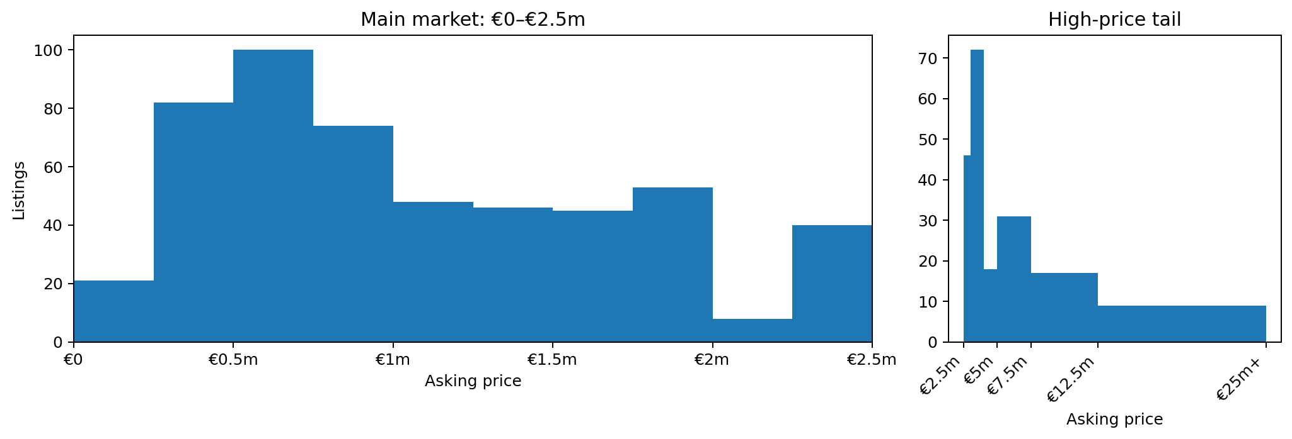
02 | PRICE DISTRIBUTION
The Main Market Is Concentrated Below €2.5m
The scale is deliberately split: the main market gets most of the chart area; the high-price tail is shown separately rather than flattening the core.
Subject Villa | Market Reference | 29 Aug 2026 | 3

Slide 4
03 | MARKET SEGMENTATION
Four Price Groups, Explained in Plain Language
C1
Low-price outliers
€<200k
11 entities
Very small low-end tail; not representative of the normal Costa Smeralda market.
C2
Core market
~€200k–€2m
595 entities
The main benchmark pool; the most useful comparison group for Subject Villa.
C3
High-price / luxury tail
Representative high tail
69 entities
Properties materially above the core; retained as a separate tail so they do not distort the core.
C4
Extreme luxury tail
Very high-price assets
31 entities
Trophy / ultra-prime assets whose pricing mechanism is materially different.
Reconciliation note: C1 11 | C2 595 | C3 69 | C4 31 | 9 unresolved / other. These are not forced into a category.
C1–C4 are analytical labels for different price-generating regimes; they are not legal market categories.
Subject Villa | Market Reference | 29 Aug 2026 | 4

Slide 5
04 | STRUCTURAL MODEL
Inside the Core: Property Form and Location Lead the Final C2 Screening
FIRST STRUCTURAL LAYER
Property form
The strongest screening separation in the reconciled 595-C2 pool.
SECOND STRUCTURAL LAYER
Location
The strongest next-stage separator after property form.
AREA Q1
~100 sqm
C2 reference
AREA MEDIAN
147.5 sqm
C2 reference
The final screening is exploratory: property form → location → area. It replaces the pre-reconciliation hierarchy and should not be read as causal inference.
Final C2 screening scores
Subject Villa remains a mid-sized property; its location and property configuration provide the more important structural context.
Subject Villa | Market Reference | 29 Aug 2026 | 5

Slide 6
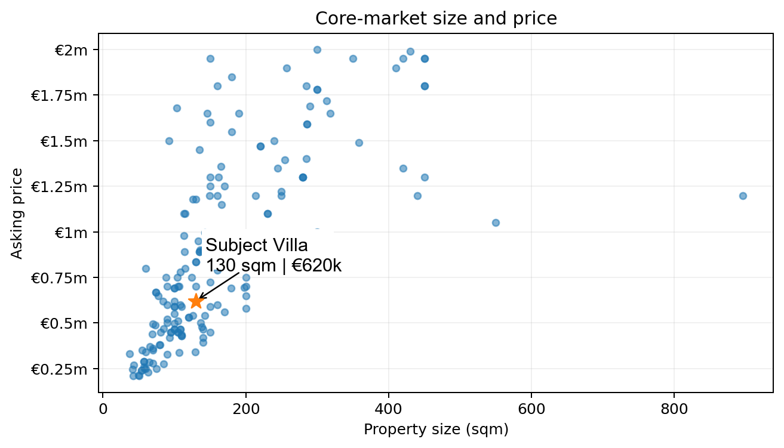
05 | SUBJECT VILLA POSITION
Subject Villa Is Mid-Sized and Low-Priced Within the Core
SUBJECT VILLA AREA
130 sqm
C2 median ≈147.5 sqm
SUBJECT VILLA PRICE
€620k
C2 median ≈€1.20m
READING
Below median
Still inside the normal core
The useful signal is not “small and cheap”. It is “mid-sized, yet priced below the core-market middle.”
Subject Villa | Market Reference | 29 Aug 2026 | 6

Slide 7
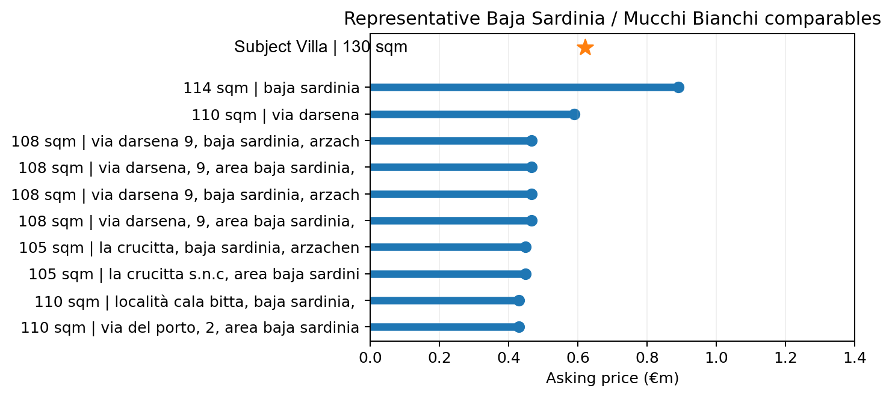
06 | BAJA SARDINIA / MUCCHI BIANCHI
From Costa Smeralda to the Local Market
The regional dataset narrows to the micro-market where Subject Villa actually competes.
Baja Sardinia / Mucchi Bianchi gives a more relevant benchmark than the full Costa Smeralda universe because the local stock contains the same broad residential forms and coastal use case.
The selected local set includes the subject reference; the local gap is universe-sensitive.
LOCAL COMPARISON POOL
63
Baja Sardinia / Mucchi Bianchi C2
LOCAL C2 MEDIAN
€700k
Subject Villa at €620k
LOCAL 3BR ANCHOR
€480k
~95–108 sqm
Local position is descriptive and sensitive to which listings enter the comparison set.
Subject Villa | Market Reference | 29 Aug 2026 | 7

Slide 8
07 | STRUCTURAL DIFFERENTIATION
Why Subject Villa Commands More Than a Standard 3BR
SIZE
130 sqm
Near the C2 size middle
SEA RELATIONSHIP
Strong
A major locational utility
BEACH PROXIMITY
~100 m
Direct seasonal-use advantage
PRIVATE OUTDOOR
~700 sqm
Large private external space
INDEPENDENCE
Three-sided
Higher privacy / less attachment
PARKING
Yes
Practical coastal utility
BUILDING FORM
Multi-level / loft
Distinctive configuration
The local evidence suggests that the price difference is structural, not simply a function of floor area. This is exactly why the recursive C2 model uses location after size.
Subject Villa | Market Reference | 29 Aug 2026 | 8

Slide 9
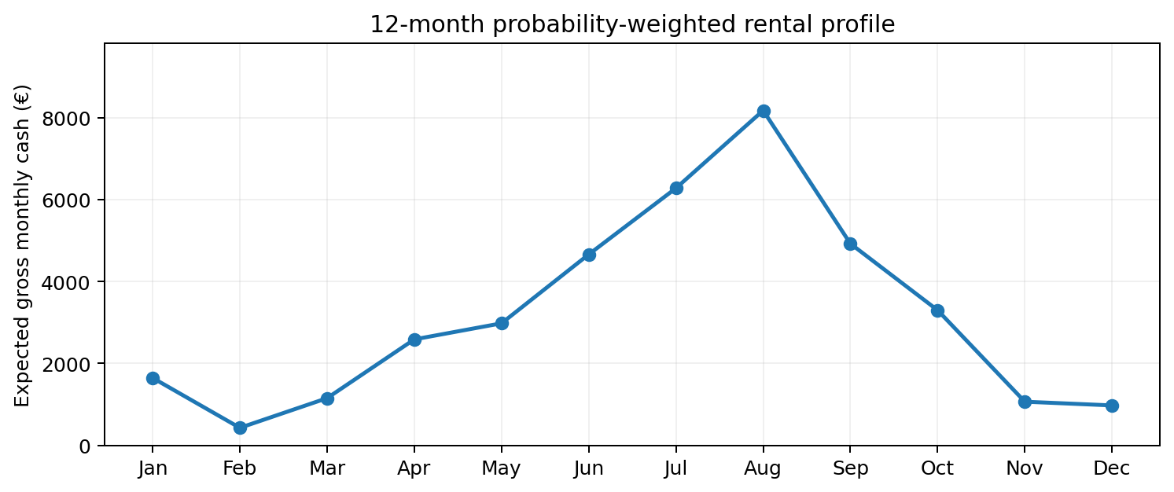
08 | RENTAL POSITION
The Rental Market Gives a Different Signal
DIRECT 3BR ANCHOR
€1,250 / week
95 sqm | 3BR | 2BA
OCTOBER MODEL
€2,115 / week
Probability-weighted
AUGUST NORMAL
€3,944 / week
Peak €4,630 / week
Rental positioning is materially stronger than the ordinary 3BR benchmark, creating the key sale-price versus rental-utility question.
Subject Villa | Market Reference | 29 Aug 2026 | 9

Slide 10
09 | RENTAL & ROI
Keep the Existing ROI Model — But Read It as Reference Data
ANNUAL GROSS RENT
€87.4k
12-month probability-weighted model
GROSS ROI
14.09%
Gross rent / €620k anchor
LIGHT MANAGEMENT
€42.1k
Linear net cash before fixed layer
FULL MANAGEMENT
€30.4k
Linear net cash before fixed layer
How to use these numbers
1. The gross model shows the rental capacity implied by the existing 12-month seasonality and occupancy proxies.
2. The operating scenarios show how platform fees, management and tax assumptions compress cash.
3. Fixed and semi-fixed property costs are then applied separately; this avoids hiding non-linear costs inside a single “ROI” number.
4. These figures are reference outputs, not realised income.
The useful comparison is not “rent pays back the house”. It is “what cash flow does the already-owned asset generate relative to its current market value?”
Subject Villa | Market Reference | 29 Aug 2026 | 10

Slide 11
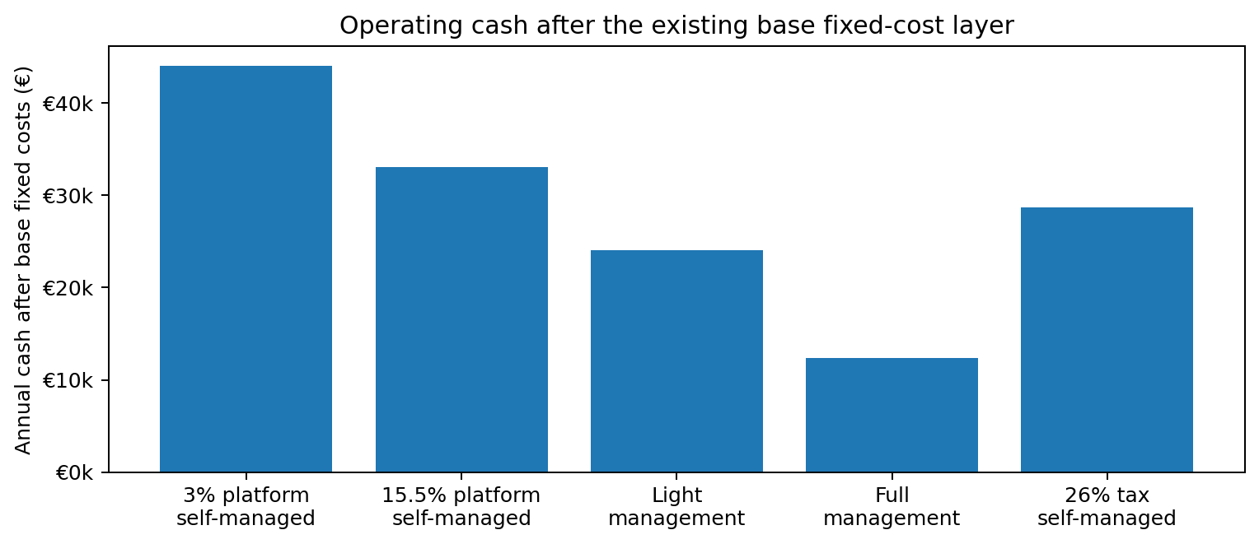
10 | OPERATING CASH
Operating Costs Change the Cash Result Materially
Base fixed / semi-fixed layer
€18.05k / year
Light management
≈ €24.1k annual cash after base fixed costs
Full management
≈ €12.3k annual cash after base fixed costs
The management model is therefore economically decisive.
The asset is much more attractive under efficient self-management or light management than under full-service management.
Subject Villa | Market Reference | 29 Aug 2026 | 11

Slide 12
11 | CAPITAL ALLOCATION
Hold or Sell? Compare Capital Uses, Not Payback
CURRENT CAPITAL VALUE
€620k
Capital tied up in the property
LIGHT-MANAGEMENT CASH
~€24.1k
After base fixed costs
FULL-MANAGEMENT CASH
~€12.3k
After base fixed costs
SELL OUTCOME
€620k released
Before transaction-specific sale costs
HOLD / RENT makes more sense when
• the property can be operated near the efficient scenarios;
• rental demand remains strong enough to sustain the model;
• the owner values keeping a scarce coastal real asset;
• there is no superior, concrete use for the released capital.
SELL becomes stronger when
• achievable rent or occupancy falls materially;
• recurring or extraordinary costs rise;
• full-service management becomes necessary;
• a better risk-adjusted destination for the capital is actually identified;
• the net sale price is materially above the €620k working anchor.
Current reference view: holding is economically plausible, but the evidence does not justify a blind “always hold” or “always sell” conclusion.
Subject Villa | Market Reference | 29 Aug 2026 | 12

Slide 13
12 | ASSET VIEW
Reference Conclusion: What the Evidence Suggests
MARKET ROLE
Core market
Normal residential price regime
SALES POSITION
€620k
Below core and local medians
STRUCTURAL POSITION
High utility
Location + private outdoor package
RENTAL POSITION
Above ordinary 3BR
Strong seasonal utility
CASH
Positive*
Depends on management
Working reference hypothesis
Subject Villa looks more interesting as a held and rented asset than as a simple “sell because it is valuable” case.
The reason is the combination of a relatively low sales-market position, a mid-sized footprint, and a structural package that the rental market may value more strongly than the sales market does.
The strongest unresolved variable is execution: achievable rent, occupancy and the true annual operating cost for this specific property.
Reference status: market analysis and decision support. Not an independent appraisal, tax opinion, or personalized investment mandate.
Subject Villa | Market Reference | 29 Aug 2026 | 13

Slide 14
APPENDIX
Evidence Base and Method
MARKET
• 966 canonical entities in the current working dataset
• 715 price-available entities
• C1 / C2 / C3 / C4 segmentation with the C3 layer calibrated to 69 scope-safe high-tail entities
STRUCTURE
• Final C2 screening: property form → location → area; exploratory, not causal
• Subject Villa: 130 sqm and €620k
LOCAL
• Selected local set: 63 rows, including subject reference
• Selected local-set median ≈ €700k (subject included)
• Local 3BR anchor ≈ €480k
RENTAL
• 12-month probability-weighted model
• Annual gross rent ≈ €87.4k
• Light-management linear net cash ≈ €42.1k before fixed layer
• Base fixed / semi-fixed cost layer ≈ €18.05k
EXTERNAL CONTEXT
• Costa Smeralda luxury stock is treated as a distinct upper-market segment, not the whole residential market
• External prime price references support strong location dispersion
LIMITATION
Asking prices are market observations, not verified transaction prices. Rental outputs are modelled reference values, not guaranteed realised income.
All conclusions are framed as reference signals: the report narrows from regional evidence to the specific asset without claiming false precision.
Subject Villa | Market Reference | 29 Aug 2026 | 14

Slide 15
06A | PRICE POSITION
The Asking Price Sits in the Lower Half of the Core
SUBJECT VILLA PRICE
€620k
Working market anchor
C2 MEDIAN
€1.20m
Price-available C2 sample
SUBJECT VILLA PERCENTILE
25th
Within C2
The property is not a low-end outlier. It is a normal core-market asset priced below the middle of the current C2 distribution.
Subject Villa | Market Reference | 29 Aug 2026 | 15

Slide 16
06B | UNIT ECONOMICS
At €4,769/sqm, Subject Villa Is Below the C2 Middle
SUBJECT VILLA
€4,769 / sqm
€620k / 130 sqm
C2 MEDIAN
€5,508 / sqm
200 C2 observations
PERCENTILE
37th
Within usable-size C2 sample
Subject Villa does not rely on an implausibly low unit price. Its unit economics remain inside the ordinary C2 range.
Subject Villa | Market Reference | 29 Aug 2026 | 16

Slide 17
06C | LOCAL MARKET
Local Market: Position Depends on the Comparison Set
BASIC LOCAL 3BR
SUBJECT VILLA
SELECTED LOCAL MEDIAN
AUDITED MEDIAN RANGE
€480k
€620k
€700k
€620k–€725k
Existing Via Darsena benchmark
130 sqm | 3BR | 2BA
Selected set includes subject reference
Alternative local universes
The selected €700k median includes the subject reference. Other archived local definitions range from €620k to €725k; no precise discount is claimed.
Subject Villa | Market Reference | 29 Aug 2026 | 17

Slide 18
06D | ASSET DIFFERENTIATION
The Premium Is Structural, Not a Size Premium
WHAT THE MARKET SEES
130 SQM
~700 SQM PRIVATE OUTDOOR
Near C2 size middle
Large external space
STRONG SEA VIEW
~100 M TO BEACH
High seasonal utility
Direct coastal use
THREE-SIDED INDEPENDENCE
PARKING + MULTI-LEVEL
Privacy / separation
Functional differentiation
The final C2 screening ranks property form first, location second and area third. Subject Villa then adds a strong local structural package that is not captured by floor area alone.
Subject Villa | Market Reference | 29 Aug 2026 | 18

Slide 19
07A | RENTAL SEASONALITY
Rental Income Is Strong — and Highly Seasonal
ANNUAL GROSS
€87.4k
Probability-weighted
JUN–OCT SHARE
71.6%
Of annual gross cash
JUL–SEP SHARE
50.8%
Peak-season concentration
This is an annual-cash asset with concentrated earning months, not a stable monthly-rent asset.
Subject Villa | Market Reference | 29 Aug 2026 | 19

Slide 20
07B | RENTAL POSITION
Subject Villa's Rental Model Sits Above the Ordinary Local 3BR Benchmark
LOCAL 3BR
€1,250 / week
95 sqm | 3BR | 2BA
OCTOBER
€2,115 / week
Probability-weighted model
AUGUST NORMAL
€3,944 / week
Peak €4,630
The rental signal is materially stronger than the ordinary 3BR sales benchmark.
Subject Villa | Market Reference | 29 Aug 2026 | 20

Slide 21
08 | OPERATING CASH
Operating Model Determines the Cash Yield
SELF-MANAGED / 3%
€44.0k
7.1% cash yield on €620k
SELF-MANAGED / 15.5%
€33.1k
5.3% cash yield on €620k
LIGHT MANAGEMENT
€24.1k
3.9% cash yield on €620k
FULL MANAGEMENT
€12.3k
2.0% cash yield on €620k
The difference between efficient self-management and full management is economically material.
Subject Villa | Market Reference | 29 Aug 2026 | 21

Slide 22
08A | HOLD / SELL
Hold or Sell Is a Capital-Allocation Question
CAPITAL TIED UP
LIGHT-MANAGEMENT CASH
FULL-MANAGEMENT CASH
EFFICIENT SELF-MANAGED
€620k
€24.1k
€12.3k
€44.0k
Current market anchor
After base fixed costs
After base fixed costs
After base fixed costs
HOLD / RENT becomes more compelling when
• the owner can operate near the efficient scenarios
• the rental profile remains achievable
• the owner values retaining a scarce coastal asset
• there is no superior identified use for the released capital
SELL becomes more compelling when
• achievable rent or occupancy falls materially
• full-service management becomes unavoidable
• extraordinary costs rise
• a real, risk-adjusted alternative use of €620k is superior
Current evidence: holding and renting is economically viable; the data do not justify a categorical Sell recommendation without a concrete alternative capital return.
Subject Villa | Market Reference | 29 Aug 2026 | 22

Slide 23
08B | SENSITIVITY & UNKNOWNS
What Would Change the Reference View?
RENTAL UNDERPERFORMANCE
MANAGEMENT LEAKAGE
Lower realised rents / occupancy would compress the strongest part of the thesis.
Full management reduces base annual cash to ~€12.3k.
EXTRAORDINARY COSTS
SUPERIOR CAPITAL USE
Major works, IMU or other unresolved costs can reduce cash materially.
A verified alternative destination for €620k could justify selling.
The key uncertainty is execution, not the market-position diagnosis: Subject Villa's sales and rental positions are now reasonably well defined.
Subject Villa | Market Reference | 29 Aug 2026 | 23

Slide 24
APPENDIX
Evidence Chain
MARKET
966 canonical entities | 715 price-available
C2
Approx. €200k–€2m working core | 595 calibrated entities
STRUCTURE
Property form → Location → Area recursive screening
LOCAL
Selected local-set median ≈ €700k (subject included)
Local 3BR anchor ≈ €480k
SUBJECT VILLA
€620k | 130 sqm | 3BR | 2BA
~700 sqm private outdoor | strong sea view | ~100 m beach
RENTAL
€87.4k annual probability-weighted gross
Jun–Oct ≈ 71.6% of annual gross
OPERATING CASH
€44.0k efficient self-managed → €12.3k full management
REFERENCE STATUS
Market positioning + decision support; not an appraisal or personalised investment mandate.
C1–C4 reconciliation currently leaves 9 price-available observations unresolved; these are excluded rather than forced into a category.
The report uses breadth only to establish context; the final judgement remains centred on Subject Villa.
Subject Villa | Market Reference | 29 Aug 2026 | 24

