Slide 1
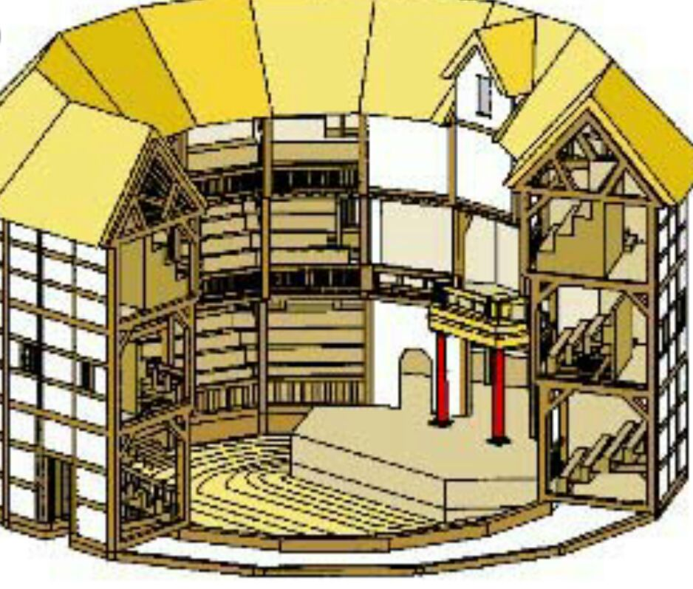
Conditions of
a production
London's public
playhouses
How plays were
performed

Slide 2
Conditions of
a production
London's public
playhouses
How plays were
performed

Slide 4
Conditions of
a production
London's public
playhouses
How plays were
performed

Slide 5
Conditions of
a production
Notes:
16

Slide 6
Stage and
audience
Conditions of
a production
Notes:
16

Slide 7
Stage and
audience
Conditions of
a production
Contents/
way of writing
Notes:
16

Slide 8
Stage: 13m x 8m
Stage and
audience
Conditions of
a production
Contents/
way of writing
Notes:
16

Slide 9
Stage: 13m x 8m
Three storey building
Stage and
audience
Conditions of
a production
Contents/
way of writing
Notes:
16

Slide 10
Stage: 13m x 8m
Three storey building
3000 people
Stage and
audience
Conditions of
a production
Contents/
way of writing
Notes:
16

Slide 11
Stage: 13m x 8m
Three storey building
3000 people
Stage and
audience
Conditions of
a production
Contents/
way of writing
Wealthy sitting in gallerie,
poor standing in yard
Notes:
16

Slide 12
Stage: 13m x 8m
Three storey building
3000 people
Stage and
audience
Conditions of
a production
Contents/
way of writing
Wealthy sitting in gallerie,
poor standing in yard
All classes
Notes:
16

Slide 13
Stage: 13m x 8m
Three storey building
3000 people
Stage and
audience
Conditions of
a production
Contents/
way of writing
Wealthy sitting in gallerie,
poor standing in yard
All classes
Comparable to audiences
at concerts nowadays
Notes:
16

Slide 14
Shakespeare was part
of a company
Stage: 13m x 8m
Three storey building
3000 people
Stage and
audience
Conditions of
a production
Contents/
way of writing
Wealthy sitting in gallerie,
poor standing in yard
All classes
Comparable to audiences
at concerts nowadays
Notes:
16

Slide 15
Shakespeare was part
of a company
Stage: 13m x 8m
Plays written specific
for the group
Three storey building
3000 people
Stage and
audience
Conditions of
a production
Contents/
way of writing
Wealthy sitting in gallerie,
poor standing in yard
All classes
Comparable to audiences
at concerts nowadays
Notes:
16

Slide 16
Shakespeare was part
of a company
Stage: 13m x 8m
Plays written specific
for the group
Three storey building
3000 people
Roles suited actors
Stage and
audience
Conditions of
a production
Contents/
way of writing
Wealthy sitting in gallerie,
poor standing in yard
All classes
Comparable to audiences
at concerts nowadays
Notes:
16

Slide 17
Shakespeare was part
of a company
Stage: 13m x 8m
Plays written specific
for the group
Three storey building
3000 people
Roles suited actors
Stage and
audience
Conditions of
a production
Contents/
way of writing
Details worked out
during rehersals
Wealthy sitting in gallerie,
poor standing in yard
All classes
Comparable to audiences
at concerts nowadays
Notes:
16

Slide 18
Shakespeare was part
of a company
Stage: 13m x 8m
Plays written specific
for the group
Three storey building
3000 people
Roles suited actors
Stage and
audience
Conditions of
a production
Contents/
way of writing
Details worked out
during rehersals
Wealthy sitting in gallerie,
poor standing in yard
All classes
Based on existing content
like plays, stories, history
Comparable to audiences
at concerts nowadays
Notes:
16

Slide 19
Shakespeare was part
of a company
Stage: 13m x 8m
Plays written specific
for the group
Three storey building
3000 people
Roles suited actors
Stage and
audience
Conditions of
a production
Contents/
way of writing
Details worked out
during rehersals
Wealthy sitting in gallerie,
poor standing in yard
All classes
Based on existing content
like plays, stories, history
sequels
Comparable to audiences
at concerts nowadays
Notes:
16

Slide 20
Shakespeare was part
of a company
Stage: 13m x 8m
Plays written specific
for the group
Three storey building
3000 people
Roles suited actors
Stage and
audience
Conditions of
a production
Contents/
way of writing
Details worked out
during rehersals
Wealthy sitting in gallerie,
poor standing in yard
collaborations
Based on existing content
like plays, stories, history
All classes
sequels
Comparable to audiences
at concerts nowadays
Notes:
16

Slide 21
Shakespeare was part
of a company
Stage: 13m x 8m
Plays written specific
for the group
Three storey building
3000 people
Roles suited actors
Stage and
audience
Conditions of
a production
Contents/
way of writing
Details worked out
during rehersals
Wealthy sitting in gallerie,
poor standing in yard
“cameos“
collaborations
Based on existing content
like plays, stories, history
All classes
sequels
Comparable to audiences
at concerts nowadays
Notes:
16

Slide 22
Conditions of
a production
London's public
playhouses
How plays were
performed

Slide 23
How plays were
performed
Notes:
19

Slide 24
Special
effects
How plays were
performed
Notes:
19

Slide 25
Attention of
the audience
Special
effects
How plays were
performed
Notes:
19

Slide 26
Attention of
the audience
Special
effects
How plays were
performed
Costumes
Notes:
19

Slide 27
Attention of
the audience
Types
Special
effects
How plays were
performed
Costumes
Notes:
19

Slide 28
Attention of
the audience
Thunder sounds
Types
Special
effects
How plays were
performed
Costumes
Notes:
19

Slide 29
Attention of
the audience
Thunder sounds
Lighning flashes/ bolts
Types
Special
effects
How plays were
performed
Costumes
Notes:
19

Slide 30
Smoke
Attention of
the audience
Thunder sounds
Lighning flashes/ bolts
Types
Special
effects
How plays were
performed
Costumes
Notes:
19

Slide 31
Trapdoors / Flying
Smoke
Attention of
the audience
Thunder sounds
Lighning flashes/ bolts
Types
Special
effects
How plays were
performed
Costumes
Notes:
19

Slide 32
Trapdoors / Flying
Smoke
Attention of
the audience
Thunder sounds
Lighning flashes/ bolts
Types
Special
effects
How plays were
performed
Downsides
Costumes
Notes:
19

Slide 33
Trapdoors / Flying
Smoke
Attention of
the audience
Thunder sounds
Lighning flashes/ bolts
Types
Special
effects
How plays were
performed
Downsides
Costumes
Smell
Notes:
19

Slide 34
Trapdoors / Flying
Smoke
Attention of
the audience
Thunder sounds
Lighning flashes/ bolts
Types
Special
effects
How plays were
performed
Downsides
Costumes
Smell
Expensive
Notes:
19

Slide 35
Trapdoors / Flying
Smoke
Attention of
the audience
Thunder sounds
Lighning flashes/ bolts
Types
Special
effects
How plays were
performed
Downsides
Costumes
Smell
Expensive
Dangerous
Notes:
19

Slide 36
Humour
Trapdoors / Flying
Smoke
Attention of
the audience
Thunder sounds
Lighning flashes/ bolts
Types
Special
effects
How plays were
performed
Downsides
Costumes
Smell
Expensive
Dangerous
Notes:
19

Slide 37
Humour
Violence
Trapdoors / Flying
Smoke
Attention of
the audience
Thunder sounds
Lighning flashes/ bolts
Types
Special
effects
How plays were
performed
Downsides
Costumes
Smell
Expensive
Dangerous
Notes:
19

Slide 38
Humour
Violence
Trapdoors / Flying
Smoke
Attention of
the audience
Thunder sounds
Lighning flashes/ bolts
Music/sounds
Types
Special
effects
How plays were
performed
Downsides
Costumes
Smell
Expensive
Dangerous
Notes:
19

Slide 39
Humour
Violence
Trapdoors / Flying
Smoke
Attention of
the audience
Thunder sounds
Lighning flashes/ bolts
Music/sounds
Types
Special
effects
How plays were
performed
Downsides
Costumes
Smell
Expensive
Dangerous
Expensive
Notes:
19

Slide 40
Humour
Violence
Trapdoors / Flying
Smoke
Attention of
the audience
Thunder sounds
Lighning flashes/ bolts
Music/sounds
Types
Special
effects
How plays were
performed
Downsides
Costumes
Indicated
social status
Smell
Expensive
Dangerous
Expensive
Notes:
19

Slide 41
Humour
Violence
Trapdoors / Flying
Smoke
Attention of
the audience
Thunder sounds
Lighning flashes/ bolts
Music/sounds
Types
Special
effects
How plays were
performed
Fashionable
Downsides
Costumes
Indicated
social status
Smell
Expensive
Dangerous
Expensive
Notes:
19

Slide 42
Humour
Violence
Trapdoors / Flying
Smoke
Attention of
the audience
Thunder sounds
Lighning flashes/ bolts
Music/sounds
Types
Special
effects
How plays were
performed
Fashionable
Downsides
Costumes
Indicated
social status
Smell
Expensive
Dangerous
Expensive
No women on stage
→ cross dressing
Notes:
19

