Slide 1
Regression and Classification projects
Predicting Uber rides prices and drugs usage
Dawid Grzesiak 473172 & Ahmad Huseynov 457962

Slide 2
Classification - Data
Source: UCI Machine Learning Repository. URL: https://archive.ics.uci.edu/dataset/373/drug+consumption+quantified
The independent variables include demographic (categorical) features related to the identity of the study participants, such as age, gender, education, country, and ethnicity.
The second group of independent variables are about personality traits such as neuroticism, extraversion, openness to experience, agreeableness, conscientiousness, impulsiveness, sensation
The target variables represent drug usage scores for different substances, ranging from 0 (never used) to 6 (used yesterday).

Slide 3
Main Challenges
Two types of drugs - quite evenly distributed soft drugs and highly imbalanced hard drugs, with majority of people who never took it

Slide 4
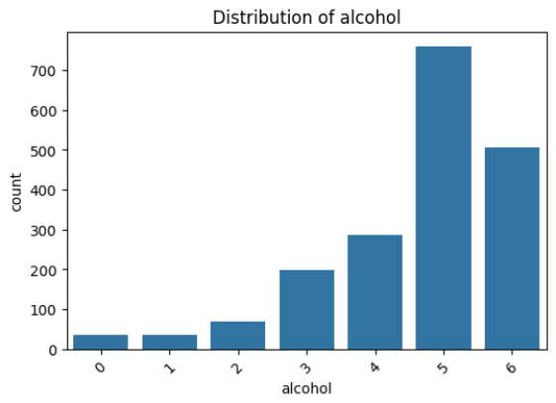
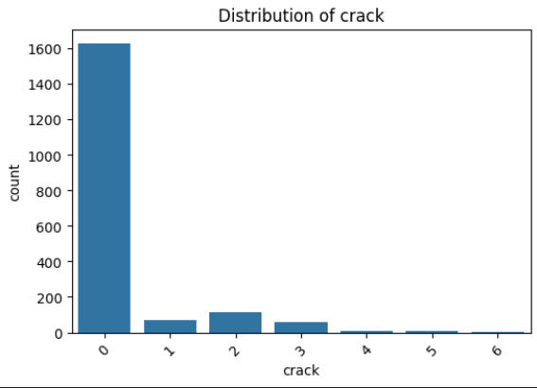
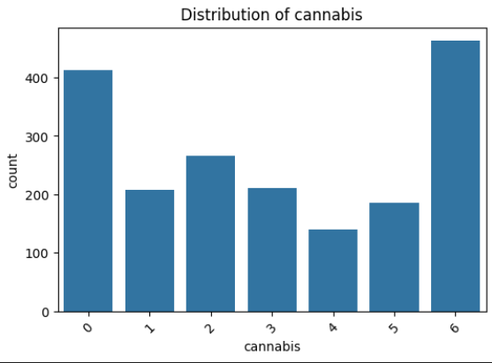
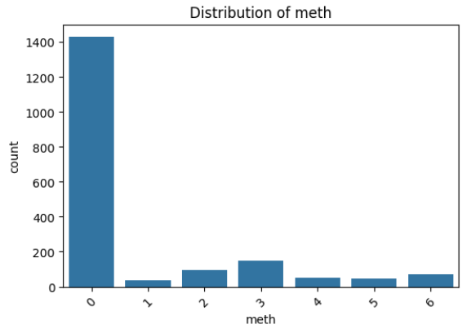
VS

Slide 5
Main Challenges Imposed by the Data
Two types of drugs - quite evenly distributed soft drugs such as alcohol or cannabis and highly imbalanced hard drugs, with majority of people who never took it.
Quite small dataset of almost 2K rows with risk to overfitting
Properly distinguishing between different drug types (soft vs. hard) is necessary for the correct interpretation of their impact on machine learning classification results.

Slide 6
How did we address these challenges?
Redefining the target variable as recent drug user vs non-recent user, where ‘recent’ means taking a drug in the last 12 months. The class imbalance issue persists, but now the main emphasis is on detecting the recent users, not defining how often do they use particular drugs.
Stratified split with respect to the given target variable (drug)

Slide 7
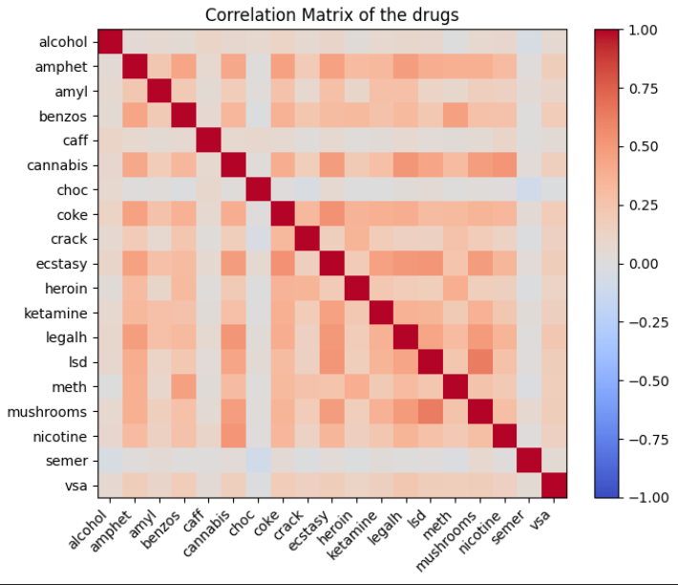
Key insights from EDA
Taking one drug is
correlated with taking another

Slide 8
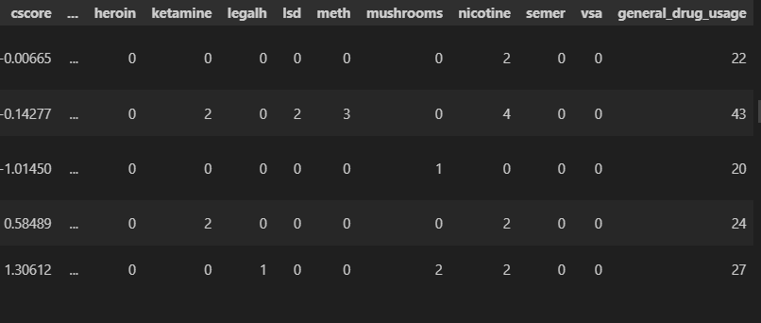
Key insights from EDA
2. Conclusion from point 1: we are rather talking about likelihood of taking drugs in general, not only-one-drug users. That is why for EDA purposes we create the general_drug_usage score, summing up all the initial 0-6 drug scores.

Slide 9
Key insights from EDA
3. From exploring the descriptive statistics of general drug score per different age groups, gender etc, we discovered:
the young male signal: drug usage peaks in the 18-24 age group (median 40 vs 18.5 in the oldest group) and males consume more than females (median 38 vs 25);
the American affect: Americans exhibiting 30% of the data have median usage score of 43, creating a sharp contrast against the Brits being 50% of the data;
the data is ethnically dominated by white people (91%), that’s why relying the further feature engineering on ethnicity imposes the risk of overfitting in the case of minority groups;
Willingness to take drugs is correlated with personality traits as impulsiveness, openness to experience and neuroticism

Slide 10
Modelling
We trained 3 algorithms:
Stochastic Gradient Descent (SGD) binary classifier
Random Forest with bootstrapping
Support Vector Machine
We analyzed 4 different performance metrics:
Base Accuracy (predict the most frequent class for each instance)
Balanced Accuracy
Precision
Recall
The performance was measured using k-fold cross validation, except for Algorithm 2, where we used the out-of-bag subsample

Slide 11
Importance of hyperparameters tuning
Metrics concerned: balanced accuracy, precision and recall:
For all the 3 algorithms, metrics increased significantly. The biggest velocity of change was observed for Random Forest and the smallest for Support Vector Machine.
The best examples is Random Forest’s recall for rare drugs such as heroin or ketamine, where the percent change increase from pre-tuning to post-tuning is above 2000%
The abovementioned spectacular increases in recall are traded off for the decrease in precision. The biggest drop is -66% for ketamine
Soft drugs exhibited much fewer increases of performance metrics compared to hard drugs

Slide 12
Model selection
Base accuracy was usually high (>75%) for every drug, except for nicotine (close to 50%) - proof for the classes imbalance issue
No test set was touched at this phase
SGD was outperformed by Random Forest and SVM, despite giving as good results as the other two algorithms in balanced accuracy. The two algorithms gave significantly better precision & recall
RF precision > SVM precision for rare drugs, but smaller/comparable for soft drugs
SVM recall > RF recall for rare drugs, but significantly smaller for soft drugs
The choice between RF and SVM depends on the research priorities

Slide 13
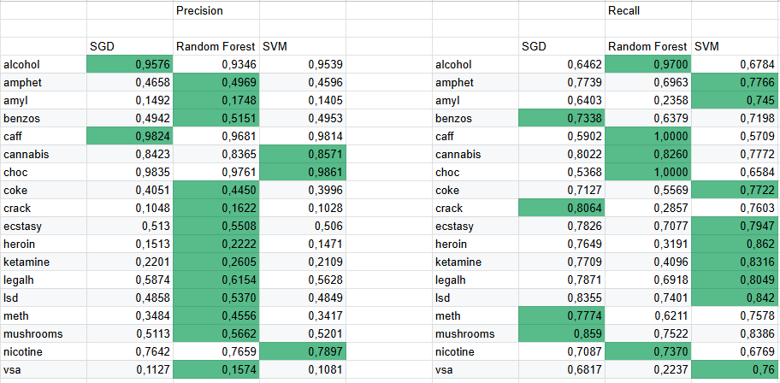
https://docs.google.com/spreadsheets/d/1ELvo4NLeOdF1JmAAhxz7UHt85nzaauMW2xkVVpqtnAY/edit?usp=sharing

Slide 14
SVM on the test set
very similar base accuracy, proving correct stratification at the train/test split
similar/slightly lower classification metrics to validation samples. We avoided extensive overfit at the training phase
Next, we included other drugs recent usage binary features in the set of independent variables. The results improved significantly (table on the right). The left table represents the test sample results for the initial model

Slide 15
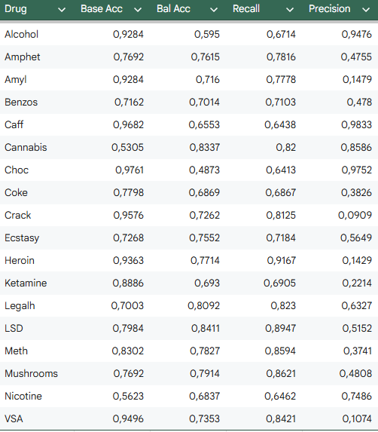
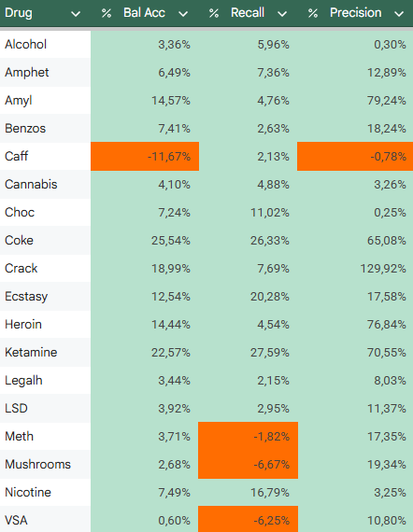

Slide 16
TL;DR
SHAP analysis on the SVM training set showed that age had the strongest influence on predictions, while ethnicity had the weakest. Among personality traits, only neuroticism and sensation seeking showed non-negligible effects compared to demographic variables.
We introduced age–gender and age–country interaction terms and applied PCA to personality traits (excluding neuroticism and sensation seeking), replacing them with the first two principal components. We dropped the ethnicity column.
The performance metrics did not improve

