Slide 1
Combinatorics
Pelatnas 1 TOKI 2015
Ahmad Zaky (TOMI 2010-2012)

Slide 2
IOI Syllabus
Sum & Product Rule
Permutations & Combinations
Binomial Coefficients
Inclusion-exclusion Principle
Pigeonhole Principle
Pascal’s Identity, Binomial Theorem
http://people.ksp.sk/~misof/ioi-syllabus/ioi-syllabus.pdf

Slide 3
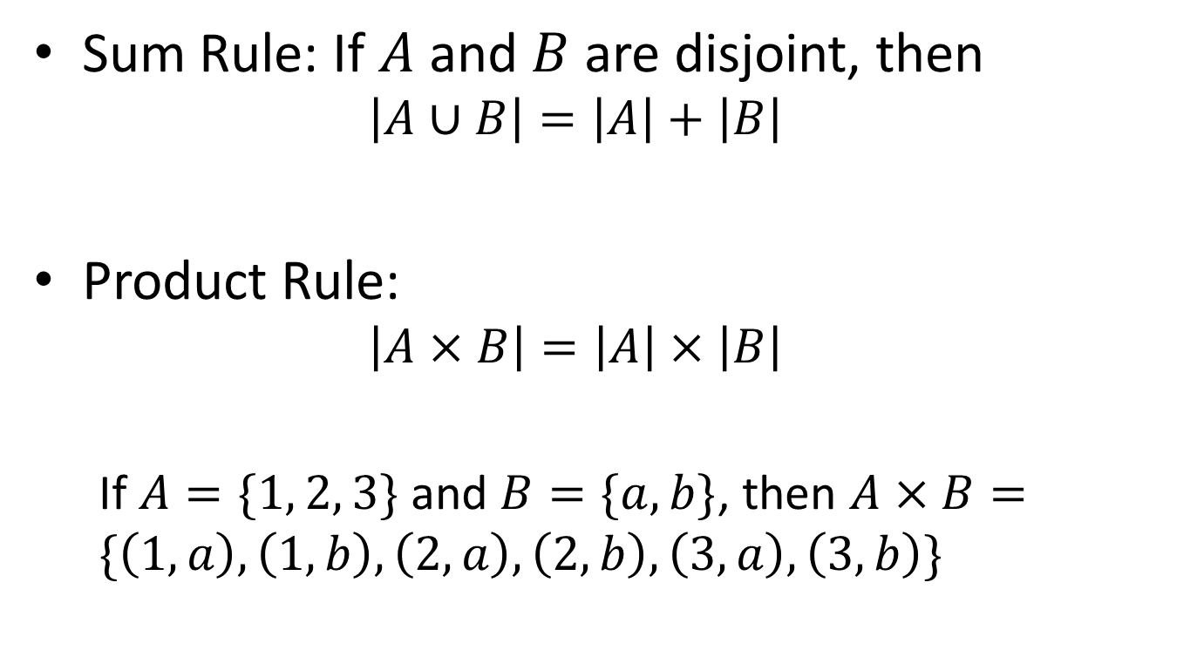
Sum & Product Rule
Sum Rule: If $A$ and $B$ are disjoint, then
$$\left|A∪B\right|=\left|A\right|+\left|B\right|$$
Product Rule:
$$\left|A×B\right|=\left|A\right|×\left|B\right|$$
If $A=\{1, 2, 3\}$ and $B=\{a, b\}$, then $A×B=\{\left(1,a\right), \left(1,b\right), \left(2,a\right),\left(2,b\right),\left(3,a\right),\left(3,b\right)\}$

Slide 4
Sum & Product Rule
OSK Problem:
Find the number of even three-digits integer such that all of the digits are different, and it is greater than 400

Slide 5
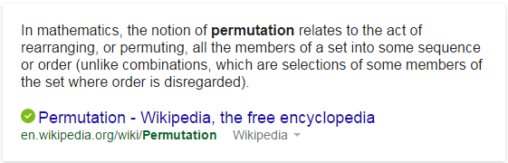

Permutations & Combinations
$n!$ ways to permute $n$ objects

Slide 6
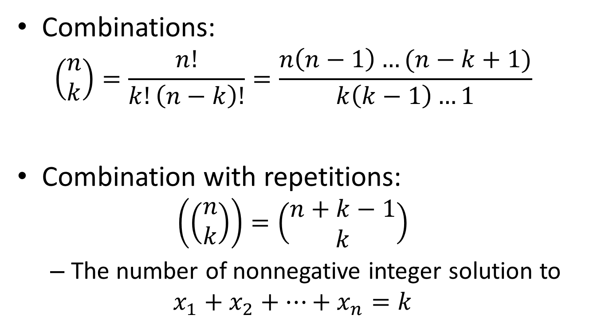
Permutations & Combinations
Combinations:
$$\left(\begin{matrix}n \\ k\end{matrix}\right)=\frac{n!}{k!\left(n−k\right)!}=\frac{n\left(n−1\right)…(n−k+1)}{k\left(k−1\right)…1}$$
Combination with repetitions:
$$\left(\left(\begin{matrix}n \\ k\end{matrix}\right)\right)=\left(\begin{matrix}n+k−1 \\ k\end{matrix}\right)$$
The number of nonnegative integer solution to
$$x_{1}+x_{2}+…+x_{n}=k$$

Slide 7
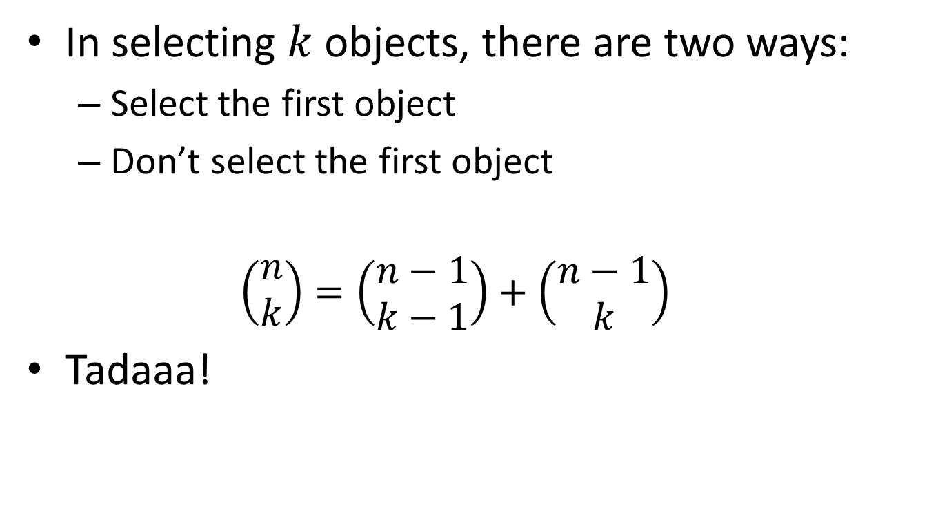
Pascal’s Identity
In selecting $k$ objects, there are two ways:
Select the first object
Don’t select the first object
$$\left(\begin{matrix}n \\ k\end{matrix}\right)=\left(\begin{matrix}n−1 \\ k−1\end{matrix}\right)+\left(\begin{matrix}n−1 \\ k\end{matrix}\right)$$
Tadaaa!

Slide 8


Pascal’s Identity
Version 1
Version 2

Slide 9
Binomial Coefficients
(tulis di papan aja deh)

Slide 10
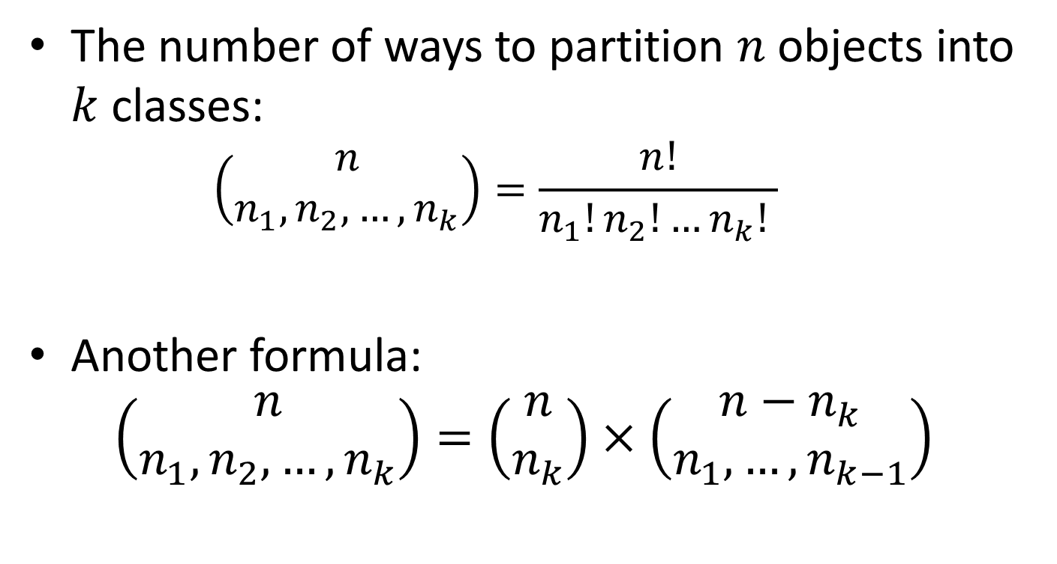
Multinomial Coefficients
The number of ways to partition $n$ objects into $k$ classes:
$$\left(\begin{matrix}n \\ n_{1}, n_{2}, …, n_{k}\end{matrix}\right)=\frac{n!}{n_{1}!n_{2}!…n_{k}! }$$
Another formula:
$$\left(\begin{matrix}n \\ n_{1}, n_{2}, …, n_{k}\end{matrix}\right)=\left(\begin{matrix}n \\ n_{k}\end{matrix}\right)×\left(\begin{matrix}n−n_{k} \\ n_{1}, …, n_{k−1}\end{matrix}\right)$$

Slide 11
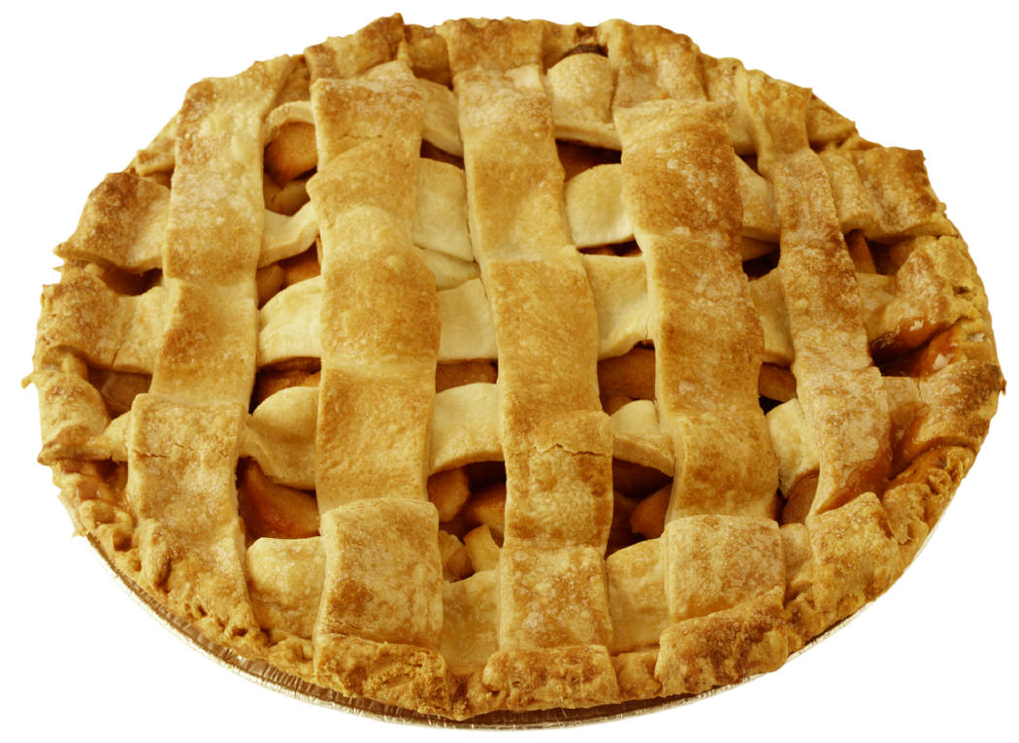
Inclusion-exclusion Principle

Slide 12
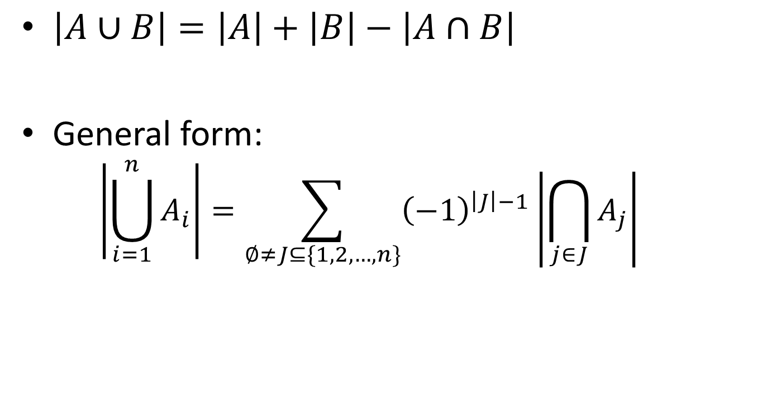
Inclusion-exclusion Principle
$\left|A∪B\right|=\left|A\right|+\left|B\right|−\left|A∩B\right|$
General form:
$$\left|\bigcup_{i=1}^{n}{A_{i}}\right|=\sum_{∅≠J⊆\{1,2,…,n\}}{{\left(−1\right)}^{\left|J\right|−1}\left|\bigcap_{j∈J}{A_{j}}\right|}$$

Slide 13
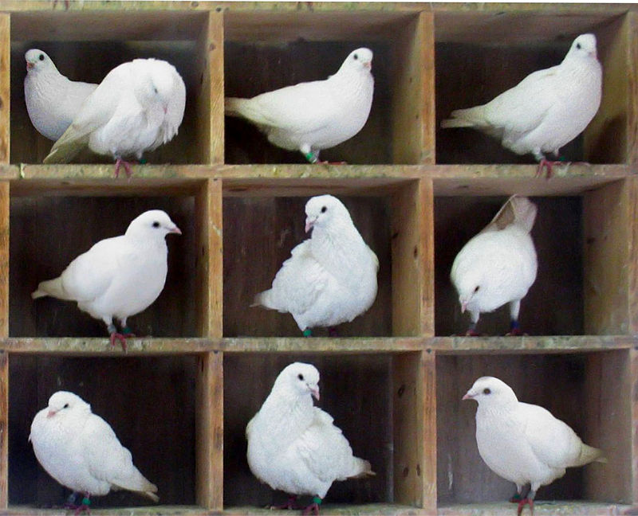
Pigeonhole Principle

Slide 14

Appendix: Generating Function
$\frac{1}{1−x}=1+x+x^{2}+…$
$\frac{1}{1−x^{n}}=1+x^{n}+x^{2n}+…$
$\frac{1}{{\left(1−x\right)}^{n}}=\sum_{k=0}^{∞}{\left({n+k−1 \atop k}\right)}x^{k}$

Slide 15
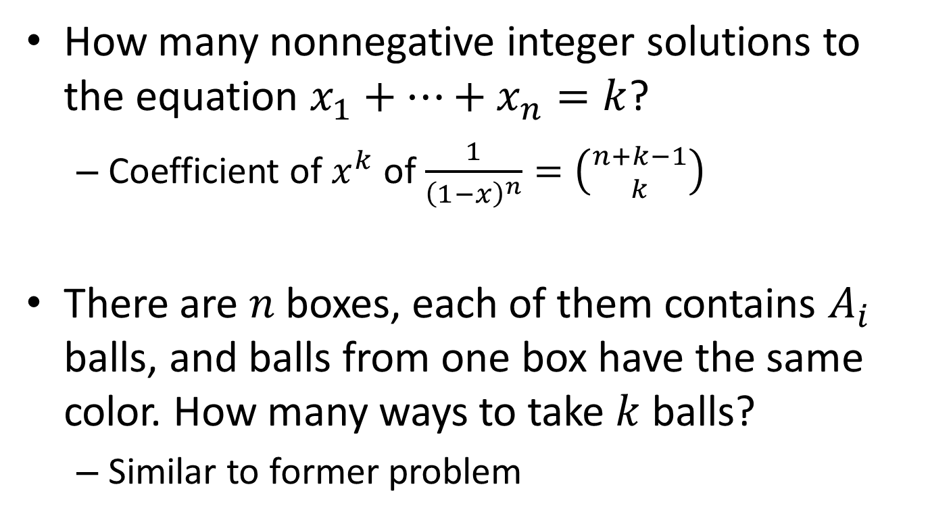
Appendix: Generating Function
How many nonnegative integer solutions to the equation $x_{1}+…+x_{n}=k$?
Coefficient of $x^{k}$ of $\frac{1}{{\left(1−x\right)}^{n}}=\left({n+k−1 \atop k}\right)$
There are $n$ boxes, each of them contains $A_{i}$ balls, and balls from one box have the same color. How many ways to take $k$ balls?
Similar to former problem

Slide 16

Problem: Card Derangement
How many ways of shuffling $n$ cards such that no card is in the correct position?

Slide 17

Problem: Menghitung Palindrom (P1 2014)
Given a string $s$ of length $n$, and $1≤l≤r≤n$, find the number of substring of $s[l..r]$ which is a palindrome.
$n≤2000, Q≤100000$

Slide 18

Problem: Play with GCDs (IEEExtreme 8.0)
Find the number of subset of $A$ such that the greatest common divisor of its elements is equal to $X$

Slide 19
Problem: Hiasan Dinding (OSN 2014)
(tulis di papan aja deh)

