Slide 1
Elementary Number Theory
Pelatnas 1 TOKI 2015
Ahmad Zaky (TOMI 2010-2012)

Slide 2
Table of Contents
Modular Arithmetic
Prime Numbers
Multiplicative Functions
Euclidean Algorithm
Diophantine Equations

Slide 3
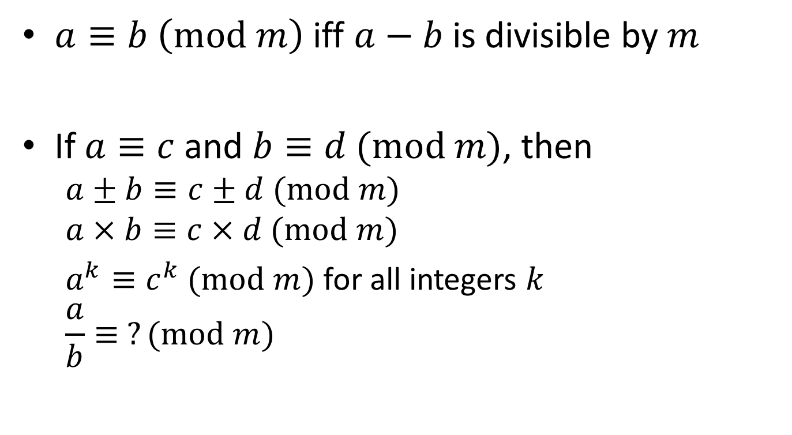
Modular Arithmetic
$a≡b \left(mod m\right)$ iff $a−b$ is divisible by $m$
If $a≡c$ and $b≡d (mod m)$, then
$$a±b≡c±d (mod m)$$
$$a×b≡c×d (mod m)$$
$a^{k}≡c^{k} (mod m)$ for all integers $k$
$$\frac{a}{b}≡ ?(mod m)$$

Slide 4
Prime Number
Positive integers which have exactly 2 positive divisors
2, 3, 5, 7, ...

Slide 5
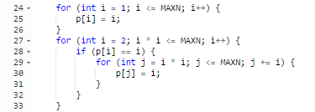

Primality Testing
Obvious $O(\sqrt{n})$ loop
Sieve Eratosthenes ($O\left(n\log{\log{n}}\right)$)
It is fast; 186ms for $n={10}^{7}$

Slide 6
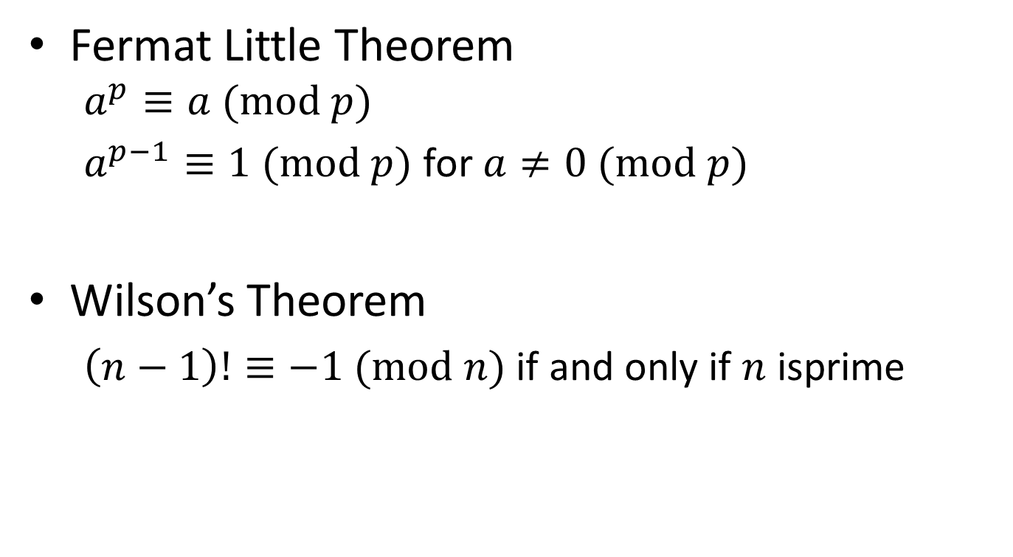
Theorems Involving Primes
Fermat Little Theorem
$$a^{p}≡a (mod p)$$
$a^{p−1}≡1 (mod p)$ for $a≠0 (mod p)$
Wilson’s Theorem
$\left(n−1\right)!≡−1 (mod n)$ if and only if $n$ isprime

Slide 7
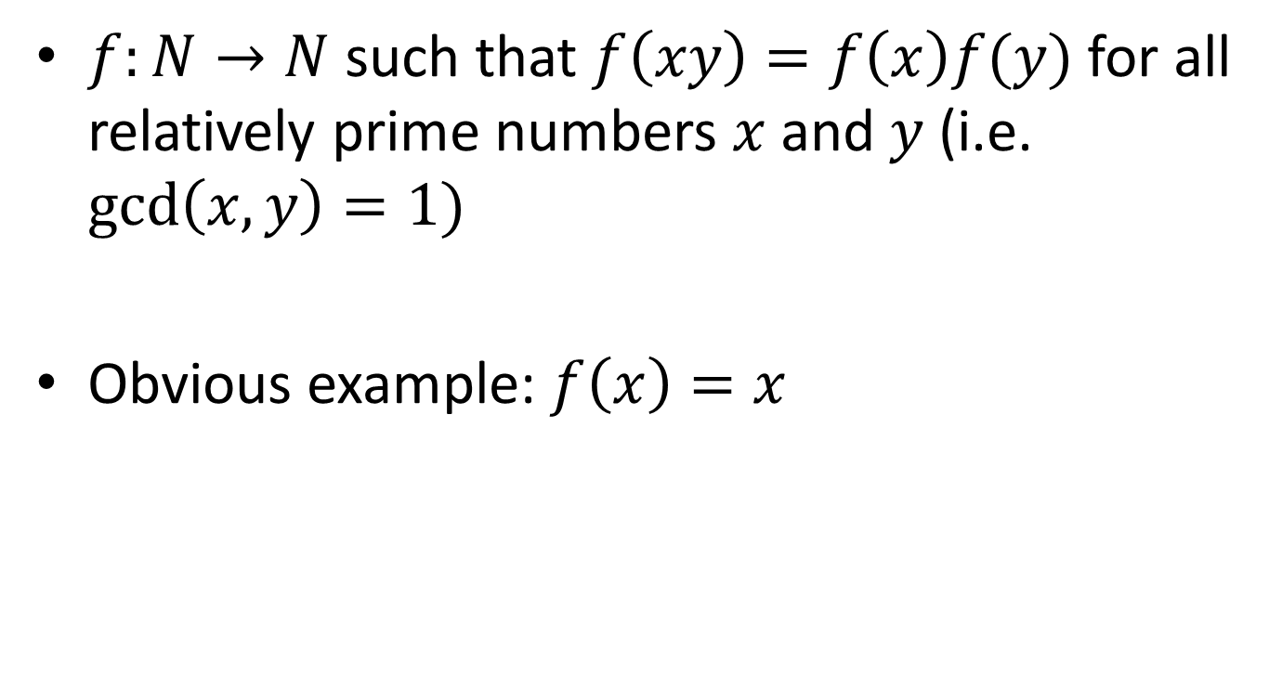
Multiplicative Functions
$f:N→N$ such that $f\left(xy\right)=f\left(x\right)f(y)$ for all relatively prime numbers $x$ and $y$ (i.e. $\gcd\left(x,y\right)=1)$
Obvious example: $f\left(x\right)=x$

Slide 8
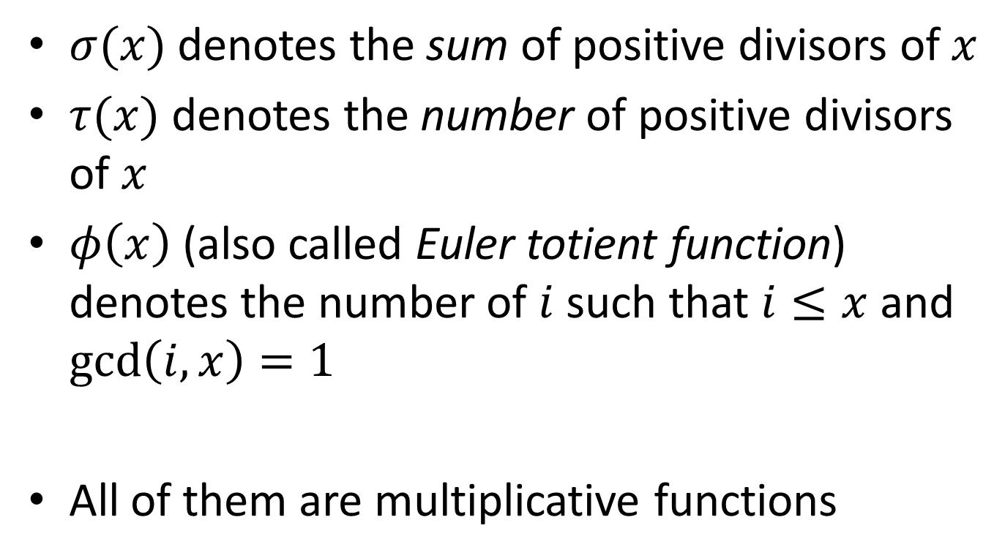
Sigma, Tau, Phi
$σ(x)$ denotes the sum of positive divisors of $x$
$τ(x)$ denotes the number of positive divisors of $x$
$φ\left(x\right)$ (also called Euler totient function) denotes the number of $i$ such that $i≤x$ and $\gcd\left(i,x\right)=1$
All of them are multiplicative functions

Slide 9
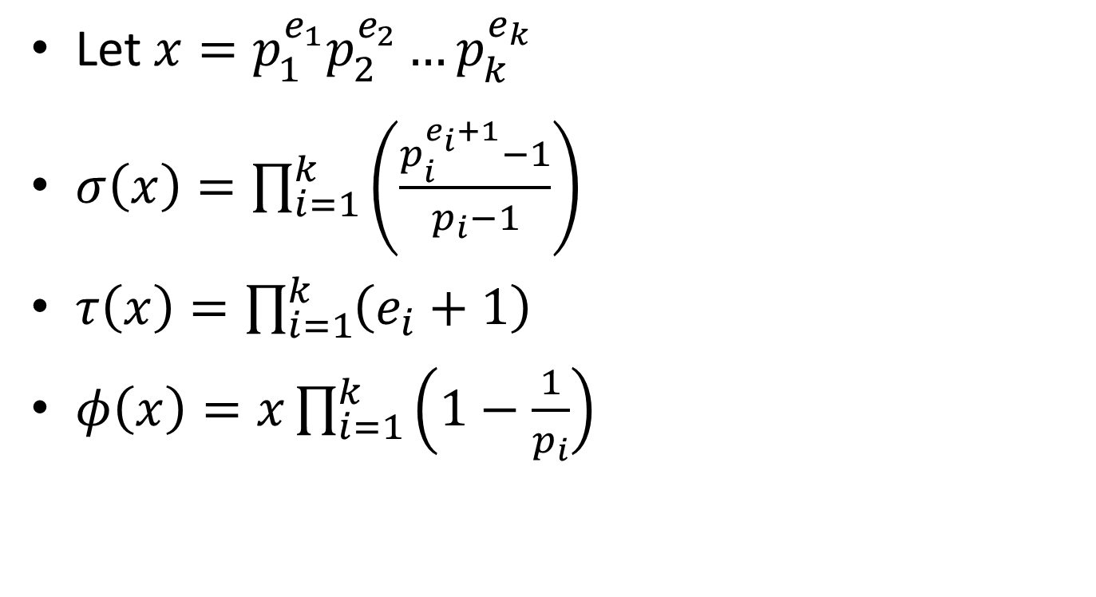
Sigma, Tau, Phi
Let $x=p_{1}^{e_{1}}p_{2}^{e_{2}}…p_{k}^{e_{k}}$
$σ\left(x\right)=\prod_{i=1}^{k}{\left(\frac{p_{i}^{e_{i}+1}−1}{p_{i}−1}\right)}$
$τ\left(x\right)=\prod_{i=1}^{k}{\left(e_{i}+1\right)}$
$φ\left(x\right)=x\prod_{i=1}^{k}{\left(1−\frac{1}{p_{i}}\right)}$

Slide 10

Euler’s Theorem
$a^{φ(n)}≡1 \left(mod n\right)$ if $\gcd\left(a,n\right)=1$

Slide 11
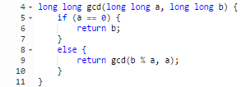

Euclidean Algorithm
$\gcd\left(a,b\right)=\gcd\left(b, a−b\right)$

Slide 12
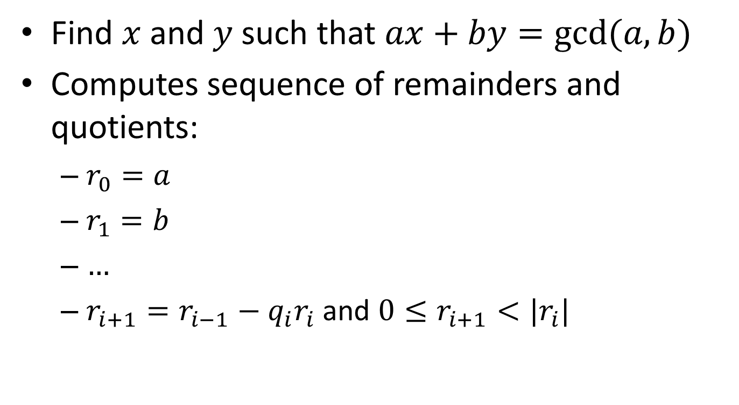
Extended Euclidean Algorithm
Find $x$ and $y$ such that $ax+by=gcd⁡(a,b)$
Computes sequence of remainders and quotients:
$r_{0}=a$
$r_{1}=b$
$…$
$r_{i+1}=r_{i−1}−q_{i}r_{i}$ and $0≤r_{i+1}<|r_{i}|$

Slide 13
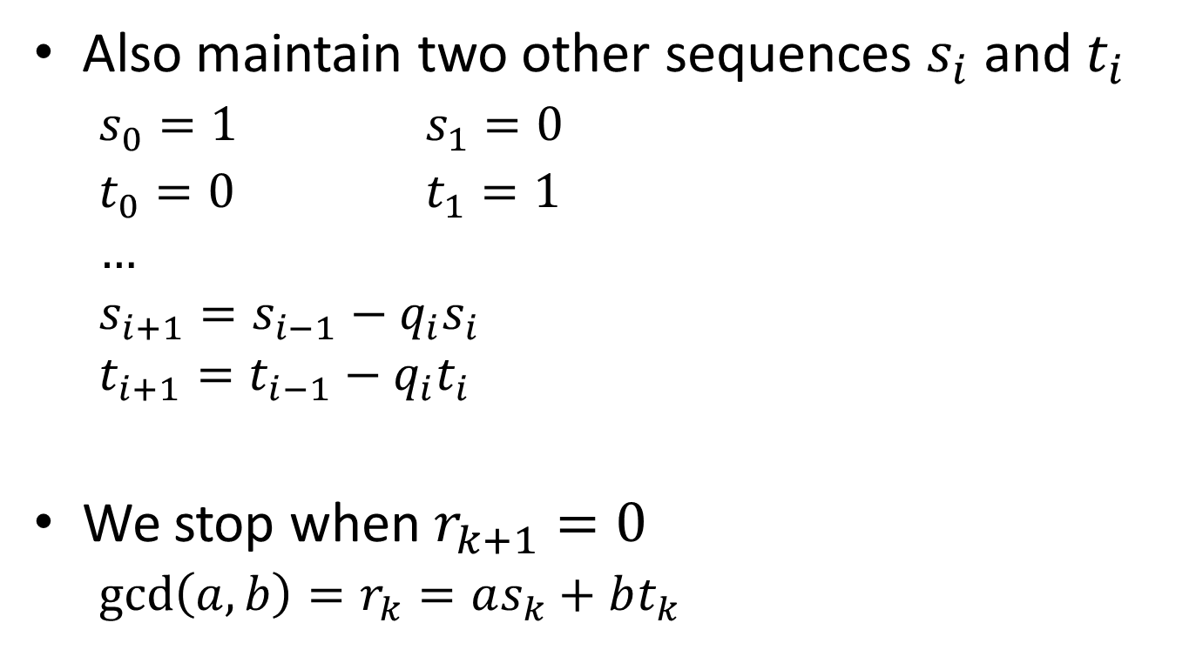
Extended Euclidean Algorithm
Also maintain two other sequences $s_{i}$ and $t_{i}$
$s_{0}=1$ $s_{1}=0$
$t_{0}=0$ $t_{1}=1$
$$…$$
$$s_{i+1}=s_{i−1}−q_{i}s_{i}$$
$$t_{i+1}=t_{i−1}−q_{i}t_{i}$$
We stop when $r_{k+1}=0$
$\gcd\left(a,b\right)=r_{k}=as_{k}+bt_{k}$

Slide 14
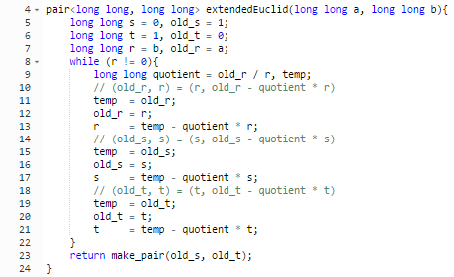
Extended Euclidean Algorithm

Slide 15
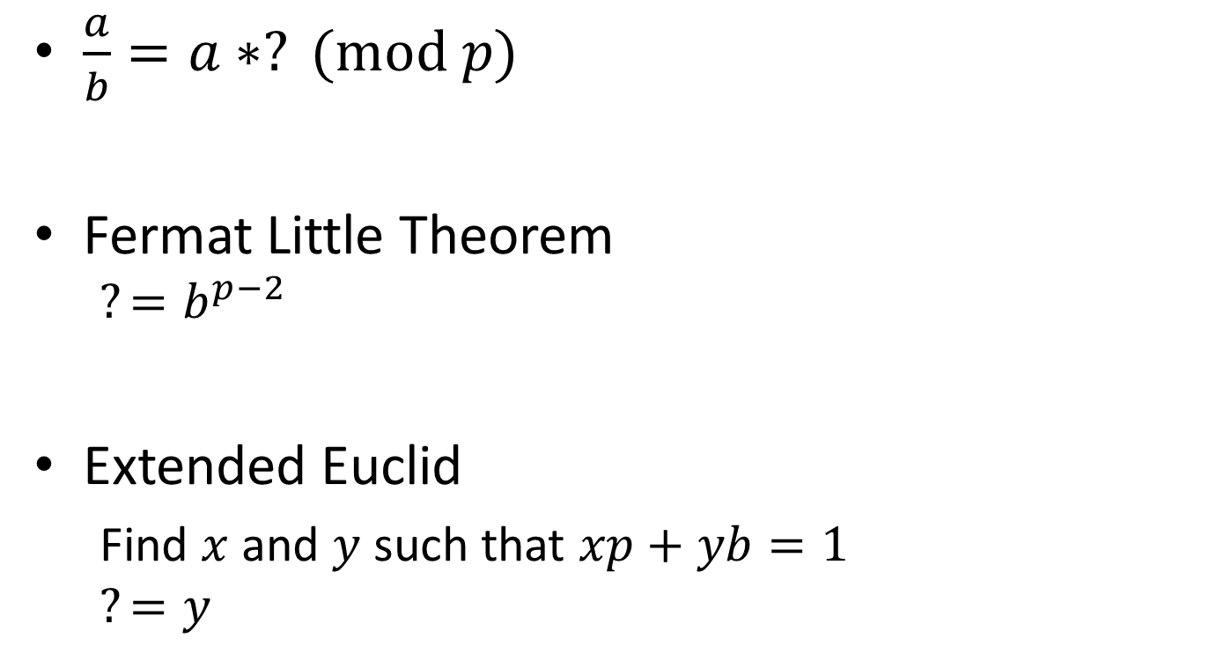
Multiplicative Inverse
$\frac{a}{b}=a∗? (mod p)$
Fermat Little Theorem
$$?=b^{p−2}$$
Extended Euclid
Find $x$ and $y$ such that $xp+yb=1$
$$?=y$$

Slide 16
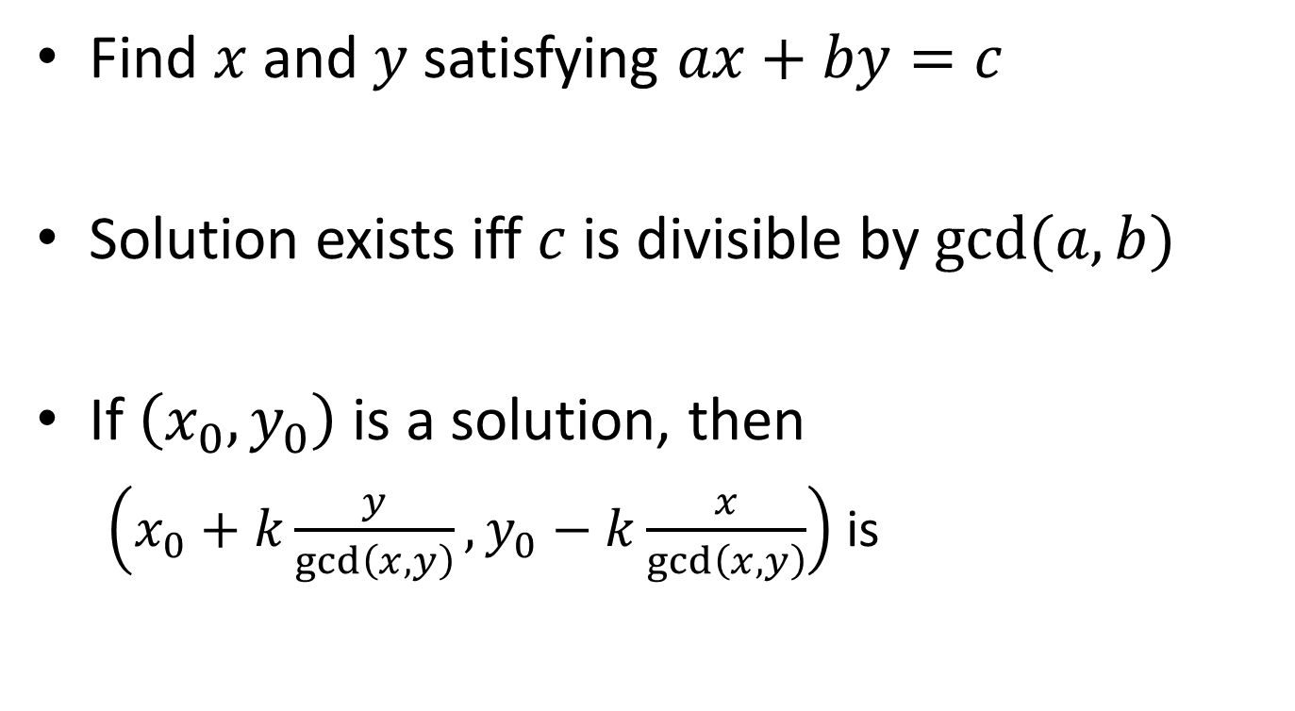
Linear Diophantine Equation
Find $x$ and $y$ satisfying $ax+by=c$
Solution exists iff $c$ is divisible by $gcd⁡(a,b)$
If $\left(x_{0},y_{0}\right)$ is a solution, then
$\left(x_{0}+k\frac{y}{\gcd\left(x,y\right)},y_{0}−k\frac{x}{\gcd\left(x,y\right)}\right)$ is

Slide 17

Problem: Benefit (UVa11889)
Given $a$ and $c$, find the smallest positive integer $b$ such that $lcm\left(a,b\right)=c$

Slide 18

Problem: Permasalahan DP (P1 2014)
If $f(a,b)$ is known, then so is $f(a×k,b×k)$
How many values of $f$ should be calculated to find all $f\left(a,b\right)$, $1≤a,b≤n$?

