Slide 1
Pemusatan Latihan Nasional
Pelatnas – Tahap 1
Tim Olimpiade Komputer Indonesia
Rully Soelaiman
rully130270@gmail.com
Jurusan Teknik Informatika
Fakultas Teknologi Informasi
Institut Teknologi Sepuluh Nopember

Slide 2

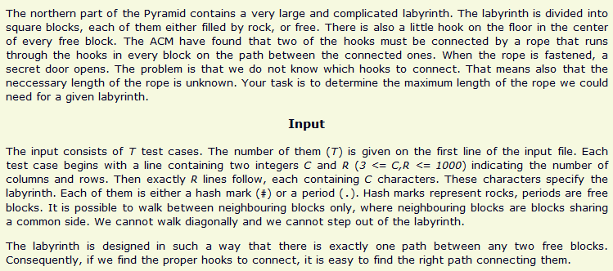
Diameter of Tree –
SPOJ 38. Labyrinth

Slide 3
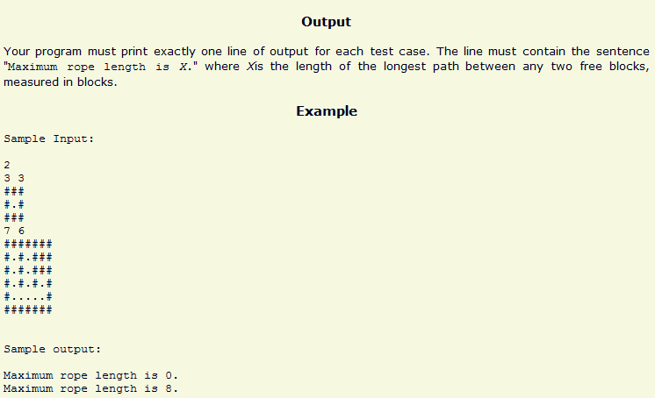
Diameter of Tree –
SPOJ 38. Labyrinth

Slide 4
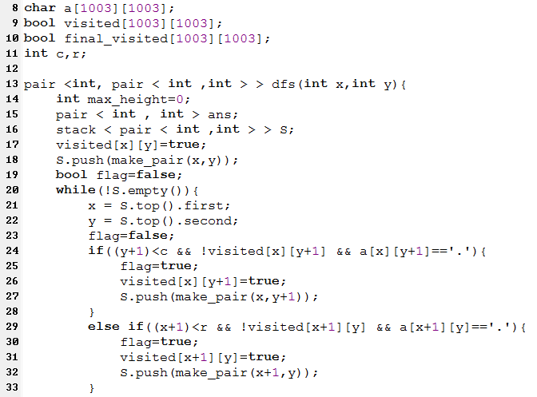
Diameter of Tree –
SPOJ 38. Labyrinth

Slide 5
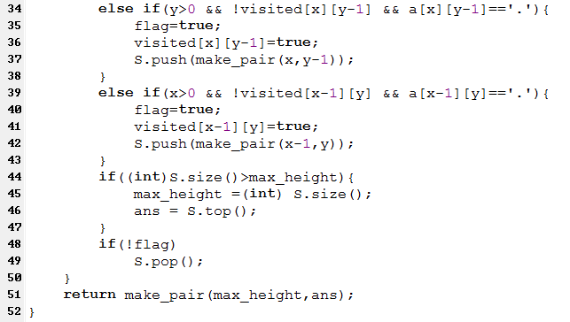
Diameter of Tree –
SPOJ 38. Labyrinth

Slide 6
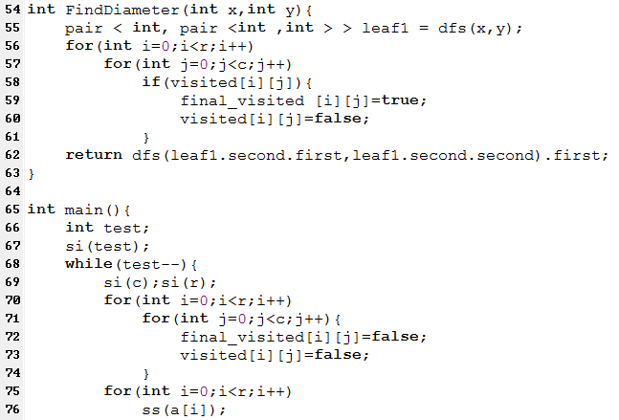
Diameter of Tree –
SPOJ 38. Labyrinth

Slide 7
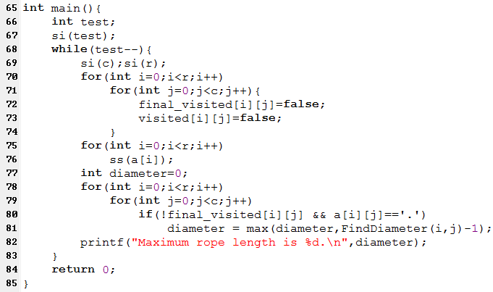
Diameter of Tree –
SPOJ 38. Labyrinth

Slide 8
Agenda
Generic MST Algorithm
Kruskal's Algorithm
Prim-Jarnik Algorithm

Slide 9
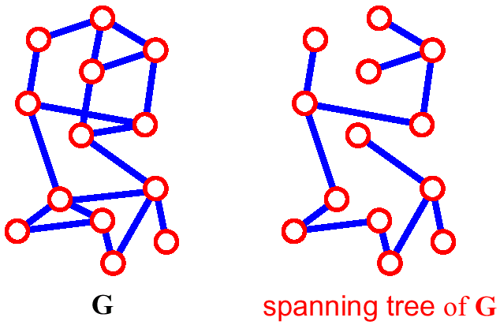
Spanning Tree
A spanning tree of G is a subgraph which
  is a tree
  contains all vertices of G

Slide 10
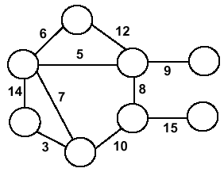
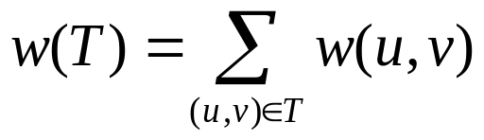
Minimum Spanning Trees
Undirected, connected graph G = (V,E)
Weight function W: E → R (assigning cost or length or other values to edges)
Spanning tree: tree that connects all the vertices (above?)
Minimum spanning tree: tree that connects all the vertices and minimizes

Slide 11
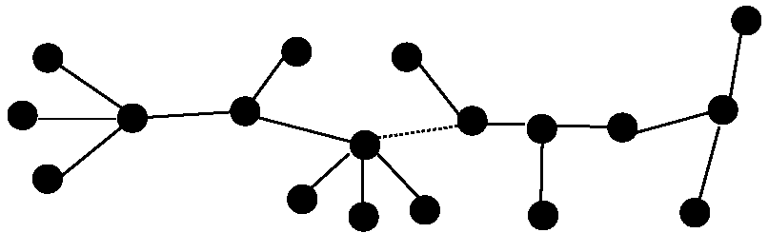
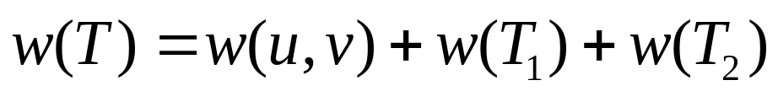
Optimal Substructure
T₂
MST T
Removing the edge (u,v) partitions T into T₁ and T₂
We claim that T₁ is the MST of G₁=(V₁,E₁), the subgraph of G induced by vertices in T₁
Also, T₂ is the MST of G₂
T₁

Slide 12
Greedy Choice
Greedy choice property: locally optimal (greedy) choice yields a globally optimal solution
Theorem
  Let G=(V, E), and let S ⊆ V and
  let (u,v) be min-weight edge in G connecting S to V – S
  Then (u,v) ∈ T – some MST of G

Slide 13
Greedy Choice (2)
Proof
  suppose (u,v) ∉ T
  look at path from u to v in T
  swap (x, y) – the first edge on path from u to v in T that crosses from S to V – S
  this improves T – contradiction (T supposed to be MST)
V-S
S
y
x
u
v

Slide 14
Generic MST Algorithm
Generic-MST(G, w)
1 A←∅ // Contains edges that belong to a MST
2 while A does not form a spanning tree do
3 Find an edge (u,v) that is safe for A
4 A←A∪{(u,v)}
5 return A
Safe edge – edge that does not destroy A’s property
The algorithm manages a set of edges A maintaining the following loop invariant
Prior to each iteration, A is a subset of some minimum spanning tree.
At each step, an edge is determined that can be added to A without violating this invariant. Such an edge is called a Safe Edge.

Slide 15
Kruskal's Algorithm
Edge based algorithm
Add the edges one at a time, in increasing weight order
The algorithm maintains A – a forest of trees. An edge is accepted it if connects vertices of distinct trees
We need a data structure that maintains a partition, i.e.,a collection of disjoint sets
  MakeSet(S,x): S ← S ∪ {{x}}
  Union(S_{i},S_{j}): S ← S – {S_{i},S_{j}} ∪ {S_{i} ∪ S_{j}}
  FindSet(S, x): returns unique S_{i} ∈ S, where x ∈ S_{i}

Slide 16
Kruskal's Algorithm
The algorithm adds the cheapest edge that connects two trees of the forest
MST-Kruskal(G,w)
01 A ← ∅
02 for each vertex v ∈ V[G] do
03 Make-Set(v)
04 sort the edges of E by non-decreasing weight w
05 for each edge (u,v) ∈ E, in order by non-decreasing weight do
06 if Find-Set(u) ≠ Find-Set(v) then
07 A ← A ∪ {(u,v)}
08 Union(u,v)
09 return A

Slide 17
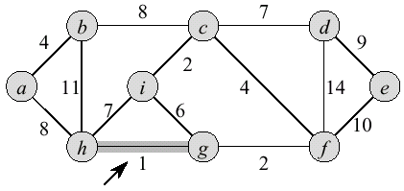
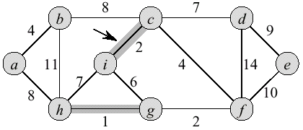
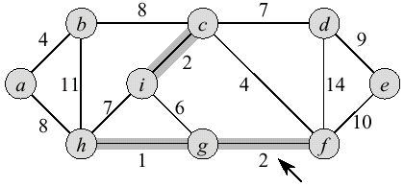
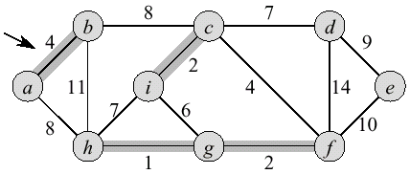
Kruskal Example

Slide 18
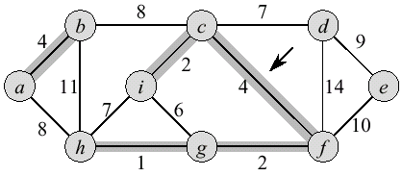
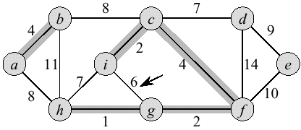
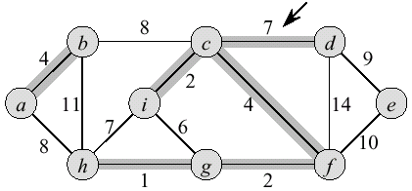
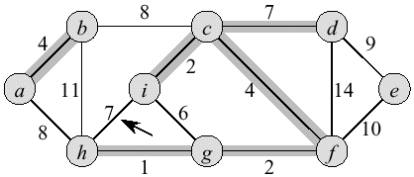
Kruskal Example (2)

Slide 19
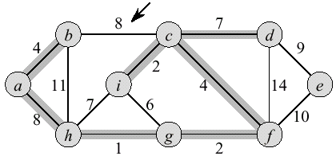
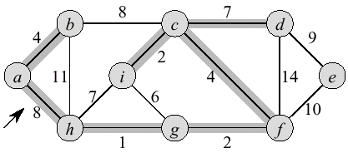
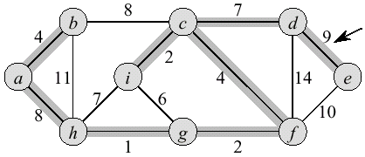
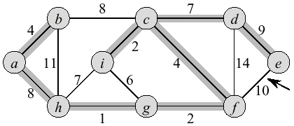
Kruskal Example (3)

Slide 20
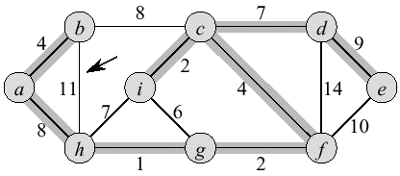
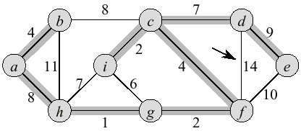
Kruskal Example (4)

Slide 21
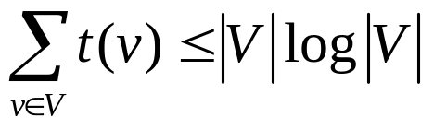
Kruskal Running Time
Initialization O(V) time
Sorting the edges Θ(E lg E) = Θ(E lg V)
O(E) calls to FindSet
Union costs
  Let t(v) – the number of times v is moved to a new cluster
  Each time a vertex is moved to a new cluster the size of the cluster containing the vertex at least doubles: t(v) ≤ log V
  Total time spent doing Union
Total time: O(E lg V)

Slide 22
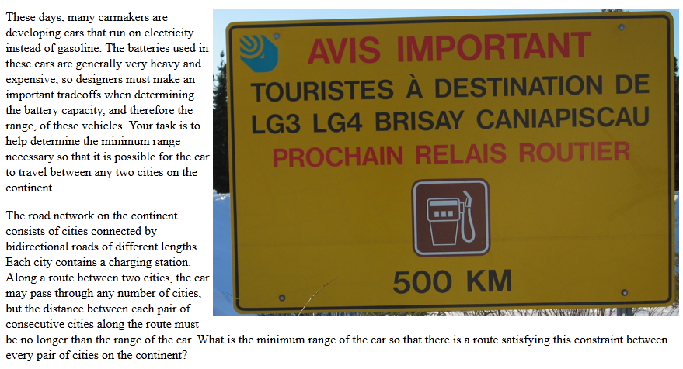
UVa 11857 – Driving Range

Slide 23
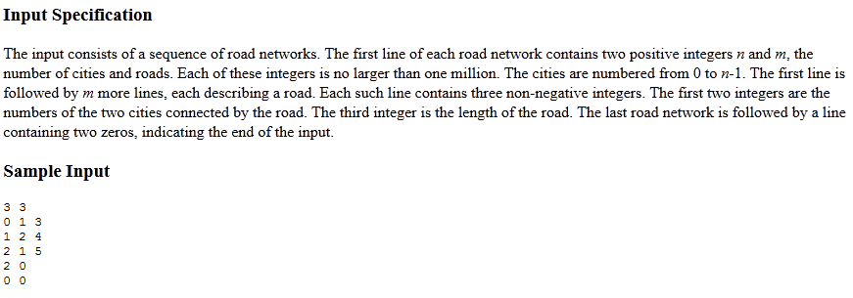
UVa 11857 – Driving Range

Slide 24
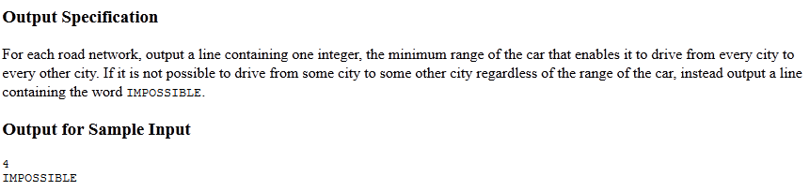
UVa 11857 – Driving Range

Slide 25
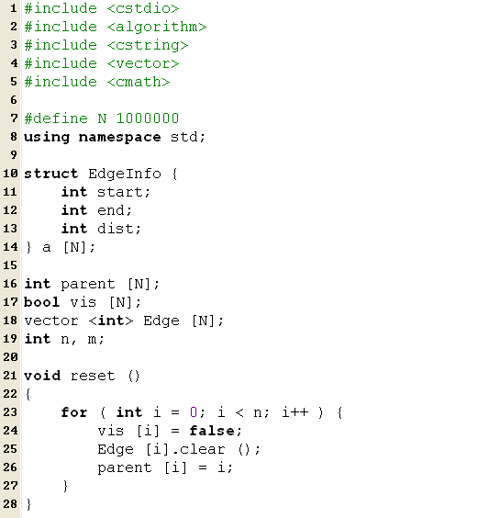
UVa 11857 – Driving Range

Slide 26
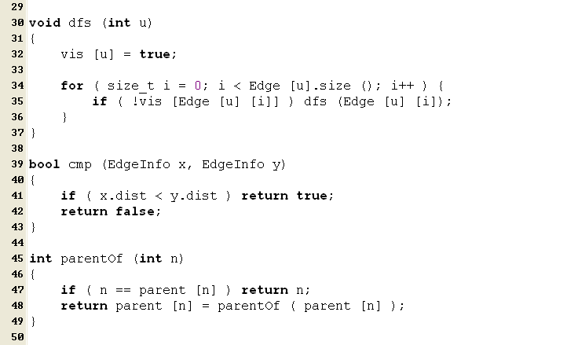
UVa 11857 – Driving Range

Slide 27
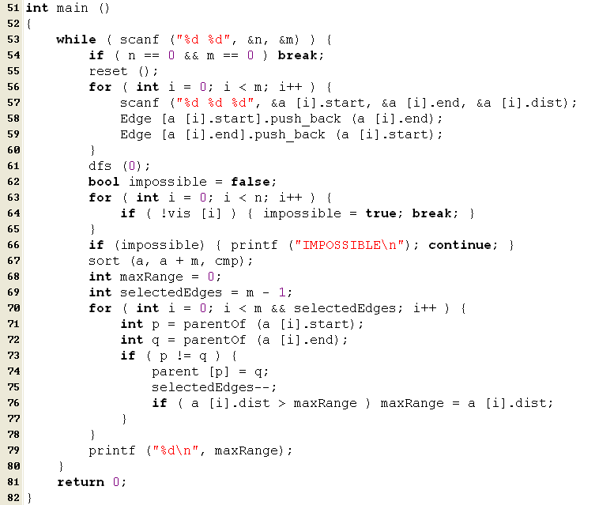
UVa 11857 – Driving Range

Slide 28
Prim-Jarnik Algorithm
Vertex based algorithm
Grows one tree T, one vertex at a time
A cloud covering the portion of T already computed
Label the vertices v outside the cloud with key[v] – the minimum weigth of an edge connecting v to a vertex in the cloud, key[v] = ∞, if no such edge exists

Slide 29
Prim-Jarnik Algorithm (2)
MST-Prim(G,w,r)
01 Q ← V[G] // Q – vertices out of T
02 for each u ∈ Q
03 key[u] ← ∞
04 key[r] ← 0
05 π[r] ← NIL
06 while Q ≠ ∅ do
07 u ← ExtractMin(Q) // making u part of T
08 for each v ∈ Adj[u] do
09 if v ∈ Q and w(u,v) < key[v] then
10 π[v] ← u
11 key[v] ← w(u,v)
updating keys

Slide 30
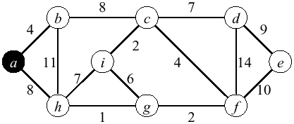
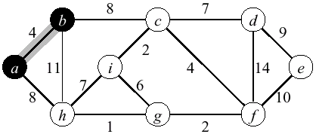
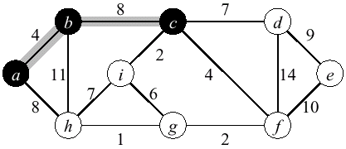
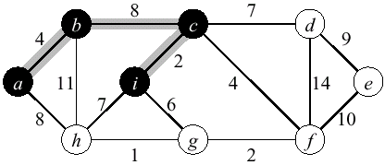
Prim Example

Slide 31
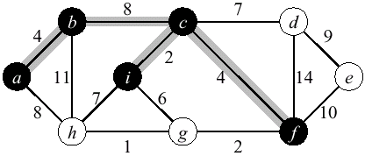
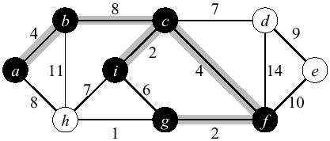
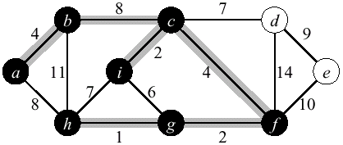
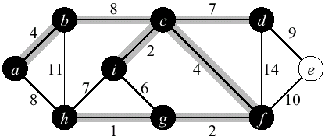
Prim Example (2)

Slide 32
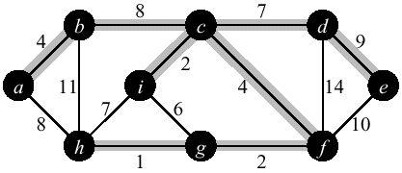
Prim Example (3)

Slide 33
Priority Queues
A priority queue is a data structure for maintaining a set S of elements, each with an associated value called key
We need PQ to support the following operations
  BuildPQ(S) – initializes PQ to contain elements of S
  ExtractMin(S) returns and removes the element of S with the smallest key
  ModifyKey(S,x,newkey) – changes the key of x in S
A binary heap can be used to implement a PQ
  BuildPQ – O(n)
  ExtractMin and ModifyKey – O(lg n)

Slide 34
Prim’s Running Time
Time = |V|T(ExtractMin) + O(E)T(ModifyKey)
Time = O(V lgV + E lgV) = O(E lgV)
Q | T(ExtractMin) | T(DecreaseKey) | Total
array | O(V) | O(1) | O(V ²)
binary heap | O(lg V) | O(lg V) | O(E lgV )
Fibonacci heap | O(lg V) | O(1) amortized | O(V lgV +E )

Slide 35
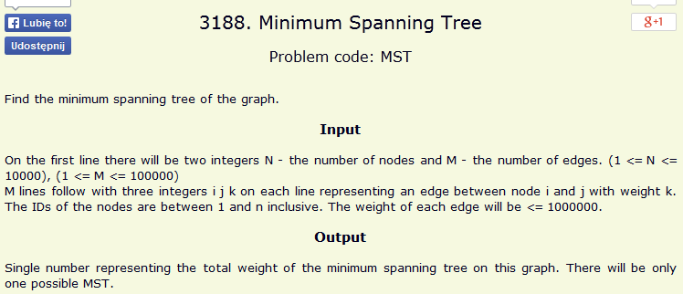
SPOJ Problem Set (partial)
3188. Minimum Spanning Tree

Slide 36
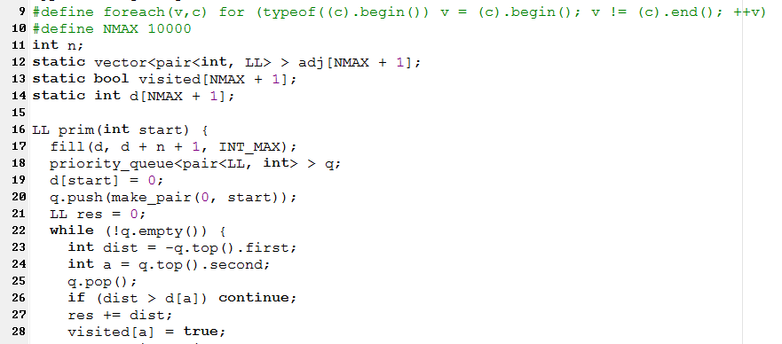
SPOJ Problem Set (partial)
3188. Minimum Spanning Tree

Slide 37
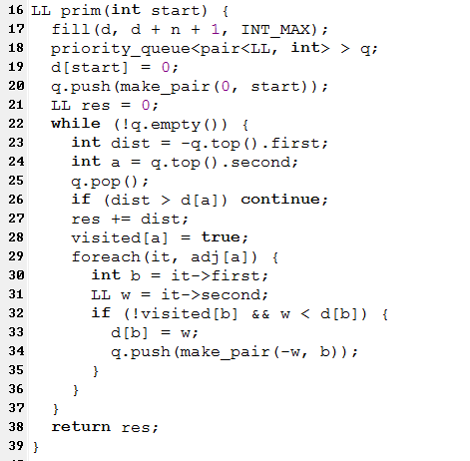
SPOJ Problem Set (partial)
3188. Minimum Spanning Tree

Slide 38
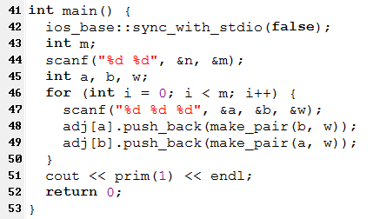
SPOJ Problem Set (partial)
3188. Minimum Spanning Tree

Slide 39
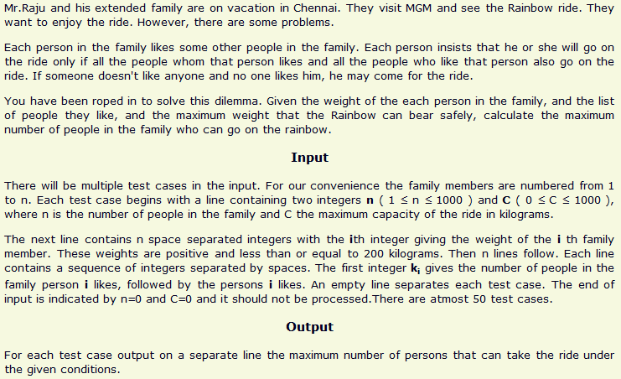
SPOJ Problem Set (classical)
3724. Rainbow Ride

