Slide 1
DP with Bitmask & Profile
Ashar Fuadi
TOKI 2009-2010

Slide 2
Traveling Salesman Problem (TSP)
There are N cities numbered 0..N-1. The distance from city i and city j is G(i, j). A salesman wants to start at city 0, visit all cities exactly once, and then returns back to city 0. Compute the minimum total distance traveled.
1 <= N <= 16

Slide 3
DP State
DP(u, mask) =
G(u, 0), if mask is empty
min {G(u, v) + DP(v, mask – {v})} for all v in mask
answer = DP(0, {1, 2, …, N-1})

Slide 4
Bit Manipulation: Basics
AND (logical version: &&)
(0 & 0) == 0 (0 & 1) == 0 (1 & 0) == 0 (1 & 1) == 1
OR (logical version: ||)
(0 | 0) == 0 (0 | 1) == 1 (1 | 0) == 1 (1 | 1) == 1
XOR (logical version: !=)
(0 ^ 0) == 0 (0 ^ 1) == 1 (1 ^ 0) == 1 (1 ^ 1) == 0
NOT (logical version: !)
(~0) == 1 (~1) == 0 (individual bits only)

Slide 5
Bit Manipulation: Basics (cont)
SHIFT LEFT
(A << B) == A * 2^{B}
SHIFT RIGHT
(A >> B) == ⌊A / 2^{B}⌋
OP= VARIANTS
A &= B → A = A & B
A |= B → A = A | B
A ^= B → A = A ^ B

Slide 6
Bit Manipulation: Sets
Set Union
A | B (bit set if present in either A or B)
Set Intersection
A & B (bit set if present both A and B)
Set Difference
A & ~B (bit set if present in A but not in B)
Set Negation
UNIVERSE ^ A (bit set if not present in A)
UNIVERSE = (1<<N) – 1, where N = number of elements

Slide 7
Bit Manipulation: Sets (cont)
Adds i-th element (if not exists)
A |= 1<<i
Toggles i-th element
A ^= 1<<i
Removes i-th element (if exists)
A &= ~(1<<i)
Checks whether i-th element exists
(A & (1<<i)) != 0 or ((A >> i) & 1) != 0
Iterates through all subsets of N elements
for (int mask = 0; mask < (1<<N); mask++)

Slide 8
Bit Manipulation: Advanced
Counts set bits
__builtin_popcount(A) or __builtin_popcountll(A)
Counts trailing zeros
__builtin_ctz(A) or __builtin_ctzll(A)
Counts leading zeros
__builtin_clz(A) or __builtin_clzll(A)
Counts ⌊lg A⌋
31 - __builtin_clz(A) or 63 - __builtin_clzll(A)
Counts ⌈lg A⌉
32 - __builtin_clz(A-1) or 64 - __builtin_clzll(A-1)

Slide 9
Bit Manipulation: Advanced (cont)
Extracts lowest set bit
A & -A (e.g., A == 0b101100 → A & -A == 0b100)
Removes lowest set bit
A - (A & -A) or A & (A - 1)
Checks if A is a power of 2
A && !(A & (A - 1))
Swaps two values
A ^= B ^= A ^= B

Slide 10
Bit Manipulation: Common Mistakes
Shift left/right exception
(A << B) is long long if A is long long.
e.g., (1 << 40LL) → overflow
Non-intuitive &, |,^ precedence with ==
A & B == X → A & (B == X)
Swap exception
A ^= B ^= A ^= B → fails if (&A) == (&B)
e.g., a[i] ^= a[j] ^= a[i] ^= a[j] → fails if i == j

Slide 11
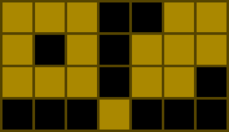
DengklekPaintingSquares (SRM 532)
Paint N × M squares according to these rules:
Each square must be either colored or empty.
Each colored square must have an even number of adjacent colored squares. Two squares are adjacent if they share a side.
For example, here is one valid solution for N=4, M=7. Black squares denote empty squares and brown squares denote colored squares.
How many valid solutions are there? (1 <= N <= 100, 1 <= M <= 8)

Slide 12
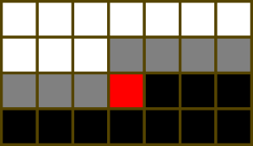
DP State
DP(i, j, profile) = number of ways to fill the squares before the red (i, j) square (in row-major fashion), given the current profile.
But what is a profile?

Slide 13
Simple Case
What if N=1?

Slide 14
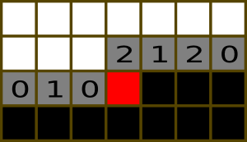
Profile
For each gray square, there are three possible states:
0. It was colored, and currently it has an even number of colored adjacent squares.
1. It was colored, and currently it has an odd number of colored adjacent squares.
2. It was not colored.

Slide 15
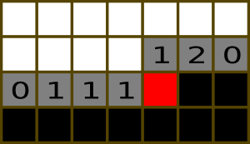
Fill Red Square with 1
Update (1, 3) and (2, 2).
Add (2, 3) to profile.
Remove (1, 3) from profile. Make sure the it is only marked as 0 or 2!

Slide 16
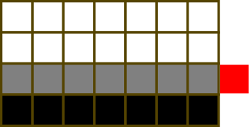
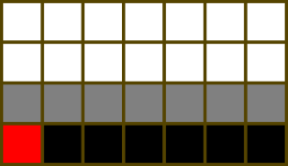
Reaching Rightmost Column...

Slide 17
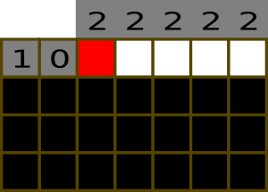
Processing First Row
Just consider all squares on the (-1)-st row as not colored.

Slide 18
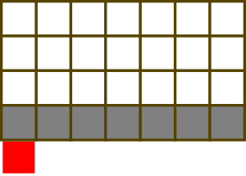
The Answer
Answer = sum DP(N, 0, profile) for all profiles that do not contain “1”.

Slide 19
Implementation
DP(0, 0, start_profile) = 1
for i = 0 .. N-1
for j = 0... M-1
for profile = 0 .. 3^M - 1
// do not color square (i, j)
if profile[j] != 1
DP(i, j+1, profile') += DP(i, j, profile)
// color square (i, j)
if profile[j] != 0
DP(i, j+1, profile'') += DP(i, j, profile)
// move profile in states (i, M, ?) to (i+1, 0, ?)
for profile = 0.. 3^M - 1
DP(i+1, 0, profile) = DP(i, M, profile)
answer = sum DP(N, 0, profile) for all profile that does not contain 1

Slide 20
Complexities
Time: O(N . M . 3^M)
Memory: O(N . M . 3^M)
Can we use less memory?
.. yes, just O(3^M), using sliding window :)

