Slide 1
Scala
Let’s start

Slide 2


Scala new Java

Slide 3





Usage of Scala

Slide 4


Functional programming
Pure functions
Immutability

Slide 5
Hello World program!
Download and execute the Scala installer for Windows based on coursier.
Along with managing JVMs, cs setup also installs useful command-line tools:
A JDK (if you don’t have one already)
The sbt build tool
Ammonite, an enhanced REPL
scalafmt, the Scala code formatter
scalac (the Scala 2 compiler)
scala (the Scala 2 REPL and script runner).

Slide 6
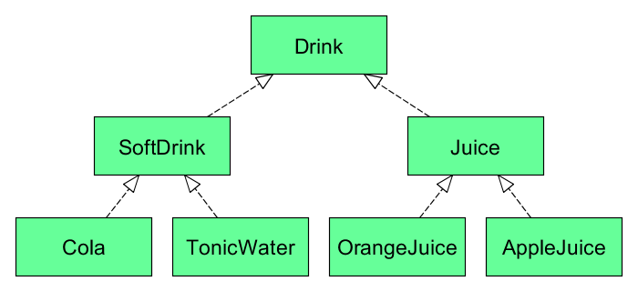
Variance, Contravariance and invariance

