Slide 1
(BSM-18940-AL-TC01)
BirdNet Thermocouple
Slave Mote for Thermocouple Sensor
Specification
Items | DETAIL | Remark
Service | IEEE802.15.4e TSCH MAC Radio Technology
 | Time Synchronized Channel Hopping Full Path and Frequency Diversity
Frequency Band | 2.4000GHz ~ 2.4835GHz
Number of Channels | 15
Modulation | DSSS
Raw Data Rate | 250kbps
Range | Indoor : 50m Outdoor : 100m
Output Power | 8dBm
Receiver Sensitivity | -93dBm
Input/output Impedance | 50Ω
CPU | ARM Cortext-M3 32bit
SRAM | 72Kbyte
FLASH Memory | 512Kbyte
Security | 128 Bit AES Based Encryption
Protocol | 6LoWPAN Internet Protocol support
Operating Temperature | -40 ~ 85℃
Operating Humidity | 10 ~ 90% | IP65 Proof
Battery Power | 7500mAh
Power Consumption | < 50µA
Case | Aluminum Anodizing
Size | 120mm(w) x 80mm(w) x 34mm(d)
Weight | < 350 g
Thermocouple Sensor | Model : Type K
 | Temperature Range : - 100 ℃ to 250℃
 | Standard Limits of Error : Grater of 3.0 ℃
Copyright ⓒ 2020 DawinICT Co., LTD. All rights reserved.

Slide 2
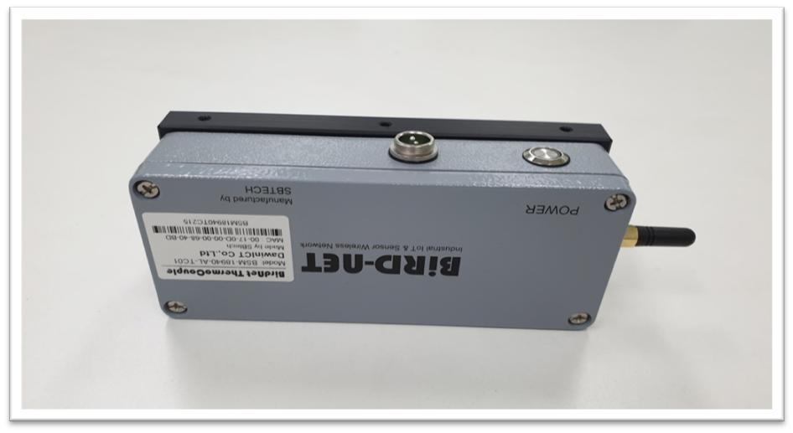
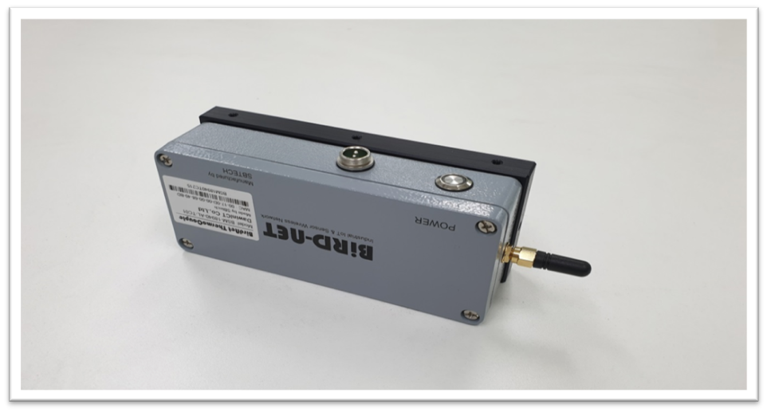
(BSM-18940-AL-TC01)
BirdNet Thermocouple
Slave Mote for Thermocouple Sensor
Product Image
Copyright ⓒ 2020 DawinICT Co., LTD. All rights reserved.

