Slide 1
Chapter Five
Exception Handling

Slide 2
Introduction
Exception handling enables a program to deal with exceptional situations and continue its normal execution.
Runtime errors occur while a program is running if the JVM detects an operation that is impossible to carry out.
For example, if you access an array using an index that is out of bounds, you will get a runtime error with an ArrayIndexOutOfBoundsException.
If you enter a double value when your program expects an integer, you will get a runtime error with an InputMismatchException.

Slide 3
Introduction
In Java, runtime errors are thrown as exceptions.
An exception is an object that represents an error or a condition that prevents execution from proceeding normally.
If the exception is not handled, the program will terminate abnormally.

Slide 4
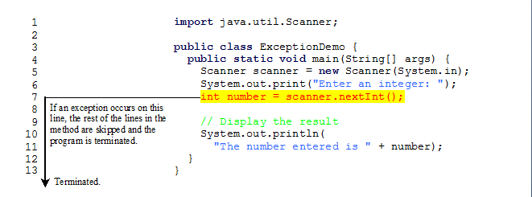
Example 1: Runtime Errors
This program generates an InputMismatchException error when reading an input.

Slide 5
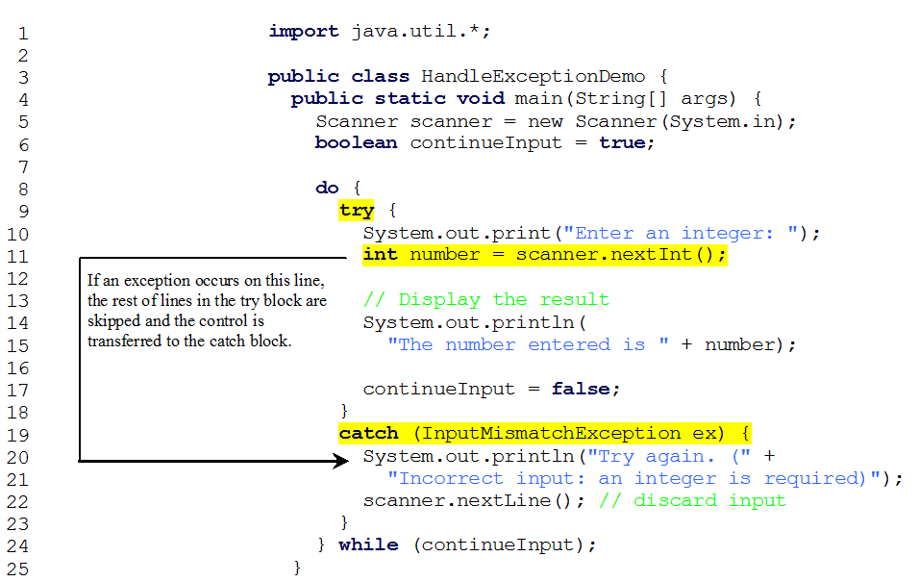
Catch Runtime Errors
This program handles/catches the InputMismatchException error when reading an input.

Slide 6
Catch Runtime Errors
When executing input.nextInt() (line 11), an InputMismatchException occurs if the input entered is not an integer, suppose 3.5 is entered.
An InputMismatchException occurs and the control is transferred to the catch block.
The statements in the catch block are now executed.
The statement input.nextLine() in (line 22) discards the current input line so that the user can enter a new line of input.
The variable continueInput controls the loop.
Its initial value is true (line 6), and it is changed to false (line 17) when a valid input is received.
Once a valid input is received, there is no need to continue the input.

Slide 7
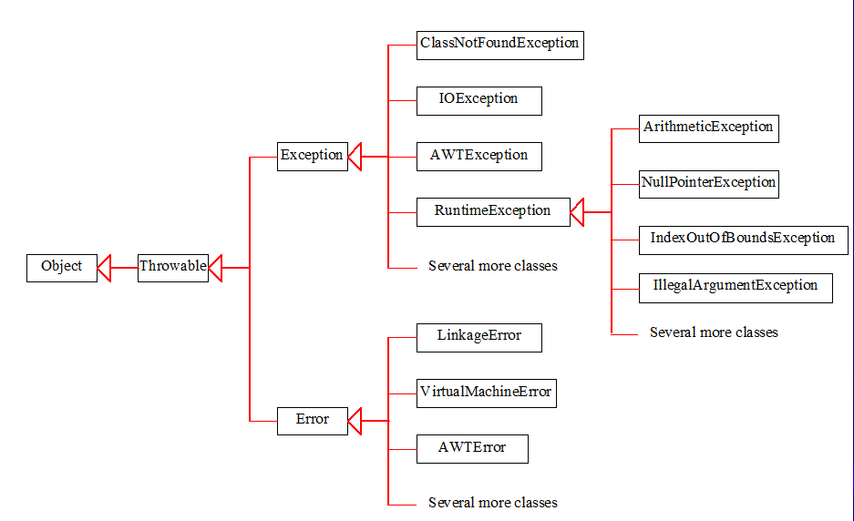
Exception Classes

Slide 8
Exception Classes
Exceptions are objects, and objects are defined using classes.
The root class for exceptions is java.lang.Throwable.
There are many predefined exception classes in the Java .
See the previous Figure

Slide 9
Exception Classes
The Throwable class is the root of exception classes.
All Java exception classes inherit directly or indirectly from Throwable.
The exception classes can be classified into three major types:
  system errors,
  exceptions, and
  runtime exceptions.

Slide 10
Exception Types
System errors are thrown by the JVM and are represented in the Error class.
Exceptions are represented in the Exception class, which describes errors caused by your program and external circumstances.
Runtime exceptions are represented in the RuntimeException class, which describes programming errors, such as bad casting, accessing an out-of-bounds array, and numeric errors. Runtime exceptions are generally thrown by the JVM.

Slide 11
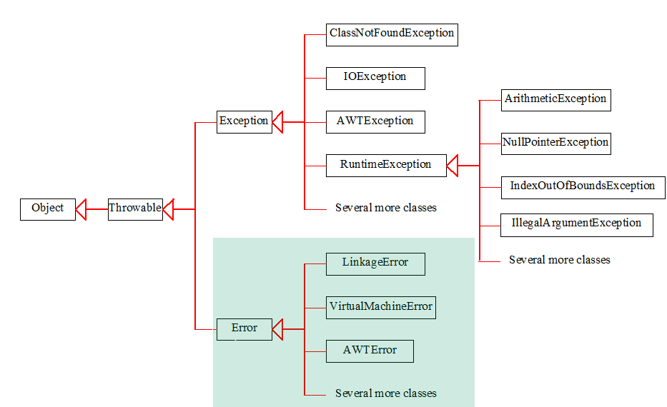
System Errors
System errors are thrown by JVM and represented in the Error class. The Error class describes internal system errors. Such errors rarely occur. If one does, there is little you can do beyond notifying the user and trying to terminate the program gracefully.

Slide 12
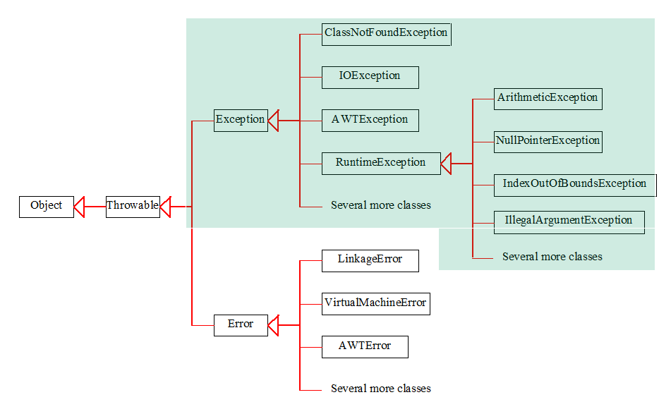
Exceptions
Exception describes errors caused by your program and external circumstances. These errors can be caught and handled by your program.

Slide 13
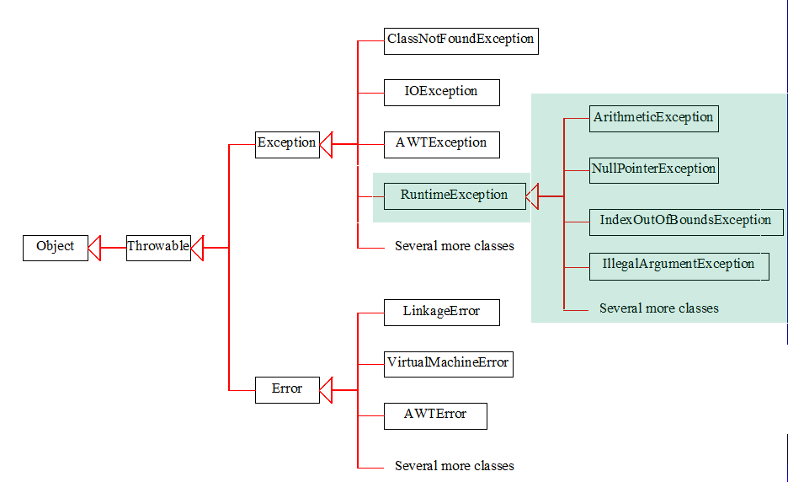
Runtime Exceptions
RuntimeException is caused by programming errors, such as bad casting, accessing an out-of-bounds array, and numeric errors.

Slide 14
Java throws and throw
If a method does not handle an exception the method must declare it using the throws keyword.
The throws keyword appears at the end of a method's signature.
You can throw an exception, either a newly instantiated one or an exception that you just caught, by using the throw keyword.
throws is used to handling of an exception
throw is used to invoke an exception explicitly.

Slide 15
Java throws and throw
Syntax
Following is the syntax of throwing an exception using throws and throw
method(parameters) throws exception
{ // Method implementation
throw new exception();
}

Slide 16
Java Throws and Throw Example
Following example shows the use of throw keyword to send an exception in case a invalid argument is passed.
public class ExcepTest {
public static void main(String args[])
{ int a = 3;
int b = 0;
Try{
System.out.println("result:" + divide(a,b)); }
Catch(IllegalArgumentException e){
System.out.println(“exception is handeled ”+e);
}
}
private static int divide(int a, int b) {
if(b == 0) {
throw new IllegalArgumentException("second argument cannot be zero."); }
return a / b; } }

Slide 17
Cont..
Following example shows the use of throw and throws keywords to send an exception in case a invalid argument is passed and handle the exception
public class ExcepTest {
public static void main(String args[]) {
int a = 3;
int b = 0;
try
{ System.out.println("result:" + divide(a,b));
} catch (Exception e)
{ System.out.println("Exception: " + e); } }
private static int divide(int a, int b) throws IllegalArgumentException {
if(b == 0) {
throw new IllegalArgumentException("second argument cannot be zero."); }
return a / b; } }

Slide 18
Declaring Exceptions
public void myMethod() throws IOException
public void myMethod() throws Exception1, Exception2, …, ExceptionN

Slide 19
Throwing Exceptions
When the program detects an error, the program can create an instance of an appropriate exception type and throw it.
This is known as throwing an exception.
Here is an example,
throw new TheException();
TheException ex = new TheException();
throw ex;

Slide 20
Throwing Exceptions Example
/** Set a new radius */
public void setRadius(double newRadius)
throws IllegalArgumentException {
if (newRadius >= 0)
radius = newRadius;
else
throw new IllegalArgumentException
("Radius cannot be negative");
}

Slide 21
Example: Declaring, Throwing, and Catching Exceptions
This example demonstrates declaring, throwing, and catching exceptions
The following program defines a circle class named CircleWithException, in which the setRadius(double newRadius) method throws an IllegalArgumentException if the argument newRadius is negative.

Slide 22
Example: Declaring, Throwing, and Catching Exceptions
public class CircleWithException {
private double radius;
private static int numberOfObjects = 0;
public CircleWithException() {
this(1.0);
}
public CircleWithException(double newRadius) {
setRadius(newRadius);
numberOfObjects++;
}
public double getRadius() {
return radius;
}

Slide 23
Example: Declaring, Throwing, and Catching Exceptions
public void setRadius(double newRadius)
throws IllegalArgumentException {
if (newRadius >= 0)
radius = newRadius;
else
throw new IllegalArgumentException(“Radius
cannot be negative ”);
}
public static int getNumberOfObjects() {
return numberOfObjects;
}
public double findArea() {
return radius * radius * 3.14159;
}
}
Declare Exception
throw Exception

Slide 24
Example: Declaring, Throwing, and Catching Exceptions
public class TestCircleWithException {
public static void main(String[] args) {
try {
CircleWithException c1 = new CircleWithException(5);
CircleWithException c2 = new CircleWithException(-5);
CircleWithException c3 = new CircleWithException(0);
}
catch(IllegalArgumentException ex) {
System.out.println(ex);
}
System.out.println("Number of objects created: " +
CircleWithException.getNumberOfObjects());
}
}

Slide 25
The finally Clause
The finally clause is always executed regardless whether an exception occurred or not
The syntax for the finally clause might look like this:
try {
statements;
}
catch (TheException ex) {
handling ex;
}
finally {
finalStatements;
}

Slide 26
The finally Clause
The code in the finally block is executed under all circumstances, regardless of whether an exception occurs in the try block or is caught.
Consider three possible cases:
  If no exception arises in the try block, finalStatements is executed, and the next statement after the try statement is executed.
  If a statement causes an exception in the try block that is caught in a catch block, the rest of the statements in the try block are skipped, the catch block is executed, and
  the finally clause is executed. The next statement after the try statement is executed.
  If one of the statements causes an exception that is not caught in any catch block, the other statements in the try block are skipped, the finally clause is executed,
  and the exception is passed to the caller of this method.

Slide 27
The finally Clause
The finally block executes even if there is a return statement prior to reaching the finally block.
The catch block may be omitted when the finally clause is used.
A common use of the finally clause is in I/O programming.
To ensure that a file is closed under all circumstances, you may place a file closing statement in the finally block.

Slide 28
Trace a Program Execution
Suppose no exceptions in the statements
try {
}
catch(TheException ex) {
handling ex;
}
finally {
finalStatements;
}
Next statement;
statements;

Slide 29
Trace a Program Execution
The final block is always executed
try {
statements;
}
catch(TheException ex) {
handling ex;
}
finally {
}
Next statement;
finalStatements;

Slide 30
Trace a Program Execution
try {
statements;
}
catch(TheException ex) {
handling ex;
}
finally {
finalStatements;
}
Next statement in the method is executed
Next statements;

Slide 31
Trace a Program Execution
Suppose an exception of type Exception1 is thrown in statement2
try {
statements1;
statements2;
}
catch(TheException1 ex) {
handling ex;
}
finally {
finalStatements;
}
Next statement;
statements2;

Slide 32
Trace a Program Execution
try {
statements1;
statements2;
statements2;
}
catch(TheException1 ex){
}
finally {
finalStatements;
}
Next statement;
The exception is handled.
Handling ex;

Slide 33
Trace a Program Execution
The final block is always executed.
try {
statements1;
statements2;
statements2;
}
catch(TheException ex) {
handling ex;
}
finally {
}
Next statement;
finalStatements;

Slide 34
Trace a Program Execution
try {
statements1;
statements2;
statements2;
}
catch(TheException ex) {
handling ex;
}
finally {
finalStatements;
}
The next statement in the method is now executed.
Next statements;

Slide 35
Trace a Program Execution
try {
statements1;
statements2;
}
catch(Exception1 ex) {
handling ex;
}
catch(TheException2 ex) {
handling ex;
throw ex;
}
finally {
finalStatements;
}
Next statement;
statement2 throws an exception of type Exception2.
statements2;

Slide 36
Trace a Program Execution
try {
statements1;
statements2;
statements2;
}
catch(Exception1 ex) {
handling ex;
}
catch(TheException2 ex) {
throw ex;
}
finally {
finalStatements;
}
Next statement;
Handling exception
Handling ex;

Slide 37
Trace a Program Execution
try {
statements1;
statements2;
statements2;
}
catch(Exception1 ex) {
handling ex;
}
catch(TheException2 ex) {
handling ex;
throw ex;
}
finally {
}
Next statement;
Execute the final block
finalStatements;

Slide 38
Trace a Program Execution
try {
statements1;
statements2;
statements2;
}
catch(Exception1 ex) {
handling ex;
}
catch(TheException2 ex) {
handling ex;
}
finally {
finalStatements;
}
Next statement;
Rethrow the exception and control is transferred to the caller
throw ex;

Slide 39
Thank You!!

