Slide 1
♥
ስለ እናት
A village for
every mother.
An anonymous postpartum wellness platform —
built for the mothers no one is listening to.
Submission · 2026

Slide 2
WHY THIS MATTERS
“I sat with my baby for three weeks
before I told anyone I was not okay.”
A new mother in Addis Ababa, 2025.
Her story is not unusual. It is the rule.
Postpartum suffering is silent because we built a world where mothers are
expected to be grateful, capable, and quiet — all at once.
ስለ እናት
2 / 12

Slide 3
THE PROBLEM
1 in 5
What that number hides
Most go undiagnosed.
No screening at routine postnatal visits.
Maternal suicide is the second-leading cause of postpartum death globally.
WHO, 2024.
Stigma keeps mothers from speaking.
Even to family. Even to clinicians.
Ethiopian mothers experiences
postpartum depression.
Source: Ethiopian J. Health Sci., systematic reviews 2020–2024.
ስለ እናት
3 / 12

Slide 4
THE BARRIER
Why don't they ask for help?
Three barriers, repeated in every interview, every clinic, every village.
SHAME
JUDGMENT
NO SPACE
“A good mother would not feel this way.”
Speaking up has a cost.
There is nowhere to go.
The cultural script equates struggle with failure. So mothers hide it — from in-laws, from husbands, from themselves.
Disclosure risks gossip, family shame, even custody concerns. The price of being honest is too high.
No mother-specific helpline. No anonymous forum. No after-hours support when the night is hardest.
ስለ እናት
4 / 12

Slide 5
WHY NOW
The moment is here.
~25M
+18%
1st
mobile internet users in Ethiopia
YoY growth in smartphone adoption
wave of trusted Ethiopian digital health
GSMA, 2024
GSMA, 2024
YeneHealth, Hakim, BeneFamily
YeneHealth proved that mothers in Ethiopia will trust digital health when it is built with cultural humility. ስለ እናት stands on that foundation — and goes one step further: into the silent moments between appointments.
ስለ እናት
5 / 12

Slide 6
THE GAP
What exists. What doesn't.
What exists
What doesn't
WhatsApp groups
Not anonymous. Phone numbers are exposed.
Generic health apps
Not built for postpartum. Not in our context.
Clinic visits
Limited time. Limited privacy. Limited access at night.
A safe, anonymous place
to ask the questions you can't ask anyone else.
Mother-specific guidance
tuned to recovery, feeding, sleep, mental health.
After-hours support
when the night is the hardest hour.
ስለ እናት
6 / 12

Slide 7
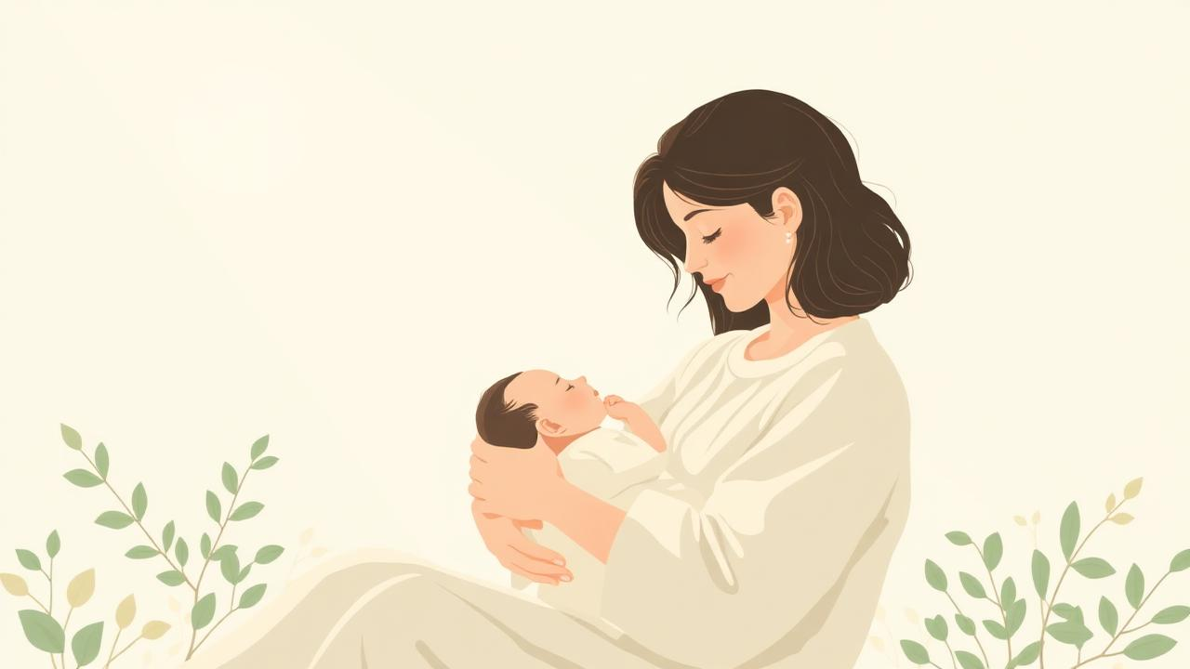
THE SOLUTION
ስለ እናት.
A safe space for postpartum mothers.
Anonymous by design. Evidence-based by default. Built for the Ethiopian context — and any mother, anywhere, who has felt this alone.
ስለ እናት
7 / 12

Slide 8
WHAT WE OFFER
Everything you need, in one place.
01
Anonymous Forum
02
AI Assistant
Ask the questions you cannot ask anyone else. Talk to mothers who understand.
Evidence-based guidance on recovery, breastfeeding, sleep, and newborn care — 24/7.
03
Wellness Check-Ins
04
Expert Events
Track mood, sleep, and energy. Small daily signals that build into self-knowledge.
Live talks and workshops with lactation consultants, therapists, and pediatricians.
ስለ እናት
8 / 12

Slide 9
A DESIGN CHOICE
We do not ask for your name.
We do not ask for your story.
We let you speak
when, and only when, you are ready.
Anonymity is not the absence of identity. It is the presence of safety.
Every product decision flows from this.
ስለ እናት
9 / 12

Slide 10
BUILT FOR TRUST
Soft on the surface. Rigorous underneath.
Evidence-based content
AI assistant grounded in WHO postpartum guidelines, ACOG, and Ethiopian Ministry of Health protocols. Every answer cites its source.
Expert-reviewed events
Lactation consultants, perinatal therapists, and pediatricians lead live sessions. No influencers, no anecdotes-as-medicine.
Crisis-aware by design
Red-flag detection triggers warm, immediate referral pathways to the Ministry of Health helpline and local providers.
ስለ እናት
10 / 12

Slide 11
THE VISION
Every mother
deserves a village.
In one year, ስለ እናት aims to:
10K
500+
3
mothers supported
expert hours delivered
languages: Amharic, Afaan Oromo, English
ስለ እናት
11 / 12

Slide 12
Thank you.
For listening. For caring. For believing mothers deserve more than silence.
Let's build the village together.
·Addis Ababa, Ethiopia
ስለ እናት
12 / 12

