Slide 1

ICU Mortality Prediction
Dawn Lun

Slide 2

Problem Statement
Using data from the first 24 hours of intensive care to predict patient mortality
Notes:
Medical care is expensive, as we all know. Medical resources is scarce. Like in the recent Coronavirus situation, it has pushed hospital resources to the brink in some country.
Intensive Care Unit, or ICU for short, is a 24/7 staffed hospital department with highly specially-trained intensivists.
Mean intensive care unit cost and length of stay were $31,574 ± 42,570 and 14.4 days ± 15.8 for patients requiring mechanical ventilation
$12,931 ± 20,569 and 8.5 days ± 10.5 for those not requiring mechanical ventilation [source] https://www.researchgate.net/publication/7800750_Daily_cost_of_an_intensive_care_unit_day_The_contribution_of_mechanical_ventilation

Slide 3


Problem Statement
US$ 31,574 ± 42,570
US$ 12,931 ± 20,569
14.4 days ± 15.8
Using data from the first 24 hours of intensive care to predict patient mortality
8.5 days ± 10.5
Maximize medical resources – address ICU shortage
Notes:
Medical care is expensive, as we all know. Medical resources is scarce. Like in the recent Coronavirus situation, it has pushed hospital resources to the brink in some country.
Intensive Care Unit, or ICU for short, is a 24/7 staffed hospital department with highly trained professionals. It has a multidisciplinary care teams led by physicians trained and credentialed intensive care medicine )
Mean intensive care unit cost and length of stay were $31,574 ± 42,570 and 14.4 days ± 15.8 for patients requiring mechanical ventilation
$12,931 ± 20,569 and 8.5 days ± 10.5 for those not requiring mechanical ventilation [source] https://www.researchgate.net/publication/7800750_Daily_cost_of_an_intensive_care_unit_day_The_contribution_of_mechanical_ventilation
Intensive care unit costs are highest during the first 2 days of admission, stabilizing at a lower level thereafter. Mechanical ventilation is associated with significantly higher daily costs for patients receiving treatment in the intensive care unit throughout their entire intensive care unit stay. Interventions that result in reduced intensive care unit length of stay and/or duration of mechanical ventilation could lead to substantial reductions in total inpatient cost.

Slide 4
Data
A dataset of more than 130,000 hospital Intensive Care Unit (ICU) visits from patients from 200 hospitals in the United States spanning a one-year timeframe.
Train set: 91,713 patients, 241 ICUs and 147 hospitals.
Unlabeled: 39,308 patients, 99 ICUs and 66 hospitals
Notes:
91713
130,000 hospital Intensive Care Unit (ICU) visits from patients, spanning a one-year timeframe.

Slide 5






EDA
Cleaning
Extraction
Selection
Modelling
Evaluation
Get acquaintance
Max < Min
By deduction
Medical reasoning
Domain Knowledge
SimpleImputer
Medical Reasoning
Target Encoding
OHE
STD = 0
Collinearity
RFE
Feature Importance
‘d1_’
Linear Regression
Decision Tree
Random Forest
GradientBoosting
CatBoost
ROC AUC curve
Probability Distribution

Slide 6
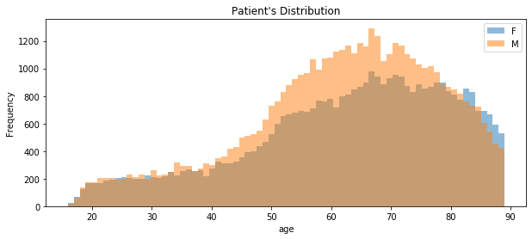
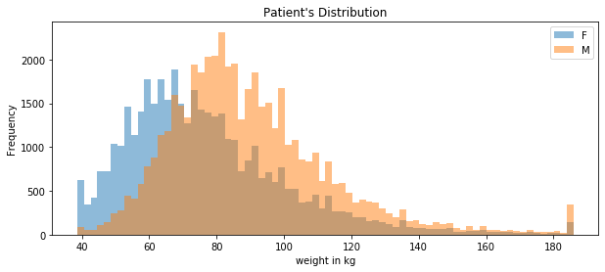
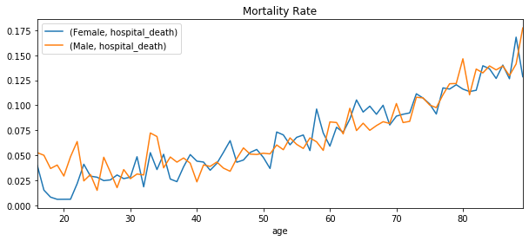
EDA
Patient Profile

Slide 7
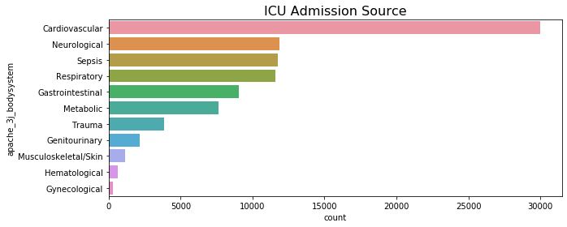
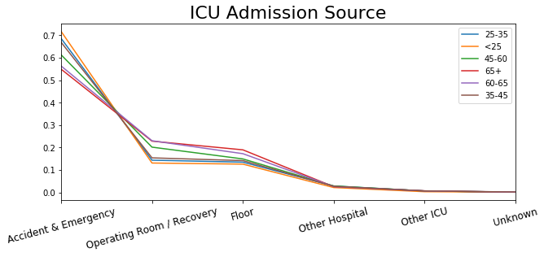
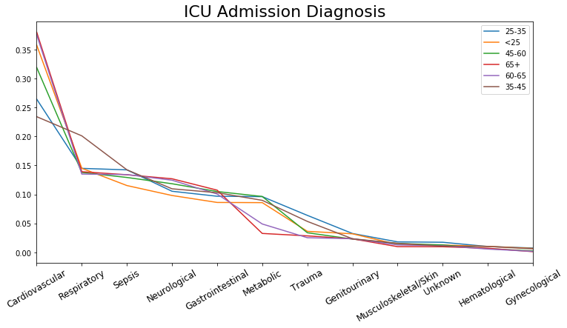
ICU admission Diagnosis
Percentage of Invasive Ventilation 32%
Percentage of Intubation 15%
Hospital death 8.6%

Slide 8

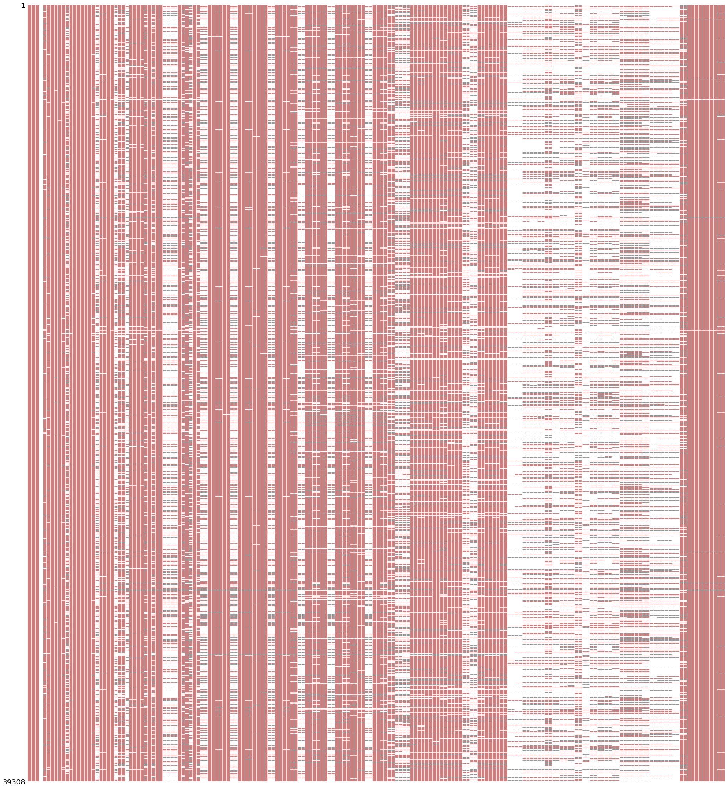
Missingness
Missingness
Train
Test

Slide 9
Features
Arterial
Blood Gas
Demographic
Vitals
Labs
hospital_death
age
gender
ethnicity
weight
height
bmi
elective_surgery
hospital_id
icu_id
hospital_admit_source
icu_admit_source
icu_stay_type
icu_type
pre_icu_los_days
Blood Pressure
Heart Rate
Temperature
Respiration Rate
SPO2
Albumin
Bilirubin
Bun
Creatinine
HCO3
Hemaglobin
Hematocrit
wbc
Inr
Lactate
Platelets
Potassium
Sodium
Glucose
Calcium
pCO2
pO2
pH
pao2fio2ratio

Slide 10
Features
APACHE
Arterial
Blood Gas
Demographic
Vitals
Labs
hospital_death
age
gender
ethnicity
weight
height
bmi
elective_surgery
hospital_id
icu_id
hospital_admit_source
icu_admit_source
icu_stay_type
icu_type
pre_icu_los_days
Blood Pressure
Heart Rate
Temperature
Respiration Rate
SPO2
Albumin
Bilirubin
Bun
Creatinine
HCO3
Hemaglobin
Hematocrit
wbc
Inr
Lactate
Platelets
Potassium
Sodium
Glucose
Calcium
pCO2
pO2
pH
pao2fio2ratio
Chronic disease
Other physiological signals

Slide 11
APACHE
Vitals
Labs
Lab blood Gas
albumin_apache
bilirubin_apache
bun_apache
creatinine_apache
glucose_apache
heart_rate_apache
hematocrit_apache
resprate_apache
sodium_apache
temp_apache
urineoutput_apache
wbc_apache
fio2_apache
map_apache
paco2_apache
paco2_for_ph_apache
pao2_apache
ph_apache
gcs_eyes_apache
gcs_motor_apache
gcs_unable_apache
gcs_verbal_apache
apache_post_operative
arf_apache
intubated_apache
ventilated_apache
apache_2_diagnosis
apache_3j_diagnosis
aids
cirrhosis
diabetes_mellitus
hepatic_failure
immunosuppression
leukemia
lymphoma
solid_tumor_with_metastasis
apache_3j_bodysystem
apache_2_bodysystem
apache_4a_hospital_death_prob
apache_4a_icu_death_prob
h1_diasbp_invasive_max | d1_diasbp_invasive_max
h1_diasbp_invasive_min | d1_diasbp_invasive_min
h1_diasbp_max | d1_diasbp_max
h1_diasbp_min | d1_diasbp_min
h1_diasbp_noninvasive_max | d1_diasbp_noninvasive_max
h1_diasbp_noninvasive_min | d1_diasbp_noninvasive_min
h1_heartrate_max | d1_sysbp_invasive_max
h1_heartrate_min | d1_sysbp_invasive_min
h1_mbp_invasive_max | d1_sysbp_max
h1_mbp_invasive_min | d1_sysbp_min
h1_mbp_max | d1_sysbp_noninvasive_max
h1_mbp_min | d1_sysbp_noninvasive_min
h1_mbp_noninvasive_max | d1_mbp_invasive_max
h1_mbp_noninvasive_min | d1_mbp_invasive_min
h1_resprate_max | d1_mbp_max
h1_resprate_min | d1_mbp_min
h1_spo2_max | d1_mbp_noninvasive_max
h1_spo2_min | d1_mbp_noninvasive_min
h1_sysbp_invasive_max | d1_heartrate_max
h1_sysbp_invasive_min | d1_heartrate_min
h1_sysbp_max | d1_resprate_max
h1_sysbp_min | d1_resprate_min
h1_sysbp_noninvasive_max | d1_spo2_max
h1_sysbp_noninvasive_min | d1_spo2_min
h1_temp_max | d1_temp_max
h1_temp_min | d1_temp_min
h1_albumin_max | d1_albumin_max
h1_albumin_min | d1_albumin_min
h1_bilirubin_max | d1_bilirubin_max
h1_bilirubin_min | d1_bilirubin_min
h1_bun_max | d1_bun_max
h1_bun_min | d1_bun_min
h1_calcium_max | d1_calcium_max
h1_calcium_min | d1_calcium_min
h1_creatinine_max | d1_creatinine_max
h1_creatinine_min | d1_creatinine_min
h1_glucose_max | d1_glucose_max
h1_glucose_min | d1_glucose_min
h1_hco3_max | d1_hco3_max
h1_hco3_min | d1_hco3_min
h1_hemaglobin_max | d1_hemaglobin_max
h1_hemaglobin_min | d1_hemaglobin_min
h1_hematocrit_max | d1_hematocrit_max
h1_hematocrit_min | d1_hematocrit_min
h1_inr_max | d1_inr_max
h1_inr_min | d1_inr_min
h1_lactate_max | d1_lactate_max
h1_lactate_min | d1_lactate_min
h1_platelets_max | d1_platelets_max
h1_platelets_min | d1_platelets_min
h1_potassium_max | d1_potassium_max
h1_potassium_min | d1_potassium_min
h1_sodium_max | d1_sodium_max
h1_sodium_min | d1_sodium_min
h1_wbc_max | d1_wbc_max
h1_wbc_min | d1_wbc_min
h1_arterial_pco2_max | d1_arterial_pco2_max
h1_arterial_pco2_min | d1_arterial_pco2_min
h1_arterial_ph_max | d1_arterial_ph_max
h1_arterial_ph_min | d1_arterial_ph_min
h1_arterial_po2_max | d1_arterial_po2_max
h1_arterial_po2_min | d1_arterial_po2_min
h1_pao2fio2ratio_max | d1_pao2fio2ratio_max
h1_pao2fio2ratio_min | d1_pao2fio2ratio_min

Slide 12
Feature Engineering
critically_ill - (binary)
GCS score sum
Bun-to-creatinine ratio
Number of total test in h1, d1, and their difference
Number of lab test in h1, d1, and their difference
Chronic_diagnosis

Slide 13
Feature Engineering
Variable | What is it
critically_ill | If any of the h1 "_invasive_" columns is not null
Acute Kidney Injury (AKI)
GCS score sum
Bun-to-creatinine ratio High potassium/creatinine – kidney problem | d1_bun_max/d1_creatinine_max
Respiratory / metabolic acidosis/alkalosis from ABG results
map | (sbp + 2*dbp)/3 (d1_sysbp_max + 2 * d1_diasbp_min)/3
h1_ttl_tests, d1_ttl_tests, total_tests_increase | Number of total test in h1, d1, and their difference
h1_num_labs, d1_num_labs, num_labs_increase | Number of lab test in h1, d1, and their difference
h1_lbg, d1_lbg, added_lbg | Whether a patient receive lab blood gas (lbg) in h1 and d1, and if its added only after h1
chronic_diagnosis | The number of chronic illness that a patient has (aids, cirrhosis, diabetes_mellitus, hepatic_failure, immunosuppression, leukemia, lymphoma, solid_tumor_with_metastasis)

Slide 14
Modelling
Linear Regression
Decision Tree
Random Forest
GradientBoosting
CatBoost

Slide 15
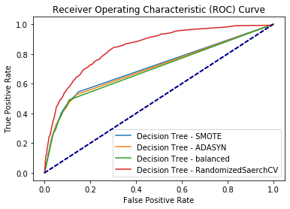
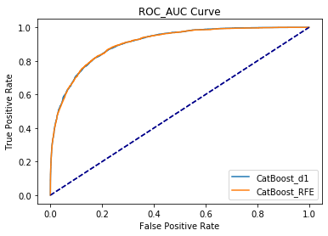

Slide 16
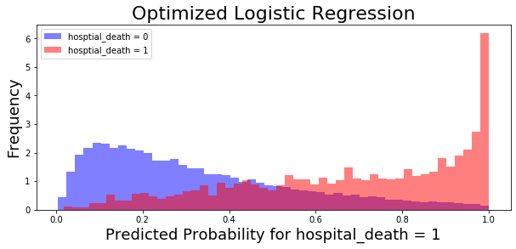
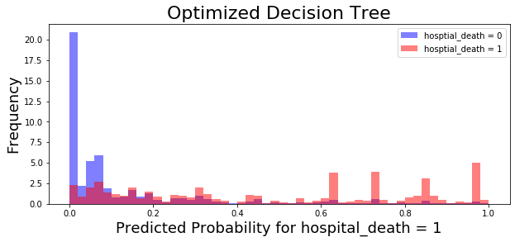
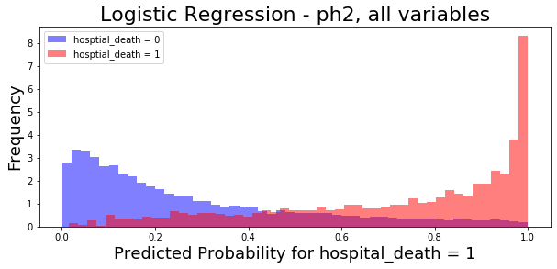
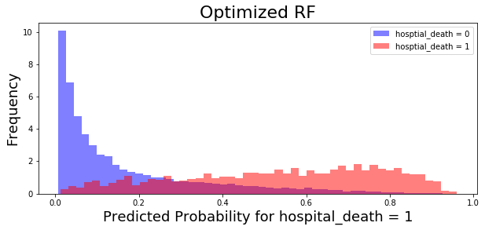
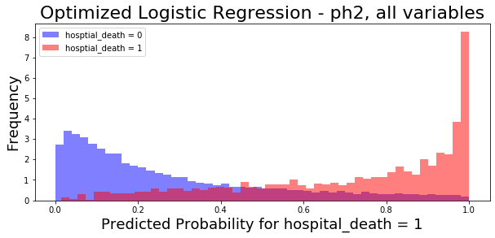
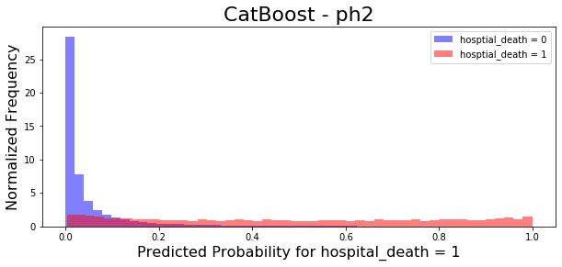
Notes:
Logistic Regression:
Positive class is better predicted than negative class: Sensitivity is better (tpr is higher)
Tree Based/GB:
Negative class is better predicted: specificity is better (tn, fp is higher)

Slide 17
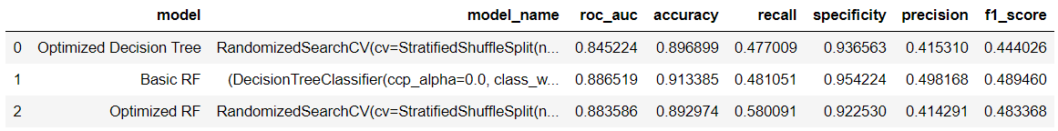
 | model | model_name | roc_auc | accuracy | recall | specificity | precision | f1_score
0 | Optimized Logistic Regression | RandomizedSearchCV(cv=StratifiedShuffleSplit(n... | 0.879223 | 0.809412 | 0.778676 | 0.812315 | 0.281564 | 0.413580
1 | Optimized Logistic Regression | RandomizedSearchCV(cv=StratifiedShuffleSplit(n... | 0.879306 | 0.809324 | 0.780192 | 0.812076 | 0.281700 | 0.413941
2 | Basic Logistic Regression | LogisticRegression(C=1.0, class_weight=None, d... | 0.878997 | 0.808278 | 0.779687 | 0.810979 | 0.280393 | 0.412457

Slide 18
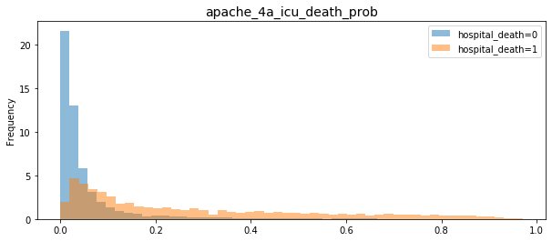

Slide 19
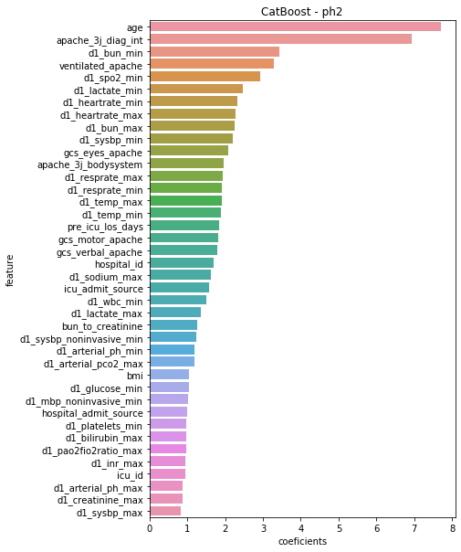
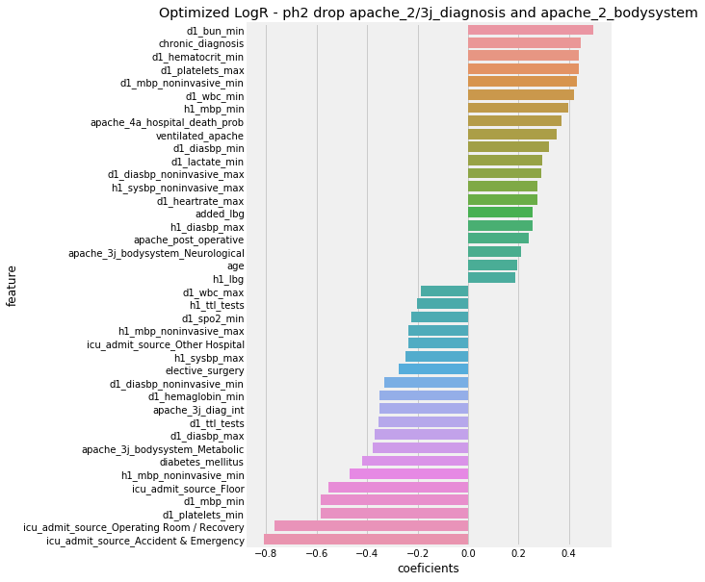
Inference
Notes:
Age Apache_3j_diag_int
d1_spo2_min
d1_bun_min
D1_heartrate_min
D1_lactate_min
Icu_id

Slide 20
Challenges
3M
The vast amount of missing data
The truth of real life data science problem – messy data
The lack of medical knowledge
Notes:
Data Dictionary is not 100% accurate
Creatinine unit (micromol/L or mg/dL?)
PaO2-FiO2 ratio (_pao2fio2ratio_)
Missing data deduction made difficult as records and data dictionarys explanation are discordant
Acute Renal Failure (arf_apache)
PaO2-FiO2 ratio (_pao2fio2ratio_)

Slide 21
Conclusion/ Suggestion
Automate APACHE recording
Medical knowledge to create better features
Explore other advanced models - LightGBM
Age is one of the strongest predictor for hospital mortality. For very elderly patients: Obtain/inquire about patient consensus if possible.
Notes:
Considering the poor clinical outcomes, and that many ICU admissions may be undesired by very elderly patients, ICU costs in this population are substantial. Our finding that a preference for comfort care predicted a lower cost independent of mortality reinforces the importance of early goals of care discussions to avoid both undesired and potentially non-beneficial interventions, consequently reducing costs.

