Slide 1
Reddit classification with NLP

Slide 3


Problem Statement

Slide 4
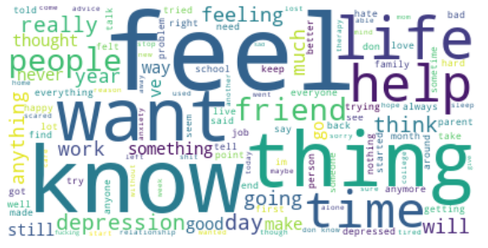
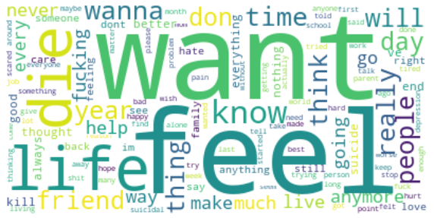
Most mentioned words
Depression_help
SuicideWatch
Tough task for the classifiers to distinguish the two subreddits
Will higher n-gram help to distinguish one from another?
Notes:
Very similar words frequently used in these two subreddits
“depression”, “depressed” VS “die”, “wanna”

Slide 5
Data Overviews - Depression_help
1241 rows, 104 columns : bool(26), float64(27), int64(8), object(43)
The message was posted between Dec 27 2019 to Jan 22 2020
Remove duplicate using pd. Drop_duplicates() with subset of ‘title’ and ‘selftext’ bring rows down to 989
Can’t remove duplicate completely if the post contents are not 100% same.
`'title'`, `'selftext'` and `'subreddit'` are the columns that will be used for classification, but information from other columns are explored below to have a better understanding of the subreddit structure and contents
25 out of 43 object columns are all null
Most of the numeric columns have no data (count =0, NaN in all describe() statistics. Potential meaningful numeric columns are:
Ups ( same as score) – number of up votes by reader
Created – time in Unix epoch time, It is the number of seconds that have elapsed since the Unix epoch, that is the time 00:00:00 UTC on 1 January 1970, minus leap seconds.
created_utc - Unix epoch time which is in UTC and local unix time.
num_comments – number of comments collected from other viewers
num_crossposts - ?
Visual inspection suggested the following columns could be of interests:
link_flair_text
author_flair_text – indicates moderator’s posts ( 2 in the data)
distinguished (moderator 1) – a setting that moderator can choose for his/her message
stickied ( 1) - Mods can highlight a post by making it a sticky. It's then always the top post on the subreddit's frontpage, independent of votes and time since posting.
crosspost_parent_list **?
crosspost_parent **?
is_video (12 are true)
media (30 with media, should i remove those rows?)

Slide 6
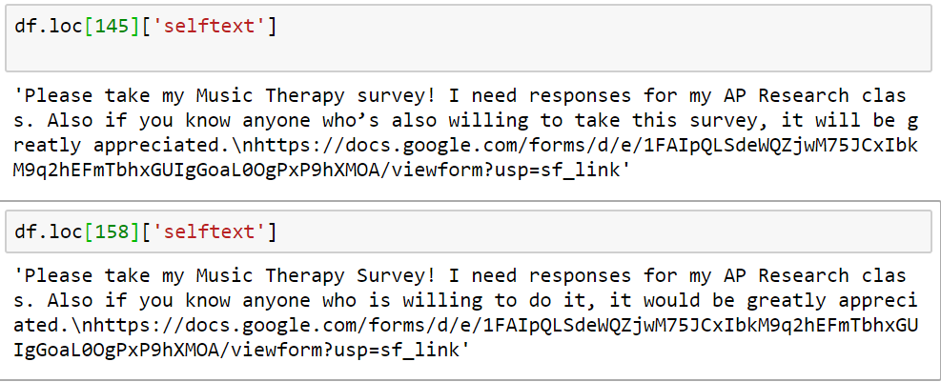
pd. Drop_duplicates() ineffective on posts like below
Can’t remove duplicate completely if the post contents are not 100% same.
Run it again after removing URL link
any other things that could cause duplicate removal failure?
Humans are unpredictable!

Slide 7
Data Cleanup
Drop duplicates
Remove posts that are not seeking help
Remove crossposts

Slide 8
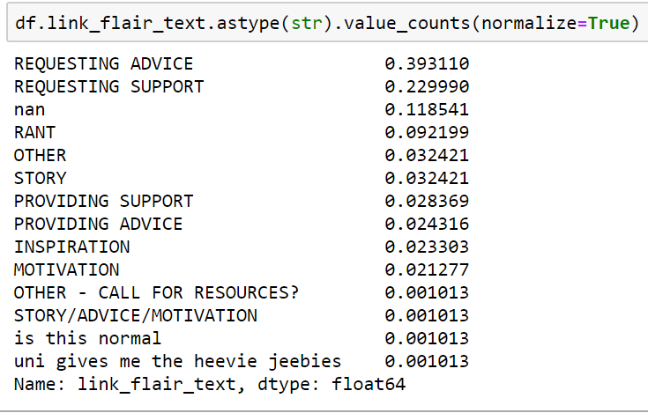
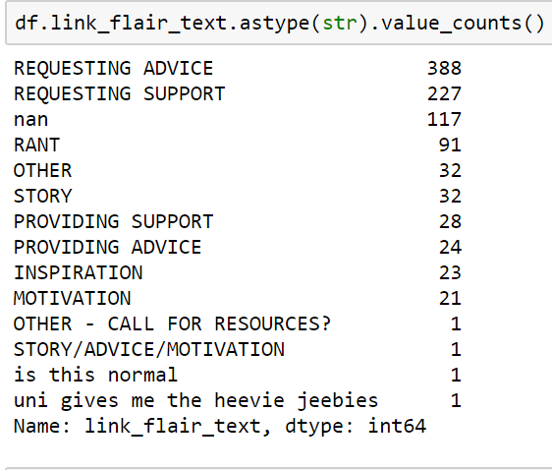
This column ‘link_flair_text’ shows that not all posts here are seeking help
There are posts seeking help
There are posts providing helps/advice
Mis-classification occurred (people asking for help, but posted under PROVIDING SUPPORT
RANT
(verb.) speak or shout at length in an angry, impassioned way.
(noun.) a long, angry speech of criticism or accusation

Slide 9
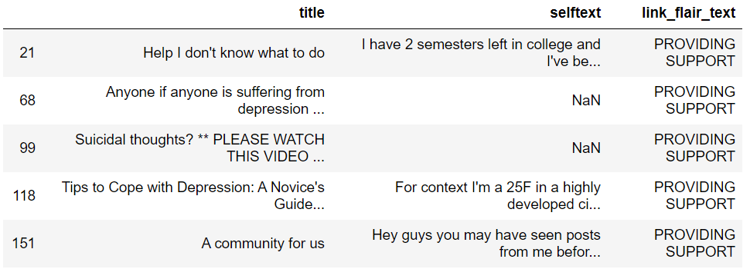
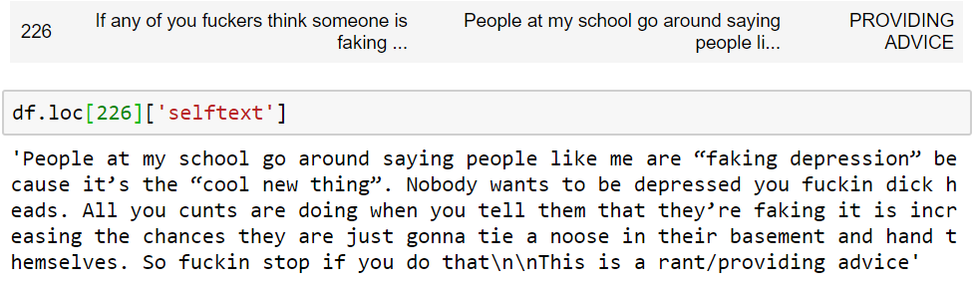
Wrong classification

Slide 10
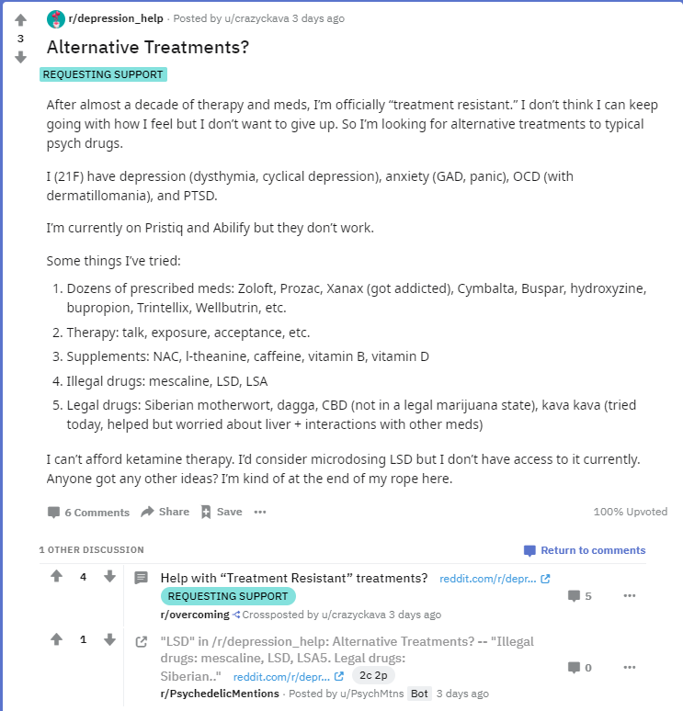
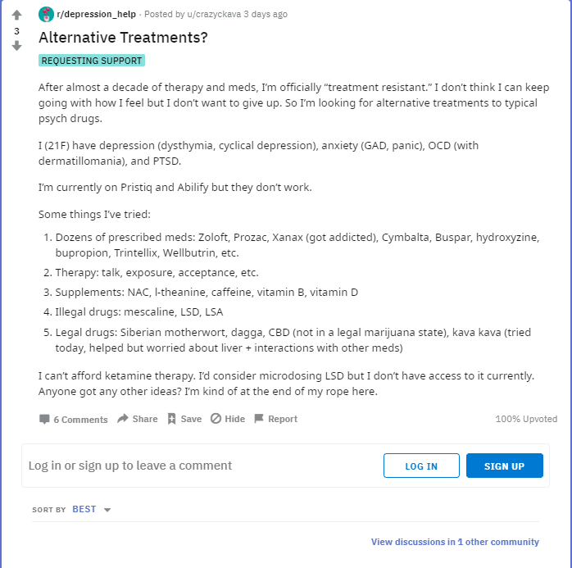

Crosspost
Notes:
https://www.reddit.com/r/depression_help/duplicates/etpwww/20_surprising_things_that_make_people_with/

Slide 11
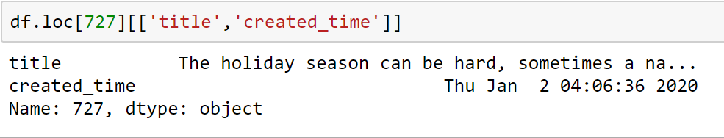
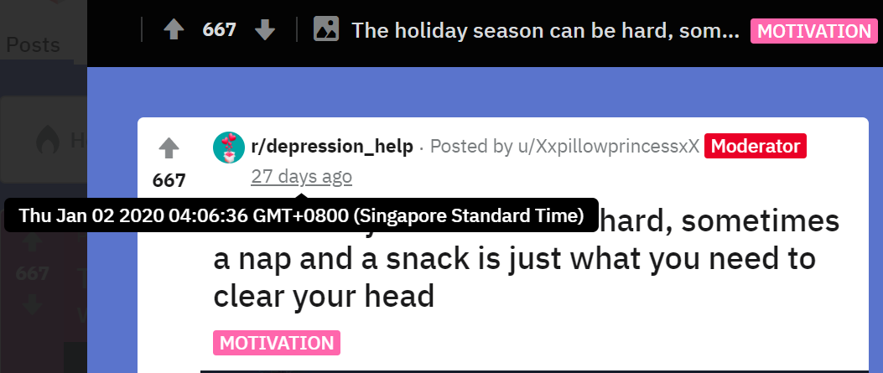
Timestamp of the message
Create_utc is used to convert into human readable time

Slide 12
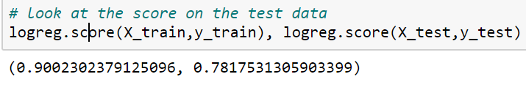
TfidfVectorizer + LogisticRegression
0.7843438219493477
{'tvec__sublinear_tf': True,
'tvec__norm': 'l2’,
'tvec__min_df': 2,
'tvec__max_features': 5000,
'tvec__max_df': 0.9,
'lr__solver': 'liblinear’,
'lr__penalty': 'l2’,
'lr__class_weight': 'balanced’,
'lr__C': 0.55}

Slide 13
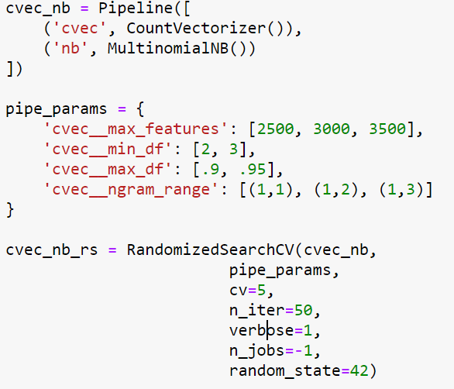
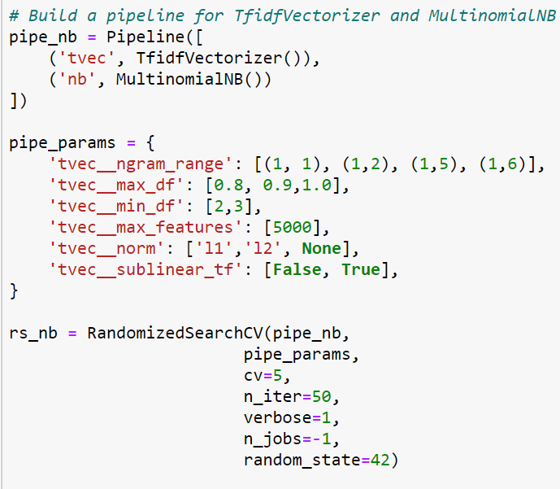
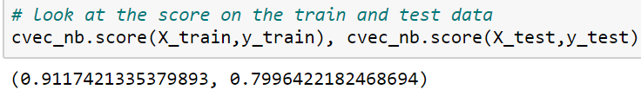
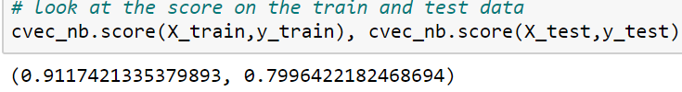
CountVectorizer + MultinomialNB
0.7881811204911742
{'cvec__ngram_range': (1, 5),
'cvec__min_df’: 2,
'cvec__max_features': 5000,
'cvec__max_df': 0.9}
TfidfVectorizer + MultinomialNB
0.7751343054489639
{'tvec__sublinear_tf': True,
'tvec__norm': 'l2’,
'tvec__ngram_range': (1, 2),
'tvec__min_df': 2,
'tvec__max_features': 5000,
'tvec__max_df': 0.9}

Slide 14
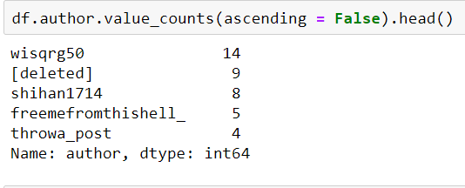
One user posted 14 messages on suicidewatch

