Slide 1
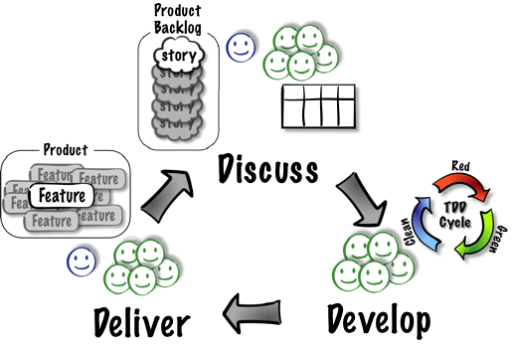
Acceptance-Test Driven Development (ATDD) Cycle

Slide 2





ATDD: Discuss
Concrete
Tests

Slide 3
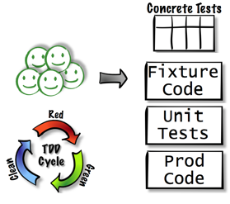
ATDD: Develop

Slide 4

ATDD: Deliver

