Slide 1
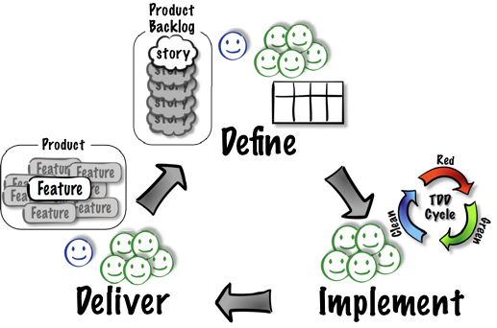
Acceptance-Test Driven Development (ATDD) Cycle

Slide 2





ATDD: Define
Concrete
Tests

Slide 3
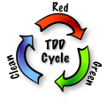



ATDD: Implement

Slide 4

ATDD: Deliver

