Slide 1
COCA Standard 9

Slide 2
CORE Elements
Within each standard, there are multiple elements that are identified as “core elements.”
A core element is critical to maintain the educational quality of the program. A COM will be found out of compliance with the standard if the COM fails to meet any core element within that standard.

Slide 3
Standard 9: Students
A COM must establish and publish admission requirements for potential applicants to the osteopathic medical education program, and must develop and apply effective policies and procedures for medical student selection and enrollment.
A COM must develop and implement policies and procedures as well as provide the human and physical resources required to support and promote health and wellness in order to meet and advance the physical, emotional, mental, career, academic and professional needs of its students, faculty and staff. All osteopathic medical students of the COM have the same rights to and must receive comparable services.

Slide 4
Standard 9.1: Admissions Policy (CORE)
A COM must establish and publish, to the public, admission requirements for potential applicants to the osteopathic medical education program and must use effective policies and procedures for osteopathic medical student selection for admission and enrollment, including technical standards for admissions. A COM must tie all admissions policies to the COM mission.

Slide 5
Standard 9.1: Admissions Policy
Application Requirements:
Minimum overall grade point average of 3.0
Minimum science grade point average of 2.75
Minimum of 492 on the MCAT

Slide 6
Standard 9.1: Admissions Policy
Course Requirements:
75% of courses required for a baccalaureate degree
Prerequisites
English
2 semesters
Composition I / II
Biology
2 semesters
Lower division
Biology, Zoology, Microbiology
Include labs
Physics
2 semesters
Chemistry
2 semesters
Chem I / II
Organic Chemistry
2 semesters
OChem I / II
Upper Division Science
At least 1 course:
Anatomy, Physiology, Microbiology, Biochemistry, Immunology, Histology, Genetics

Slide 7
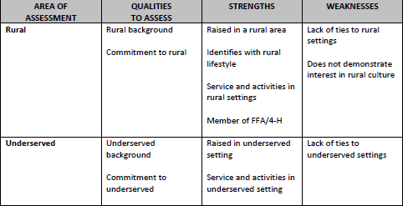
Standard 9.1: Admissions Policy
Mission: Educate osteopathic primary care physicians with an emphasis on serving rural and underserved Oklahoma
85% of class must be Oklahoma residents
Rural preference
Rural recruitment
Operation Orange
Blue Coat to White Coat
Regional College Outreach
Healthcare in the Heartland
MAPS Conference
Alumni Open Houses

Slide 8












Standard 9.1: Admissions Policy
Mission: Educate osteopathic primary care physicians with an emphasis on serving rural and underserved Oklahoma
Admissions options
3+1 Program
Primary Care
Rural
Partner Universities in Oklahoma
Guaranteed Interview
Partner Universities in Oklahoma
Bridge Program
Disadvantaged groups

Slide 9
Element 9.2 Academic Standards (CORE)
A COM must publish and follow policies and procedures on academic standards that include grading, class attendance, tuition and fees, refunds, student promotion, retention, graduation, students’ rights and responsibilities, and the filing of grievances and appeals
Located on Centernet: https://health.okstate.edu/com/academics/index.html
Academic Standards Handbook
Grades, attendance, student promotion, grade appeals, etc.
Student Handbook
Students’ rights and responsibilities, attendance, student financial responsibility, tuition and fees

Slide 10
Element 9.3 Transfer Policies
A COM must publish and follow policies regarding transfer or admissions with advanced standing. A COM may only accept credits from a school accredited by the COCA or Liaison Committee on Medical Education (LCME) where the student is eligible for readmission. The COM must ensure that if transfer occurs from an LCME accredited school of medicine, the student must acquire OMM/OPP competency prior to graduation from the COM. The last two years of education must be completed at the COM granting the degree.

Slide 11

Element 9.3 Transfer Policies
Transfers from other COMs accredited by COCA
2-year minimum
Dual degree credits

Slide 12

Element 9.4 Secure Student Record Keeping
A COM must develop an accurate, confidential and secure system for official student record keeping that includes: Admissions, advisement, academic and career counseling, evaluation, grading, credits and the training of faculty and staff in the regulations surrounding these records.

Slide 13
Element 9.4 Secure Student Record Keeping
OSU Policies and Procedures for Faculty:
Record retention policy: http://libraries.ok.gov/wp-content/uploads/RecordsMgt_GRDS_UC_2016.pdf
Retain gradebooks for 5 years
Retain exams for until returned or expiration of grade appeal (4 months after due)
FERPA
Faculty, staff , and other employees must complete FERPA training before accessing student education records
“Legitimate educational interest”
Current and former students have right to access records

Slide 14
Element 9.5 Academic Counseling (CORE)
A COM must provide academic counseling to assist its students in study skills, learning styles, learning resources, and other assistance for academic success.
Before school starts all incoming first year students take several tests to assess their strengths and weaknesses
Every first year student is assigned a faculty advisor and a second year student mentor
Dr. Carrie Gilstrap, Director of Academic Success, starts 10/1
Denise Fulbright, Learning Skills Specialist
One-on-one advising for every identified “at risk” student for COMLEX Level I preparation
Advising as needed for COMAT and Level II preparation

Slide 15
Element 9.6 Career Counseling (CORE)
A COM must provide career counseling to assist its students in evaluating career options and applying to graduate medical education training programs
Career Development assists students with career planning for the residency application process for 1st through 4th year medical students. MSPEs, Personal Statements, CVs
Holds various workshops throughout the year on such topics as:
How to apply for residency, navigating ERAS and CIM
MSPEs, The Match, Personal Statements, CVs, etc.
Hosts Annual Residency Fair
Presentations during transition and didactic weeks
https://health.okstate.edu/com/student-life/career-development.html

Slide 16
Element 9.7 Financial Aid & Debt Management Counseling
A COM must provide its students with counseling to assist them with financial aid applications and debt management.
Required financial aid counseling
Entrance counseling
Exit counseling
AACOM online modules
Average Student Loan Debt Load | Student Loan Default Rate
$194,411 | 1.2%

Slide 17
Element 9.8 Mental Health Services (CORE)
A COM must provide its students with confidential access to an effective system of counseling and mental healthcare.
A mental health representative must be accessible 24 hours a day, 365 days a year, from all locations where students receive education from the COM.

Slide 18
Element 9.8 Mental Health Services (CORE)
OSU-CHS Mental Health Resources
All students have 24/7 access to Mental Health Resources 365 days/year
24/7 Services provided through ComPsych GuidanceResources
In-the-moment support
Crisis calls
Referral to counselor in area where student is located (in- and out-of-state).
10 free, confidential sessions available on annual basis
Telephone counseling is also available by appointment.
Students can call 866-519-8354

Slide 19
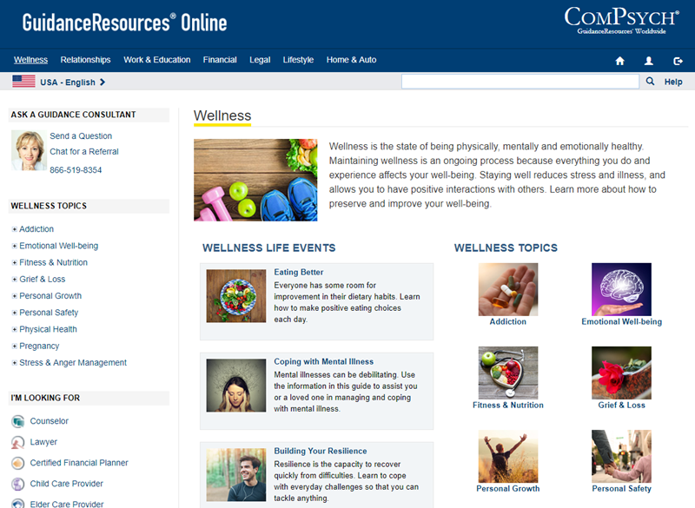
Element 9.8 Mental Health Services (CORE)
Other Services through Guidance Resources
Work-Life Solutions
Financial Information
Legal Support
Health Coaching
Call: 866-519-8354
Go Online: guidanceresources.com

Slide 20
Element 9.8 Mental Health Services (CORE)
OSU-CHS Well-Being Clinic
Kelly Dunn, MD
Joined the Department of Psychiatry & Behavioral Sciences, July 2018
Medical Director of Student and Resident Wellness
Clinical Assistant Professor of Psychiatry
Provides a spectrum of services
Coaching and Advisement
Behavioral Medicine Services
Students can schedule an appointment at this link: https://DrDunn.as.me/

Slide 21
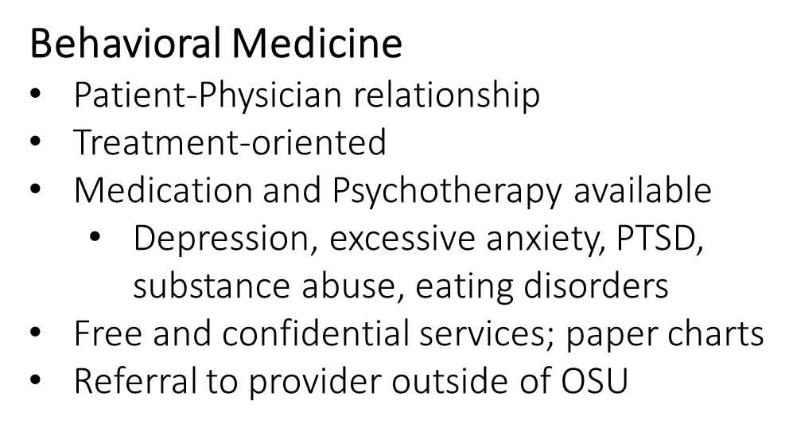
Element 9.8 Mental Health Services (CORE)
Spectrum of Services
Concerned with healing
Concerned with growth
Coaching & Advisement
Coach/Advisor
Optimizing Well-being
Prevent and reduce burnout
Just need to talk to someone
Critical Incident Stress Debriefing
Major life event support
Concerned about a peer

Slide 22



Element 9.8 Mental Health Services (CORE)
Download the App:
Confidential way to
text me.
Kelly.dunn@okstate.edu
Confidential way to book an appointment. Text me on OhMD for the link.
Office: Barson A-329
Off campus location available

Slide 23
Element 9.8 Mental Health Services (CORE)
OSU-Tulsa Counseling Clinic
5 free counseling sessions
Additional sessions are $10/per session
Located on the OSU-Tulsa campus at 700 N. Greenwood, in Main Hall room 2419
Appointments can be set by calling 918-594-8568

Slide 24
Element 9.8 Mental Health Services (CORE)
Community Resources
COPES
Community Outreach Psychiatry Emergency Services (COPES)
24/7 assistance
Through Family & Children’s Services
Free and confidential services for persons in Tulsa County
918-744-4800
Information found at: http://www.fcsok.org/services/crisiscare-center-2/mobile-crisis-copes/
National Suicide Prevention Lifeline: 1-800-273-8255

Slide 25
Element 9.9 Physical Health Services (CORE)
A COM must provide its students with access to diagnostic, preventive and therapeutic health services, accessible in all locations where students receive education from the COM
Students may visit OSU Health Care Center
Student insurance pays for any sick and preventative care visits at HCC
Students pay a “health fee” which covers:
Flu shots
Immunizations (and follow ups) needed after matriculation
Annual TB screening
Lab tests (other than needle sticks/accidents/exposures/titers)

Slide 26
Element 9.10 Non-Academic Health Professionals
A COM must ensure that any health professional providing health services, via a therapeutic relationship, must recuse him/herself from the academic assessment or promotion of the student receiving those services.
Health care provider is precluded from any evaluation role for a student if:
The provider has a therapeutic relationship with the student
The provider provides sensitive health services
Avoid conflicts of interest

Slide 27
Element 9.11 Health Insurance
A COM must require that all students have health insurance.
All students are required to maintain an active health insurance policy while enrolled at the OSU College of Osteopathic Medicine.
Students are required to provide proof of insurance prior to matriculation and they are required to maintain it throughout their course of study.
Office of Student Affairs utilizes MedProctor to verify coverage during 1st and 2nd years.
Students are required to provide and pay for their personal coverage.

