Slide 1


Slide 2
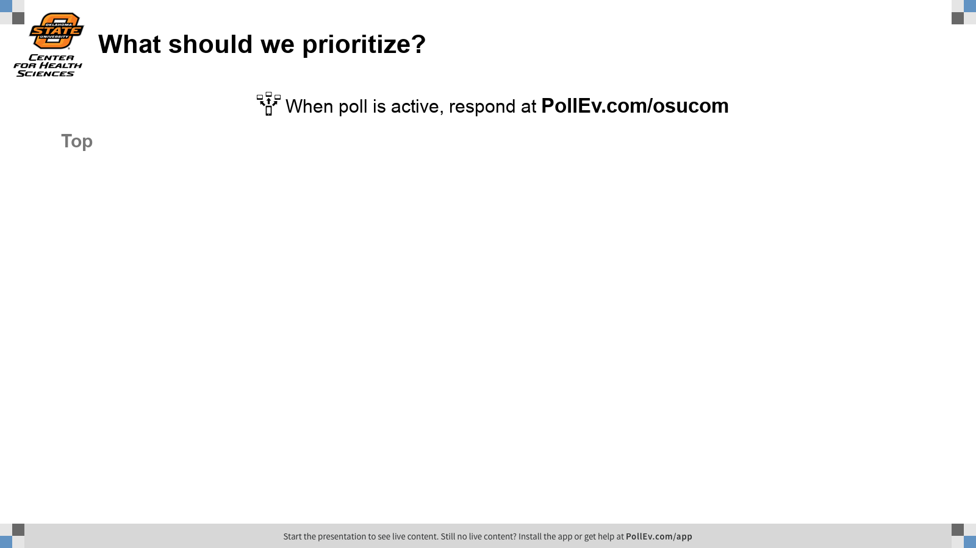
Notes:
What should we prioritize?
https://www.polleverywhere.com/discourses/0i3FU4r1vnvN3aktemNJ8

Slide 3
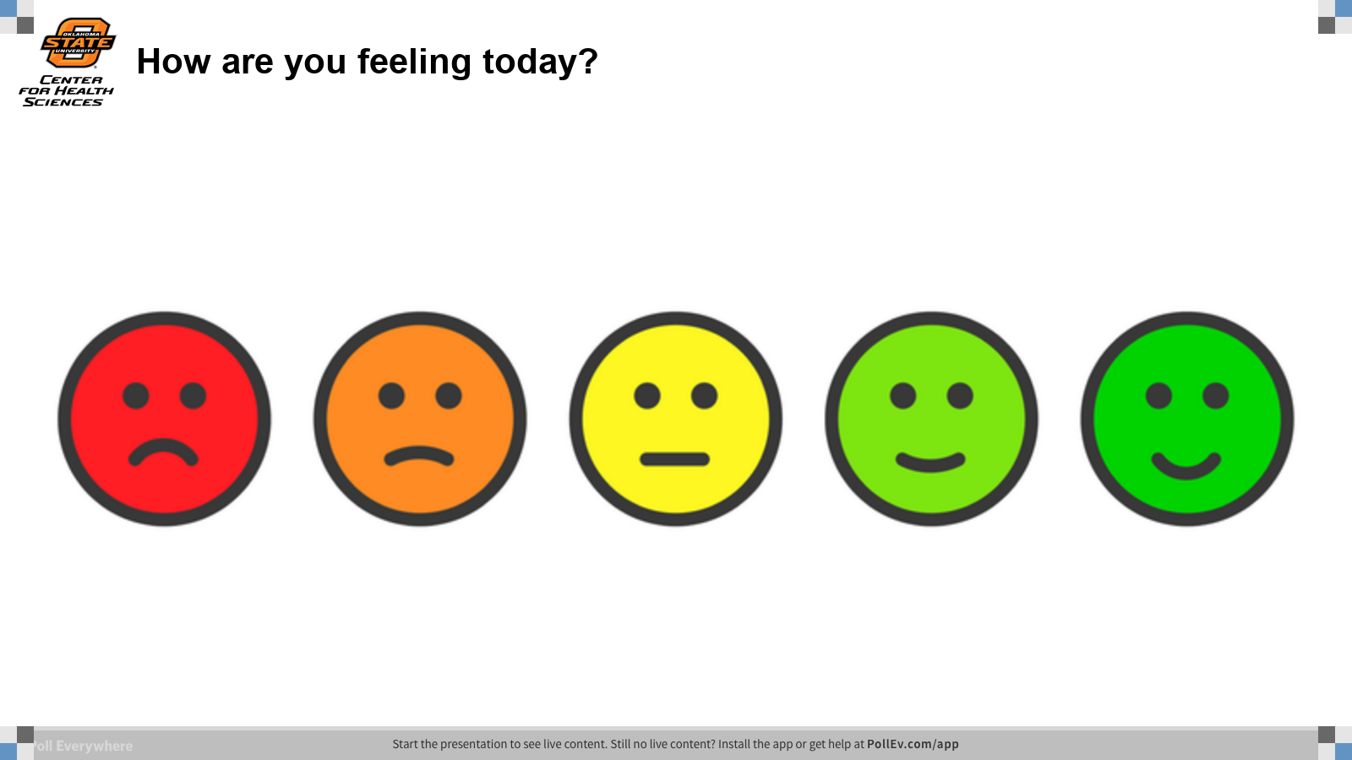
Notes:
How are you feeling today?
https://www.polleverywhere.com/clickable_images/Mnzi0YsZc8SWE1EZjo7te

Slide 4

TODAY’S OBJECTIVES
Describe WHY SharePoint can be useful
Explain WHAT SharePoint is and what it can include
Practice learning HOW SharePoint works

Slide 5
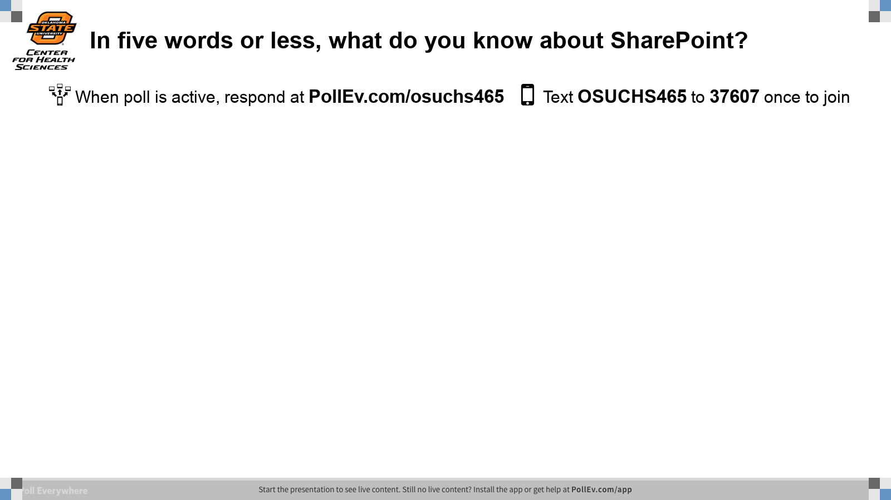
Notes:
In five words or less, what do you know about SharePoint?
https://www.polleverywhere.com/free_text_polls/8WEFNquOyNPyPpZKUhsKC

Slide 6

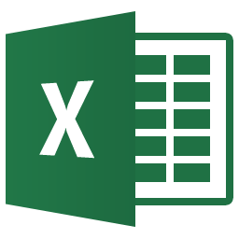





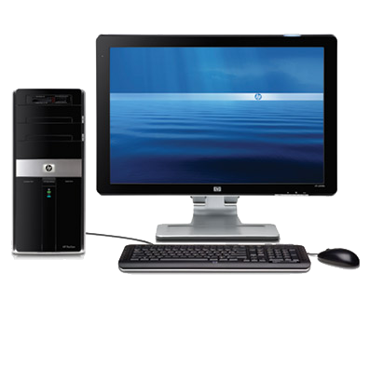



Why SharePoint?
Notes:
Advantages of SharePoint Document Libraries over using Shared Network Storage (group drive):
Scenario 1: Collaborating with one or more people over one document (e.g. syllabus)- tend to have numerous versions saved! But Sharepoint saves these versions while maintaining only ONE document. And you can edit it at the SAME TIME, which Austin will talk a little more about later.
Scenario 2: Working off-campus? With Sharepoint you can access all of your files securely just with internet. No VPN required!
Sharepoint is no additional cost to you! If you have something that is more efficient and convenient, why not use it?

Slide 7

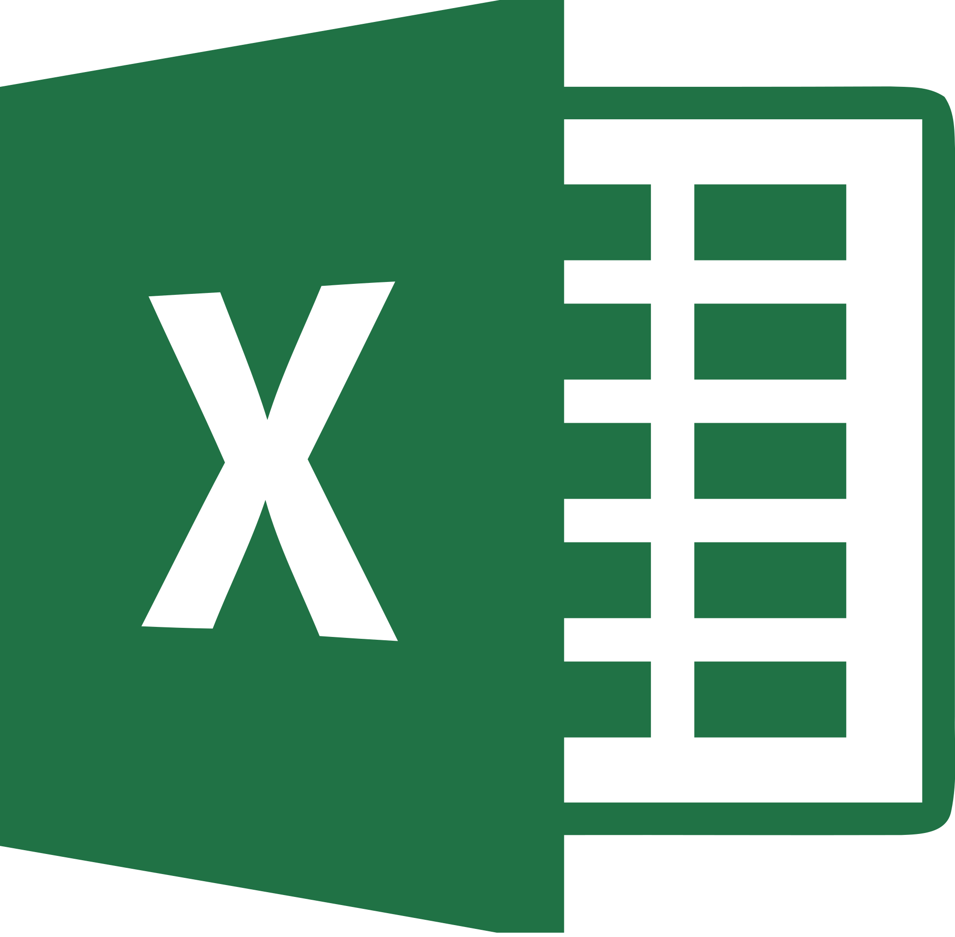


What is SharePoint?
Office 365
Notes:
Office 365 organizational structure

Slide 8
What is SharePoint?
SharePoint
Shared Document Libraries
Database
Team Collaboration & Communication
Intranet
Website
Notes:
SharePoint organizational structure

Slide 9





OneDrive & Shared Document Libraries
Group Drive
Everyone with permission can edit the doc together!
All but one person are locked out. Only one person can edit the file at a time.
Notes:
SharePoint organizational structure

Slide 10
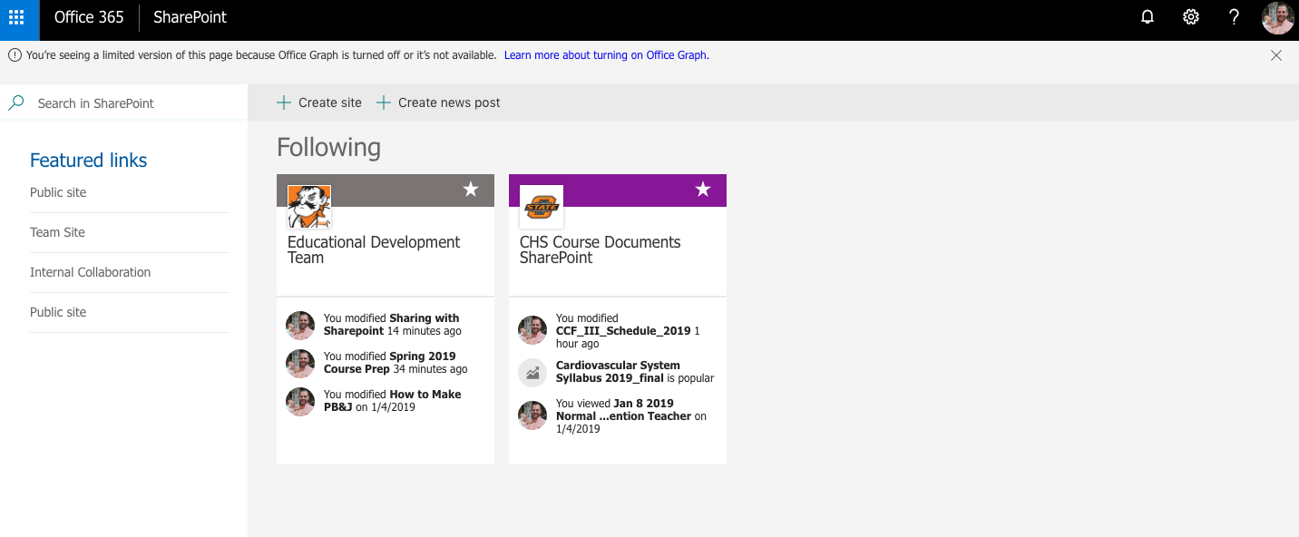
How do you Access SharePoint?
Just go to office.com!
Notes:
Juxtaposition of editing docs with group drive vs SharePoint (Office 365)

Slide 11
PRACTICE WITH SHAREPOINT
Access our shared folder: bit.ly/oedsharepoint

Slide 12
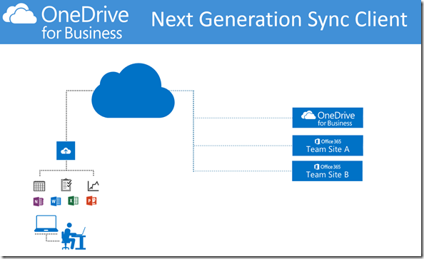
Stay N’Sync

Slide 13
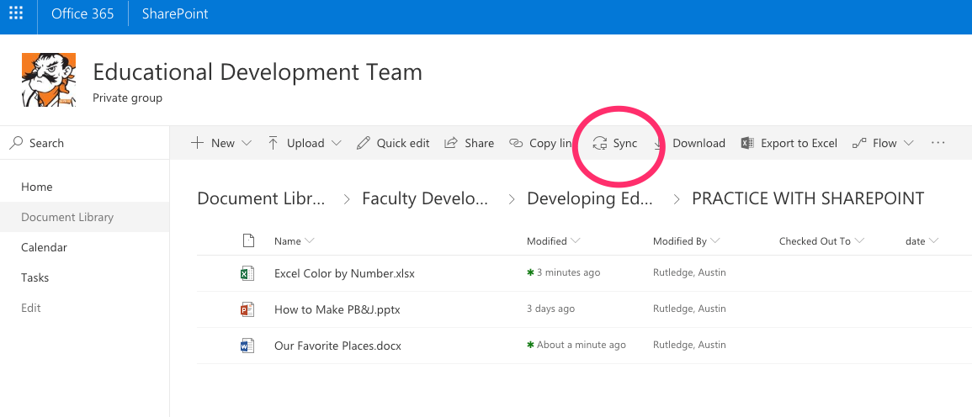
Stay N’Sync

Slide 14
Next Steps
Contact IT
Do you need a SharePoint site?
Syncing SharePoint Document Libraries with OneDrive Sync Client
SharePoint / Office 365 functionality
Contact OED
Using SharePoint functionality for instruction
Access permissions for CHS Course Documents SharePoint Site

Slide 15
References
Sync files with One Drive for Business sync client Syncing with One Drive for Business Video Tutorial
What is a SharePoint document library?
9 Killer Features of SharePoint Document Libraries
Notes:
Add user guides / videos found online

Slide 16
What we learned today… any questions?
Describe WHY SharePoint can be useful
Explain WHAT SharePoint is what it can include
Practice learning HOW SharePoint works
Austin Rutledge, austin.Rutledge@okstate.edu
Jessica Rucker, jessica.lacson@okstate.edu
IT, chs.helpdesk@okstate.edu
Find us online: http://health.okstate.edu/oed
We Tweet! @oedchs

Slide 17
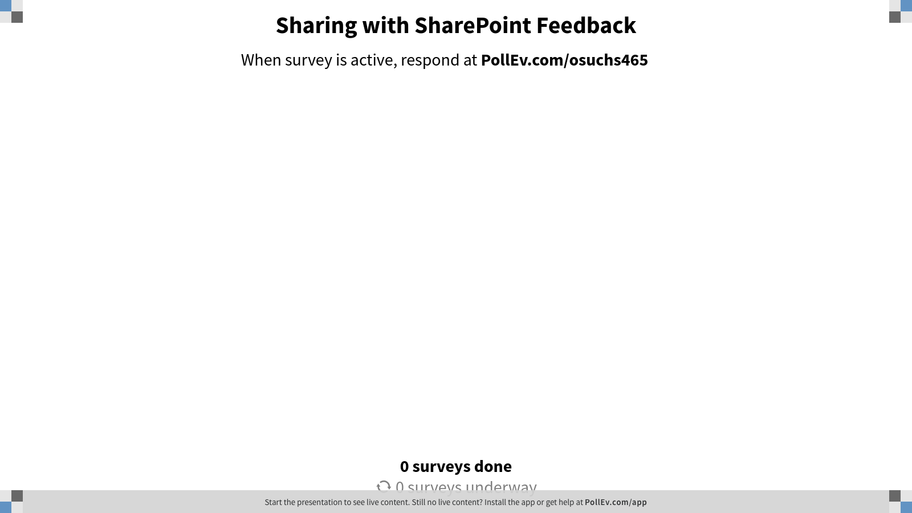
Notes:
Sharing with SharePoint Feedback
https://www.polleverywhere.com/surveys/MnRh1m6b4FLmZivQ1jgBO

Slide 18
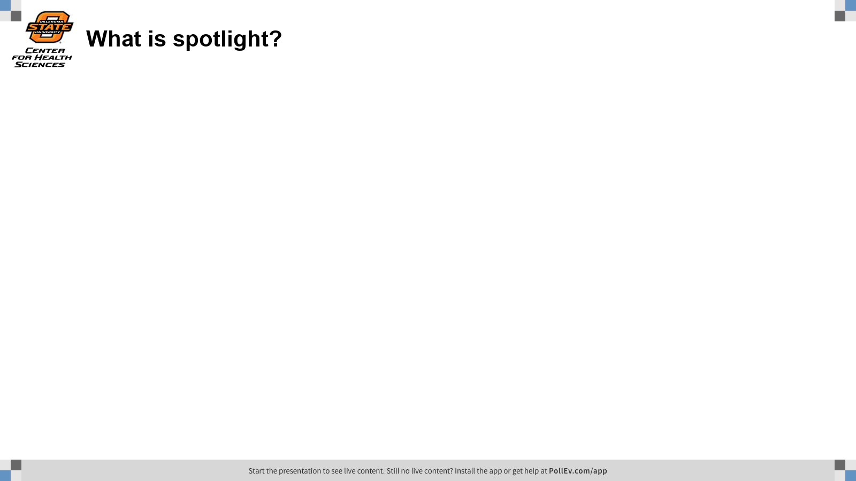
Notes:
What is spotlight?
https://www.polleverywhere.com/free_text_polls/Jg8KOTCXhxz6my3aAduN6

