Slide 1
COCA Standard 1 and 2
William J. Pettit, D.O.

Slide 2
Standard 1: Mission and Governance
A COM must have a written statement of mission and goals for the osteopathic medical education program, conduct ongoing planning and assessment, and have written bylaws that describe an effective organizational structure and governance processes. In the conduct of all internal and external activities, the COM must demonstrate integrity through its consistent and documented adherence to fair, impartial, and effective processes, policies, and practices.

Slide 3
Element 1.1: Program Mission: (CORE)
COCA Continuing Accreditation Standards | Evidentiary Submission for COCA Continuing Accreditation Standards
A College of Osteopathic Medicine (COM) must produce and publish a written mission statement for the program that explains the overall purpose of the program and serves as guide for program planning and assessment. If the COM is part of a larger educational institution or parent institution, the COM’s mission shall be consistent with the institution’s mission. The COM must review the program mission periodically and revise it as appropriate, including faculty and students, at a minimum, in the process. | 1. Provide copies of program mission / vision (optional) / goals or objectives (optional) and a public link to where the documents are published. 2. If the COM is part of a larger educational institution (parent institution), provide a copy of the parent institution’s mission statement. The documents should show last updated date (or effective date) and revision history. 3. Provide documentation of the revision process, participants, and meeting minutes documenting the most recent governing board approval of the COM’s mission.

Slide 4
Oklahoma State University College of Osteopathic Medicine
Mission:
Oklahoma State University College of Osteopathic Medicine educates osteopathic primary care physicians with an emphasis on serving rural and underserved Oklahoma.
Vision:
Oklahoma State University College of Osteopathic Medicine will be recognized for:
Fulfilling the health care needs of rural and underserved Oklahoma
Producing graduates who are dedicated, effective, and compassionate community leaders
Providing excellent care and health-related community service
Being a leader and innovator in education
Being the medical school of choice

Slide 5
Oklahoma State University Center for Health Sciences
Mission:
The Oklahoma State University Center for Health Sciences educates and trains osteopathic physicians, scientists and health care professionals, with an emphasis on providing health care for rural and underserved areas of Oklahoma.
Vision:
Oklahoma State University Center for Health Sciences will be recognized for:
Fulfilling the health care needs of rural and underserved Oklahoma
Producing graduates who are dedicated, effective and compassionate community leaders
Advancing the frontier of medical research
Providing excellent care and health-related community service
Being a leader and innovator in education
Being the medical and graduate school of choice

Slide 6
Oklahoma State University
Mission:
Building on its land grant heritage, Oklahoma State University promotes learning, advances knowledge, enriches lives, and stimulates economic development through teaching, research, extension, outreach, and creative activities.
Vision:
Oklahoma State University will lead in the creation of a better Oklahoma, nation, and world by advancing the quality of life for all, and will fulfill the obligations of a first class, land grant educational institution.

Slide 7
Element 1.2: Strategic Plan:
COCA Continuing Accreditation Standards | Evidentiary Submission for COCA Continuing Accreditation Standards
A COM must produce and publish a current strategic plan addressing all core aspects of the COM mission. The strategic plan review and revision must include faculty and students, at a minimum. | 1. Provide a copy of the COM strategic plan. 2. Provide the list of individuals who participated in the plan creation. 3. Provide a link to where the documents are published.

Slide 8
Shaping the Future of Health and Healthcare in Oklahoma
Oklahoma State University College of Osteopathic Medicine2016 – 2026 Strategic Plan

Slide 9
Element 1.3: Licensing and Regional / Institutional Accreditation: (CORE)
COCA Continuing Accreditation Standards | Evidentiary Submission for COCA Continuing Accreditation Standards
A COM must maintain in effect any charter, licenses, or approvals required for it to function as an institution of higher education, including the provision of degree programs beyond the secondary level. The parent / sponsoring institution under which the COM operates (or the independent COM itself) must be recognized by an institutional accrediting agency that is recognized by the USDE. The COM must report to the COCA any adverse actions that are taken against its parent institution by its institutional accreditor within five business days of notification of such action. | 1. Provide a copy of the charter, license, or letter of approval from all agencies issuing such approvals. 2. Provide a public link to where the most recent institutional accreditation documents are published.

Slide 12
Element 1.4: Governance & Program Policies: (CORE)
COCA Continuing Accreditation Standards | Evidentiary Submission for COCA Continuing Accreditation Standards
A COM must have a governing body, or be part of a parent institution with a governing body, that defines the mission of the COM and/or institution, approves the strategic plan, provides financial oversight, and approves requisite policies. The COM must publish and abide by policies regarding: a. Conflict of Interest for board members, employees, and institutionally employed faculty. b. Due process for all employees, students, faculty, and credentialed instructional staff. c. Confidentiality of employment, student, and medical records. d. Fiscal management and accountability. e. Ethics, incorporating the AOA Code of Ethics. | 1. Provide the bylaws of the governing body and a list of members of the body. 2. Provide a copy of the policies for: a. Conflict of Interest for board members, employees, and institutionally employed faculty. b. Due process for all employees, students, faculty, and credentialed instructional staff. c. Confidentiality of employment, student, and medical records. d. Fiscal management and accountability. e. Ethics, incorporating the AOA Code of Ethics.

Slide 13
CODE OF ETHICS
The Oklahoma State University College of Osteopathic Medicine annually adopts and reaffirms adherence to the AOA Code of Ethics
Formal Recommendation FS 15-16-009 (Approved-Placement in Faculty Resource Manual 5-13-16)
Formal Recommendation FS 15-16-003 (Approved-Annual reaffirmation 12-3-15)
Formal Recommendation FS 08-09-005 (Approved-Adoption of AOA Code of Ethics 10-10-08)
General Faculty Reaffirmation (Approved-Reaffirmation Vote 12-18-15)
General Faculty Reaffirmation (Approved-Reaffirmation Vote 12-16-16)
The full AOA Code of Ethics document can be accessed digitally at:
http://www.osteopathic.org/inside-aoa/about/leadership/Pages/aoa-code-of-ethics.aspx

Slide 14
Element 1.5a: Non-Discrimination: (CORE)
COCA Continuing Accreditation Standards | Evidentiary Submission for COCA Continuing Accreditation Standards
A COM must demonstrate non-discrimination in the selection of administrative personnel, faculty and staff, and students based on race, ethnicity, color, sex, sexual orientation, gender, gender identity, national origin, age or disabilities, and religion. | 1. Provide a copy of the non-discrimination policy. 2. Provide a public link to where the document is published.

Slide 15
Non-Discrimination (CORE)
A COM must demonstrate non-discrimination in the selection of administrative personnel, faculty and staff, and students based on race, ethnicity, color, sex, sexual orientation, gender, gender identity, national origin, age or disabilities, and religion.
Evidentiary Submission:
1.Provide a copy of the non-discrimination policy.
2.Provide a public link to where the document is published.

Slide 16
Non-Discrimination
1.1 Oklahoma State University Center for Health Sciences is an equal opportunity and affirmative action employer, and as such, provides equal opportunity for employment and advancement of all employees without regard to age, race, ethnicity, color, religion, sex, sexual orientation, genetic information, gender, gender identity or expression, national origin, disability, protected veteran status, or other protected category.

Slide 17
Element 1.6: Degree-Granting Body:
COCA Continuing Accreditation Standards | Evidentiary Submission for COCA Continuing Accreditation Standards
The governing body of the COM and/or institution must confer the degree Doctor of Osteopathic Medicine (DO) upon those students who have satisfactorily completed the requirements for graduation and have been recommended for graduation by faculty. | 1. Provide a copy of the bylaws or governing documents that demonstrate the conferral of degree. 2. Provide a copy of the COM policy demonstrating that the faculty senate (or approved body) must recommend candidates for graduation. 3. Provide minutes from the Faculty Association meeting where this occurred for the most recent graduates.

Slide 18
Graduation Requirements
A student who has satisfactorily completed all academic requirements and who has been recommended by the College faculty may be awarded the Doctor of Osteopathic Medicine (DO) degree, provided the student has:
Passed COMLEX Level 2 CE and PE and reported the scores to the College prior to graduation All students graduating in 2008 and later must take and pass the COMLEX Level 2 CE and PE as a requirement for graduation. Testing for Level 2 Cognitive Evaluation is done several times each year at computer testing sites; the student is responsible for identifying the time and place they will take each exam and may register for each exam by going to the NBOME website: http://www.nbome.org/ The Level 2 Performance Evaluation is done numerous times each year at the testing center in Conshohocken, Pennsylvania and each student must arrange to travel to that site after registering for the exam online.
No unremediated "D" or "U" grades and no grades of "I"
Successfully completed all clinical rotations
Complied with all legal and financial requirements of the College
Exhibits the ethical, professional, behavioral, and personal characteristics necessary for the practice of osteopathic medicine
Demonstrated acceptable competence in the knowledge, skills, and attitudes required of an osteopathic physician
Been recommended for graduation by the appropriate bodies of the College
Attended the commencement graduation rehearsal and ceremony (only in unusual circumstances, and with prior approval of the Dean, will a degree be awarded in absentia)
A student will meet the graduation requirements listed in the catalog in effect at the time of his/her initial enrollment, provided that no more than six years have elapsed between matriculation and graduation.
A student who is required to repeat an academic year will meet the graduation requirements listed in the catalog for that year

Slide 19
Faculty Recommendation for Student Graduation and Promotion
Dr. Rouch presented the list of students for graduation or promotion via PowerPoint presentation. A vote was taken for each class individually.
The list of MS IV Class Students was presented for the faculty to vote their Approval for graduation contingent upon completing all requirements.
Vote taken: Unanimously Approved Number of students: 105
The list of MS I Class Students was presented for the faculty to vote their Approval for promotion contingent upon completing all requirements.
Vote taken: Unanimously Approved Number of students: 113
The list of MS II Class Students was presented for the faculty to vote their Approval for promotion contingent upon completing all requirements.
Vote taken: Unanimously Approved Number of students: 114
The list of MS III Class Students was presented for the faculty to vote their Approval for promotion contingent upon completing all requirements.
Vote taken: Unanimously Approved Number of students: 108

Slide 20
Element 1.7: Clinical Education Affiliation Agreements: (CORE)
COCA Continuing Accreditation Standards | Evidentiary Submission for COCA Continuing Accreditation Standards
A COM must be able to demonstrate executed affiliation agreements addressing the required clinical educational experiences for students | 1. Provide a copy of the COM approved affiliation agreement. (All signed agreements may be evaluated on-site)

Slide 21
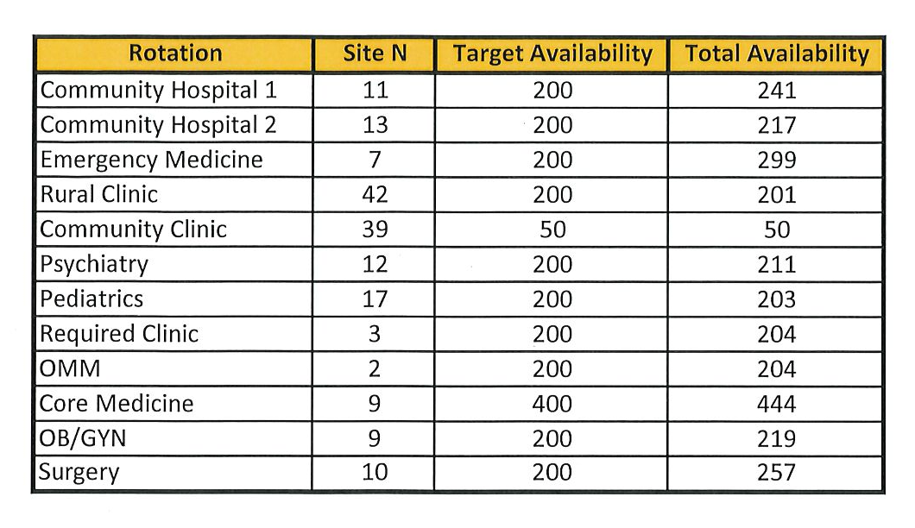
Clinical Required Rotations

Slide 22
Standard 2: Leadership and Administration
A COM must have leadership and senior administrative staff with the knowledge, skills, time, and support necessary to achieve the goals of the osteopathic medical education program and to ensure the functional integration of all programmatic components.

Slide 23
Element 2.1: Dean Qualifications: (CORE)
COCA Continuing Accreditation Standards | Evidentiary Submission for COCA Continuing Accreditation Standards
A COM must have a Dean who is qualified by education, training, and experience to provide effective leadership in education, scholarly activity, and patient care. The Dean shall have an earned DO degree from a COCA accredited College of Osteopathic Medicine, medical license, board certification (at some time in his/her career), and at least five years’ experience in academic leadership roles that include budget management authority. | 1. Provide the current job description for the Dean. 2. Provide a full CV for the Dean. 3. Provide a copy of the Dean’s diploma from a COCA accredited college of osteopathic medicine. 4. Provide a copy of the Dean’s medical license. 5. Provide a copy of the Dean’s board certification documents.

Slide 24
Element 2.2: Full Time Dean: (CORE)
COCA Continuing Accreditation Standards | Evidentiary Submission for COCA Continuing Accreditation Standards
The Dean must be employed full-time by the COM and/or its parent institution | 1. Provide the employment contract (compensation redacted) demonstrating that the Dean is employed full time.

Slide 25
Element 2.3: Academic and Administrative Leadership:
COCA Continuing Accreditation Standards | Evidentiary Submission for COCA Continuing Accreditation Standards
A COM must have academic and administrative leadership to accomplish the mission of the medical school. Assistant/Associate Deans must have proven experience in teaching, educational design and evaluation, scholarly activity, and academic leadership in a medical education setting appropriate for the position. | 1. Provide an organization chart that shows the leadership positions and reporting relationships. 2. Provide the current job description for each member of the administrative leadership team (Associate Deans, Assistant Deans, senior level administrators). 3. Provide a full CV for each member of the administrative leadership team (Associate Deans, Assistant Deans, senior level administrators).

Slide 26
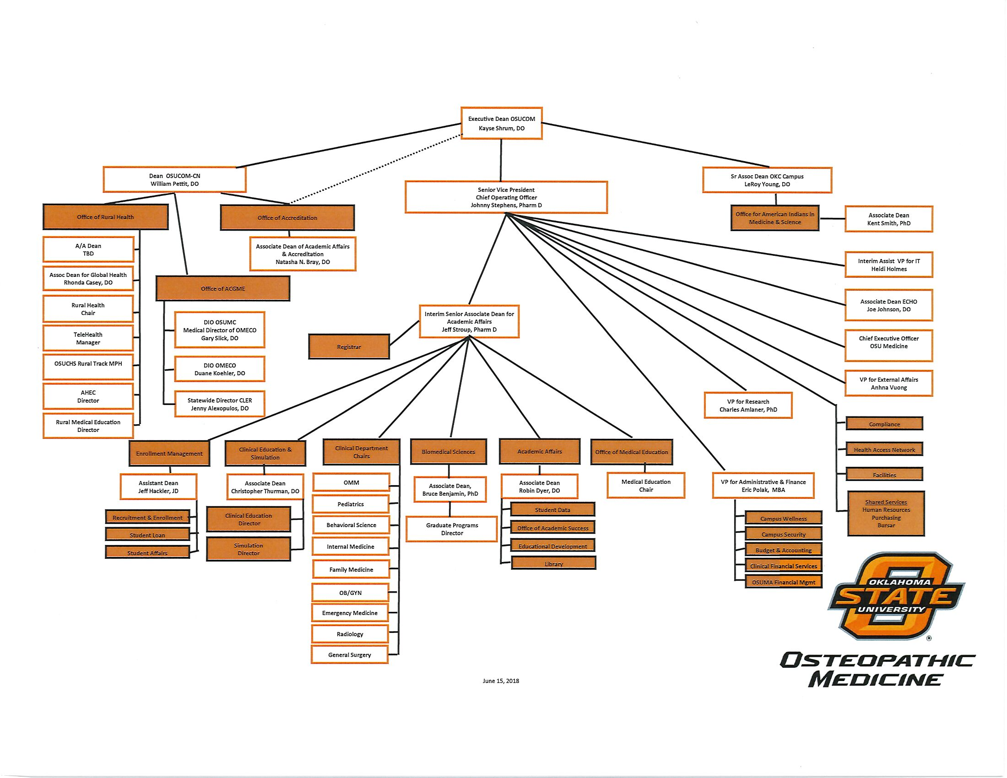

Slide 27
Element 2.4: Accreditation Standard Complaint Policies and Procedures: (CORE)
COCA Continuing Accreditation Standards | Evidentiary Submission for COCA Continuing Accreditation Standards
A COM must publish policies and procedures that include a confidential accreditation standard complaint resolution process that includes a description of how these complaints are filed, resolved through an adjudication process, without retaliation, and maintained through the COM’s records retention system. The accreditation standard complaint filing process must include a process for filing confidential complaints with the COCA and the contact information of the COCA. | 1. Provide documentation of policies and procedures regarding accreditation standard complaints and their adjudication. 2. Provide sample records of accreditation standard complaints that have been received, adjudicated, and resolved. 3. Provide a public link to where the accreditation standard complaint policies and procedures are published.

Slide 28
Complaints Regarding Non-Compliance with AOA Accreditation Standards Policy
OSU-CHS is committed to meeting and exceeding the standards for accreditation of colleges of osteopathic medicine as described by the American Osteopathic Association Commission on Osteopathic College Accreditation. A copy of the standards is available upon request from the Office of Academic Affairs. Students who believe that the College may not be in compliance with a standard of accreditation have the right to file a complaint through the following procedure:
1. A written, dated and signed complaint must be filed with the Office of Student Affairs.
2. Student Affairs will consult with the Senior Associate Dean and form an ad hoc committee of faculty and students to investigate the complaint.
3. The results of the investigation shall include findings of fact, a determination of standard compliance or non-compliance, and recommended corrective actions. The results will be communicated in writing to the Senior Associate Dean, Student Affairs and the student complainant.
4. If corrective action is indicated, the Senior Associate Dean will respond with a description/plan for such action within 30 days of receipt of the ad hoc committee results.
5. Records of all proceedings regarding complaints will be maintained by the Office of Student Affairs.
6. In the event that the student complainant is not satisfied with the ad hoc committee determination and/or corrective action, the student may communicate his/her complaint at the following address:
Secretary, Commission on Osteopathic College Accreditation
American Osteopathic Association
142 East Ontario Street
Chicago, IL 60611-2864
Phone (312) 202-8000
predoc@osteopathic.org

Slide 29
COCA Standard 3
Eric J Polak

Slide 30
Standard 3: Finances
A COM must have sufficient financial resources readily available to meet the needs of the COM and to achieve the COM mission, consistent with its projected and authorized student class size.

Slide 31
Element 3.1: Financial Resources (CORE)
COCA Continuing Accreditation Standards | Evidentiary Submission for COCA Continuing Accreditation Standards
A COM must ensure that the financial resources of the school meet the requirements of Title IV of the Higher Education Act and are adequate to sustain a sound program of osteopathic medical education and to accomplish the programmatic and institutional Goals. | Provide the operational budget (income, revenue sources, and expenses) for the COM including the last three years of data.

Slide 32
Element 3.1 (continued)
COM Financials
 | FY 2018 | FY 2017 | FY 2016
State Sources | $ 11,468,333 | $ 11,942,916 | $ 12,001,021
Tuition & Fees | $ 12,204,194 | $ 10,779,675 | $ 10,047,400
Other Revenues | $ 53,692,752 | $ 52,345,738 | $ 40,124,835
Use of Endowment Income | $ 782,209 | $ 636,803 | $ 570,408
Clinical Revenues | $ 120,317,000 | $ 110,907,000 | $ 94,993,000
Total Revenues | $ 198,464,488 | $ 186,612,132 | $ 157,736,664
Instructional & Academic Support | $ 52,329,246 | $ 62,638,318 | $ 55,947,407
Research (Internally Funded) | $ 2,405,749 | $ 2,502,568 | $ 2,448,314
Educational Outreach & Public Service | $ 709,279 | $ 416,178 | $ 405,400
Student Services | $ 831,540 | $ 869,825 | $ 675,058
Institutional Support | $ 4,450,368 | $ 3,879,734 | $ 3,645,625
Facilities O&M | $ 3,244,760 | $ 3,223,609 | $ 2,833,106
E&G Part I Expenditures | $ 63,970,942 | $ 73,530,231 | $ 65,954,909
COM Clinical Expenditures | $ 118,756,722 | $ 107,444,032 | $ 90,295,028
Total Expenditures | $ 182,727,664 | $ 180,974,262 | $ 156,249,937
Funds Available for Other Programs | $ 15,736,824 | $ 5,637,870 | $ 1,486,727

Slide 33
Element 3.2: Financial Planning and Budgeting
COCA Continuing Accreditation Standards | Evidentiary Submission for COCA Continuing Accreditation Standards
A COM must have a budgeting process that is designed to support the mission of the COM. | Provide a copy of the flowchart demonstrating the budget development process. Provide information as to all persons with budgetary management and oversight. Demonstrate in the flowchart where final budget approval occurs

Slide 34
Element 3.2: (continued)
As a college of Oklahoma State University and part of the system governed by the Oklahoma State Regents for Higher Education (OSRHE) final authority for the approval of the COM budget falls with this 9-member board appointed by the Governor. Prior to submission and approval by OSRHE the budget goes through numerous local levels of approval by the Regents for the Oklahoma Agricultural and Mechanical Colleges (A&M Regents) and Oklahoma State University (OSU).
The Dean of the COM has established a process where the budget committee consisting of the Senior Vice President and Chief Operating Officer, the Senior Associate Dean of the COM, the Vice President for Administration and Finance, the Director of Human Resources and the Associate Vice President for Budget and Finance develop the draft budget with input from department chairs and directors.
Once the draft budget is approved by the Dean, the President of the Center for Health Sciences submits the consolidated campus budget, including tuition and fee requests for the COM and graduate programs, to be included with the budget request for OSU. This request is then considered by the Budget and Planning Committee of the A&M Regents and recommended for approval by the full A&M Regents. Once this approval is granted the OSU budget, including tuition and fee requests, is considered for approval by OSRHE.
Post approval meetings including the senior associate dean and VP for Administration & Finance are held with various select department heads to implement the approved budget.

Slide 35
Post Approval Meetings with Select Department Heads
Legend
Submission for approval
Information exchange
OK State Regents for Higher Education
Regents for the Oklahoma Agricultural & Mechanical Colleges
President, OSU
President, OSU-CHS
Dean, OSU-COM
Budget Committee
COM Senior Associate Dean
VP Administration & Finance
Academic Department Heads
Instructional Support Departments
Student Affairs Committee
Administrative Department Heads
Faculty Committees (if applicable)

Slide 36
Element 3.3: Budgetary Authority
COCA Continuing Accreditation Standards | Evidentiary Submission for COCA Continuing Accreditation Standards
A COM or parent institution must provide the Dean with the resources and budgetary authority necessary to fulfill his or her responsibility for management of the COM. | Provide the current job description demonstrating the Dean possesses budgetary authority for the COM. Provide the employment contract (compensation redacted) demonstrating that the Dean possesses budgetary authority for the COM.

Slide 37
Element 3.4: Financial Audit (CORE)
COCA Continuing Accreditation Standards | Evidentiary Submission for COCA Continuing Accreditation Standards
A COM or its parent institution must commission an annual independent audit confirming financial viability and provide evidence of resolution of concerns cited in the audit’s accompanying management letter. | Provide the annual audited financial statement and audit report for the COM or its parent institution for the latest complete fiscal year.

