Slide 1
COCA Standard 7
William J. Pettit, D.O.

Slide 2
Standard 7: Faculty and Staff
The faculty members at a COM must be qualified through their education, training, experience, and continuing professional development and provide the leadership and support necessary to attain the institution's educational, research, and service goals.
A COM must ensure that its medical education program includes a comprehensive, fair, and uniform system of formative and summative medical student assessment and protects medical students’ and patients’ safety by ensuring that all persons who teach, supervise, and/or assess medical students are adequately prepared for those responsibilities.

Slide 3
Element 7.1: Faculty and Staff Resources and Qualifications: (CORE)
At all educational teaching sites, including affiliated sites, a COM
must have sufficient faculty and staff resources to achieve the
program mission, including part time and adjunct faculty, who are
appropriately trained and degreed. The physician faculty, in the
patient care environment, must hold current medical licensure
and board certification/ board eligibility. The non-physician
faculty must have appropriate qualifications in their fields.

Slide 4
Adjuncts and Faculty Numbers
Adjunct Faculty: 813 currently
Since April 30, 2018 we have removed 91 Adjuncts.
Faculty Members: 176 currently
We will have 2 more faculty members starting at the end of September.

Slide 5
Element 7.2: Faculty Approvals at All Teaching Sites:
A COM must academically credential and/or approve the faculty
at all COM and COM-affiliated and educational teaching sites

Slide 6
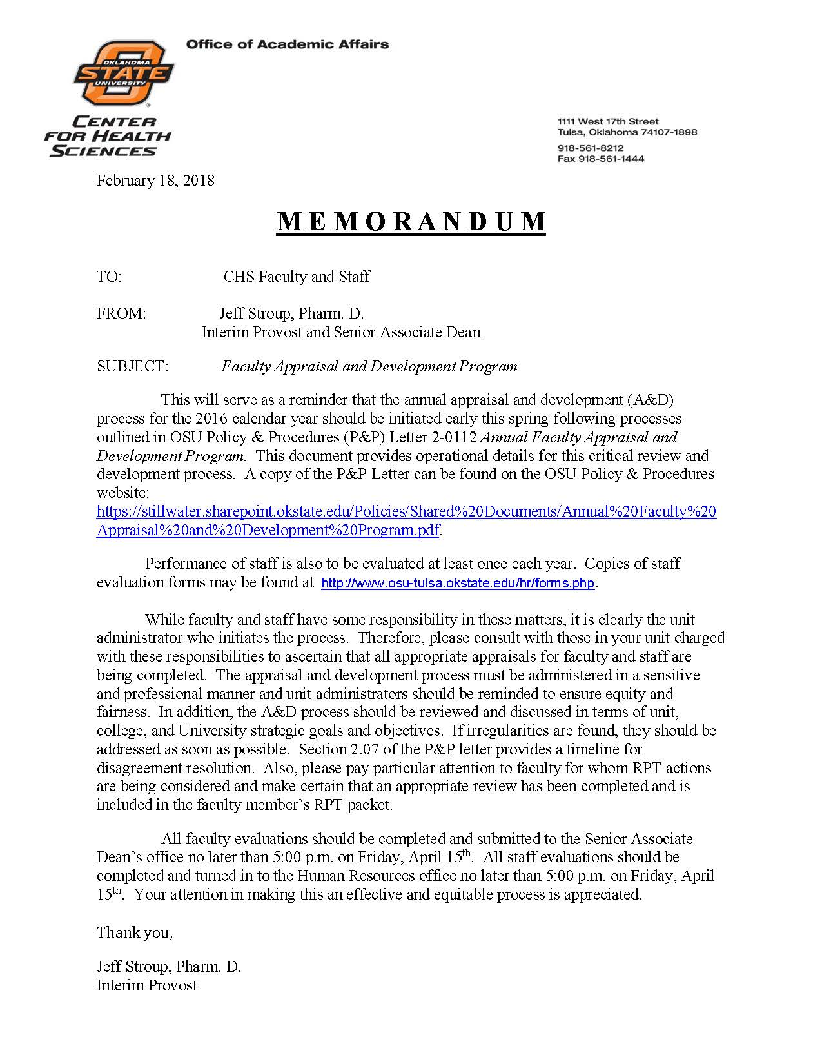
COM Faculty Annual Appraisals Notice

Slide 7
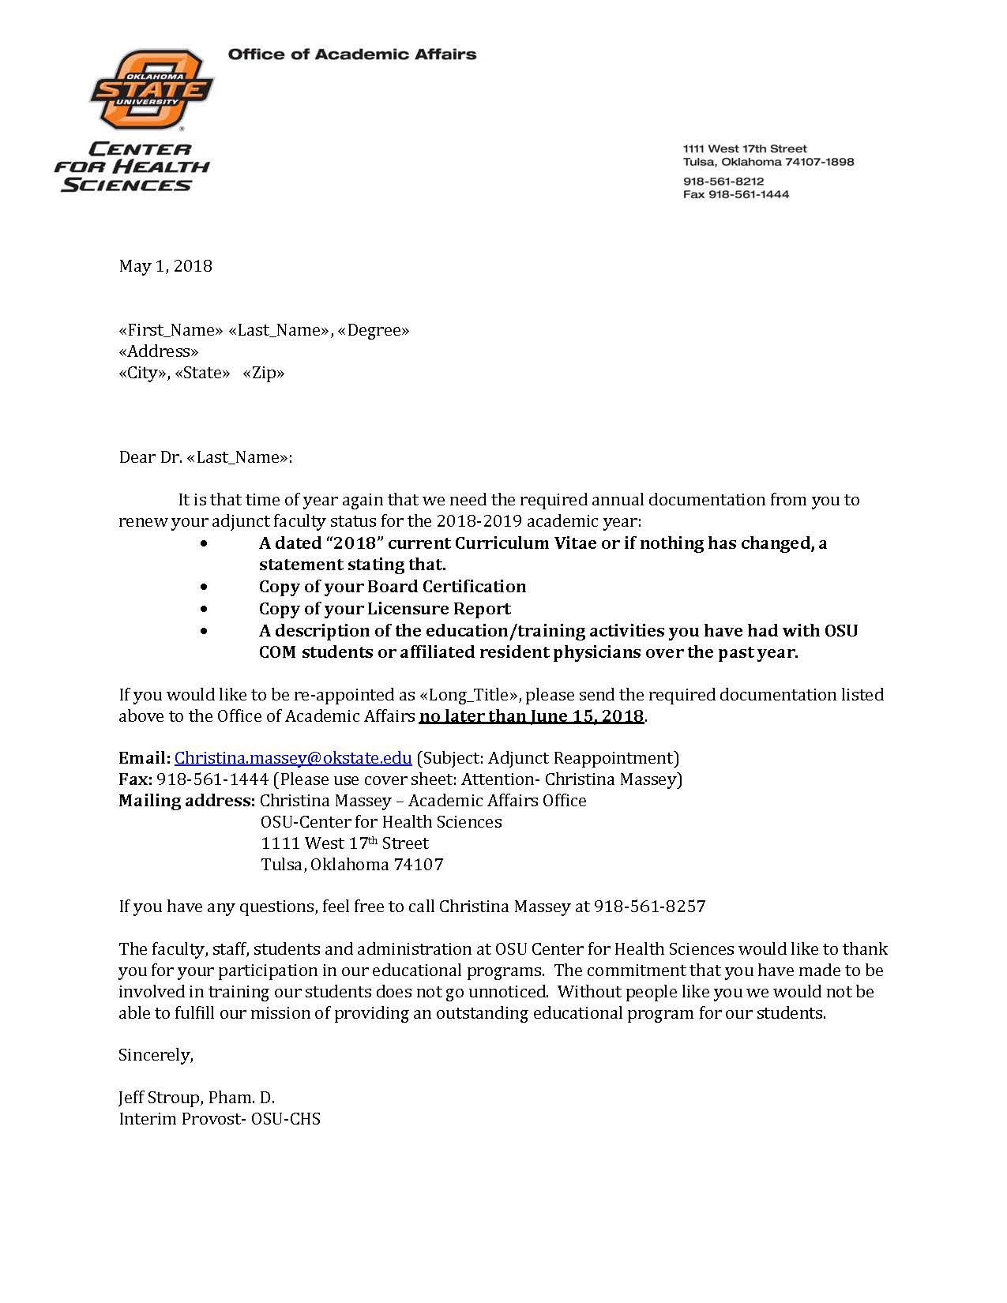
Adjunct Renewal Notice

Slide 8
Element 7.3: Departmental Chair Qualifications
A COM must employ Department Chairs, or their equivalent, with
proven experience in teaching and academic leadership in a
medical education setting. For clinical department chairs, the
chair must have an active medical license and active board
certification in the discipline in which they serve as chair.

Slide 9
Element 7.4: Primary Care Leadership
A COM must employ a Doctor of Osteopathic Medicine with an
active medical license and active board certification from a
primary care discipline to serve as the Department Chair of
Primary Care (or equivalent). If the COM does not have an
organized Department of Primary Care, the Department Chair of
either Family Medicine or Internal Medicine or Pediatrics must be
a Doctor of Osteopathic Medicine with active board certification.

Slide 10
Element 7.5: OMM/OPP Leadership: (CORE)
A COM must employ a Doctor of Osteopathic Medicine with an
active medical license and active board certification from the
American Osteopathic Board of Neuromusculoskeletal Medicine
(AOBNMM) or a Certificate of Special Proficiency in OMM (CSPOMM)
to serve as the Department Chair of OMM/OPP, or
equivalent.

Slide 11
Element 7.6: Faculty Development:
A COM must develop and implement an ongoing needs-based,
assessment-driven, faculty development program that is in
keeping with the COM’s mission.

Slide 12
Element 7.7: Faculty Association
A COM must have a faculty organization that serves as a
representative forum for faculty participation for the free
exchange of ideas and concerns of all faculty.

Slide 14
Element 7.8: Faculty Appointment and Advancement
A COM must have clear policies and procedures in place for
faculty appointment, renewal of appointment, promotion,
granting of tenure (if a tenure program exists), and remediation.
The policies and procedures must provide each faculty member
with written information about his or her term of appointment,
responsibilities, lines of communication, privileges and benefits,
performance evaluation and remediation, terms of dismissal, due
process, and, if relevant, the policy on practice earnings.

