Slide 1
COCA Standard 6 - Curriculum
Randy Wymore, Ph.D.
Brandy Close, Ph.D., M.Ed.
Christopher Thurman, D.O.

Slide 2
Element 6.1: Curriculum Design and Management: (CORE) A COM must have in place a body (e.g., a faculty committee) that exercises collective responsibility for the education program as a whole, and has responsibility for the development, management, evaluation, and enhancement of the curriculum. This committee must include student and faculty representation from the pre-clinical (years 1 and 2) and clinical education (years 3 and 4) years. The curriculum must meet the mission of the COM.

Slide 3
Curriculum Oversight Structure
Dean
Assessment & Evaluation Coordination Committee
Chair: Faculty Member
Representative from OED
Assoc. Dean Acad. Affairs
Assoc. Dean Biomed. Sci.
Assoc. Dean Clinical Ed.
Dir. of Clinical Ed.
Chair COC
OED Representative
Rural Medicine Representative
Other faculty
Curriculum Advisory Committee:
Senior Associate Dean, Chair
Associate Dean of Rural Health
Associate Dean of Clinical Education
Associate Dean of Biomedical Sciences
Associate Dean of Enrollment Management
Director, Biomedical Sciences Graduate Program
Chair of Curriculum Oversight Committee
Director of Office of Educational Development
Chief Operations Officer
4 Faculty appointed by the Dean, 2-year terms
Curriculum Oversight Committee:
Chair – elected by the COC
4 elected Faculty (2 Biomedical Sciences, 2 Clinical Sciences)
Years 1 & 2 Coordination Committee Chair
Years 3 & 4 Coordination Committee Chair
Bridge Committee Chair
Director of Curricular Affairs & Instructional Design
Academic Skills Coordinator
Chair of Learning Resources Committee
Local Information Technology Representative (non-voting)
Chair of Academic Standards Committee
Chair of Biomedical Sciences Graduate Committee
Director of Medical Library Services
The Registrar
Years 1 & 2 Student Rep.
Years 3 & 4 Student Rep.
Curriculum Coordination Committees

Slide 4
Curriculum Oversight Committee
Curriculum Coordination Committees
Years 1 & 2 Student Bridge Years 3 & 4
Chair Assoc. Dean Biomed Sci. Assoc. Dean Clinical Ed. BMF Director Systems Director Focus Courses Director OMM Coordinators DTP Coordinator CMF Coordinator Anatomy Coordinator CS Coordinators Dir. Cur. Affairs 1st Year Student 2nd Year Student | Chair COC 1st Yr. President 2nd Yr. President 3rd Yr. President 4th Yr. President SGA President 1st yr. Student 1st. Yr. Student 2nd Yr. Student 2nd Yr. Student Pres. BSGA DO/PhD Student DO/MS Student Bridge Student | Chair Assoc. Dean Enroll. Assoc. Dean Acad. Affairs Assoc. Dean Biomed. Sci. Bridge Faculty Rep. Bridge Student Rep. Bridge Student Rep Rep. of OED | Chair Assoc. Dean Clinical Ed. Assoc. Dean Biomed. Sci. Director Clinical Ed. Dir. Cur. Affairs Chair Student Success Clerkship Directors: Pediatrics Psychiatry Rural OMM Family Med. Internal Med. Surgery OB Gyn. Emergency Med. 2nd year class pres. 3rd year class pres. 4th year class pres.

Slide 5
Curriculum Oversight Committee (14 voting members; quorum=8)
Chair – (elected by the COC) S. Chronister
4 elected Faculty at Large (three year terms)
Biomedical Sciences H. O’Brien (2021) & Harp (2019)
Clinical Sciences S. Chronister (2021) & J. Jones (2019)
Years 1 & 2 Coordination Committee Chair Davis
Years 3 & 4 Coordination Committee Chair Thurman
Thread Committee Chair TBD
Director of OED Zumwalt
Academic Skills Coordinator Fulbright
Chair of Learning Resources Committee N. Wilson
Local IT Representative (non-voting) Dirickson
Chair of Academic Standards Committee Meek
Chair of BSGC Curtis, K.
Chair of Student Success Committee Wymore
Director of Medical Library Services Goodell
The Registrar Sumner

Slide 6
Years 1 & 2 Curriculum Coordination Committee (14 voting members; quorum=8)
Chair Davis
Assoc. Dean Biomed. Sci. Benjamin
Assoc. Dean Clinical Ed. Thurman
BMF Director Meek
MSF Coordinator Rouch
Systems Rep(s) Davis
OMM Coordinators Wilson/Ching
Service Learning & CE Van Winkle
Anatomy Coordinator Smith
CCF Coordinators Steele/Reust
CPS Coordinator Steele
Rep. of OED Austin Rutledge
Chair Student Success Wymore
1st Year Student TBD
2nd Year Student Crystal Goree

Slide 7
Years 3 & 4 Curriculum Coordination Committee (16 voting members; quorum=9)
Assoc. Dean Clinical Ed. Thurman
Assoc. Dean Biomed. Sci. Benjamin
Director Clinical Ed. Sammons
Dir. Cur. Affairs/or rep. Ballard
Chair Student Success Wymore
Chair Years 3 & 4
Student Success TBD
Clerkship Directors:
Pediatrics Jones
Psychiatry Ford
Rural Koehler
OMM McConaghy
Family Med. A. Carey
Internal Med. Cook
Surgery Roberts
OB Gyn. Oraee
2nd Year Class Pres. Craig Cooper
3rd Year Class Pres. Nate Nelson
4th Year Class Pres. Tim Nissen

Slide 8
6.2-What are the programmatic level educational objectives for the DO degree? How do we provide this information to the public, students, and faculty?

Slide 9
Objectives of Oklahoma State University College of Osteopathic Medicine Curriculum
Identify, critically analyze and solve problems that consider issues across multiple contexts as osteopathic practitioners related to patient care.
Demonstrate knowledge of evidence-based practice in the treatment of patients and the application of relevant research.
Perform appropriate diagnostic and treatment skills that encompass the understanding and application of new scientific knowledge of patient care.
Effectively lead and communicate with peers and healthcare team members.
Demonstrate effective physician-patient interactions.

Slide 10
Objectives of Oklahoma State University College of Osteopathic Medicine Curriculum
6. Initiate and sustain life-long learning in order to remain well-informed of relevant scientific evidence related to patient care and medical research.
7. Effectively provide premier quality of care driven by compassion, integrity, honesty, cultural awareness, and ethical principles.
8. Demonstrate the osteopathic philosophy in medical practice while upholding the Osteopathic Oath in professional conduct.
9. Apply medical knowledge and skills to provide exemplary patient care to underserved and rural Oklahoma communities.
10. Incorporate osteopathic manipulative medicine as a diagnostic and treatment modality in patient care.
2017-2018 Online Academic Catalog: pg. 33-34

Slide 11
6.4-What are the osteopathic core competencies? How do we track the teaching and assessment of these in our curriculum? How are thee incorporated into course goals?
AOA Core Competencies**
1. Osteopathic Philosophy and Osteopathic Manipulative Medicine
2. Medical Knowledge
3. Patient Care
4. Interpersonal and Communication Skills
5. Professionalism
6. Practice-Based Learning and Improvement
7. Systems-Based Practice
2017-2018 Online Academic Catalog: pg. 34

Slide 12
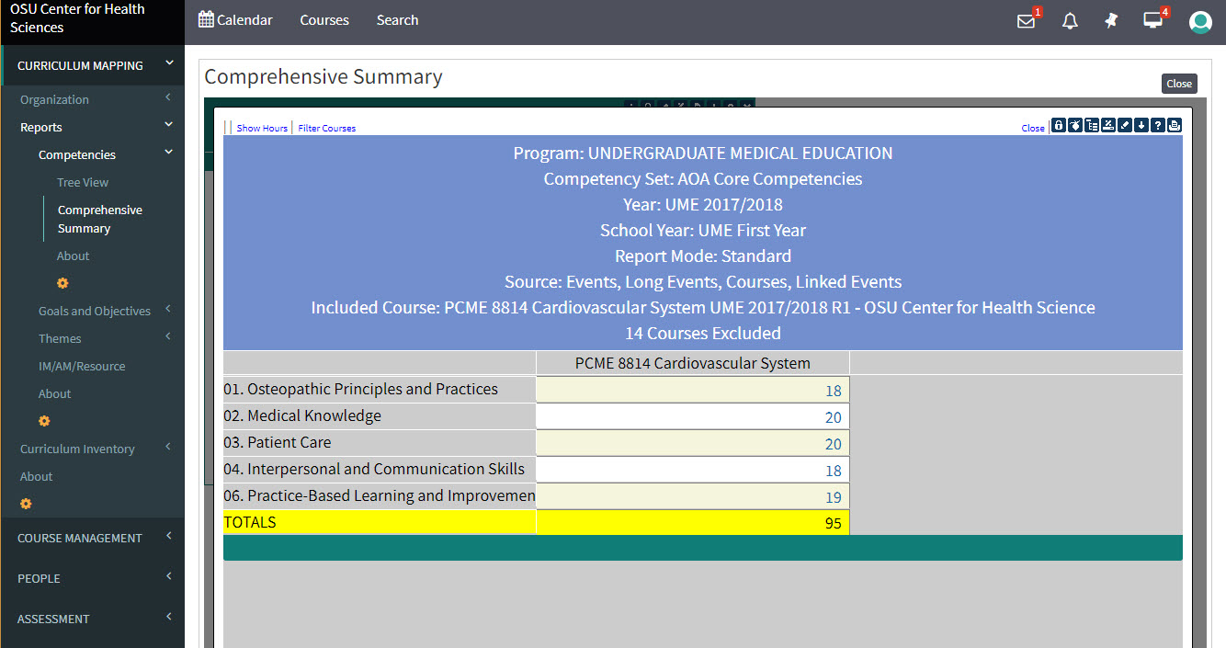
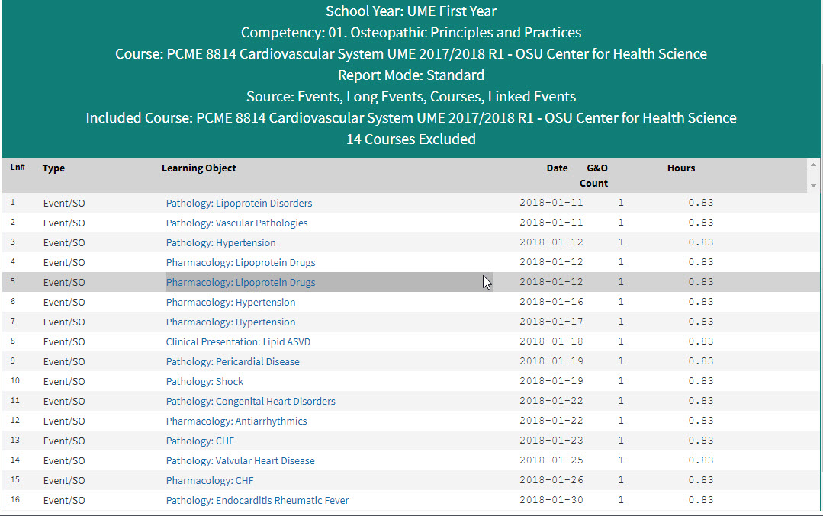
Tracking the teaching of the competencies occurs through our curriculum mapping housed in LCMS+

Slide 13
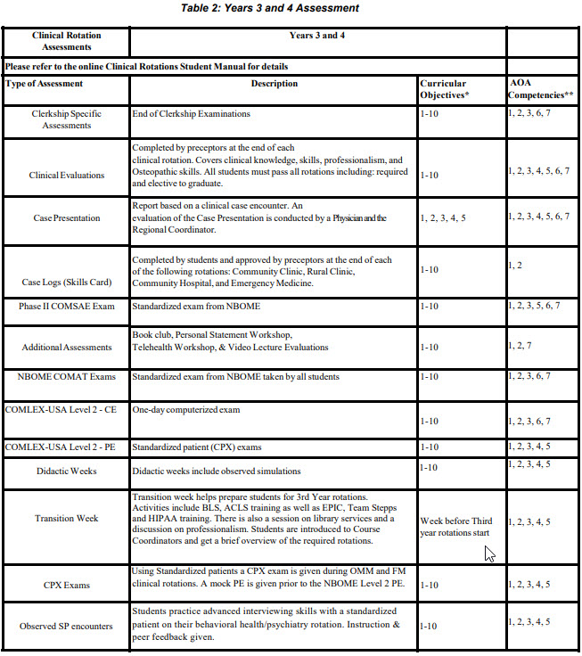
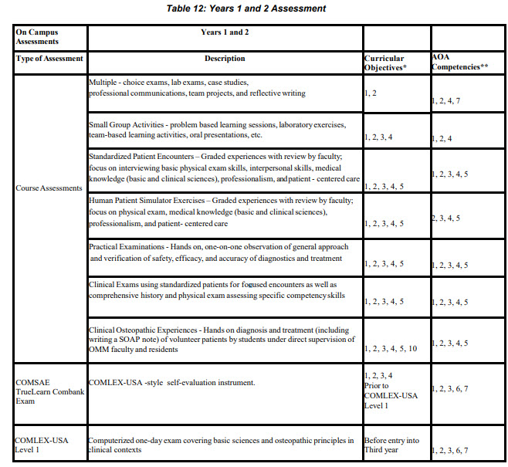
Tracking the assessment of the competencies occurs through our curriculum mapping housed in LCMS+
2017-2018 Online Academic Catalog: pg. 34-35

Slide 14
6.6-Where do students get observational and hands-on OMM experiences in the 3rd and 4th year?
3rd Year-Required OMM rotation
4th Year-OMM didactics during Didactic Week 4 (first week of the academic year) during week of Kaplan Board Review
LCMS+ OMM Modules vs. clinic site Observed OMM procedure
ACOFP OMM modules (used by OB/GYN, Surgery, IM, Peds, Community hospital and Emergency Medicine).
http://www.acofp.org/ACOFPIMIS/Acofporg/apps/OMT/OMT_Agreement_SR.aspx

Slide 15
6.9-Do we have enough clinical rotations for 120% of our class size? Does that include the additional 50 students at Tahlequah?
At this time, we currently have 200 or more slots available for each of the required rotations.
This exceeds 120% for our current class size of 115 plus the 50 additional students at Tahlequah (120%=198 slots required).
Availability is collected annually each fall, and the sites are evaluated annually during the mandatory site visits.

Slide 16
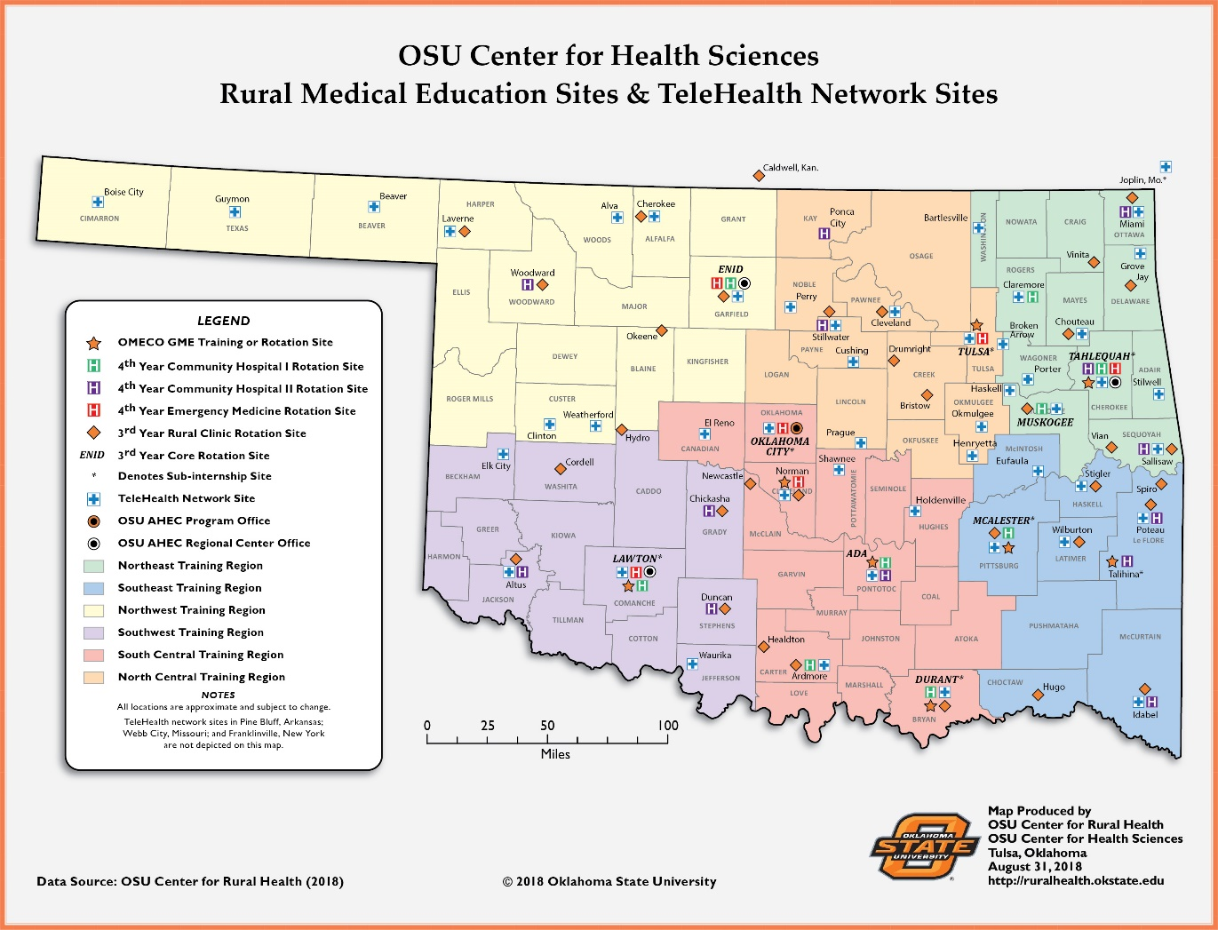

Slide 17
How do we audit rotation sites? Process for credentialing faculty?
Course coordinator determines rotation needs / who should be recommended
Course coordinator / Dept Chair submits a current CV for the prospective adjunct faculty, as well as a letter of recommendation to the Senior Associate Dean for Academic Affairs
Senior Associate Dean for Academic Affairs reviews the submitted documents, conducts licensure and other background checks, and notifies the candidate by letter of their approval or rejection

Slide 18
6.11-How do we ensure that the experience at one rotation site is the same as at another location?
Site-specific evaluations of student performance and feedback are required every year, and are a formal part of the mandatory annual site visits.
These site visits and assessments allow course coordinators to ensure parity in student experiences and make corrections when deficiencies are found.
Office of Clinical Education houses and distributes evaluations / recommendations for site-specific changes
Voted by the Year 3-4 Curriculum Coordination Committee, then the COC.

Slide 19
Element 6.12-COMLEX-USA: All students must successfully pass COMLEX-USA Level 1, Level 2 CE, and Level 2 PE prior to graduation from an osteopathic medical school. The COM must publish to the public the COMLEX -USA Level 1, Level 2 CE, Level 2 PE, and Level 3 first time pass rate for all students in each class at the COM. Faculty responsibility to ensure students have the content necessary to pass the COMLEX exams. Additional assistance: Integrated Systems Review course Board review course Question banks & COMSAE exams Identification of at risk students Dr. Dunn Learning resource specialist One on one advising of all at risk students

