Slide 1
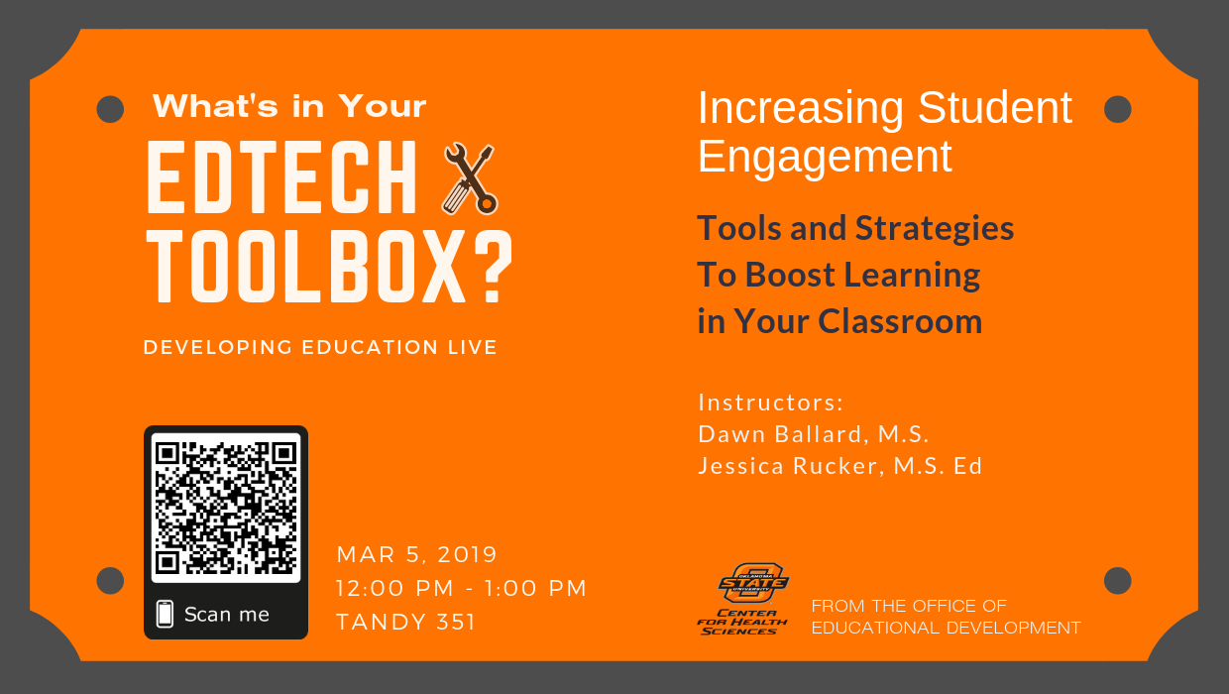

Slide 2
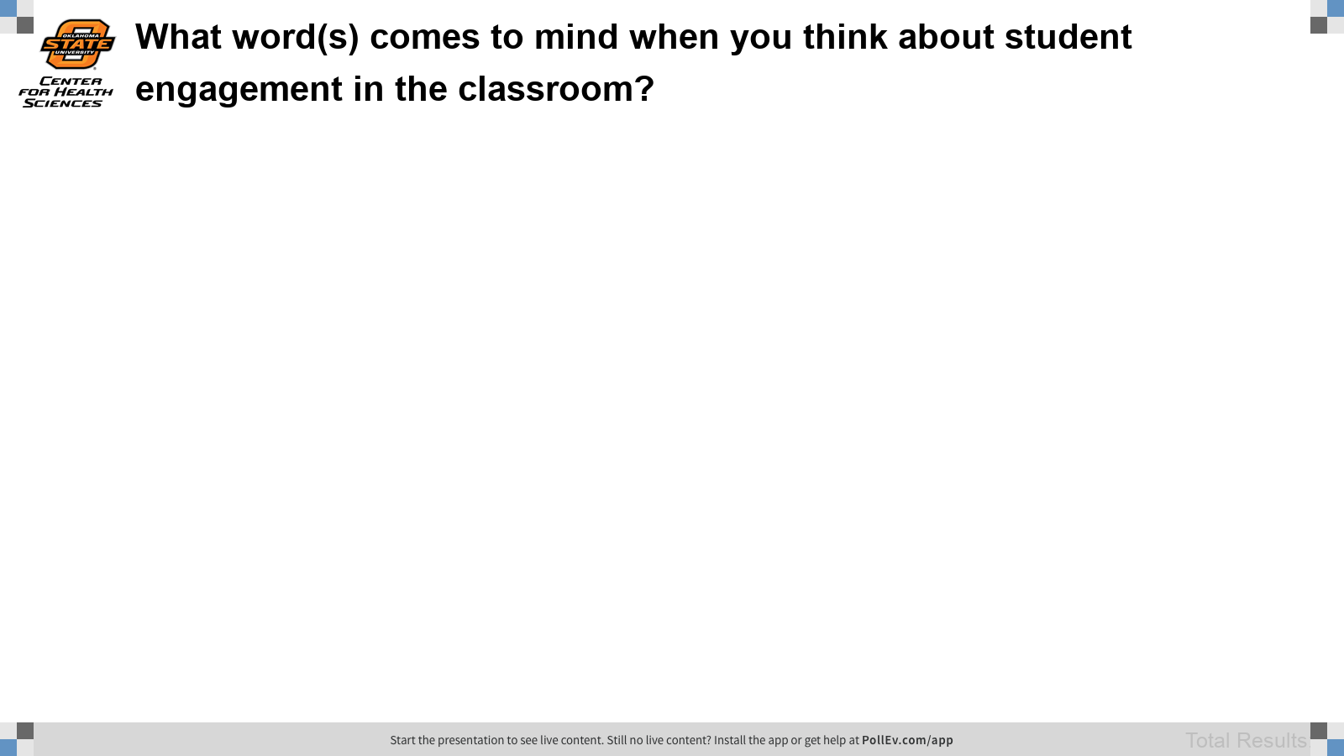
Notes:
Poll Title: What word(s) comes to mind when you think about student engagement in the classroom? https://www.polleverywhere.com/free_text_polls/pjwkyxuGTLC39xpT8E1Pu

Slide 3
TODAY’S OBJECTIVES
DEFINE
Define student engagement
RECOGNIZE
Recognize WHEN students are engaged
DESCRIBE
Describe WHY student engagement matters
IDENTIFY
Identify WHAT tools and strategies help boost student engagement

Slide 4
“Students who are engaged are involved, but not all students who are involved are engaged.”- Philip Schlechty
Engaged
Attentive
Persistent
Connected
Committed
Notes:
So, how do we know when a student is engaged?
There are four components that are always present when students are engaged. Those four components are:
The engaged student is attentive - In the sense that they pay attention to and focuses on the tasks associated with the work being done.
The engaged student is committed – They voluntarily (without the promise of extrinsic awards or the threat of negative consequences) deploys scarce resources under his/her control (time, attention, and effort) to support the activity called for by the task.
The engaged student is persistent- sticks with the task even when it presents difficulties.
The engage student is connected- finds meaning and value in the tasks that make up the work.
Main Point- The main difference between students who are engaged and those who are not is the way they respond to the situation or tasks at hand.

Slide 5

Engagement vs. Entertainment
Active involvement
Acquiring new knowledge tied to the learning objectives
Asking questions to increase understanding
Making connections
Curious and interested in learning more
Simply participating
Any new knowledge acquired is not tied to the learning objectives
Trying to conform just to get it “right”
No connections
Enjoy the activity and want to do it again
Notes:
https://mindstepsinc.com/wp-content/uploads/Engagement.pdf
Examples of engagement: CPS, TBL’s
Example of entertainment: Videos, some games
Note that incorporating some elements that are entertaining is not always bad, but you definitely want to limit them and keep them relevant. A good example is to use a meme or short video as a hook or icebreaker. Short games in places of quizzes can be good review with less pressure.

Slide 6
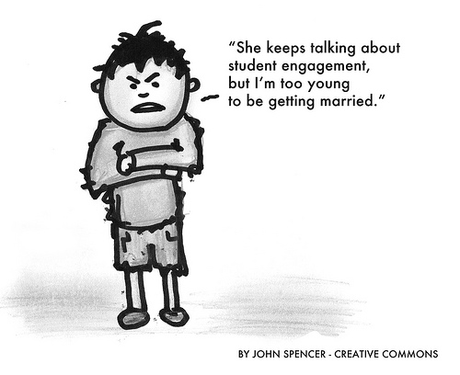
Why does student engagement matter?
Attendance
Lifelong Learning
Wellness
Notes:
Attendance: Faculty and students often differ on whether being present in lecture is best for learning. The fact is, if all the student is doing in class is watching, listening, and taking notes, they can get the same learning experience at home, where it’s more comfortable and convenient (and often more efficient). But if lectures involve more engagement and active learning, then those present in class are reaping more rewards, i.e. you add value to the present learning experience that cannot be obtained by watching the recording. Thus, increasing student engagement is likely to encourage students to come to class, which then boosts teacher morale and is a win-win for everyone.
Lifelong learning: When something is engaging, it often sparks one’s interest and curiosity to learn more. Increasing student engagement is a way to fuel that passion for medicine/healthcare to help remind students why they’re doing what they’re doing. I’ve seen in some student evaluations that students had not previously considered pursuing some field for their residency/long-term career, but after that course, they are now considering it. Engagement can help open that door to explore topics in new ways.
Wellness: Some studies have shown that “engaged students are more able to cope with academic stress and are more satisfied, which perhaps will lead in the future to more professionals having a sense of well-being and less feeling burned out…) (Casuso-Holgado et al., 2013) Engagement can also build a positive classroom culture and facilitate relationships as students and faculty interact.
Is engagement directly linked to achievement? Depends. Some studies have proven so, but other studies had unremarkable findings. It depends on how it is implemented and what role it plays to facilitate learning. Engagement is still just one of many factors that influence academic achievement, but studies have shown it to be a positive influence.

Slide 7
Goal
Get Students engaged in learning by:
Thinking
Talking
Moving
Emotionally Involved
Notes:
From Dawn’s active learning webinar

Slide 8

What tools can I use?
Audio
Audience Response
Games
Concept Mapping
Video
Non-tech
Notes:
Image by picjumbo_com on Pixabay

Slide 9



Audience Response Tools
Poll Everywhere (piloting this semester)
Nearpod (we currently have a subscription)
Turning Point (used in the past)
Notes:
Note: Our next session will cover more in-depth strategies on how to use audience response tools effectively!
Poll Everywhere: insert polls, quiz questions, word clouds, and other types of questions directly into your PowerPoint
Nearpod: web-based, syncs instructor’s pacing with students’ devices (instructor controls the pace). Downside is that it does not allow you to edit slides after importing them online.
Turning Point: Also has PowerPoint integration, but students pay for access (we had some issues with glitches and getting support in the past)

Slide 10




Quizzing Games
Kahoot!
01
Quizizz
02
Socrative
03
Notes:
All of these games can be used for formative assessment – able to review student understanding at the class, individual student or question level. Digital games gives students opportunities to explore ideas in simulated realities.
Kahoot! is a game-based learning platform that makes it easy to create, discover, play and share fun learning games in minutes., check out previous presentation
Socrative –It allows teachers to create simple quizzes that students can take quickly on laptops – or, more often, via classroom tablet computers or their own smartphones.
Quizizz is another great tool that allows you to conduct student paced formative assessments in a fun and engaging way. See Demo

Slide 11
Concept Mapping
Concept Mapping Tools
Popplet
Bubbl.us
Mindmeister
Mindomo
Coggle
Notes:
Popplet (demo): very intuitive, easy to use
Bubbl.us: Also easy to use

Slide 12



Presentations/Storytelling/ Infographics
Powtoon
Flipgrid
Piktochart
Notes:
(Demo) Piktochart – Helps to visually tell stories. Infographics are visual representations of information and data. They help break down information and data that would otherwise have been difficult to digest. (click Piktochart image on right)
Flipgrid helps to ignite discussion in your course by providing students an opportunity to respond to a statement or question - the students respond using video. Students can also respond to one another creating discussion-.
Powtoon - allows you to quickly and easily create animated presentations with your students by manipulating pre-created objects, imported images, provided music and user created voice-overs

Slide 13
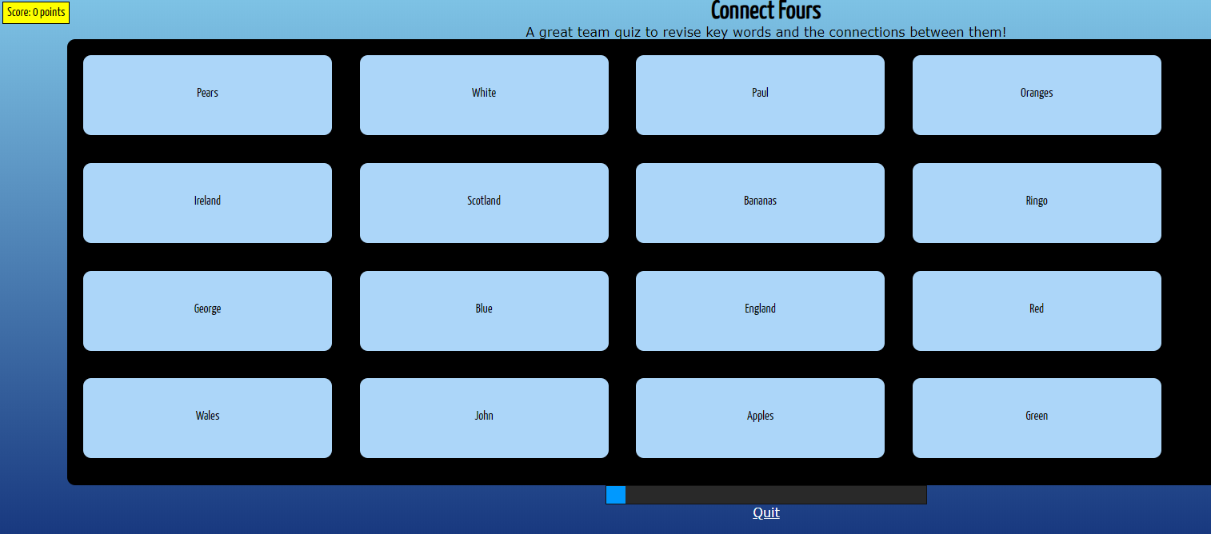
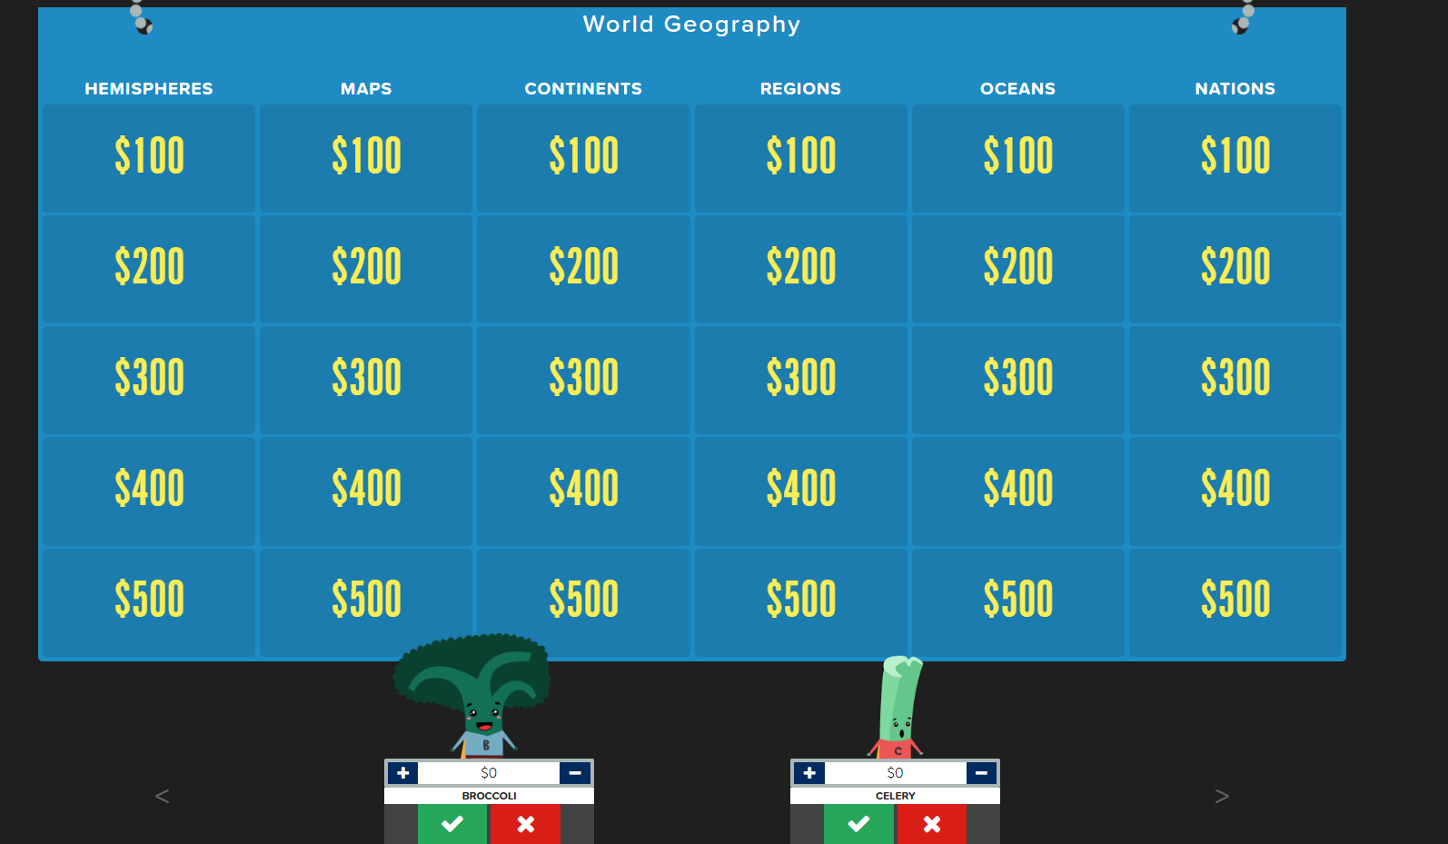
Gaming
Connect Fours
Jeopardy Rocks
Notes:
Connect Fours: Good for whole-class review
Jeopardy Rocks: Good for whole-class review or team competition (but you must moderate and select based on who gets questions right)

Slide 14



Video/animation
Animoto
1
EDpuzzle
2
My Simple Show
3
Notes:
Animoto is a cloud based video creation service that produces video from photos, video clips, and music into video slideshows.
EDPuzzle allows instructors to easily customize a video by adding questions and audio throughout the video to have more engaging video lessons.
My Simple Show is a video maker tool that allows users to create professional educational explainer videos in minutes.(demo) Click image on right

Slide 15




Audio (music and podcasting)
Panopto
Audacity
Anchor
Notes:
Image by Free-Photos on Pixabay

Slide 16
No-tech tools/Low Tech
10:2 Method
01
Background Knowledge Probe
02
Use incomplete handouts
03
Focused Listing
04
Insert Learning
05
Notes:
10:2 - For every 10 minutes of instruction, allow the students 2 minutes to process and respond to the instruction. Prompted by a reflective question to focus thinking, students are given 2 min to ponder on the information by verbally sharing with a classmate or writing individually
BKB– short, simple questionnaire for use at the beginning of a course prior to introducing a new topic. Designed to collect information on students’ prior knowledge
Handouts– Powerpoint presentations do not have to include everything presented in the lecture. Handouts that students have to complete as they participate in class ensure they are actively making individualized notes that are meaningful to them.
Focused Listing– A technique that focuses students’ attention on a single important term, name or concept from a particular lesson or class session and directs them to list several ideas that are closely related to that “focus point”
Insert Learning – able to insert questions, discussions, and insight directly into any website. It’s a good way to assess what your students are learning as they read

Slide 17



Strategies
Level 1: Minor Tweaks
Pause Procedure
Humor
Relevant storytelling
Level 2: Moderate shift
Demonstrations
Short team tasks (e.g., concept mapping, games)
Level 3: Major Overhaul
Team-based learning
Jigsaw
**For more active learning strategies, check out Dawn’s webinar**
Notes:
Pause Procedure: Student attention span is approximately 15 minutes, after that students’ minds being to wander and retention dramatically drops. One study compared two groups- one implemented the pause procedure and one was straight lecture. The pause group recalled an average of 108 correct facts while the straight lecture group recalled an average of 80 correct facts. On an exam assessing long-term retention, the pause group averaged 8-9% more than the no pause group. (Ruhl et al.)
Overhaul: “Good activities develop a deep understanding of the important ideas to be learned” (Prince, 2004).

Slide 18
Faculty Panel
1. What tools/strategies do you use to increase student engagement? What made you choose that tool/strategy?
2. What do you do when something in your course isn’t working?
3. What tool or strategy would you most like to try but haven’t yet?
4. What have been the most engaging learning experiences you recall from when you were a student?

Slide 19
Next Steps
Explore resources on our Faculty Development LCMS+ page (search "facdev" under Courses) and OED website
Check out Dawn’s Active Learning Webinar
Contact OED
For individualized consulting, assistance with design and implementation

Slide 20
References
Casuso-Holgado, M., Cuesta-Vargas, A., Moreno-Morales, N., Labajos-Manzanares, M., Barón-López, F., & Vega-Cuesta, M. (2013). The association between academic engagement and achievement in health sciences students. BMC Medical Education, 13, 1-7. https://doi.org/10.1186/1472-6920-13-33
Gettinger, M., & Ball, C. (2007). Best practices in increasing academic engaged time. In A. Thomas & J. Grimes (Eds.), Best practices in school psychology V (pp. 1043-1075). Bethesda, MD: National Association of School Psychologists. https://pdfs.semanticscholar.org/c810/68758c7ae1c3098ad919cbf43e3dbc05436f.pdf
Jackson, R. (2009). Are students engaged or merely entertained? [PDF File]. Retrieved from https://mindstepsinc.com/wp-content/uploads/Engagement.pdf
Prince, M. (2004). Does active learning work? A review of the research. Journal of Engineering Education, 93, 223-231. https://doi.org/10.1002/j.2168-9830.2004.tb00809.x
Zazulia, A. & Goldhoff, P. (2014). Faculty and medical student attitudes about preclinical classroom attendance. Teaching and Learning in Medicine, 26, 327-334. https://doi.org/10.1080/10401334.2014.945028
Notes:
Ruhl, K., C. Hughes, and P. Schloss, “Using the Pause Procedure to Enhance Lecture Recall,” Teacher Education and Special Education, Vol.10, Winter 1987, pp. 14–18.
Zepke, N., & Leach, L. (2010). Improving student engagement: Ten proposals for action. Active Learning in Higher Education, 11(3), 167–177. https://doi.org/10.1177/1469787410379680

Slide 21

What we learned today… any questions?
Define student engagement
Recognize WHEN students are engaged
Describe WHY student engagement matters
Identify WHAT tools and strategies help boost student engagement
Dawn Ballard, dawn.ballard@okstate.edu
Jessica Rucker, jessica.lacson@okstate.edu
Find us online: http://health.okstate.edu/oed
We Tweet! @oedchs

Slide 22
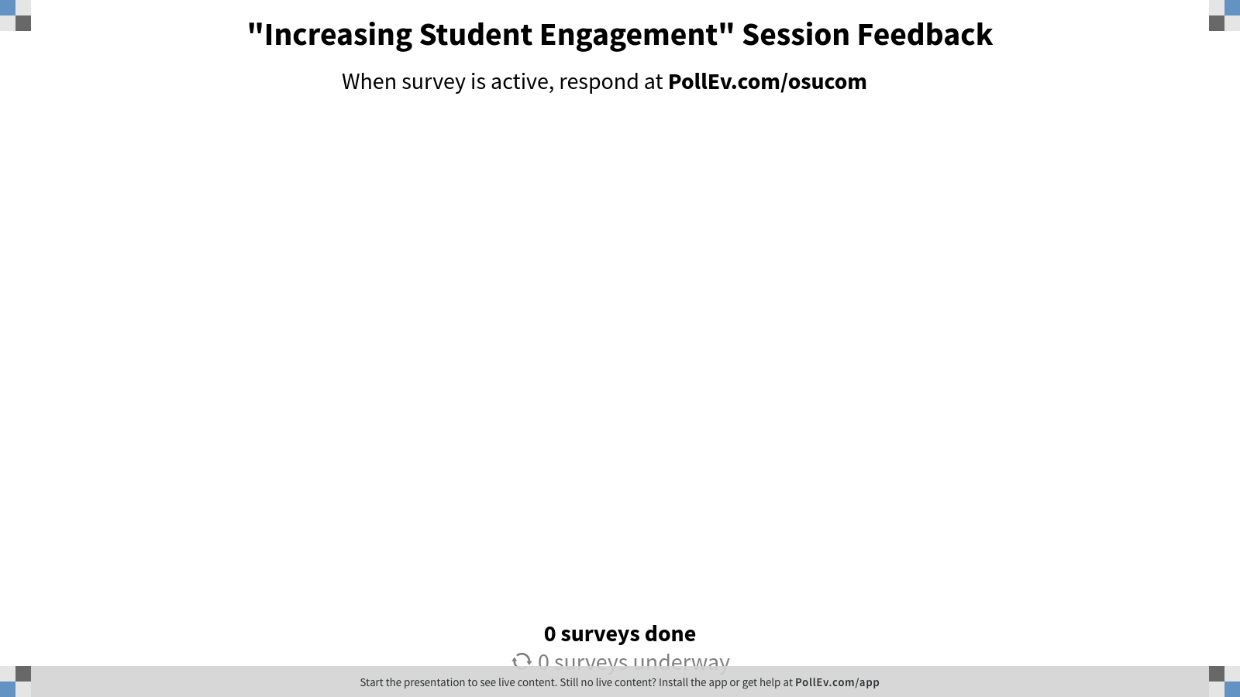
Notes:
Poll Title: "Increasing Student Engagement" Session Feedback https://www.polleverywhere.com/surveys/Tko4wFSGbGBOV4JsqFN1W

