Slide 1

Keeping Your Audience Active
Active Learning Strategies
If you can’t hear music, please follow these steps:
Click Communicate
Click Integrated Voice Conference
Click Join Conference

Slide 2


Presented by:
Dawn Ballard M.S. Coordinator of Instructional Design Oklahoma State University Center for Health Sciences @DawnBallardOK

Slide 3
Learning Outcomes
After this session, participants will be able to:
Distinguish
Distinguish between active learning and passive learning
Create
Create a plan for facilitating active learning strategies in the classroom
Use
Use some common and simple active learning strategies in your teaching
Identify
Identify Benefits and Challenges of Active Learning

Slide 4

Lectures
“Lectures and other didactic sessions are the predominant form of teaching in the pre-clerkship curriculum and are used for a broad spectrum of formal content. . . Typically, lecture is the least authentic with respect to the context in which learning occurs and how learners engage with material and information.”
Cooke, Irby, & O’Brian (2010), Educating Physicians, p.92.
Notes:
Traditional lecture has been part of the educational scene since the invention of the classroom. Yet, study after study has shown that the conventional lecture is simply not effective. Today’s educators are learning to embrace an active lecture technique to enjoy the benefits of the lecture while also enjoying greater student engagement.

Slide 5

Teaching with Lectures
Delivery can be boring
Students can be passive
Instructor can ignore student learning
Instructor can present too much material
Success may depend upon students’ note-taking abilities*
Notes:
When an instructor stands in front of a group of students and presents a traditional lecture, the students are largely passive players in the conversation. They are not asked to do anything, and thus are not engaged. Also, it does not address the needs of varied learning styles. Traditional lecture limits discussion and focuses on rote learning above other, perhaps more valuable, expressions of learning.

Slide 6
How to Solve the Problem Without Giving Up Lectures
In spite of these problems, lecture itself is necessary, and it can be an effective way to present information.
We’ve limited some of the problems with lectures using lecture capture technology (Panopto).
Active learning approaches are a key alternative.
Notes:
Instructors teaching actively will understand that the typical attention span of students is much shorter than the 50-90 minute class, and they will incorporate strategies to reset student attention through changes in the presentation. Finally, the lecture is not read, but rather follows an outline and builds on student questions and responses to keep students engaged.

Slide 7


What is Active Learning?
Active learning, as the name suggests, is an instructional strategy where students take an active role their own learning, participating in activities and, reflecting on their learning. Students are fully engaged in the learning process rather than being passive participants.
Notes:
Our role today is to provide you with strategies you can use during a traditional lecture. However, these are applicable in any other teaching format you use.

Slide 8
Four Basic Elements of Active Learning
Talking and Listening
Writing
Reading
Reflecting
Notes:
Talking and listening — Students actively process information when they ask or answer questions, comment, present, and explain. When students go beyond passive listening to relate, analyze, and use what they are hearing, they are engaged in active learning.
Writing – Students can actively process information by putting it in their own words; this can help students organize their thoughts and reflections and prepare them for discussion.
Reading –Instructors often expect students to learn through reading. It’s easy for students to read passively in order “to get it done.” Providing questions, summary exercises, opportunities for posts or reflection, etc., can transform it into an active process. Students can often benefit from instruction on active reading.
Reflecting – Class periods are often packed with information. Students sometimes need time to process the material and connect it to what they’ve already learned. Reflecting on the applications and implications of new knowledge can help develop higher-order thinking skills and Metacognition.

Slide 9
WHAT IS ACTIVE LEARNING?
PROBLEM SOLVING
INTERACTING
DISCUSSING
REFLECTING
DOING/
ENGAGING
TEACHING
APPLICATION
ACTING

Slide 10
WHY ACTIVE LEARNING?
No Active Learning
Active Learning
34% Failure Rate
22% Failure Rate
+6% better on examinations
Source: Freeman et al. (2014) Active learning increases student performance in science, engineering, and mathematics. PNAS, June 10, 2014, vol. 111, no. 23
Notes:
Freeman et. al's (2014) meta-analysis of 225 studies comparing active learning approaches with traditional lecturing showed improved exam scores and decreased failure rates for active learning

Slide 11
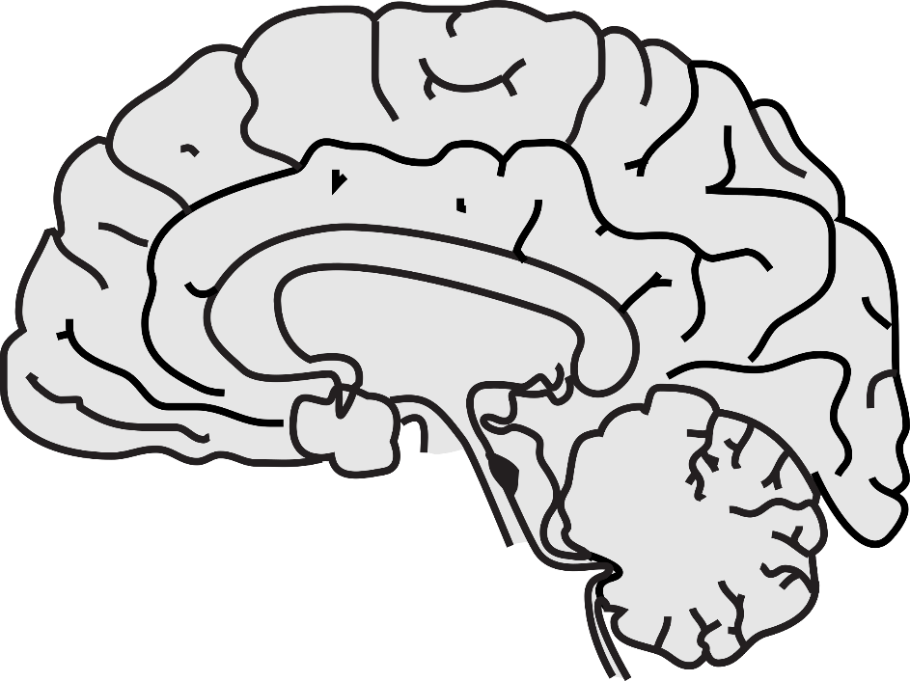
WHY ACTIVE LEARNING
INFORMATION
ENGAGEMENT
10-20 Minutes
Attention Span = 10-20 Minutes
Notes:
Student attention often begins to decline after 10 to 15 minutes of lecture. Retention also drops considerably after the first 10 minutesThat means that even if information and experiences are useful, it doesn’t automatically turn into knowledge if it is not reflected or processed.
How long is a typical attention span? Depends on time-of-day, motivation, enjoyment, emotion, prior knowledge  Bunce et al., 2011. Study: Students in three General Chemistry courses reported attention lapses (frequency and duration). Key Findings: • Attention lapses were frequent but brief. • Fewer attention lapses during active-learning activities and in the lecture segments immediately after. 4/17/2

Slide 12
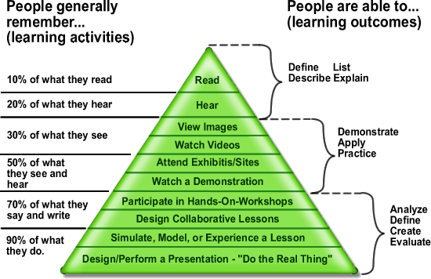
Edgar Dale’s Cone of Experience
Notes:
According to Dale’s research, the least effective method at the top, involves learning from information presented through verbal symbols, i.e., listening to spoken words. The most effective methods at the bottom, involves direct, purposeful learning experiences, such as hands-on or field experience. Direct purposeful experiences represents reality or the closet things to real, everyday life.
The cone charts the average retention rate for various methods of teaching. The further you progress down the cone, the greater the learning and the more information is likely to be retained. It also suggests that when choosing an instructional method it is important to remember that involving students in the process strengthens knowledge retention.
It reveals that “action-learning” techniques result in up to 90% retention. People learn best when they use perceptual learning styles. Perceptual learning styles are sensory based. The more sensory channels possible in interacting with a resource, the better chance that many students can learn from it. According to Dale, instructors should design instructional activities that build upon more real-life experiences. Dales’ cone of experience is a tool to help instructors make decisions about resources and activities. The instructor can ask the following: • Where will the student’s experience with this instructional resource fit on the cone? How far is it removed from real-life? • What kind of learning experience do you want to provide in the classroom? • How does this instructional resource augment the information supplied by the textbook? • What and how many senses can students use to learn this instructional material? • Does the instructional material enhance learning?

Slide 13

Benefits of Active Learning
Several research studies demonstrate the positive impact active learning can have upon students' learning outcomes:
Increased content knowledge, critical thinking and problem-solving abilities, and positive attitudes towards learning in comparison to traditional lecture-based delivery
Increased enthusiasm for learning in both students and instructors
Development of graduate capabilities such as critical and creative thinking, problem-solving, adaptability, communication and interpersonal skills
Improved student perceptions and attitudes towards information literacy

Slide 14
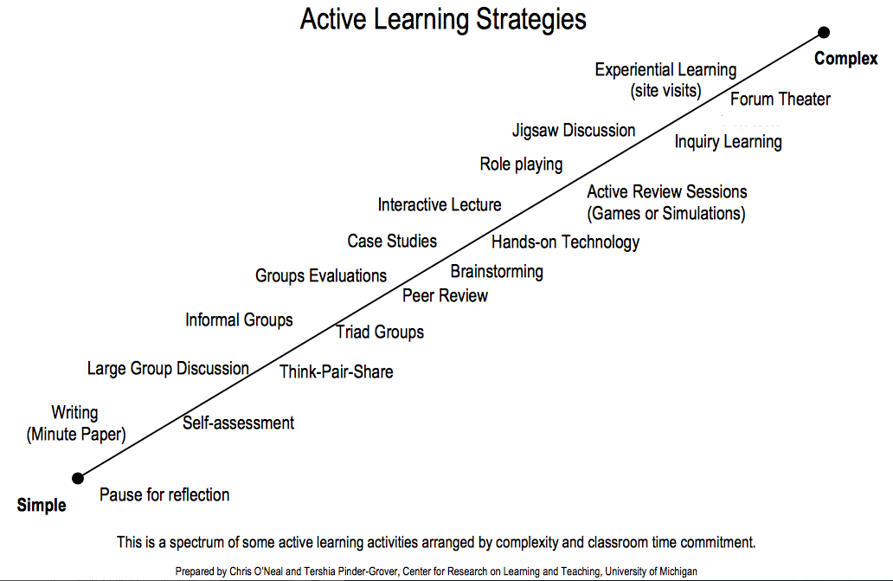
More Time
Less Time

Slide 15
What are some techniques to use?
Pause Procedure
Think- Pair-Share
Demonstrations
Peer Discussion
One Minute Paper
Notes:
Here are some easy supplements for lecture

Slide 16
Pause Procedure
Pausing lecture and students take notes
Pausing lecture and students discuss what is presented
Pausing lecture and polling students – discuss answers
Very effective, it gets them to reflect on the topic, and reflect on their participation in the class
Its worth getting them to discuss in pairs what they thought
Notes:
Probably the simplest and most effective technique
Consists of taking a break from lecture after 20-30 minutes into the lesson, and getting the students to do something for a few minutes
Write down the three key ideas we have covered in class so far
Compare Notes with partner
Pausing lecture and students take notes
Pausing lecture and students discuss what was presented
Pausing lecture and polling students-discuss student answers; faculty led tutorial on correct answer

Slide 17
Tips for making it work
Having a Transition statement
“Take the next ____ min to…”
Set a watch or timer
Stay quiet
Be sensitive – should you wander, or stay put?

Slide 18
Suggested Outline for Lecture Change-Ups
9:10
Welcome and review questions
9:15
Intro lecture
9:30
Think, Pair, Share question (with reporting and discuss)
9:45
Lecture
10:00
Discussion of a visual
10:15
Lecture
10:25
Writing activity (Most important idea/muddiest point)

Slide 19

Think, Pair, Share
THINK: Take 2 minutes to think about what active learning means to you
PAIR UP: Turn to the person next to you and discuss your ideas
SHARE: Have one person share your thoughts with the larger group
Image Source: Wikipedia Commons
Notes:
The Think-Pair-Share strategy is designed to differentiate instruction by providing students time and structure for thinking on a given topic, enabling them to formulate individual ideas and share these ideas with a peer. Question, all write strategy in “Think” section. (Have students think and write before talking to partner.)
When used at the beginning of a lecture, a Think-Pair-Share strategy can help students organize prior knowledge and brainstorm questions.
When used later in the session, the strategy can help students summarize what they're learning, apply it to novel situations, and integrate new information with what they already know.
The strategy works well with groups of various sizes and can be completed in as little as two or three minutes, making it an ideal active learning strategy for classes in which lecture is the primary instructional method.
promotes classroom participation by encouraging a high degree of pupil response, rather than using a basic recitation method in which a teacher poses a question and one student offers a response.

Slide 20
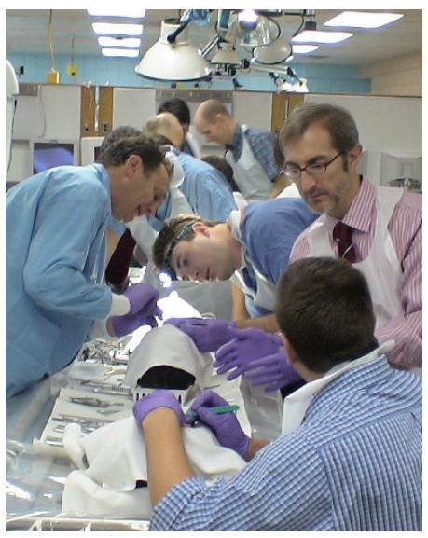
Demonstration
Ask students to predict the result of a demonstration, briefly discussing with a neighbor.
Notes:
After demonstration, ask them to discuss the observed result and how it may have differed from their prediction; follow up with instructor explanation. This approach asks students to test their understanding of a system by predicting an outcome. If their prediction is incorrect, it helps them see the misconception and thus prompts them to restructure their mental model.

Slide 21
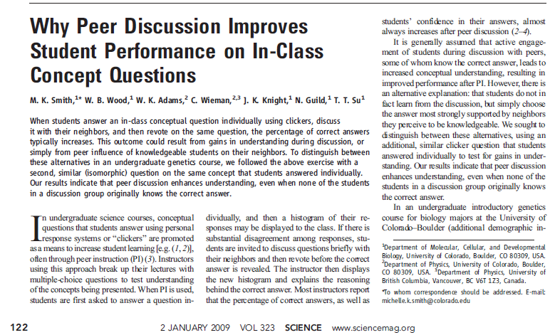
Peer Discussion
Notes:
This modification of the think-pair-share involves personal response devices . Pose a conceptually based multiple-choice question. Ask students tothink about their answer and vote on a response before turning to a neighbor to discuss. Encourage students to change their answers after discussion, if appropriate, and share class results by revealing a graph of student responses. Use the graph as a stimulus for class discussion. This approach is particularly well-adapted for large classes and can be facilitated with a variety of tools (

Slide 22
ONE-MINUTE PAPER
INSTRUCTIONS:
What was the most challenging for you in this material?
Notes:
Commonly administered at the end of class, the minute paper typically asks “What was the most important concept you learned in class today?” or, “What do you see as the main points of today’s activities/lecture/discussion?” to gain a sense of student comprehension related to the day’s specific focus. Prompts can also pose reflection-oriented questions.
Can serve as a classroom assessment technique to help instructors gauge how well students are learning the material, what they understand, and what the instructor needs to spend more time on.
Ask students a question that requires them to reflect on their learning or to engage in critical thinking. Have them write for one minute.
Ask students to share responses to stimulate discussion or collect all responses to inform future class sessions.
Review responses and note any useful comments. During the next class period emphasize the issues illuminated by your students’ comments. This writing often provides the foundation for the “Think * Pair * Share” strategy: students write, then talk in pairs or trios about ideas, with some sharing with the entire class.

Slide 23
Items to replace some lectures
Strip Sequence
Concept Map
Decision Making Activities
Case-based Learning
Notes:
This is a mix of learning models and literacy strategies that can be used to accomplish what we hope a lecture might–“give information” and “promote understanding.” Not every one is a perfect replacement for what a “good lecture” is, but most, in spirit and function, are close.

Slide 24
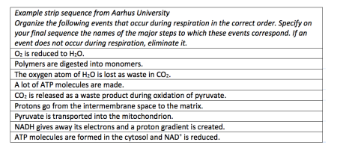
Strip Sequence
Notes:
Give students the steps in a process on strips of paper that are jumbled; ask them to work together to reconstruct the proper sequence. This approach can strengthen students’ logical thinking processes and test their mental model of a process. (

Slide 25
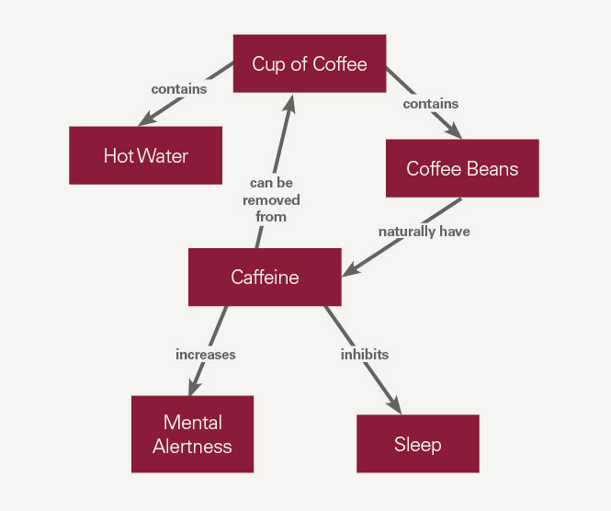
Concept Mapping
Decisions must be made to construct the map.
Organizes information by grouping facts and concepts; learning is at a higher level than just memorization of facts.
Illustrates relationships between facts and concepts through cross-links.
Easy visualization fosters long-term memory; exam reviews are faster and more effective.
Guides reading to prevent linear focus; the need to look for groupings and comparisons promotes reading to answer a question.
6. Fosters self-directed lifelong learning.
Notes:
Use mapping to put things into perspective, to analyze relationships, and to prioritize.
Use mapping to organizing a subject or a case; patient data can be organized to think more clearly about cause and effect and new information needed to determine diagnosis or treatment.
Mapping is a way to integrate old and new knowledge.
Save your maps and review them for preparing for tests. They can be verbalized back into a “story.”

Slide 26
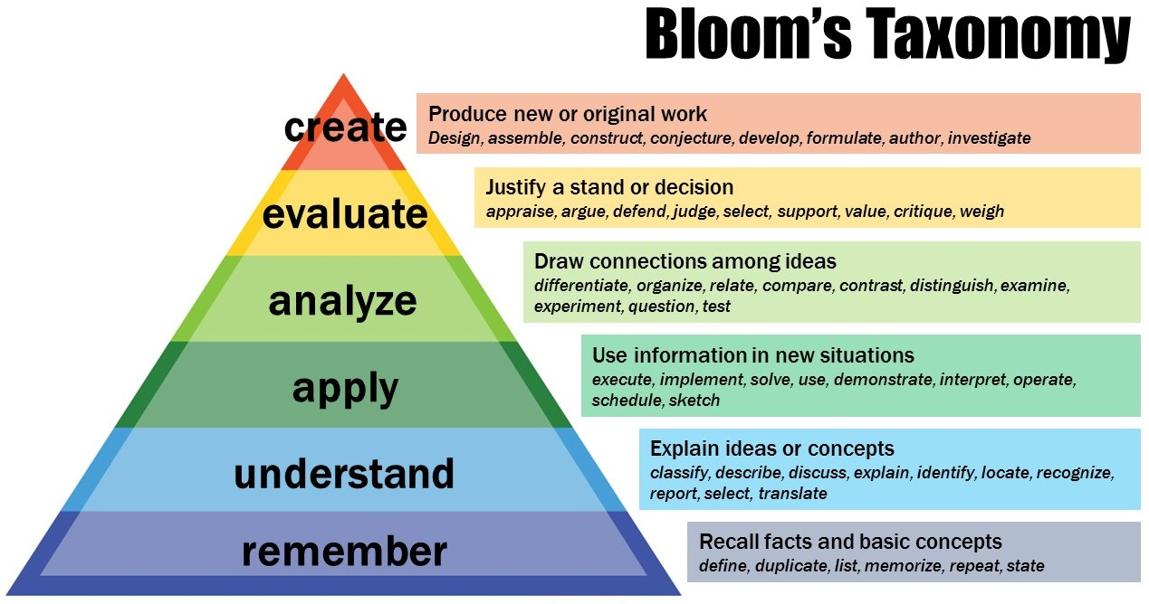
Student Generated Questions
Notes:
Provide students with a copy of your learning goals for a particular unit and a figure summarizing Bloom’s taxonomy (with representative verbs associated with each category). Challenge groups of students to create test questions corresponding to your learning goals and different levels of the taxonomy. Consider having each group share their favorite test question with the whole class or consider distributing all student-generated questions to the class as a study guide. This approach helps students consider what they know as well as implications of the instructor’s stated learning goals

Slide 27
Case Based Learning
CBL can use interesting clinical cases that illustrate various aspects of clinical learning
Because the material is based on real patients and real resources, it will be interesting and relevant to learners and allows the teacher to pre-select material which illustrates specific learning points.
Can use typical clinical scenarios as a stimulus for discussion or to encourage learners to seek out more information about a topic.
Case based format encourages active learning and demonstrates how to apply theoretical concepts to practice.
Addresses and corrects conceptualization of fundamental principles
Some extent of collaborative and cooperative learning
Repetition and building upon concepts while role-modeliong

Slide 28
Jigsaw Group Projects
In jigsaw projects, each member of a group is asked to complete some discrete part of an assignment; when every member has completed his assigned task, the pieces can be joined together to form a finished project.
As they read and share information, they refer to prompts such as: what do you think each idea means? What is the big idea? How can this idea be applied to help understand the concept(s)? What questions do you have about what you read? What do you agree/not agree with?

Slide 29
STRATEGY
OUTCOME
Student Generated Questions
Activation of prior knowledge and grasp of leaning goals
Think-Pair-Share
Explaining, Discussion, and Collaboration
Peer Instruction, Evaluating, and Synthesizing
Jigsaw
Case Studies/Problem-Solving
Real-World Relevancy, Analyzing, and Application
One-Minute Paper
Reflection on the learning process

Slide 30
What are the possible challenges?

Slide 31
Challenges
How do we cover all the necessary content?
Students resist non-lecture environments
Students are unwilling to engage
Class size
Students and Faculty don’t know how to
Notes:
Working at a medical school, we have the advantage of having highly motivated, capable, and well-prepared students with a high level of "self-regulation" who are all moving to the same final goal (being a doctor).

Slide 32
How do I begin?
Step 1
Analyze needs for implementing, ask these questions
How will this strategy help students to meet the learning objective?
What concepts or topics do students struggle with the most based on observation, in-class student responses, quiz/test scores and/or other assignments?
Do students need more personalized attention applying certain skills and knowledge in-class where your expertise could guide or coach their development?

Slide 33
How do I begin?
Step 2
Identify topic and questions
Example: Water pollution in the Hudson River, New York City
Questions: Is the Hudson River really polluted? What are acceptable levels? Who decides these levels? Is there a single right answer to this problem?
Notes:
The first step is to identify the topics you wish to apply active learning strategies. Additionally, identify the overarching questions about this topic.

Slide 34
How do I begin?
Step 3
Identify Learning Objectives and Outcomes
Step 4
Plan and design the activity
Step 5
Identify sequence of learning events
Step 6
Evaluate and assess
Notes:
Now that you have clearly identified learning objective and outcomes, you can begin to plan and design the activity.
For example, you could lecture for 10-15 minutes, carry out an active learning activity, and, then, return to lecturing. Or, one week you could lecture, but assign an active learning activity for homework; then, the next week, you could flip your class and carry out active learning exercises with students already familiar with the lecture material during class time. There are many ways to sequence the learning events. Your job is to carefully think through the planning and delivery of these events to support your learners.
You should analyze the effectiveness of the active learning activity and assess whether or not it aided student understanding and met the associated learning objectives

Slide 35
Active vs Passive
Active learning:
Student-centered
Students are talking
Students construct knowledge
Passive learning:
Teacher-centered
Teacher is talking
Students receive knowledge

Slide 36
Goal
Get Students engaged in learning by:
Thinking
Talking
Moving
Emotionally Involved

Slide 37
References
Bloom B. S. Taxonomy of Educational Objectives, Handbook I: The Cognitive Domain. (1956) New York: David McKay Co Inc.
Brame, C., (2016). Active learning. Vanderbilt University Center for Teaching. Retrieved [10/16/2018] from https://cft.vanderbilt.edu/active-learning/.
Cerbin, B. (2009). When Students Learn (or don’t learn) from Active Learning Experiences by Bill Cerbin- Student Learning. [online] Catl.typepad.com. Available at: http://catl.typepad.com/student_learning/2009/08/when-students-learn-or-dont-learn-from-active-learning-experiences.html
Freeman et al. (2014) Active learning increases student performance in science, engineering, and mathematics. PNAS, June 10, 2014, vol. 111, no. 23
Miller, Michelle D. (2014) Minds Online: Teaching Effectively with Technology. Harvard University Press

