Slide 1
Automatic Extraction of Performance Metrics from the Scientific Literature with an Extract-and-Verify Loop
Dawn (Mengli) Duan
Michael Guerzhoy
Canadian AI 2025 - LLM Workshop
Notes:
Hi everyone, welcome to our work on LLM assisted extraction methods.

Slide 2
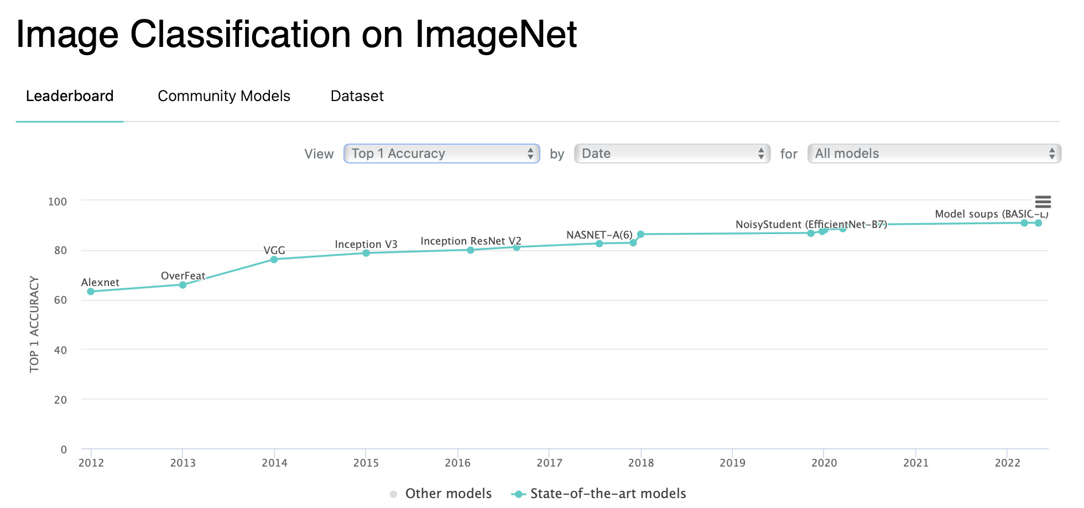
An Motivating Example: Image Classification on ImageNet
You are Computer Vision (CV) researcher trying to submitting your work to top journey
State-of-the-art (SOTA) performances in leaderboard
Submitting your new results
Non-trivial task for SOTA performances extraction!
Manual annotations
Human interpretations
Notes:
Before we starts, lets think about a scenario where yourself, as a CV researcher trying submit a new work. You read a bit
This ties back nicely to our work. In our work, we look at the extraction of Top-1 Accuracy reported on ImageNet for Image Recognition tasks.

Slide 3
Motivation & Contributions
Motivation: extracting performance metrics from scientific literatures is HARD!
SOTA performance metrics in CS community
Extract-and-verify use LLMs to extract performance metrics automatically from scientific literatures.
Contributions:
100-paper development with manual labelled Top-1 Accuracy on the ImageNet dataset
Correctly extracts the Top-1 accuracy of 67% on the development set
Notes:
State-of-the-art (SOTA) performance metrics reported in research publications play a central role in benchmarking model progress, comparing results, and conducting meta-analyses~\cite{mcgill_mcklin_kaylor_2019, bornmann2021growthratesmodernscience, barry2022understanding}. However, the task of extracting performance metrics from scientific papers remains largely manual, error-prone, and inconsistent. This is due to the wide variation in reporting styles, ambiguous metric descriptions, and the frequent use of error rates or qualitative statements in place of clearly labeled accuracy values.

Slide 4
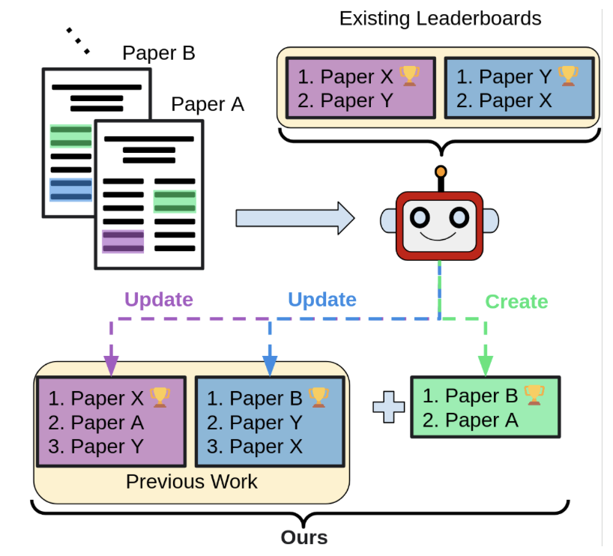
SCILEAD [EMNLP 24]
A manually-curated Scientific Leaderboard dataset (~40 Papers)
An LLM-based framework to construct scientific leaderboards automatically

Slide 5
Related Work
SCILEAD [EMNLP 24’]
Efficient performance tracking: Leveraging large language models for automated construction of scientific leaderboards [Paper][Code]
Manually-curated Scientific Leaderboard dataset (~40 Papers)
[*OURS*] 100-paper development set
LLM-based framework to construct scientific leaderboards
Prompting techniques
In-Context Learning (ICT)
Self-Critique
Self-Refine

Slide 6
Paper Collection

Slide 7
Annotated Development Set
Paper Collection
Label-Verification Protocol
Dataset Alignment on ImageNet
Notes:
we describe the construction of our development set. We begin with the automated
crawling pipeline that fetched candidate PDFs, then describe the manual annotation protocol and
finally discuss how metric selection and dataset-subset alignment were intersting across all papers. A preshawing

Slide 8
Metholodologies
Notes:
Methodology [major part of presentation]: describe the main elements of your solution; briefly describe any relevant implementation aspects (e.g., reusing existing codebases or software, implementing something new from scratch, etc.);

Slide 9
EXTRACT-AND-VERIFY
What is EXTRACT-AND-VERIFY
Leverages an iterative loop: the model first extracts potential accuracy metrics and cites the source sentence, then re‐examines its own outputs to confirm consistency or highlight omissions.
This verification step forces the LLM to reflect on potential errors—especially when multiple snippet extractions conflict.
Why is it import
Particularly effective for discarding spurious references (e.g., baseline or dev‐set accuracies) and ensuring that the extracted top‐1 accuracy indeed matches the final reported performance on ImageNet.

Slide 10
Extract-and-verify
…
Paper i
1: Sentences/Accuracies
404
Expected Output:\nSentence: "We report top-5 accuracy on the ILSVRC 2010 dataset in Table 2
...
…
…
…
…
404
Expected Output:\nSentence: "ImageNet AlexNet 42.6 19.6
Vote on most common extractions
…
Chunk 1
Chunk 2
Verify: Sentence/Prompt
92.4
Extraction Prompt
Chunk n
n: Sentences/Accuracies
Input
Output

Slide 11
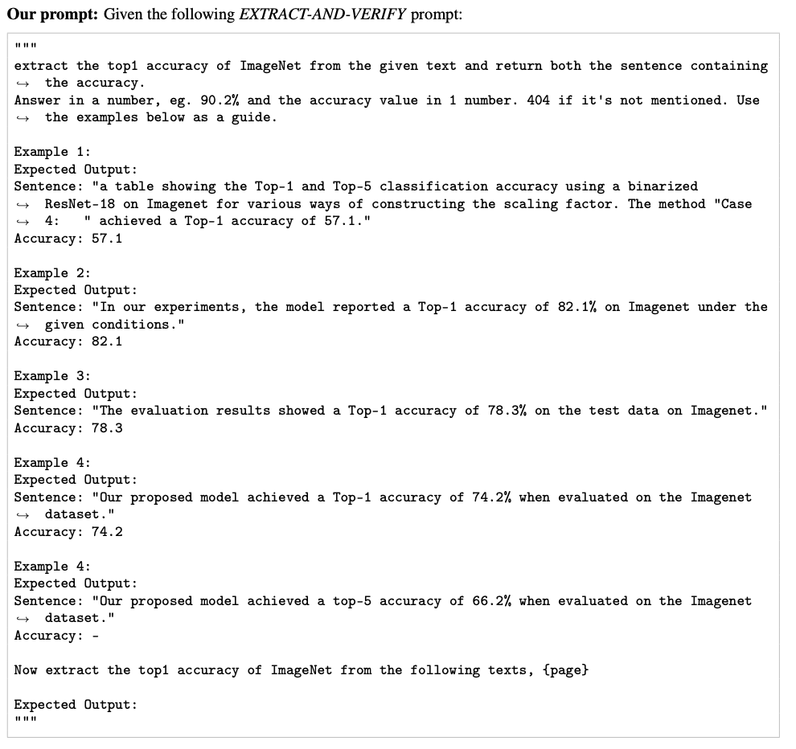
EXTRACT-AND-VERIFY: Prompt template

Slide 12
Experimental Setup
Hardware & Environment
CPU: 10‑core Apple M1 Pro, 3.20 GHz
GPU: NVIDIA GeForce RTX 4080 (16 GB memory)
Experiments run for 100 training epochs.
Model & Training
Optimizer: Adam with learning rate 0.001
Regularization: L2 penalty of 0.0001
Gradient Clipping: 5
Batch Size: 64
Notes:
The experiments were conducted on a 10-core Apple M1 Pro CPU clocked @ 3.20GHz and GPU NVIDIA GeForce RTX 4080 with 16GB of memory.

Slide 13
Experimental Results
EXTRACT-AND-VERIFY vs. SCILEAD
Classification Metrics
Regression Metrics
Notes:
We evaluate our proposed EXTRACT-AND-VERIFY system against SCILEAD on our 100-paper
development set. Two types of evaluation are conducted: (i) classification accuracy—assessing
whether the predicted Top-1 value exactly matches the annotated ground-truth, and (ii) regression-
based metrics—quantifying how close the extracted values are numerically.

Slide 14
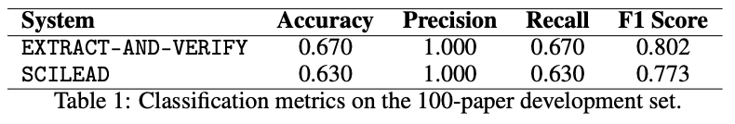
Evaluation Results on Development Set: Classification Metrics
Number of times where extracted values match with ground-truth
Notes:
Our EXTRACT-AND-VERIFY pipeline correctly extracts the Top-1 accuracy in 67 out of 100 papers,
compared to 63 by SCILEAD. However, our method yields higher recall and F1 score, reflecting
better overall coverage and extraction consistency. These classification-based findings align with
our regression analysis discussed below.
We are measuring our results on..
The accuracy of the system

Slide 15
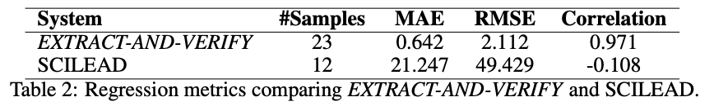
Evaluation Results on Development Set: Regression Metrics
(y* - y) where y -> ground-truth
MAE: avg magnitude of abs error
RMSE: Squared error before avg
No. samples report an extracted value y*
Pearson correlation: the strength and direction of the linear relationship between y* and y
Notes:
Our system shows a dramatically lower MAE and RMSE (Mean Absolute Error (MAE) and Root Mean Squared Error (RMSE).
compared to SCILEAD, indicating tighter
alignment with the annotated ground-truth values. The high Pearson correlation (r = 0.971) also
suggests that our method better preserves the relative ranking of performance metrics across papers,
whereas SCILEAD shows weak and even negative correlation.
The correlation we measured is the input from the

Slide 16
Qualitative Analysis
Straightforward (“Easy”) Examples
Difficult (“Challenging”) Examples
Notes:
We illustrate our results with a qualitative analysis of easy and difficult cases.

Slide 17
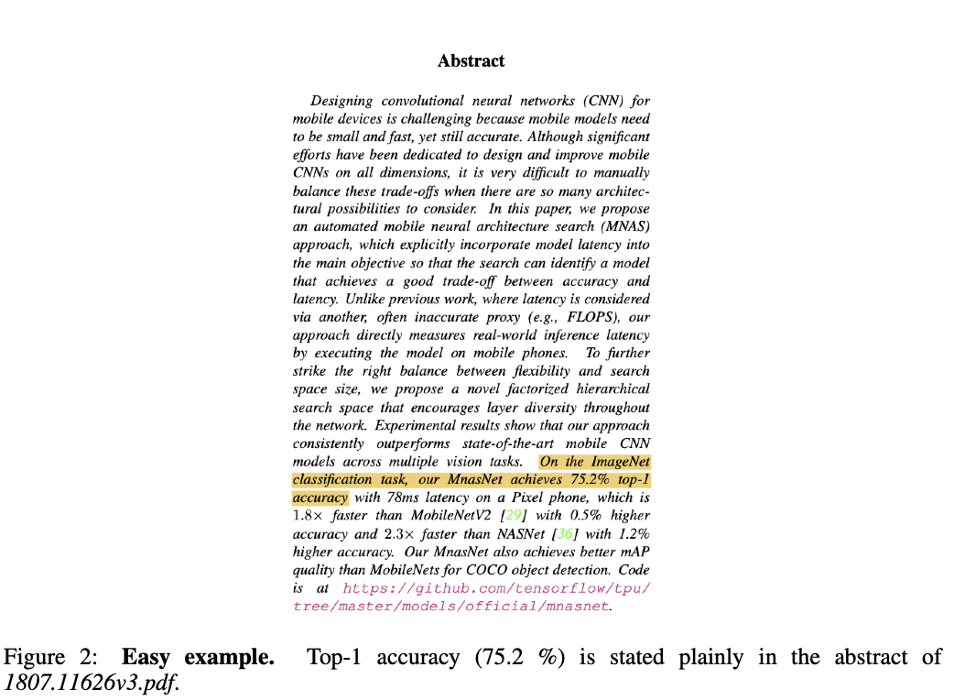
Straightforward (“Easy”) Examples

Slide 18
Straightforward (“Easy”) Example 1
Notes:
Our EXTRACT-AND-VERIFY pipeline correctly extracts the Top-1 accuracy in 67 out of 100 papers,
compared to 63 by SCILEAD. However, our method yields higher recall and F1 score, reflecting
better overall coverage and extraction consistency. These classification-based findings align with
our regression analysis discussed below.

Slide 19
Straightforward (“Easy”) Example 1 cont’d
Notes:
Our EXTRACT-AND-VERIFY pipeline correctly extracts the Top-1 accuracy in 67 out of 100 papers,
compared to 63 by SCILEAD. However, our method yields higher recall and F1 score, reflecting
better overall coverage and extraction consistency. These classification-based findings align with
our regression analysis discussed below.

Slide 20
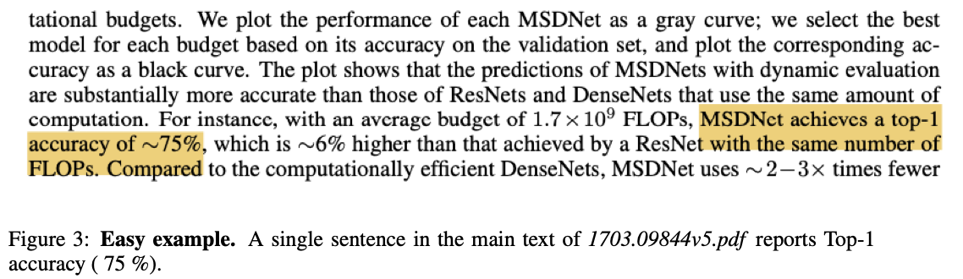
Straightforward (“Easy”) Example 2
Notes:
Our EXTRACT-AND-VERIFY pipeline correctly extracts the Top-1 accuracy in 67 out of 100 papers,
compared to 63 by SCILEAD. However, our method yields higher recall and F1 score, reflecting
better overall coverage and extraction consistency. These classification-based findings align with
our regression analysis discussed below.

Slide 21
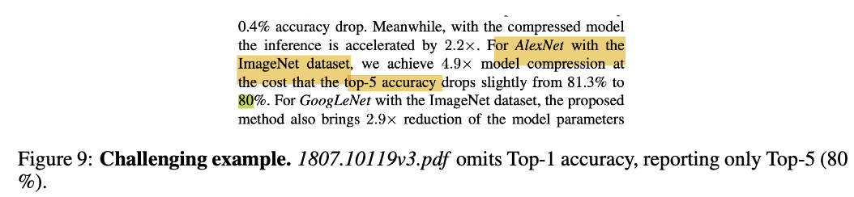
Difficult (“Challenging”) Examples: Top-1 omitted, Top-5 present

Slide 22
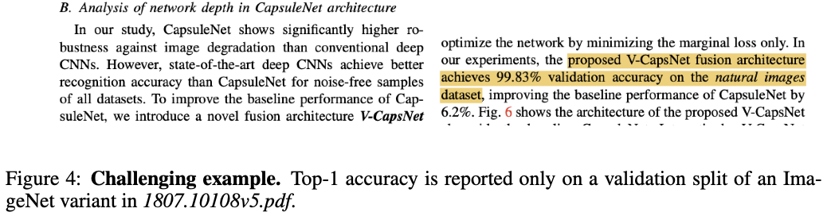
Difficult (“Challenging”) Examples: Alternate dataset variant

Slide 23
Next Steps
Increasing dataset size and incorporating multiple human-curated metrics from diverse domains
Fine-Tune our systems further for roboustness
Notes:
Next steps [minor]: what are the additional things you will do for the final report? These can include more experiments, enhancements to your method, another baseline, another dataset, etc.

Slide 24
EXTRACT-AND-VERIFY
An end-to-end pipeline built on LLMs for automatically extracting Top-1 accuracy metrics from scientific papers.
100-paper development set that report Top-1 Accuracy on the ImageNet dataset and manually annotate it
Correctly extracts the Top-1 accuracy of 67% on the development set, better than prior work
Conclusion
Notes:
I hope this gives you a glance into the exciting advances we’re seeing in our work Extract and Verify. I’d be happy to take any questions or discuss further.
We introduced EXTRACT-AND-VERIFY, an end-to-end pipeline built on large language models
(LLMs) for automatically extracting Top-1 accuracy metrics from scientific papers. To support
this goal, we curated and publicly released a development set of 100 human-annotated computer
vision papers focused on ImageNet classification. The dataset is larger than the one used in prior
work ¸Sahinuç et al. [2024]. To our knowledge, we are the first to apply a self-verification loop to
scientific metric extraction.
Evaluated on the development set, EXTRACT-AND-VERIFY correctly retrieved the Top-1 accuracy
in 67 out of 100 papers, outperforming the SCILEAD ¸Sahinuç et al. [2024], which succeeded in 63
cases.
Increasing our dataset size and incorporating multiple human-curated metrics from diverse domains
would enable fine-tunining of metric extraction systems further.
By releasing both our annotated dataset and extraction pipeline, we aim to establish a reproducible
benchmark for future work on LLM-assisted metric extraction and support broader research into
automating scientific understanding from machine learning literature.

Slide 25
Thank you!
Questions?

Slide 26
Appendices

Slide 27
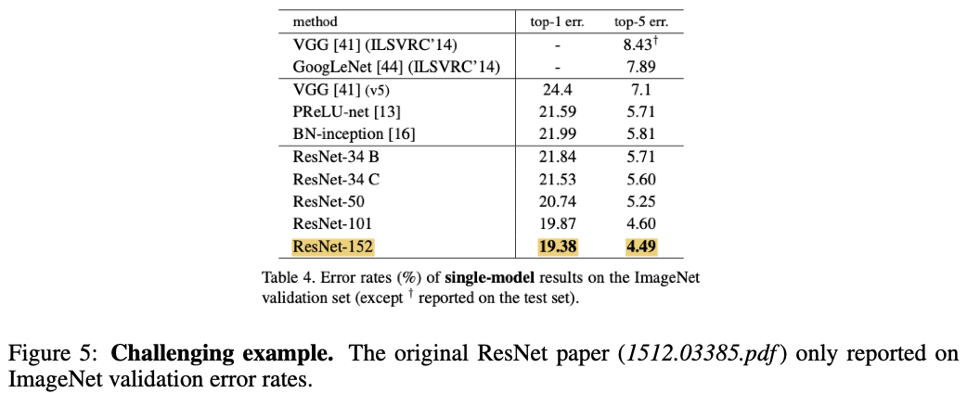
Difficult (“Challenging”) Examples: Table-only reporting

